Slide 1

CLOUD-NATIVE AI RESEARCH DISCOVERY PLATFORM
CNAD Project Review-2
Wednesday, September 23th, 2026
 | Under the Guidance of Dr. Patha Srilatha Associate Professor Department of CSE, KLH CSE Bowrampet Campus
Team Members B.Akhil - 2420030141 P.Ruthvik - 2420030546 S.Akshay - 2420030579

Slide 2
Outline of Project Work
Focus
Introduction
Literature Survey
Challenges
Research Objectives
Conclusion & Future Work
References
Publications Details

Slide 3
Problem Statement
Traditional research work is time-consuming because students and researchers need to search through multiple sources to find relevant research papers. Understanding lengthy papers, extracting important information, identifying related research, and organizing papers also requires significant manual effort. Existing tools often provide research search, AI analysis, or paper management separately. Therefore, there is a need for a centralized, intelligent, and scalable platform that integrates research paper discovery, AI-powered analysis, recommendations, and research management in a cloud-native environment.

Slide 4
Objectives
To develop a centralized research discovery platform for finding relevant academic papers easily.
To provide AI-powered summaries for quick understanding of lengthy research papers.
To automatically extract keywords, concepts, and important research insights from papers.
To recommend related research papers based on topics and paper content.
To provide paper comparison for analyzing multiple research papers.
To provide bookmarks, collections, and search history for organized research management.
To process uploaded research PDFs using PDF text extraction and AI analysis.
To build a scalable and reliable cloud-native application using Docker, Kubernetes, and AWS EKS.
To integrate cloud storage, database, research APIs, and AI services into one platform.
To implement secure and modular services that can be independently developed, deployed, and scaled.

Slide 5
Literature Survey
Authors | Title of the Paper | Methodology | Inferences | Limitation / Future Work
Bawkar et al. [4] | AI Research Paper Summarizer and Recommendation Engine | Uses NLP/transformer models for research-paper summarization and FAISS for similarity-based recommendation, with arXiv API, MongoDB and FastAPI. | Shows that AI can automate paper summarization and related-paper recommendation, reducing the effort required to understand research literature. | Future work can improve semantic accuracy, recommendation quality, scalability, and AI analysis capabilities.
Kreutz & Schenkel [5] | Scientific Paper Recommendation Systems: A Literature Review of Recent Publications | Reviews paper-recommendation methods, datasets, evaluation approaches and open challenges in scientific literature recommendation. | Shows that automated recommendation helps researchers discover relevant papers from the rapidly growing research literature. | Challenges remain in relevance evaluation, personalization, datasets, and recommendation quality.
Becker [6] | An AI-Enabled Microservices Architecture for Real-Time Machine Learning Inference in Cloud-Native Systems | Uses AI-enabled microservices, containerization and Kubernetes for scalable machine-learning inference. | Demonstrates that combining AI services with microservices and Kubernetes supports scalable and portable AI applications. | Further work can improve resource efficiency, deployment optimization, scalability, and model management.

Slide 6
Problem Gap Identification
Existing solutions generally address academic search, research-paper recommendation, or AI-based literature analysis separately, but they do not provide a single integrated platform that combines research discovery with AI-powered understanding and cloud-native deployment. Researchers still need to use multiple tools to find, understand, and organize research information efficiently. There is therefore a gap for a scalable, modular, and reliable cloud-native platform that integrates AI-based research analysis, paper recommendations, and research management within one system.
Our project aims to address this gap by combining AI-powered research discovery with a cloud-native microservices architecture, enabling the platform to be containerized, scalable, reliable, and deployable on the cloud.

Slide 7
Existing Problem / Approach | Problem Gap Identified | Our Proposed Solution
1. Manual Research Paper Analysis – Researchers need to read lengthy papers to understand their important information. | Extracting summaries, keywords, methodology, findings, limitations, and research insights manually is time-consuming. | AI-Powered Research Analysis – Uses AI to automatically analyze papers and provide structured research insights.
2. Difficulty in Discovering Related Research – Researchers often perform separate searches to find papers related to their topic. | Manual searching can make it difficult to discover relevant and connected research papers efficiently. | Intelligent Research Discovery & Recommendation – Searches research sources and recommends related papers based on paper content and metadata.
3. Lack of Cloud-Native Research Platforms – Many research applications focus mainly on search or analysis without a complete cloud-native architecture. | Limited support for scalability, independent service deployment, reliability, monitoring, and cloud-based storage. | Cloud-Native Architecture – Uses microservices, Docker, Kubernetes, AWS EKS, AWS S3, ECR and CloudWatch to build a scalable platform.

Slide 8
Innovation, Creativity, and Novelty
Innovation
Combines AI research discovery and analysis in one platform.
Integrates research APIs with AI services.
Uses microservices architecture for modular development.
Supports scalable cloud-based research workflows.
Creativity
Generates AI summaries, keywords, and research insights.
Recommends related research papers automatically.
Provides paper comparison and research organization.
Includes bookmarks, collections, and search history.
Novelty
Integrates Research Discovery + AI Analysis + Cloud-Native Architecture.
Uses Docker and Kubernetes for containerized deployment.
Uses AWS S3, MongoDB Atlas, and AWS EKS.
Combines AI, cloud storage, and orchestration.
Provides an end-to-end cloud-native AI research platform.

Slide 9
Problem Definition & Requirements
Problem Definition
Researchers need to search through multiple academic sources to find relevant papers.
Understanding lengthy research papers and extracting important information is time-consuming.
Finding related research papers and research insights manually is difficult.
Existing solutions do not provide a single integrated research discovery and AI analysis platform.
There is a need for a scalable cloud-native platform for research discovery, analysis, and management.
Functional Requirements
User registration, login, and authentication.
Research-paper search and discovery using research APIs.
PDF upload, storage, and text extraction.
AI-based summary, keyword, concept, methodology, findings, and limitation extraction.
Related-paper recommendations and paper comparison.
Bookmarks, collections, and search history.
Non-Functional Requirements
Scalability using Docker, Kubernetes, and AWS EKS.
Cloud storage using AWS S3 and cloud database using MongoDB Atlas.
Security through authentication, validation, and secure environment variables.
Reliability and monitoring using Kubernetes and AWS CloudWatch.

Slide 10
System Architecture and Design
The system follows a cloud-native microservices architecture.
React.js provides the user interface for research discovery and management.
An API Gateway handles requests and routes them to the required services.
Authentication, Paper, PDF Processing, AI Analysis, and Search & Recommendation are implemented as separate services.
MongoDB Atlas stores users, papers, AI analyses, bookmarks, collections, and search history.
AWS S3 stores uploaded research-paper PDFs.
OpenAlex provides external research-paper metadata for discovery.
FastAPI + PyMuPDF handles PDF text extraction and AI services perform research-paper analysis.
Services are containerized using Docker and managed using Kubernetes.
AWS EKS provides the cloud Kubernetes environment, with ECR for container images and CloudWatch for monitoring.
Architecture Flow
User → React Frontend → API Gateway → Microservices → MongoDB Atlas / AWS S3 / OpenAlex / AI API
Docker → Kubernetes → AWS EKS → Cloud Monitoring

Slide 11
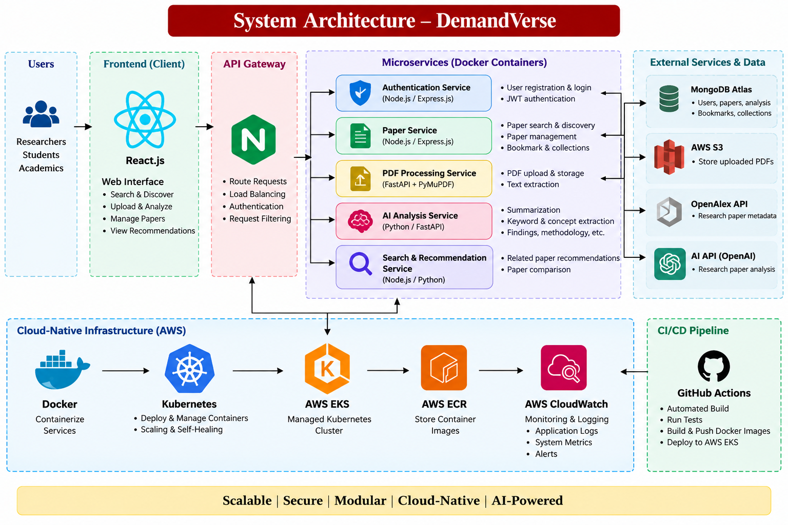

Slide 12
Module Integration
The React frontend sends user requests to the API Gateway.
The API Gateway routes requests to the required microservice.
Paper Service manages research-paper search, metadata, bookmarks, and collections.
PDF Processing Service receives uploaded PDFs, stores them in AWS S3, and extracts text using PyMuPDF.
The extracted text is sent to the AI Analysis Service for summarization, keywords, methodology, findings, and research insights.
Search & Recommendation Service uses paper information to provide related research papers.
Results and user data are stored in MongoDB Atlas.
All services are Docker containers managed by Kubernetes, with AWS EKS providing the cloud environment.
Main Integration Flow
User → React → API Gateway → Microservices → AWS S3 / AI API / OpenAlex → MongoDB Atlas → React
Overall Implementation Flow
Authentication → Research Discovery → Paper Management → PDF Processing → AI Analysis → Recommendation → Docker/Kubernetes → AWS Cloud

Slide 13
Module Design / Module-wise Description and Implementation
Module | Description | Implementation
1. Authentication | User registration, login and secure access. | Node.js, Express.js, JWT, bcrypt, MongoDB
2. Research Discovery | Search and discover relevant research papers. | OpenAlex API, Node.js, MongoDB
3. Paper Management | Manage paper details, bookmarks and collections. | Express.js + MongoDB
4. PDF Processing | Upload PDFs, store them in cloud and extract text. | AWS S3, FastAPI, PyMuPDF
5. AI Research Analysis | Generate summaries, keywords, concepts, methodology, findings and limitations. | Python, FastAPI, AI API
6. Recommendation & Comparison | Recommend related papers and compare selected papers. | Search/Recommendation Service + MongoDB
7. Cloud-Native Deployment | Containerize and manage application services. | Docker, Kubernetes, AWS EKS, AWS ECR
8. CI/CD & Monitoring | Automate deployment and monitor application performance. | GitHub Actions + AWS CloudWatch

Slide 14
Feasibility
The project can be developed using React, Node.js, Express.js, Python/FastAPI, MongoDB, and AI APIs.
Docker and Kubernetes enable containerized and modular deployment.
AWS EKS and S3 provide suitable cloud infrastructure for deployment, scaling, and storage.
The platform provides a practical and centralized solution for research discovery, AI analysis, and paper management.
The use of open-source technologies and cloud resources helps reduce development and infrastructure costs.
The project can be developed incrementally and tested module by module, making implementation manageable.
GitHub Actions, Kubernetes, and AWS support automated deployment, maintenance, and scalability.

Slide 15
Project Plan
Phase 1 – System Design & Architecture
Finalize the cloud-native architecture, microservices, database design, API flow, and system workflow.
Phase 2 – Application & AI Development
Develop research discovery, paper management, PDF processing, and AI-based research analysis modules.
Phase 3 – Cloud Storage & Service Integration
Integrate MongoDB Atlas, AWS S3, research APIs, and AI services with the application.
Phase 4 – Docker & Kubernetes Implementation
Containerize application services using Docker and configure Kubernetes deployments, services, health checks, and scaling.
Phase 5 – AWS Cloud & CI/CD
Deploy container images using AWS ECR and AWS EKS, and implement GitHub Actions CI/CD for automated deployment.
Phase 6 – Monitoring, Testing & Evaluation
Implement AWS CloudWatch monitoring, perform functional and integration testing, and evaluate scalability, reliability, and performance.

Slide 16
Phase | Activity | Current Status / Output
Phase 1 | System Architecture & Module Design | Completed – Cloud-native architecture, microservices structure, database and API workflow designed.
Phase 2 | Application & AI Development | Implemented – Research discovery, paper management, PDF processing and AI-based research analysis developed.
Phase 3 | Cloud Integration & Storage | Implemented / In Progress – MongoDB Atlas, AWS S3, research APIs and AI services integrated.
Phase 4 | Docker & Kubernetes Implementation | In Progress – Application services containerized using Docker and Kubernetes deployment configured.
Phase 5 | AWS Cloud Deployment | In Progress – AWS ECR and AWS EKS configuration prepared for cloud deployment.
Phase 6 | CI/CD & Monitoring | In Progress – GitHub Actions and AWS CloudWatch integration being configured for automated deployment and monitoring.
Phase 7 | Testing & Final Demonstration | Planned – Perform functional, integration and cloud deployment testing and evaluate scalability and reliability.

Slide 17
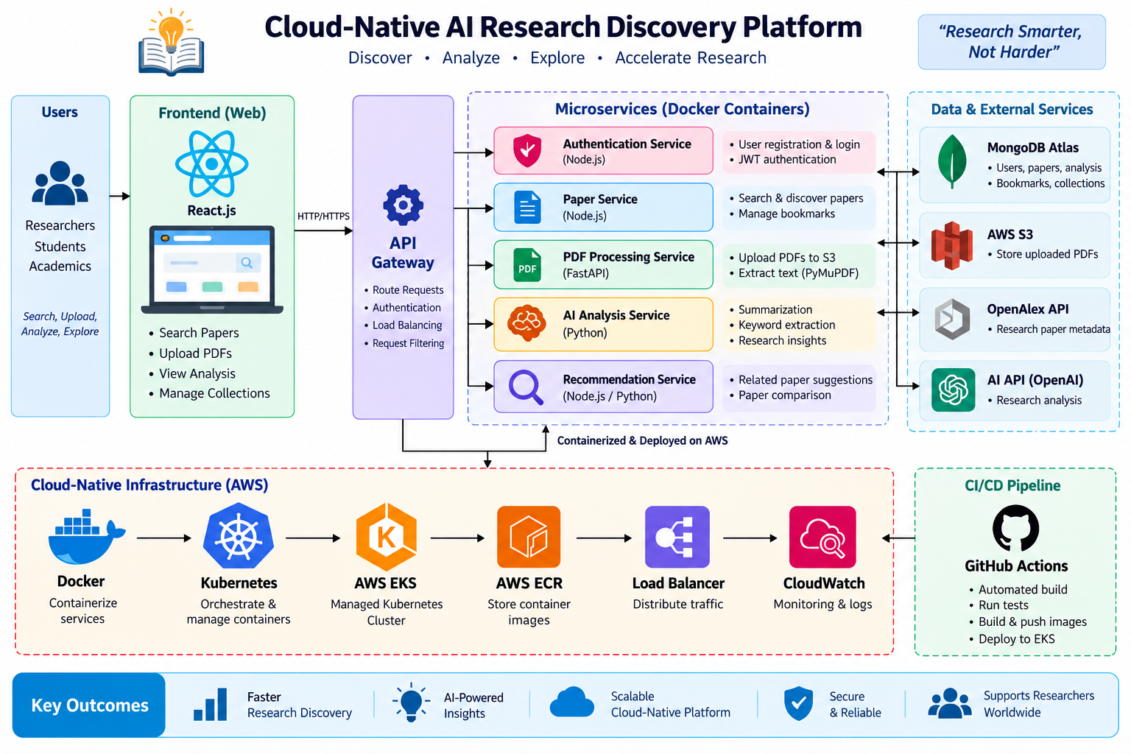
Project Architecture / Overview

