Slide 2
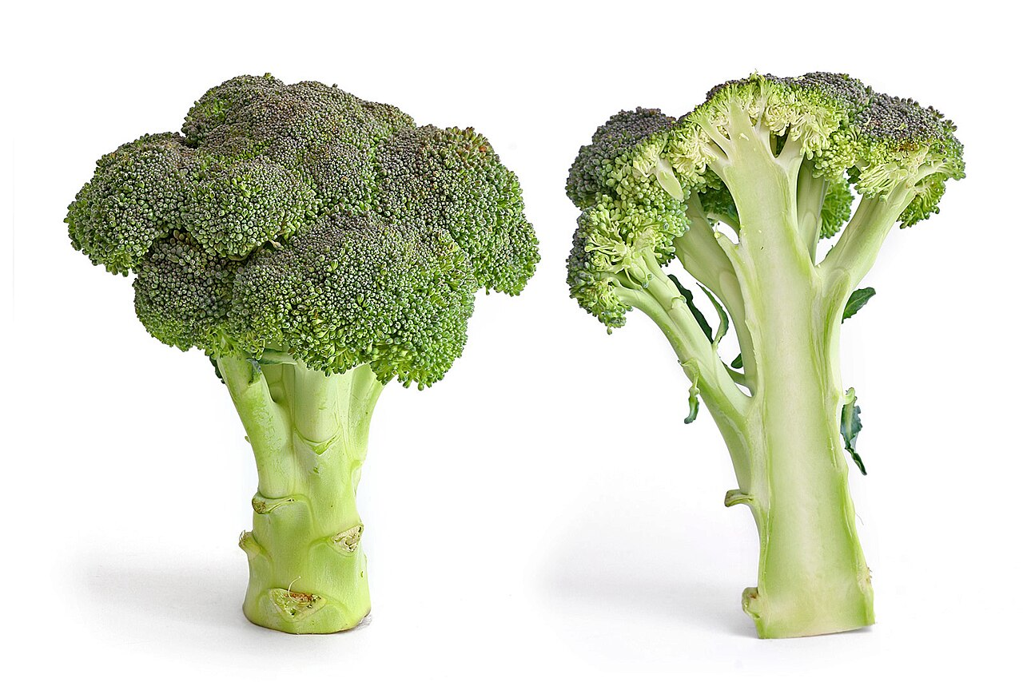
Fractals

Slide 3
Serpenski Triangle
Consider a triangle.
Divide each side into half.
Connect the midpoints.
Remove the middle triangle.

