Slide 1
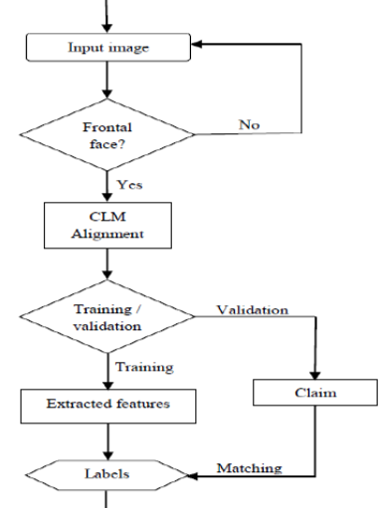
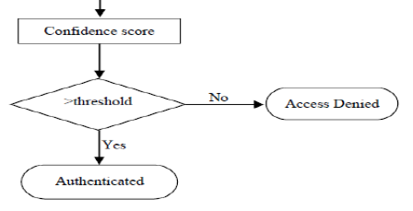
PROCESS FLOW

Slide 2
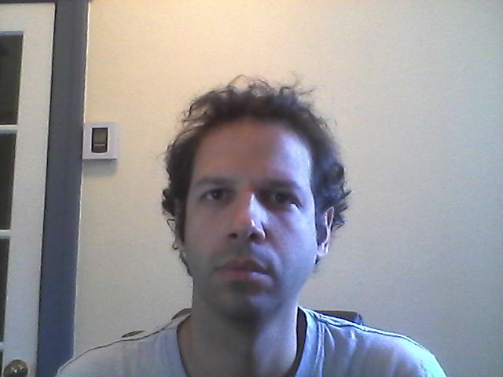
PRE-REQUEST
Training faces should be 2D-frontal image.
Maximum number of training images must be 10.

Slide 3

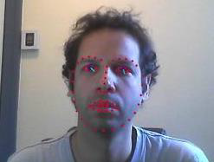

PRE-TRAINING
Faces should be detected.
Aligned to affine transformation.
Input image Face detection Face cropping
(CLM)

Slide 4
EXPERIMENTAL SCENARIO
S No | PARAMETER | VALUES
1 | Dataset | FRGC | RT-US
2 | Color | Grayscale | Grayscale
3 | Number of Images for Training | 10 | 10
4 | Number of labels | 286 | 10
5 | Number of Images for Validations | 50 | 40
6 | Algorithm for training | CNN | CNN
7 | Resolution | 96 x 96 | 96 x 96
8 | Pre-processing | NILL | NILL

Slide 5
LIBRARIES INVOLVED
DLIB
CUDA
TORCH 7
THEANO
CAFFE

Slide 6
TOOLS AND LANGUAGE
Python script
C++
Lua
Ubuntu
Python 2.7.4

Slide 7
EVALUATION
we have evaluated two parameters,
--- True Acceptance Ratio (TAR)
--- True Rejection Ratio (TRR)
TAR is the statistic measure of system verifies a true person of identity claims.
TRR is the measure of percentage of times the system correctly rejects the false claiming of a person.

Slide 8
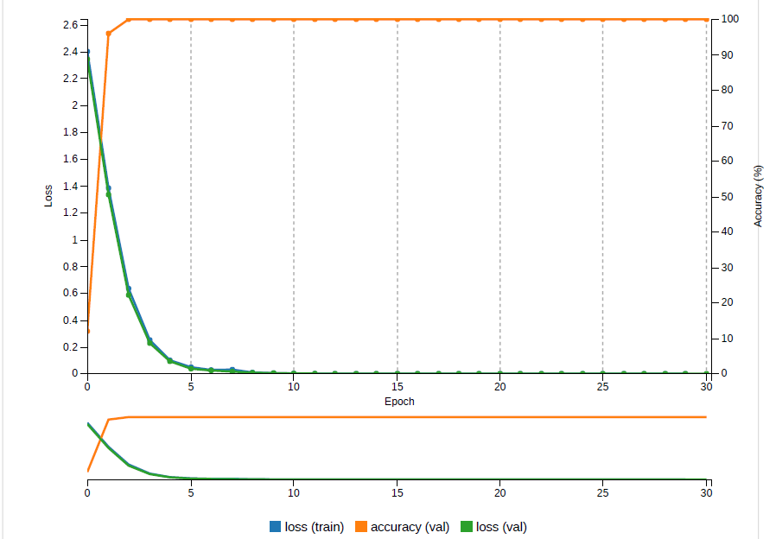
RESULTS

Slide 9
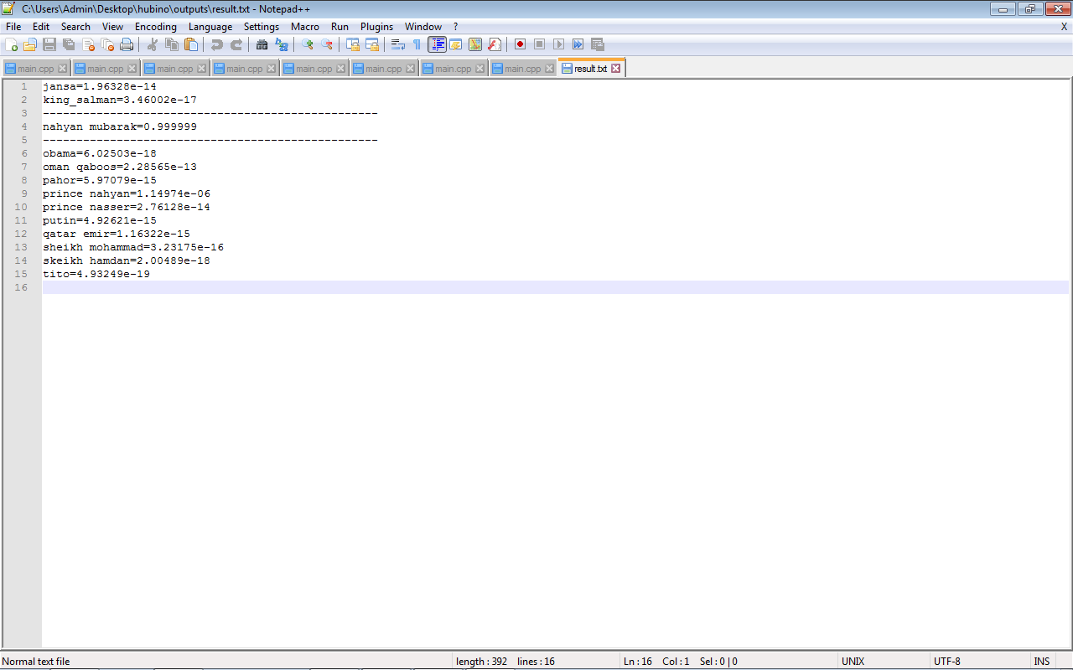
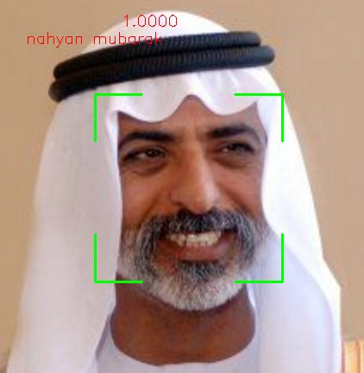
RESULTS

