Slide 1
REAL TIME FACE AUTHENTICATION USING DEEP NEURAL NETWORK
External Guide: Internal Guide: Presented By,
Karthikeyan T S K.Vasanthamani S.Sharma
Technical Lead, Assistant professor 14ML07
CV-developer team, Department of ECE
Hubino PSG college of technology

Slide 2
INTRODUCTION
Face recognition is the most popular and recent technique for authentications.
Face recognition is depends on two things. They are face detection and face identification .
Face detection is used for identifying whether the detected object is face or not.
Face identification is used for authenticating the known faces and ignoring the unknown faces.
FACENet, Deepface are the recent face recognition technologies.

Slide 3
FACE RECOGNITION vs. FACE VERIFICATION
Face Recognition (or Identification) involves a one to many comparison of the input image with a template library.
Face Authentication (also called verification) involves a one to one check that compares an input image with only the image that the user claims to be.

Slide 4
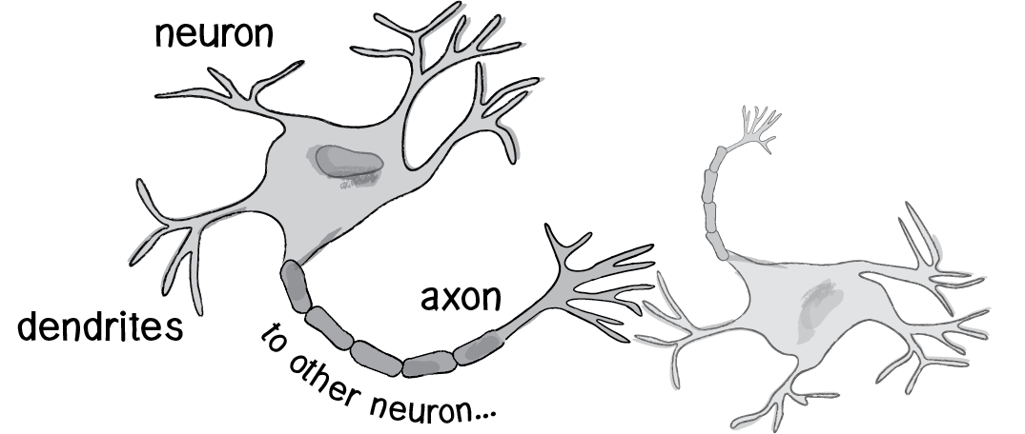
NEURAL NETWORKS
The human brain can be described as a biological neural network—an interconnected web of neurons transmitting elaborate patterns of electrical signals.
Dendrites receive input signals and, based on those inputs, fire an output signal via an axon.

Slide 5
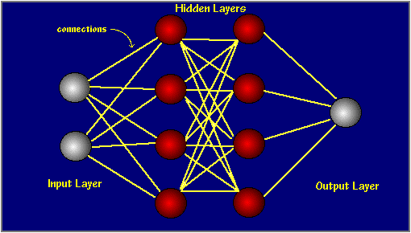
There are several strategies for learning like supervised, unsupervised and reinforcement.
Networks like perceptron, sigmoid function.

Slide 6
DEEP CONVOLUTIONAL NETWORKS
Neural networks are time consuming and much harder to train the networks.
In neural networks, there will be instability because of vanishing or exploding gradient problem.
In order to get more accuracy and less time for training a special architecture is used called deep convolutional network (CNN).
CNN uses three basic ideas local perceptive region, shared weights and pooling.

Slide 7
CNN Contd..,
Local Perceptive Region:
The input pixels are connect to a layer of hidden neurons. But not connecting to every input pixel to every hidden neuron.
Instead, only a make connections in small, localized regions of the input image.
That region in the input image is called the local receptive field for the hidden neuron.
Then sliding the local receptive field across the entire input image.

Slide 8
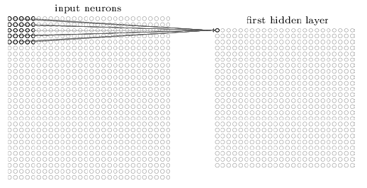
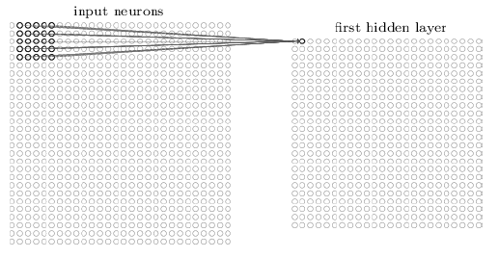
CNN Contd..,
Stride connected to 1st neuron
Stride connected to 2nd neuron

Slide 9
CNN Contd..,
Shared Weights and Biases:
Each local perception region shares the sigmoid function,
This means that all the neurons in the first hidden layer detect exactly the same feature.
More abstract terms, convolutional networks are well adapted to the translation invariance of images
“move a picture of a cat a little ways, and it's still an image of a cat”
The map from the input layer to the hidden layer a feature map.

Slide 10
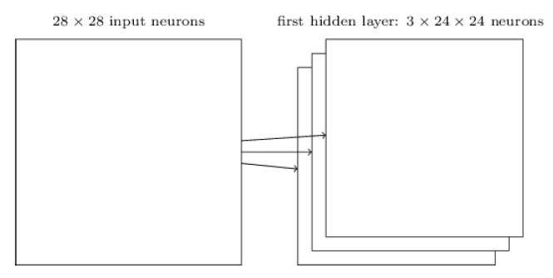
CNN Contd..,
The shared weights and bias are often said to define a kernel or filter.

Slide 11
CNN Contd..,
Pooling Layer:
The pooling layers is to simplify the information in the output from the convolutional layer.
The pooling layer takes each feature map output from the convolutional layer and prepares a condensed feature map.
The common pooling method is max-pooling, a pooling unit simply outputs the maximum activation in the 2 x 2 input region.
The intuition is that once a feature has been found, its exact location isn't as important as its rough location relative to other features.

Slide 12
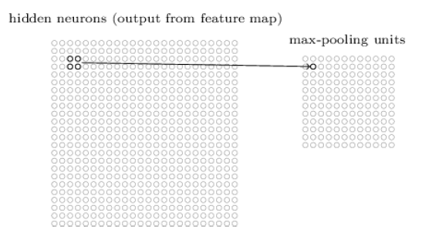
CNN Contd..,

Slide 13
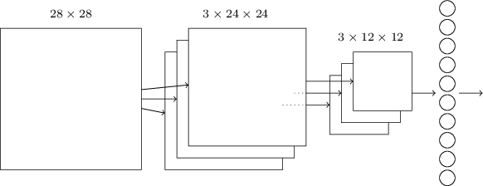
COMPLETE CNN
Input image
Hidden layer or feature map
Pooling layer
Output layer

Slide 14
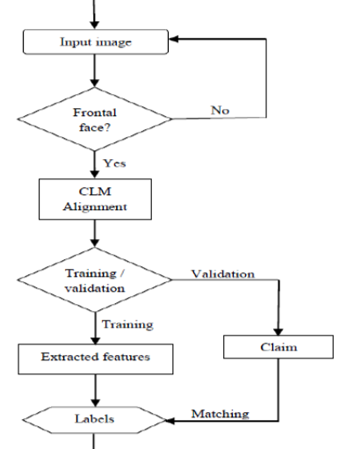
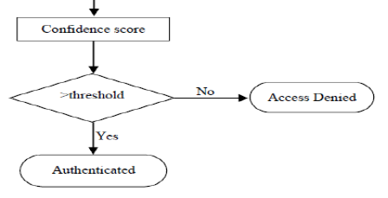
PROCESS FLOW

Slide 15

PRE-REQUEST
Training faces should be 2D-frontal image.
Maximum number of training images must be 10.

Slide 16
CLM ALIGNMENT
Constrained Local Model (CLM) is a method for locating sets of constrained statistical feature points on a digital image.
CLM constructing point distribution model (PDM) on the images and uses posteriori probability (MAP) for the face model parameters to linearization of the shape model.
-- Sampling of a small region from the input image around the face, projecting it into a reference frame.
-- For each point, generate a response by giving a loss value for each pixel.
-- Searching for optimized loss function by the combination of points which manipulating the shape model parameters.

Slide 17

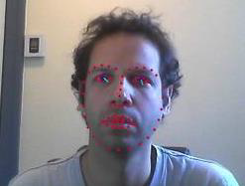
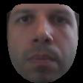
PRE-TRAINING
Faces should be detected.
Aligned to affine transformation.
Input image Face detection Face cropping
(CLM)

Slide 18
DATA SETS
Face Recognition Grand Challenge (FRGC)
Hubino datasets

Slide 19
EXPERIMENTAL SCENARIO
S No | PARAMETER | VALUES
1 | Dataset | FRGC | RT-US
2 | Color | Grayscale | Grayscale
3 | Number of Images for Training | 10 | 10
4 | Number of labels | 286 | 10
5 | Number of Images for Validations | 50 | 40
6 | Algorithm for training | CNN | CNN
7 | Resolution | 96 x 96 | 96 x 96
8 | Pre-processing | NILL | NILL

Slide 20
LIBRARIES INVOLVED
DLIB
CUDA
TORCH 7
THEANO
CAFFE

Slide 21
TOOLS AND LANGUAGE
Python script
C++
Lua
Ubuntu
Python 2.7.4

Slide 22
EVALUATION
we have evaluated two parameters,
--- True Acceptance Ratio (TAR)
--- True Rejection Ratio (TRR)
TAR is the statistic measure of system verifies a true person of identity claims.
TRR is the measure of percentage of times the system correctly rejects the false claiming of a person.

Slide 23
IMPLEMENTATION
Convolutional neural network is used to train the set of 10 images for each label and the query image with the identity label is validated against the labels.
The output is similarity confidence score of two images
The threshold is optimum value chosen in such a way that false acceptance rate is minimized.
The face verification system taken 20 epochs for converging the learning rate and the training losses are reduced to 0 before 5th epoch itself.

Slide 24
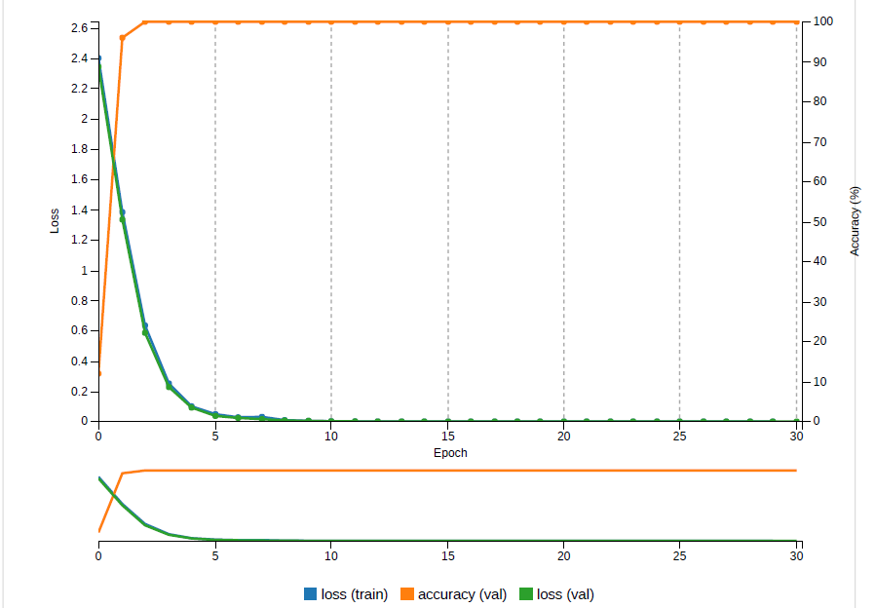
RESULTS

Slide 25

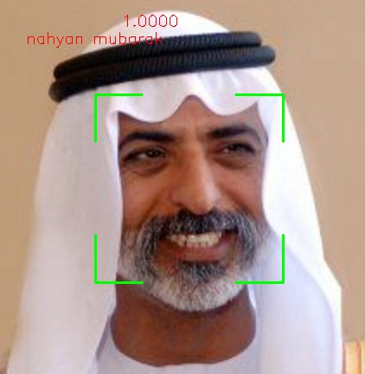
RESULTS

Slide 26
CONCLUSION
We proposed the new methodology for face authentication for higher and accurate acceptance rate of 91.5%.
The proposed Convolutional neural network with Constrained Local Model for both 2D and 3D digital face verification and implemented using computer vision technology in C++ language.
The major components of this work would be the advantage of more efficient training with 10 images for each label.

Slide 27
REFERENCE
[1]. Florian Schroff, Dmitry Kalenichenko, James Philbin “FaceNet: A Unified Embedding for Face Recognition and Clustering”, CVPR, June 2015,pg no:815-823.
[2]. Yaniv Taigman, Ming Yang, Marc’Aurelio Ranzato, “DeepFace: Closing the Gap to Human-Level Performance in Face Verification”,

Slide 28


Slide 29


