Slide 1
CryptoJacking Detection Tool
Submitted in the partial fulfillment for the award of the degree of
BACHELOR OF ENGINEERING
IN
AIT-Computer Science Engineering(IS)
Submitted by:
Rishi 21BCS11879
Akshay 22BIS80006
Shyam Sunder 22BIS80005
Under the Supervision of:
Ms. Gurpreet Kaur (E16578)
Department of AIT-CSE
DISCOVER . LEARN . EMPOWER

Slide 2
Outline
What Is CryptoJacking?
Introduction to Project
Problem Definition
Project Objectives
Technology Stack
Project Architecture
Features
Use Cases
Conclusion

Slide 3
What Is CryptoJacking?
CryptoJacking is a type of cyberattack where hackers secretly exploit a victim’s computer or device to mine cryptocurrency without their consent. This attack can occur through malicious scripts embedded in websites, infected software, or browser-based ads. It causes excessive CPU/GPU usage, leading to slower device performance, increased electricity consumption, and potential overheating. CryptoJacking is difficult to detect and poses a significant threat to both personal and organizational devices.

Slide 4
Introduction to Project
Cryptojacking is the unauthorized use of your system’s resources to mine cryptocurrency, often slowing your computer and driving up energy costs. Our tool monitors CPU, memory, GPU usage, and network connections to spot suspicious activity. Once detected, it delivers real-time alerts and provides quick prevention steps—like terminating rogue processes or blocking suspicious IPs. Throughout this talk, we’ll highlight key features, explain the underlying architecture, and discuss future improvements.

Slide 5
Problem Defination
Cryptojacking is a covert attack where malicious actors secretly use a victim’s computing resources to mine cryptocurrency. This hidden process can dramatically slow down system performance, drain power, and introduce broader security vulnerabilities.
Covert Resource Exploitation: Cryptojacking involves hackers secretly using a victim’s CPU or GPU for cryptocurrency mining.
System Performance Degradation: This unauthorized mining process causes the computer to run more slowly, consume extra power, and potentially overheat.
Security Vulnerability: Traditional antivirus programs may fail to detect cryptojacking because it often masquerades as normal processes or browser scripts.
Lack of Specialized Detection: Without dedicated monitoring of resource usage and network connections, users remain unaware of these stealth attacks.
Need for Real-Time Prevention: Individuals and organizations require a solution that can instantly detect, alert, and block cryptojacking attempts before they escalate into more severe threats.

Slide 6
Objective
Early Detection: Monitor system resources (CPU, memory, GPU) and network connections to quickly spot suspicious activity indicative of cryptojacking.
Real-Time Alerts: Provide immediate notifications when unusual spikes or known malicious domains are detected, helping users take swift action.
Preventive Measures: Offer convenient controls to terminate rogue processes and block suspicious IPs through firewall rules, reducing cryptojacking risks.
Comprehensive Logging: Maintain logs for all alerts, processes terminated, and IPs blocked, aiding in future investigations and audits.
User-Friendly Interface: Present data in a clear, intuitive dashboard so both technical and non-technical users can proactively respond to threats.

Slide 7
Technology Stack
Python 3: The core language used for building all logic and modules.
PyQt5: Provides the GUI framework for creating the application’s windows, tabs, and alerts.
psutil: Enables real-time system monitoring (processes, CPU usage, memory usage, network connections).
Matplotlib: Used to generate live charts and visualizations for CPU, memory, and GPU usage.
GPUtil: Helps retrieve GPU load for detecting high graphics card usage (potential cryptomining).
Requests: Facilitates HTTP requests, such as fetching or updating blacklist data from external sources.

Slide 8
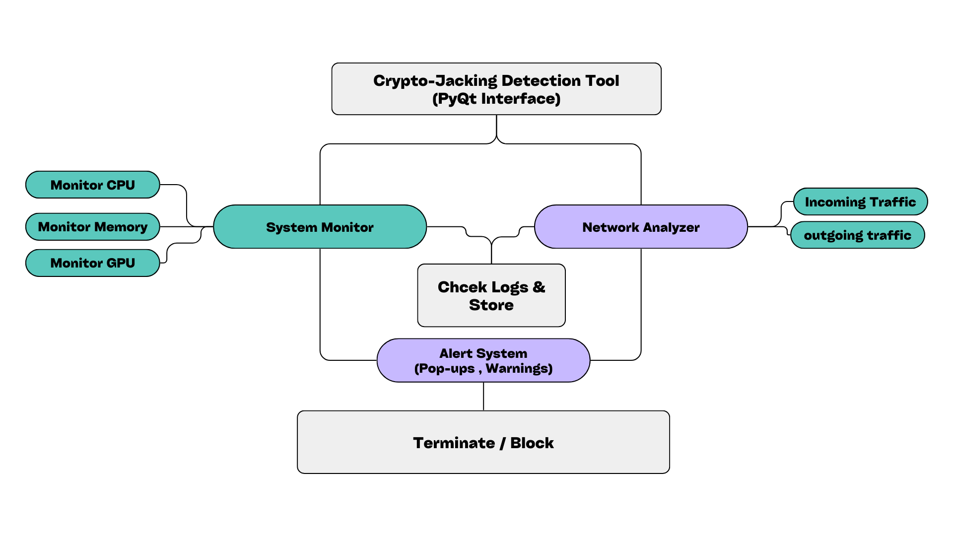
Project Architecture

Slide 9
Features
Real-Time Monitoring Continuously tracks system resources—including CPU, memory, and GPU usage—and identifies abnormal spikes that may suggest hidden cryptocurrency mining processes.
Network Analysis Scans active TCP/UDP connections for suspicious or blacklisted domains related to crypto-mining pools, helping you detect unsafe network activity.
Alert System Displays pop-up warnings when suspicious activity is found, ensuring users can take immediate action to investigate or neutralize potential threats.
User-Friendly GUI Features a tabbed interface (Dashboard, System Resources, Network Activity, Alerts & Logs, Settings) with clear charts, tables, and actionable controls to simplify threat management.

Slide 10
Use Cases
Home Computers: Quickly detect and terminate hidden mining scripts that slow down personal devices.
Office Environments: Monitor workstations for unauthorized miners, protecting productivity and resources.
Server Infrastructure: Guard cloud and on-premises servers against covert mining attacks.
University Labs: Prevent illicit mining on shared computers by continuously scanning for resource spikes.
Cybersecurity Research: Safely study new cryptojacking methods in a controlled environment, refining detection strategies.

Slide 11
Conclusion
Our CryptoJacking Detection & Prevention Tool safeguards systems by continuously tracking resource usage, scanning network activity, and providing swift countermeasures against hidden cryptocurrency mining. By offering real-time alerts, process termination, IP blocking, and detailed logging, it equips users with an effective and user-friendly solution to protect against cryptojacking threats.

Slide 12
Thank You
Department of AIT-CSE
DISCOVER . LEARN . EMPOWER

