Slide 1
<HTML>
By Akshay Sethia

Slide 2

Areas to be Covered …
About
Why HTML ?
Its Basic Structure
A Small and Basic HTML Page
How to run a HTML file.
Some HTML basics concepts

Slide 3

ABOUT HTML
<head><title>HTML – Hypertext Markup Language</title></head>
<body><p>HTML is the standard markup language for documents designed to be displayed in a web browser. It can be assisted by technologies such as Cascading Style Sheets (CSS) and scripting languages such as JavaScript. Web browsers render HTML documents into multimedia web pages.</p></body>

Slide 4

HTML …
HTML elements are delineated by tags, written using angle brackets. Tags such as <img /> and <input /> directly introduce content into the page.
What is the Main use of HTML
HTML elements are the building blocks of HTML pages. With HTML constructs, images and other objects such as interactive forms may be embedded into the rendered page.
HTML provides a means to create structured documents by denoting structural semantics for text such as headings, paragraphs, lists, links, quotes and other items.
HTML elements are delineated by tags, written using angle brackets. Tags such as <img/> and <input/> directly introduce content into the page.

Slide 5
HTML STRUCTURE
HTML is composed of the following Sections
<!DOCTYPE HTML> Tag
This line is added to the HTML file to specify the latest version of HTML.
<html>
Tag
This tag specifies the beginning and ending of the whole HTML file. All Tags Fall into this except for the first one.
<head>
Tag
The head tag is the part of the Html page where all the information about the web goes.
<body>
Tag
The Body tag is the tag which contains the information and content of the whole webpage.

Slide 6
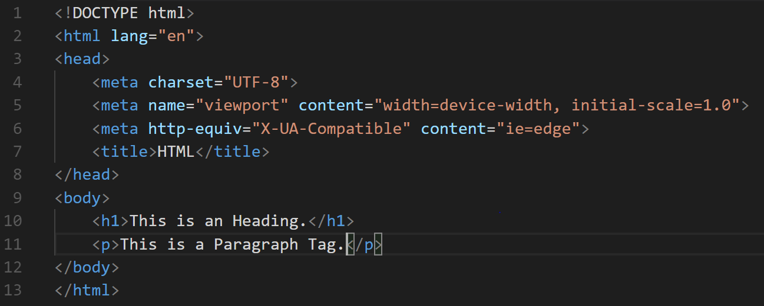

Basic <html> Page
The Right Side Of The Screen Depicts A Basic HTML Code.
The First Line sets the HTML file to The Latest Version and the html tag represents the start of the html file.
The Had Tag consists of the meta tags and the title of the webpage.
The Body tag consists of the Heading and the paragraph tag along with their contents.

Slide 7


How to run an HTML file
Firstly, we need a Text Editor, Notepad would also work fine.
Now create an .html file and fill it with some sample html code, (take a look above if you need help).
Now save the file and open it using any browser.
Kudos, you compiled your first HTML page successfully and executed it.

Slide 8
HTML BASICS
Now, as we know how to run an HTML file, lets get our hands into the Basics of HTML, with which the wonders of the web were created !
HTML Headings
HTML Paragraphs
HTML headings are defined with the <h1> to <h6> tags.
<h1> defines the most important heading. <h6> defines the least important heading.
Example –
<h1>This is heading 1</h1>
<h2>This is heading 2</h2>
<h3>This is heading 3</h3>
HTML paragraphs are defined with the <p> tag.
Paragraph tags are the one which help us to add paragraphs and small hints of info to our webpage.
Example –
<p>This is a paragraph.</p>
<p>This is another paragraph.</p>

Slide 9

MOBILE VERSION
HTML, along with the help of CSS, JS can be made Mobile Responsive. To make a website responsive, a html file is structured according to different screen sizes and the CSS and JS codes are applied accordingly.

Slide 10

THANK YOU!
Akshay Sethia
Phone:
9841481122
Email:
Akshay.sethia@capgemini.com

