Slide 1

Note: The data and information in this document is reflective of a hypothetical situation and client. This document is to be used for KPMG Virtual Internship purposes only.
Sprocket Central Pty Ltd
Data analytics approach
Akshay Shivanandi

Slide 2
Note: The data and information in this document is reflective of a hypothetical situation and client. This document is to be used for KPMG Virtual Internship purposes only.
Agenda
Introduction
Data Exploration
Model Development
Interpretation

Slide 3
Note: The data and information in this document is reflective of a hypothetical situation and client. This document is to be used for KPMG Virtual Internship purposes only.
Introduction
Identifying Top 1000 customers and recommend to target for Sprocket Central Pty Ltd.
Outline of Problem:
Sprocket Central is a company that specializes in high-quality bikes and accessible cycling accessories to riders.
Their marketing team is looking to boost business sales by analyzing provided datasets.
Using 3 datasets provided the aim is to analyze and recommend 1000 customers that Sprocket Central should target to drive most value for the organization.
Contents:
New and Old Customer Age Distributions
RFM analysis for customer classification
Distribution by Job Industry
Bike related purchases in last 3 years by gender
Customers owning cars.

Slide 4
Note: The data and information in this document is reflective of a hypothetical situation and client. This document is to be used for KPMG Virtual Internship purposes only.
Data Exploration
Identifying and Cleaning Data Quality Issues
Key Issues for Data Quality Assessment:
Accuracy: Correct Values
Completeness: Data Fields with Values
Consistency: Values free from Contradiction
Currency: Values up to date
Relevancy: Data items with value meta-data
Validity: Data containing allowable values
Uniqueness: Records that are duplicated
Accuracy | Completeness | Consistency | Currency | Relevancy
Customer Demographics | *DOB: Inaccurate | *Job_title: Incomplete (Blanks) *Customer_id: Incomplete | *Gender: Inconsistency | *Deceased_indicator: Filtered | *Default: Deleted
Customer address |  | *Customer_id: Incomplete
Transaction data | *Profit: Missing | *Customer_id: Incomplete *Online_order: Blank *Brand: Blank |  |  | *Order_status: Removed cancelled items

Slide 5
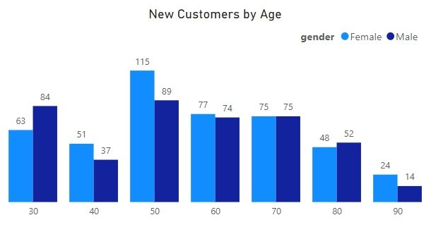
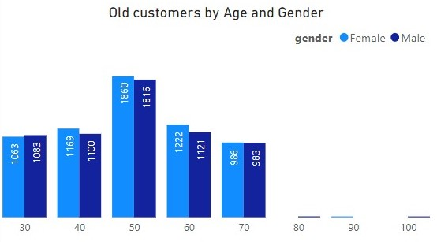
Note: The data and information in this document is reflective of a hypothetical situation and client. This document is to be used for KPMG Virtual Internship purposes only.
Data Exploration
Old & New Customer Age Distribution
Most of the customers are aged between 40-49 in Old and New list.
Customers under 20 & above 70 are lowest in old list.
In New Customers list, majority of them are 41-69.
There is increase in 71-89 category in new list compared to old list

Slide 6
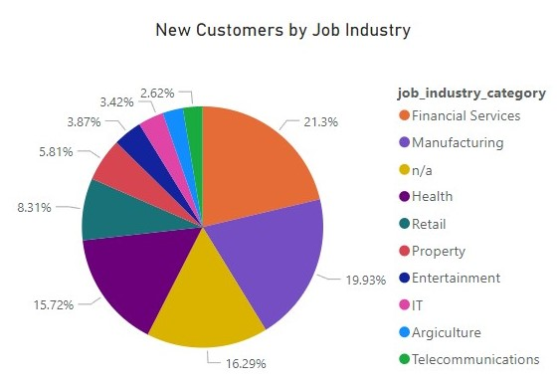
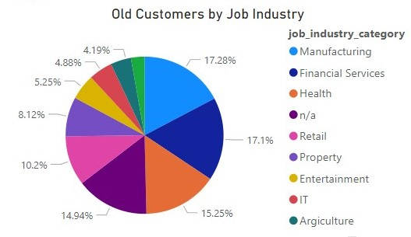
Note: The data and information in this document is reflective of a hypothetical situation and client. This document is to be used for KPMG Virtual Internship purposes only.
Data Exploration
Distribution by Job Industry
Majority of the customers are from Manufacturing and Financial Services Industry in both New and old list.
Most of the customers are coming from Manufacturing, Financial services, Health and Retail Industries both in Old and New lists.
IT, Entertainment, Agriculture & Telecommunication industries having very low purchases.

Slide 7
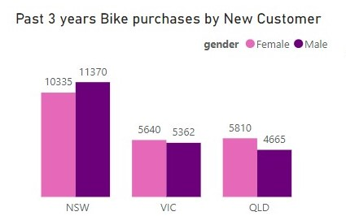
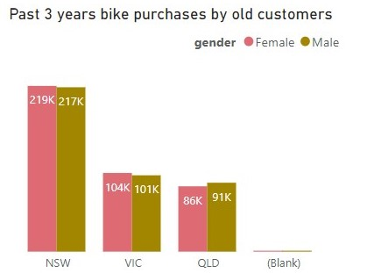
Note: The data and information in this document is reflective of a hypothetical situation and client. This document is to be used for KPMG Virtual Internship purposes only.
Data Exploration
Bike related purchases in past 3 years by gender and place
Majority of the purchases are coming from NSW in both old and new lists.
Proportion of bikes purchased by Female customers are higher than Males.
In NSW, Male customers purchasing the bikes is more than Females by around 10000

Slide 8
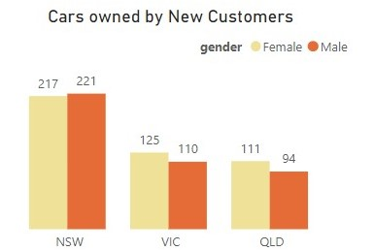
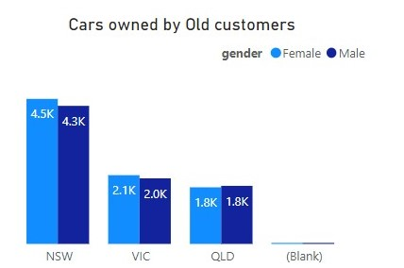
Note: The data and information in this document is reflective of a hypothetical situation and client. This document is to be used for KPMG Virtual Internship purposes only.
Data Exploration
Customers owning cars
Customers owning cars are higher in NSW for both New and Old list.
Overall Female customers owning the cars are higher than Male customers.
There is decline of Female customers owning cars compared to Males

Slide 9
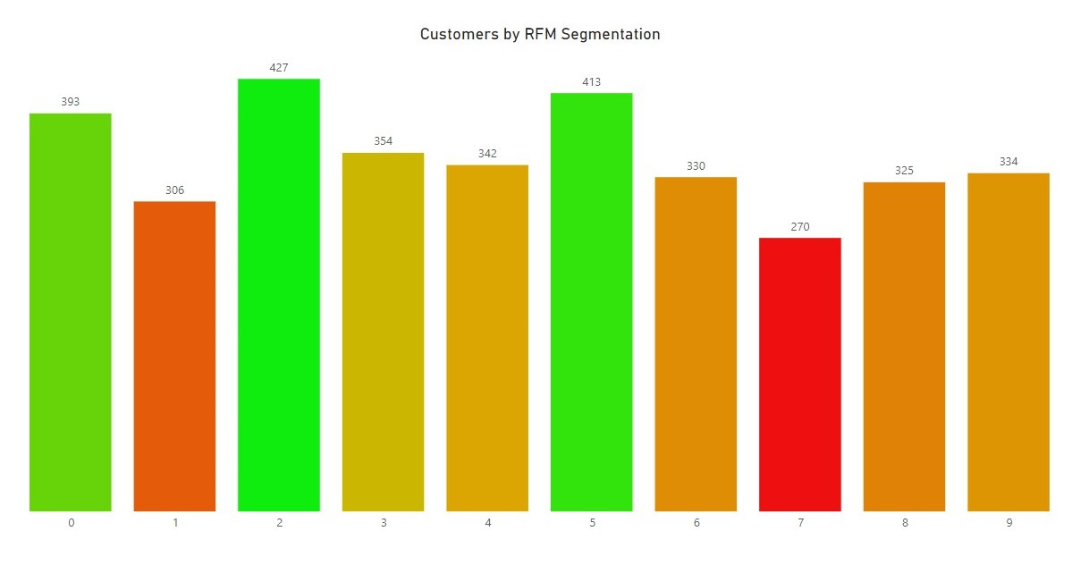
Note: The data and information in this document is reflective of a hypothetical situation and client. This document is to be used for KPMG Virtual Internship purposes only.
Model Deployment
RFM Analysis and Customer Classification
RFM(Recency, Frequency, Monetary) analysis is used to determine which customers business should target to increase its revenue and value
RFM model shows customers that have displayed high levels of engagement with business in 3 categories.
RFM segmentation is plotted in graph as shown, 9 being High valued customers and 0 as Low valued customers.

Slide 10
Note: The data and information in this document is reflective of a hypothetical situation and client. This document is to be used for KPMG Virtual Internship purposes only.
Interpretation
Customer Target and Methodology
Summary Table to target Top 1000 Customers
Rating | Customer Title | RFM Value | No. of Customers | Cumulative Customers | Top 1000 Customer Selection
9 | Highly Satisfactory | 444 | 334 | 334 | 334
8 | Mostly Satisfactory | 434 | 325 | 659 | 325
7 | Satisfactory | 423 | 270 | 929 | 270
6 | Moderately Satisfactory | 414 | 330 | 1259 | 71
5 | Somewhat Satisfactory | 344 | 413 | 1672 | 0
4 | Neutral | 323 | 342 | 2014 | 0
3 | Somewhat Unsatisfactory | 244 | 354 | 2368 | 0
2 | Unsatisfactory | 223 | 427 | 2795 | 0
1 | Mostly Unsatisfactory | 142.6 | 306 | 3101 | 0
0 | Highly Unsatisfactory | 114 | 393 | 3494 | 0

