Slide 1
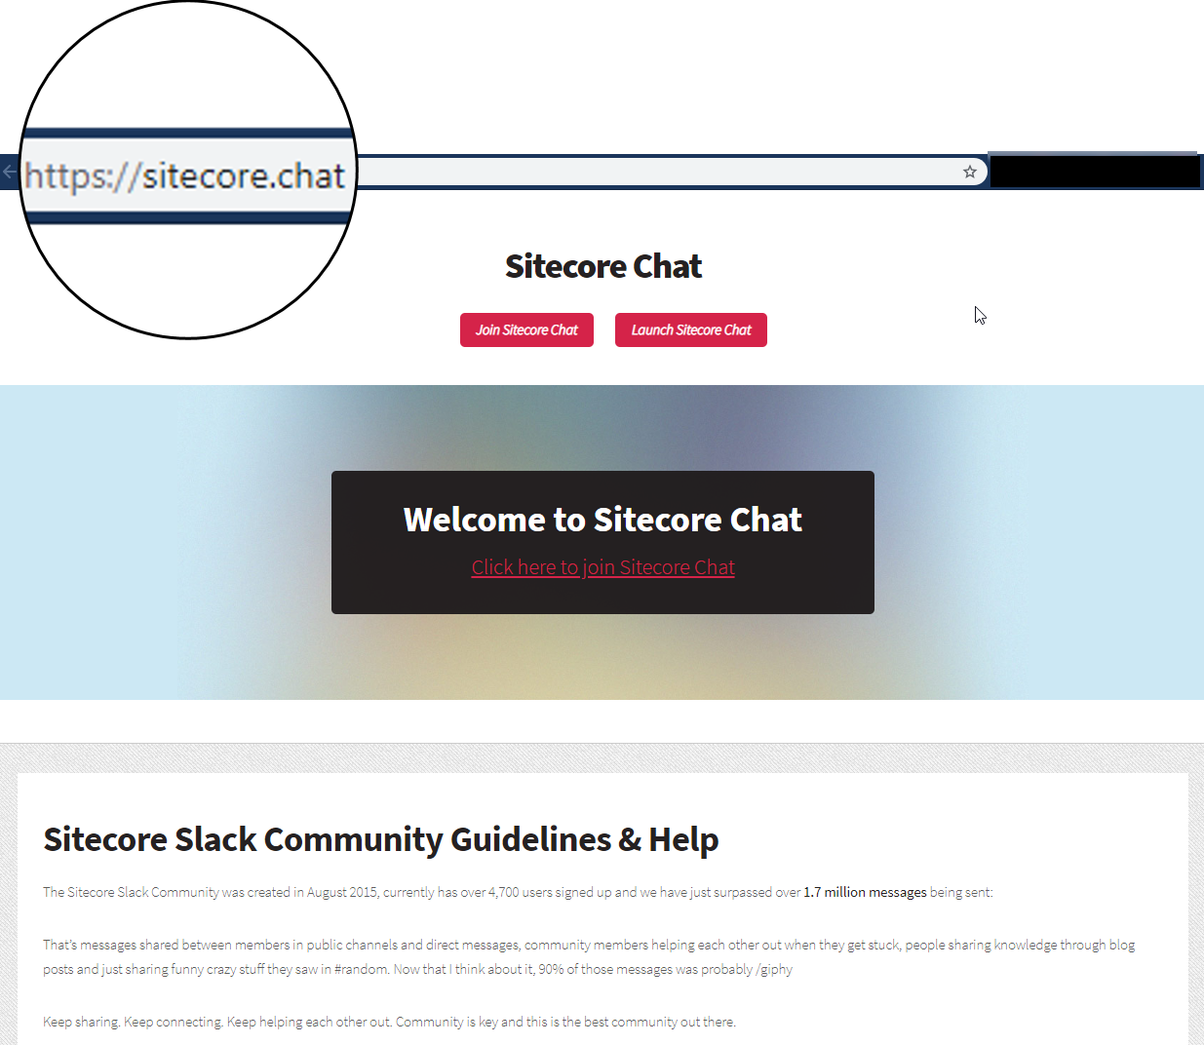
1,892,219 Messages Sent
47 Public Channels
5011 Members
1087 Active Members

