Slide 1
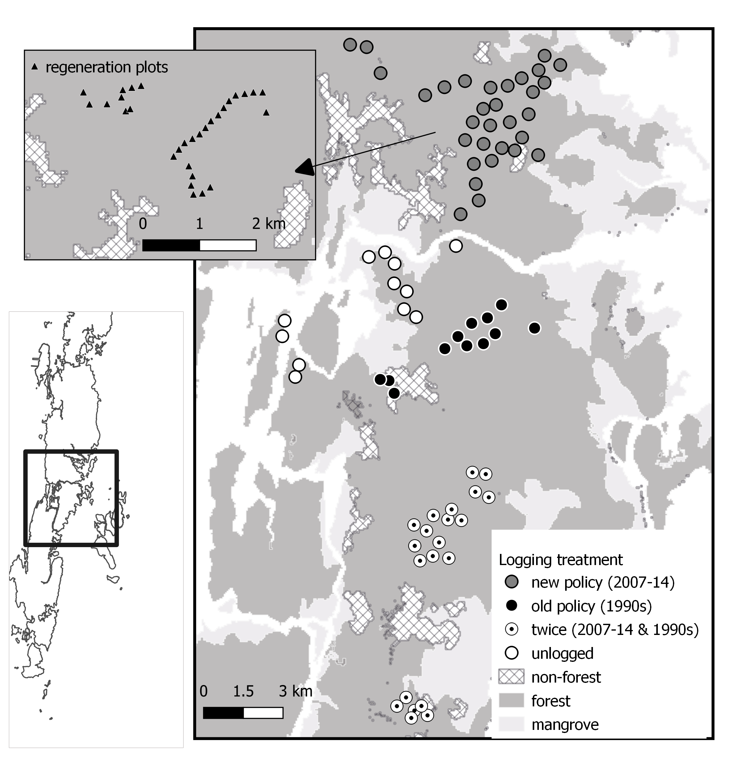
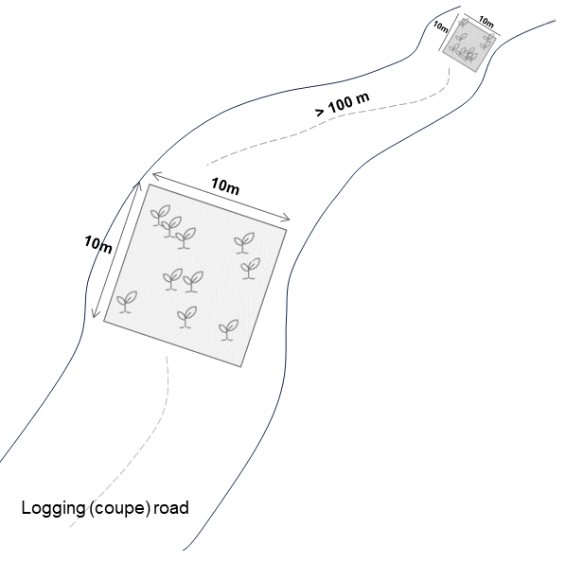
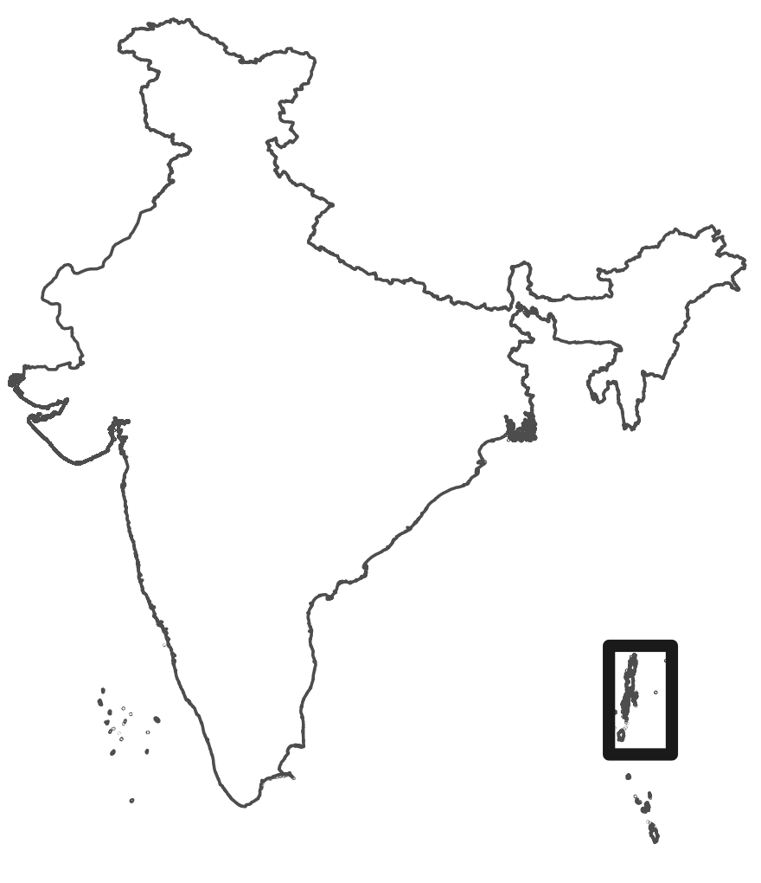
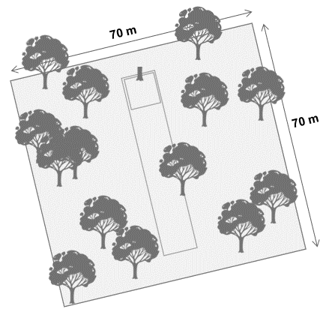
A
B
C

Slide 2

70 m
70 m

Slide 3

10m
10m
> 100 m
10m
10m
Logging (coupe) road

Slide 4
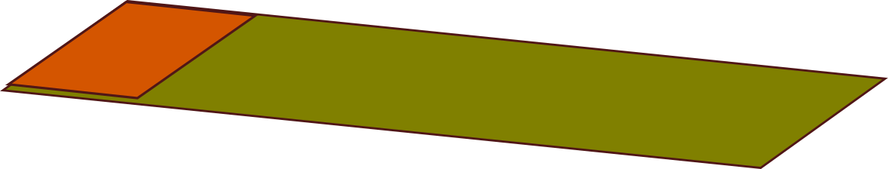
stems with girth ≥10cm
recorded (0.01ha)
stems with girth ≥30cm recorded (0.05ha)
stump
50 m
10 m
direction of treefall
10 m
Notes:
4

