Slide 1
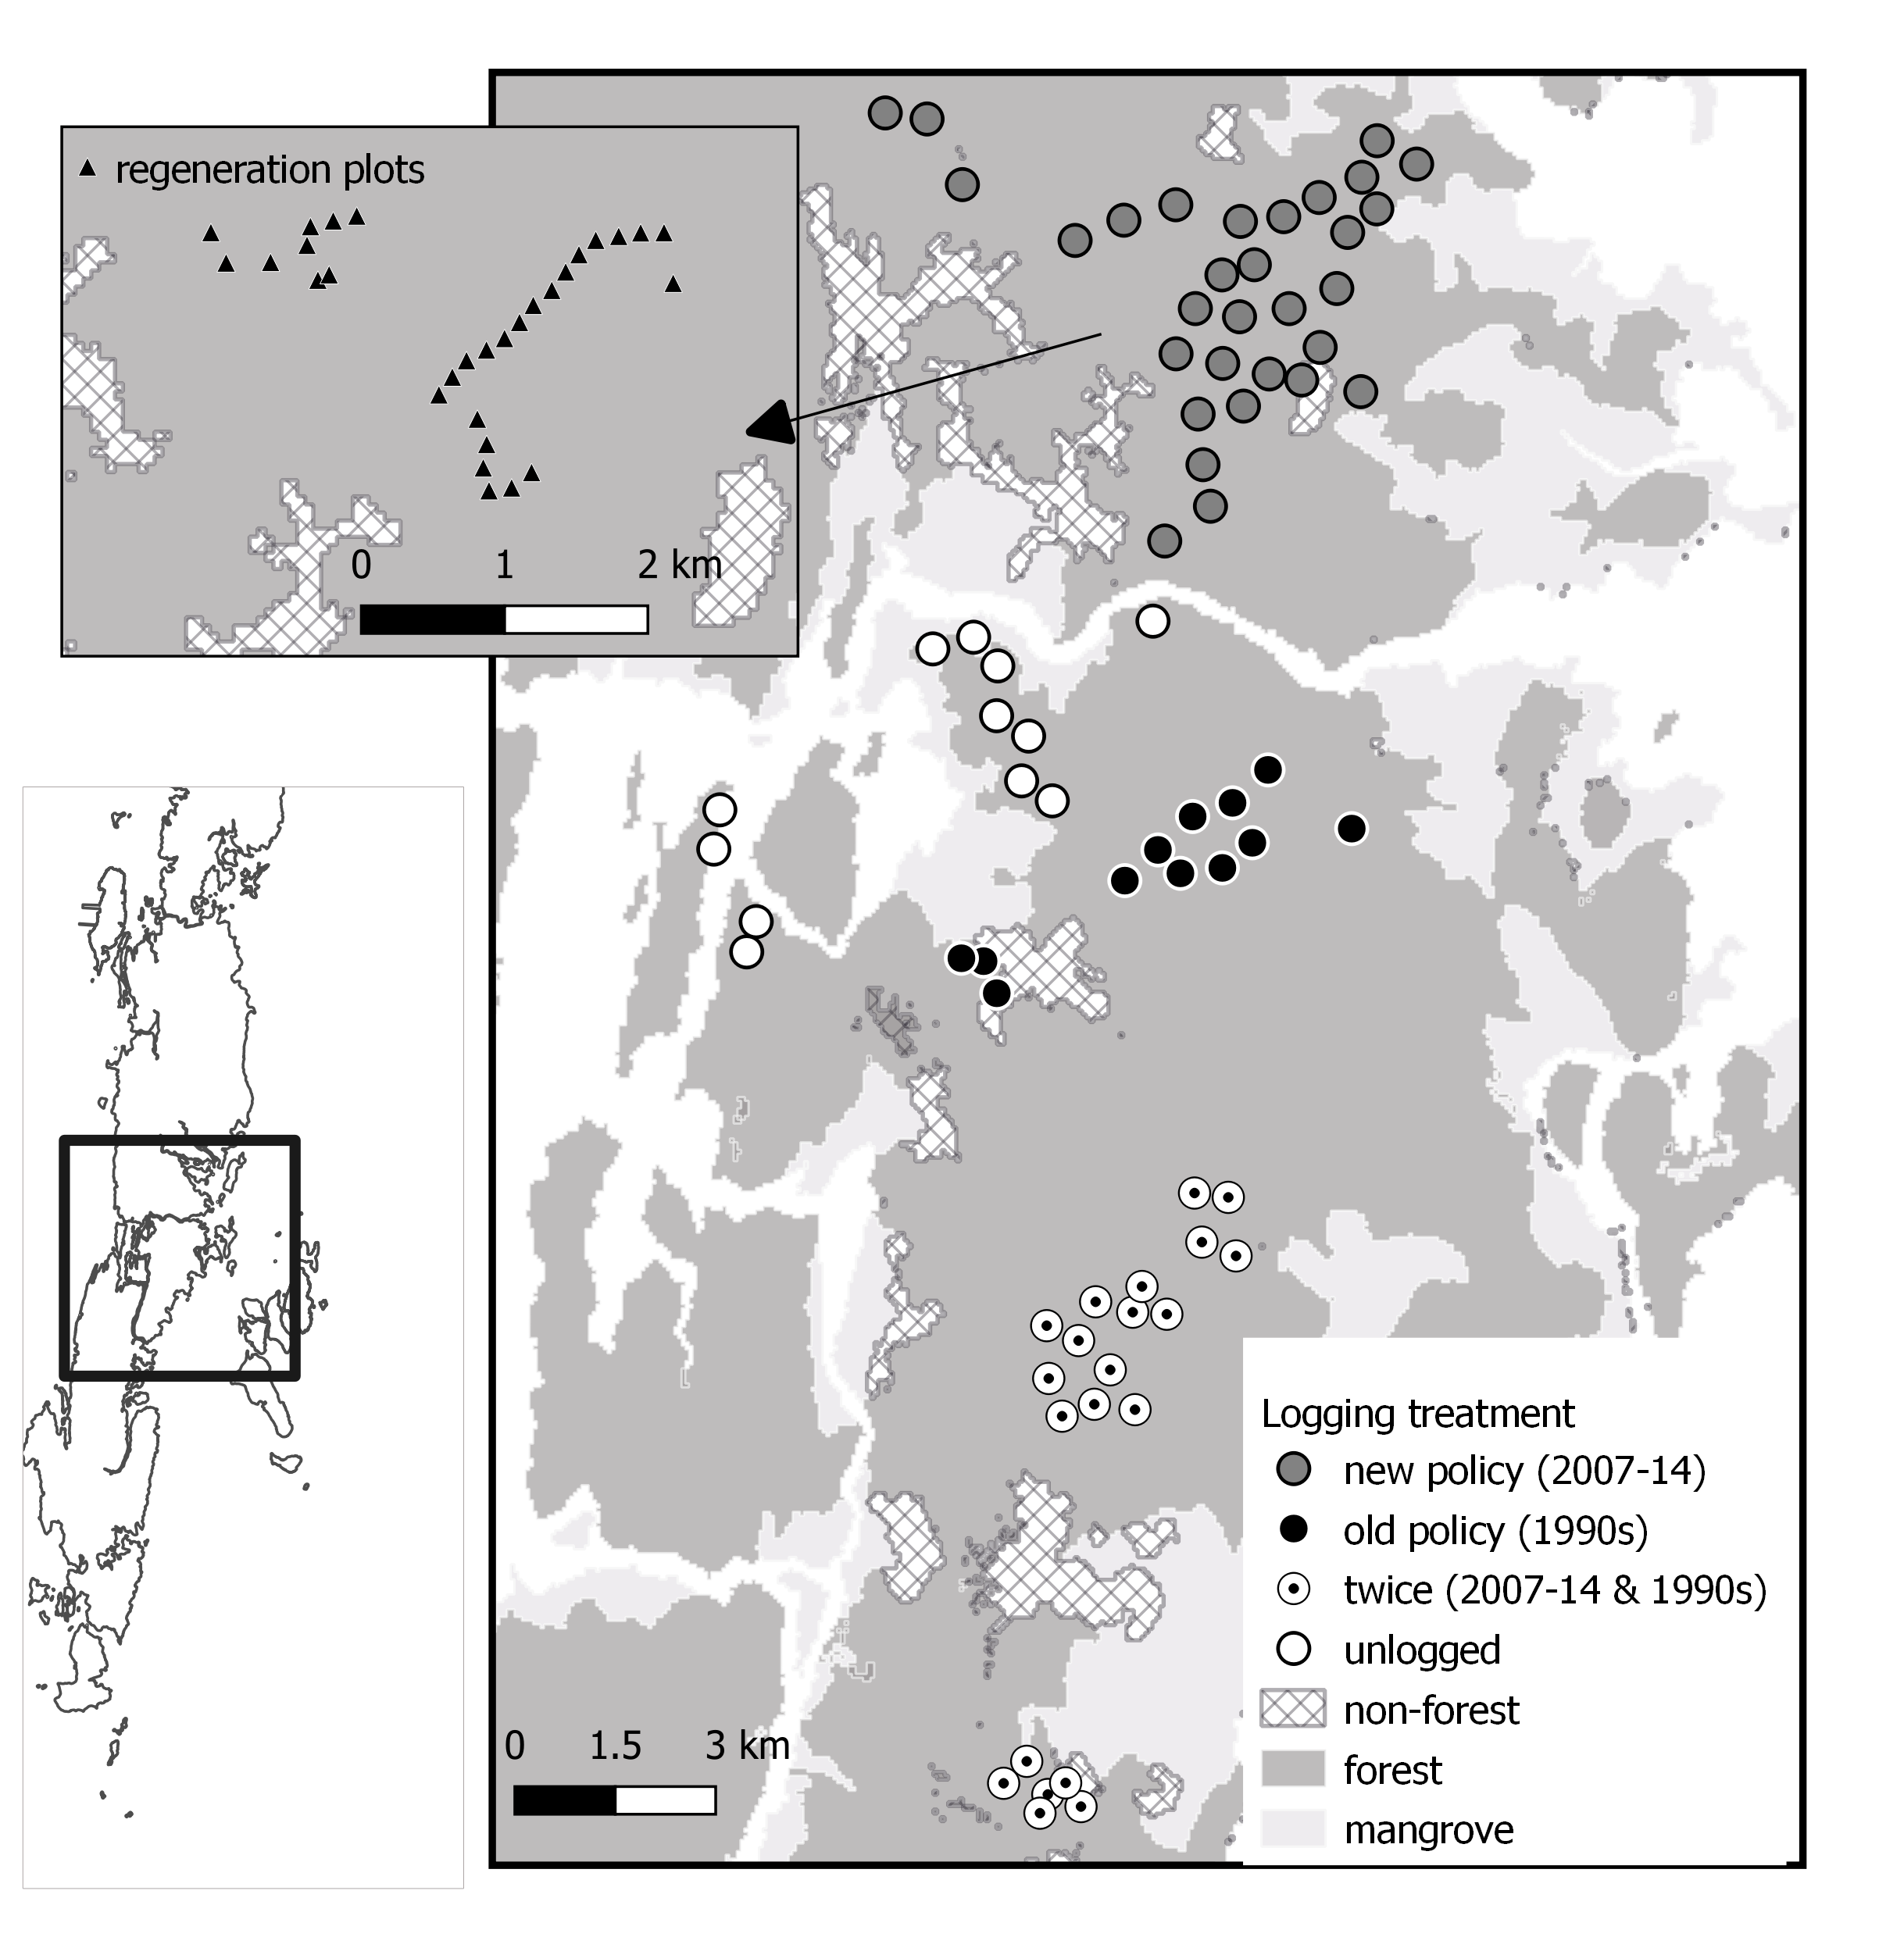
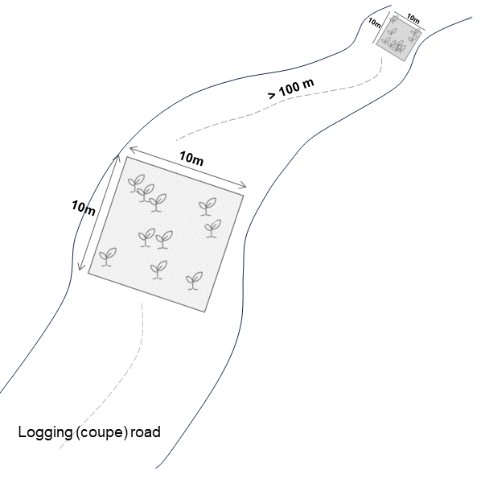
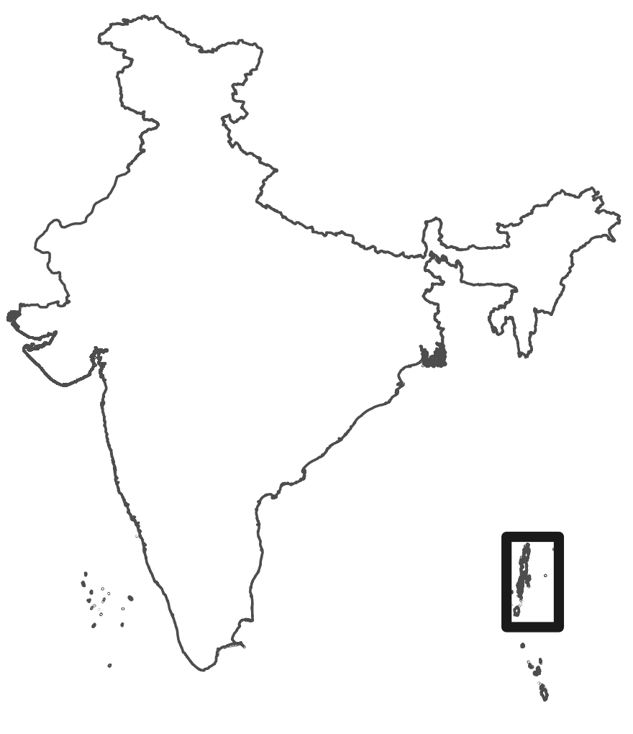
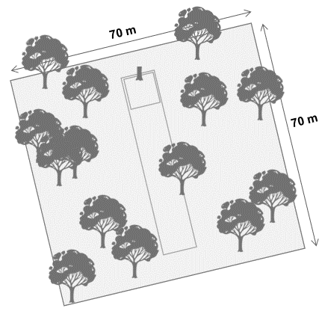
A
B
C

Slide 2

70 m
70 m

Slide 3

10m
10m
> 100 m
10m
10m
Logging (coupe) road

