Slide 1
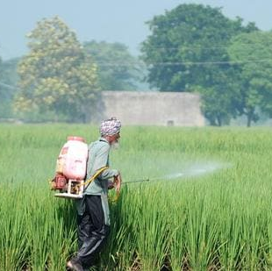



Predicting Fertilizer Input for Rice Cultivation in India
Erdös Institute Data Science Bootcamp May 2022
Team Barrel:
Akshay Suresh
Arman Darbinyan
Dmitry Shcherbakov
Emilio Codecido
Leonardo Santana

Slide 2
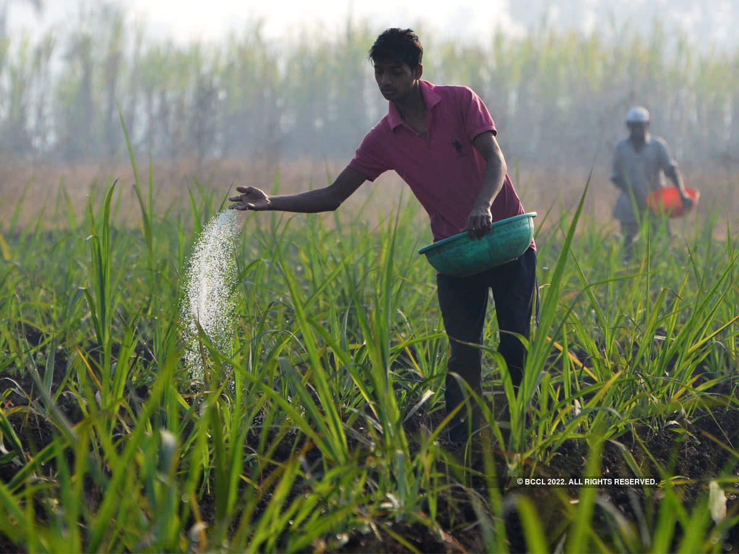
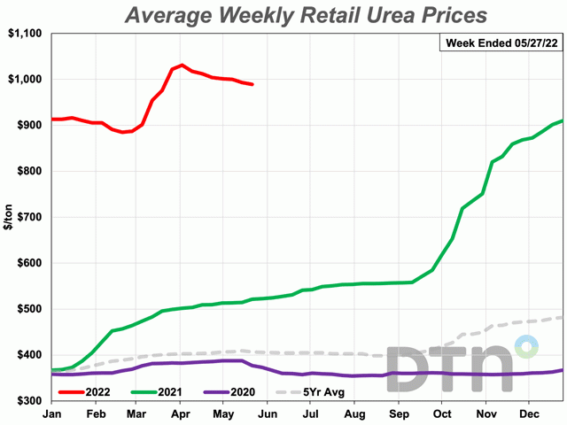
Sustaining India’s Food Self-sufficiency
Resource-intensive farming
Soaring fertilizer prices
Provision of consistent subsidies to farmers
India’s dependence on imports:
Urea – 33 %, Phosphate – 90%, Potash – 100%
Precise fertilizer budgeting required by policy-makers

Slide 3
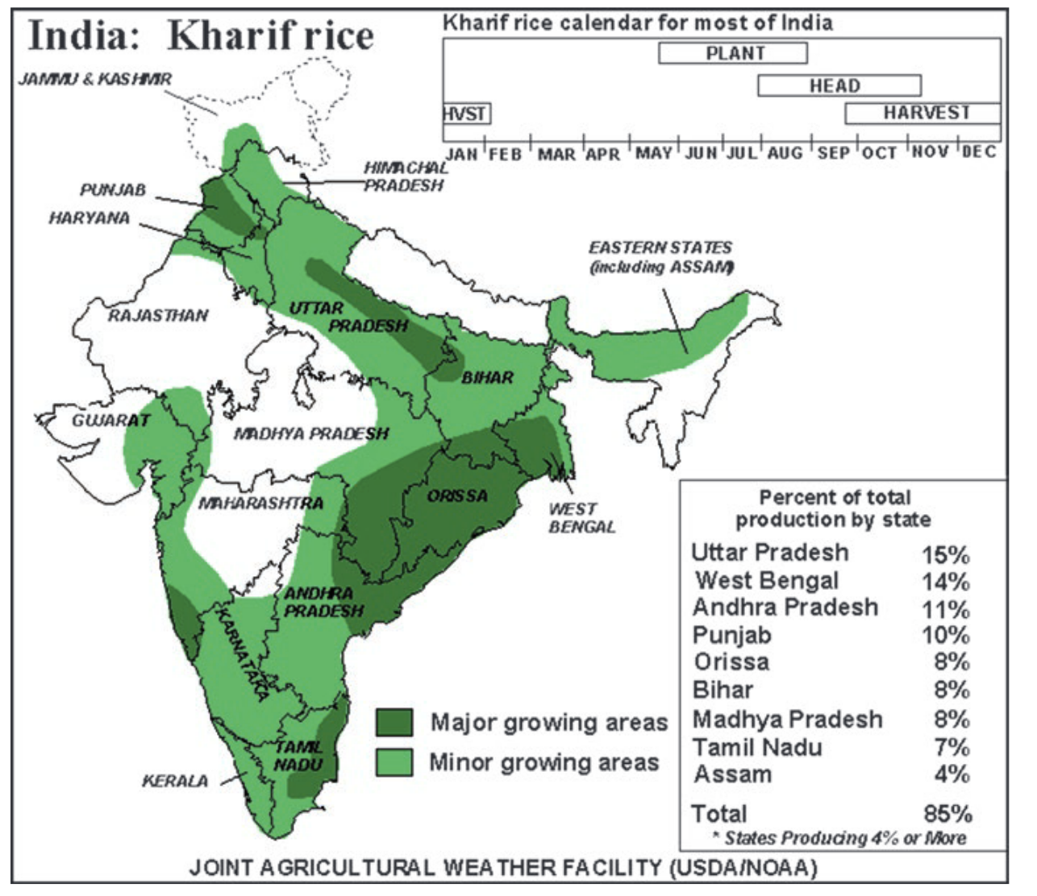
Our Goal
Help policy-makers by
“predicting expected NPK fertilizer input (kg/ha) to obtain a desired rice yield (kg/ha)”
accounting for diverse rice cultivation environments.
Mahajan, G., Kumar, V., Chauhan, B.S. (2017)

Slide 4
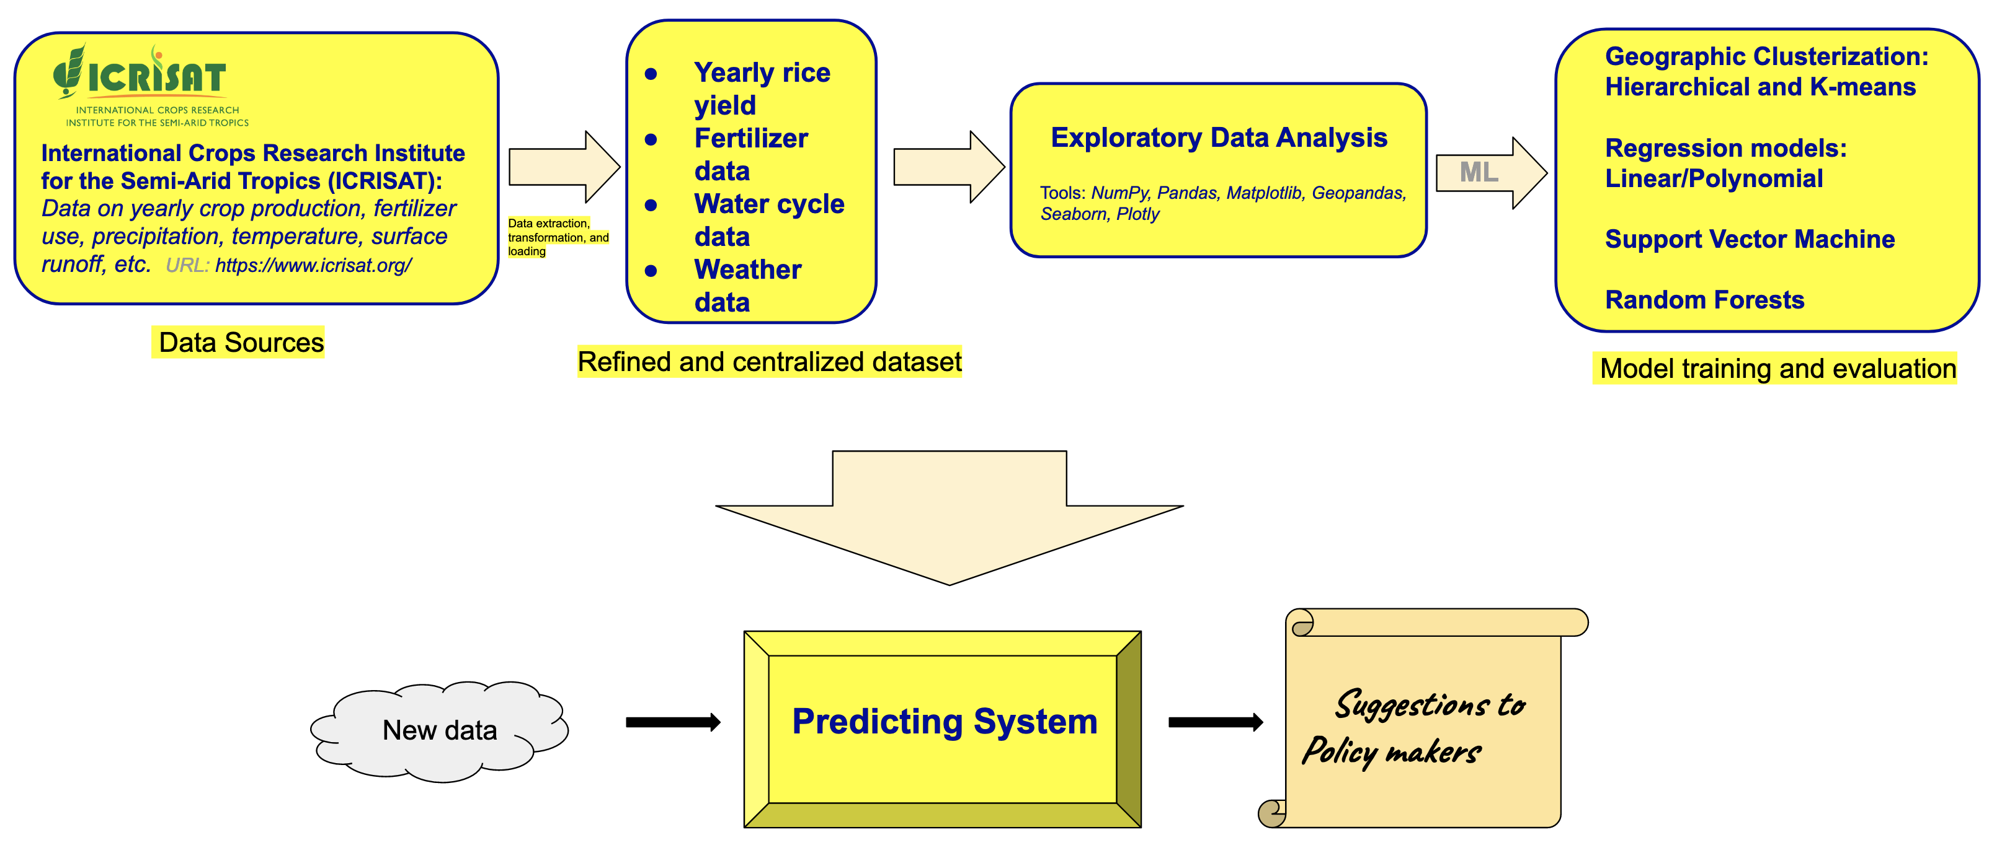
Workflow
(Akshay, Emilio)
(Leonardo, Arman, Dmitry)
(all team members)

Slide 5
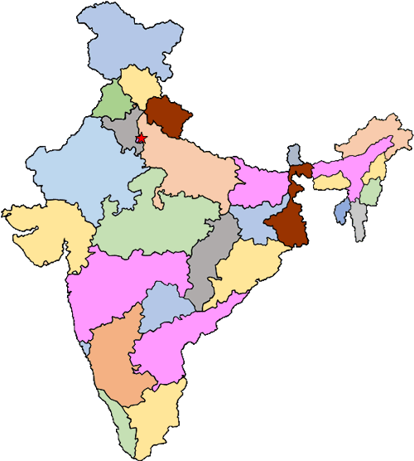

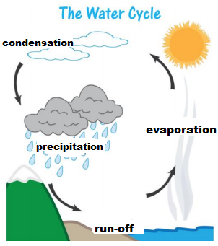

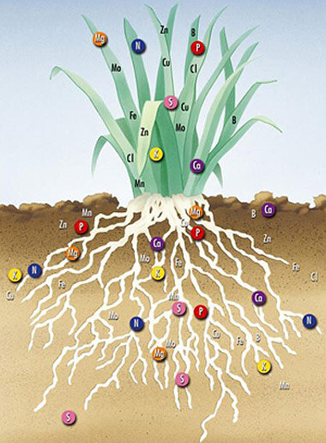
Data Features
Geography
Seasonality and temperature
Precipitation, runoff, evapotranspiration
Wind speed
Fertilizer input

Slide 6
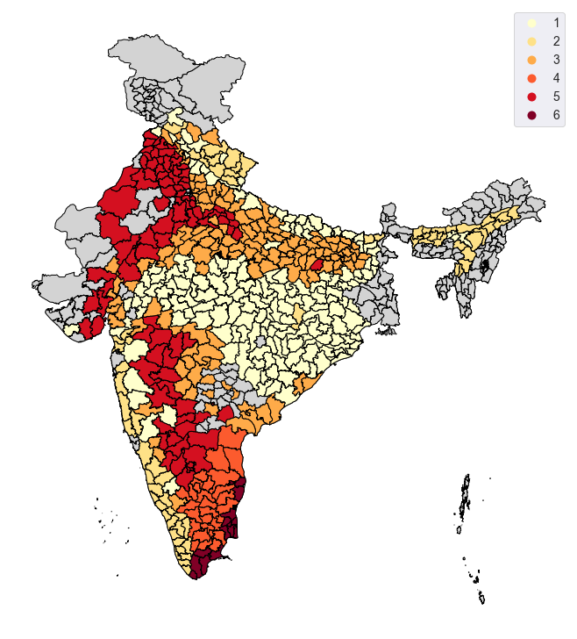
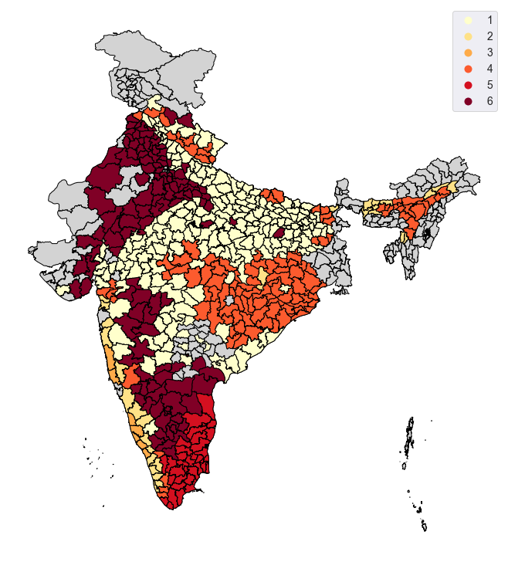
Clustering
Method 1: Correlation-based Hierarchical Clustering on 12 environmental parameters
Method 2: K-means clustering (validation)
Composition of clusters in Method 1 by the classification of districts from Method 2:

Slide 7
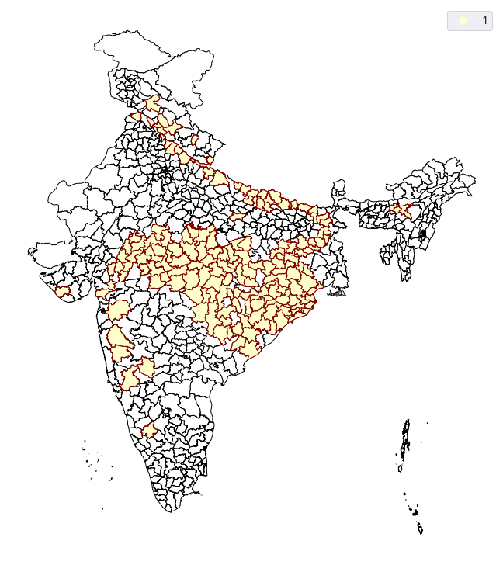
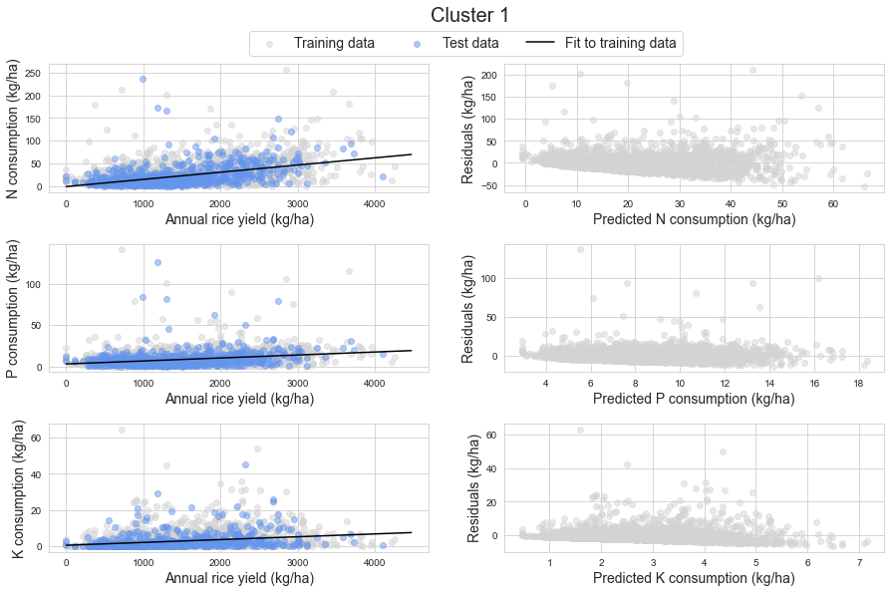
Cluster-level Modeling
Simple linear regression
80-20 train-test split
10-fold cross-validation

Slide 8
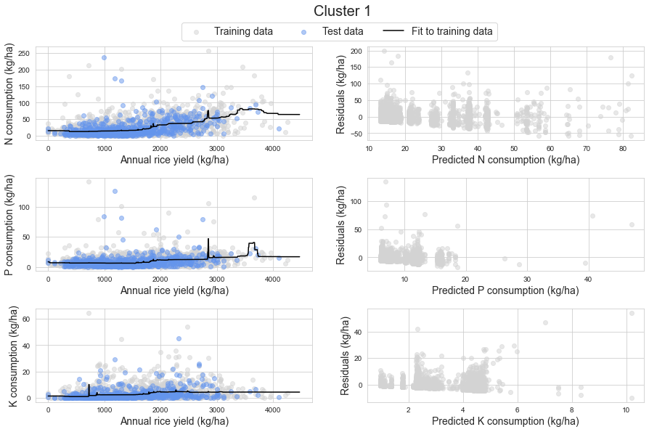
Cluster-level Modeling
Random forest regression
80-20 train-test split
10-fold cross-validation

Slide 9
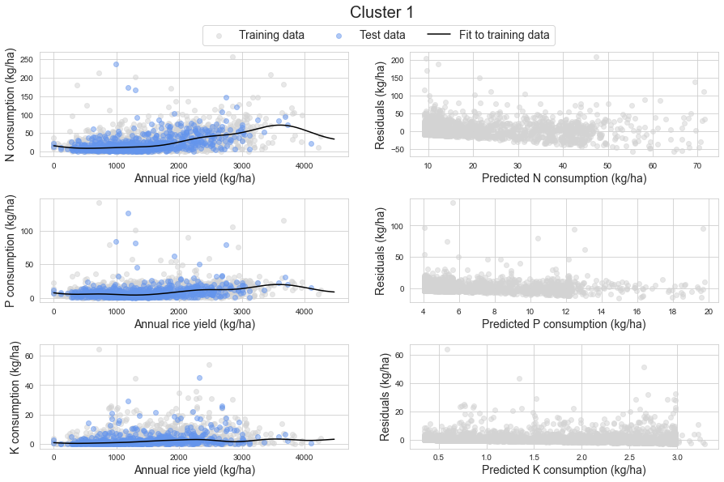
Cluster-level Modeling
Radial basis function kernel
Support vector regression
80-20 train-test split
10-fold cross-validation

Slide 10
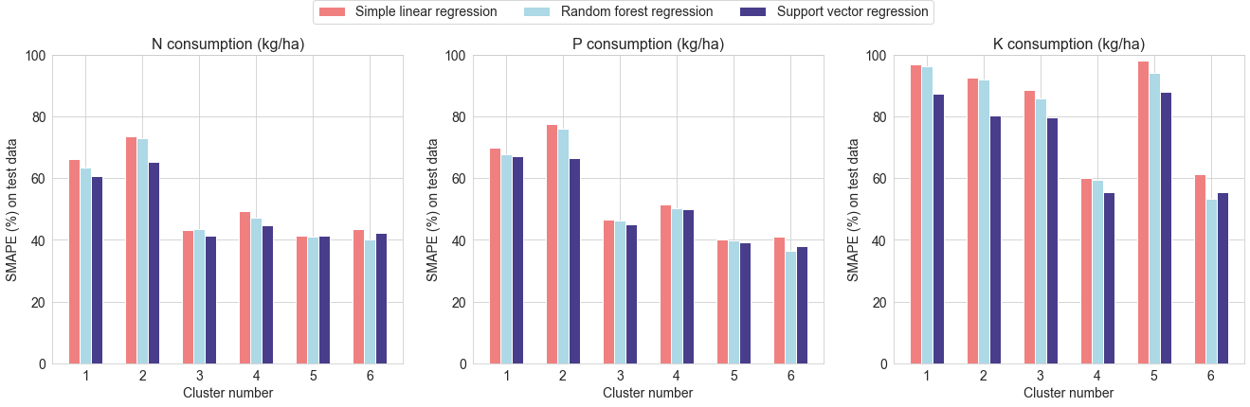
Model Comparison
Symmetric mean absolute percent error:

Slide 11


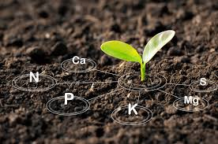

Summary and Future Work
Built cluster-level models predicting fertilizer input for a given rice yield.
Future model extensions:
New variables:
Impact of crop rotation and off-season farming practices.
solar irradiance
soil nutrients
cloud cover
Stakeholders: Agriculture policy-makers
Acknowledgements:
Special mention to James Bramante for mentoring us through our project.

