Slide 1
Internet At Home
Predict which students do not have internet at home
-Akshay Suresh, Noul Singla, Sai Charan Konanki

Slide 2




PROBLEM STATEMENT
Statement
For the given student’s personal, academic and educational information, predict if the student has internet connectivity at home.
Type of Problem
Classification
Source
Kaggle

Slide 3
PERFORMANCE MEASUREMENT
CRITERIA | IMPORTANCE | MEASURE
TRUE NEGATIVE RATE | VERY IMPORTANT | HIGH
INTERPRETATION OF RESULT | IMPORTANT
NEGATIVE PREDICTIVE VALUE | AVERAGE | HIGH
ACCURACY | AVERAGE | HIGH
TRUE POSITIVE RATE | NOT IMPORTANT | HIGH

Slide 4
DATA PROCESSING
76.6% of students have internet connectivity
TRAINING
60% of Data
SELECTION
77.6% of students have internet connectivity
20% of Data
76.1% of students have internet connectivity
TEST
20% of Data

Slide 5

DATA PROCESSING
There are 11 continuous, 5 ordered categorical and 17 categorical variables.
There is no strong correlation between the predictors.
There are no missing values or outliers in the dataset.

Slide 6
Overview
TRAINING
60% of Data
SELECTION
20% of Data
LDA
Logistic
TREE
NB
TEST
20% of Data

Slide 7
LOGISTIC REGRESSION
FORWARD STEP SUBSET SELECTION
BACKWARD STEP SUBSET SELECTION
LASSO SUBSET SELECTION
Logistic
TRAINING
60% of Data
SELECTION
20% of Data
LDA
TREE
NB
TEST
20% of Data

Slide 8
LOGISTIC REGRESSION
Performance comparison of Forward step subset selection, Backward step subset selection and LASSO
Best model would be selected based on
True Negative Rate
Negative Predictive Value
Accuracy
Thresholds are varied to achieve a high true negative rate while making sure that the negative predicted value and accuracy are not affected drastically

Slide 9
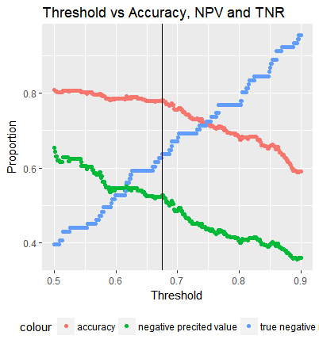
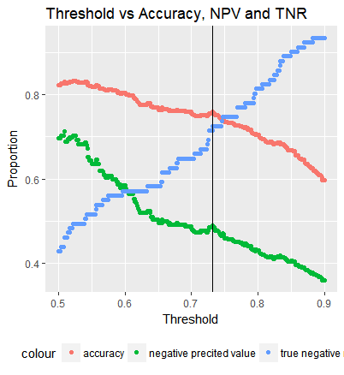
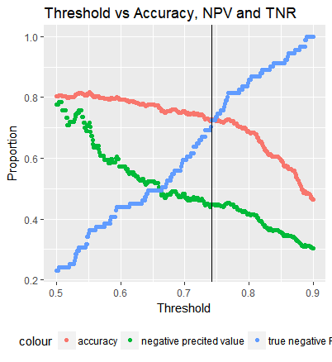
LOGISTIC REGRESSION THRESHOLDING
Forward Subset Selection
Backward Subset Selection
LASSO

Slide 10
PERFORMANCE COMPARISION
Model | Threshold | Accuracy | NPV | TNR
LASSO | 0.74 | 0.74 | 0.46 | 0.68
Forward | 0.67 | 0.78 | 0.52 | 0.63
Backward | 0.73 | 0.76 | 0.49 | 0.725

Slide 11
Linear Discriminant Analysis
TRAINING
60% of Data
LDA
SELECTION
20% of Data
Logistic
TEST
20% of Data
NB
TREE

Slide 12
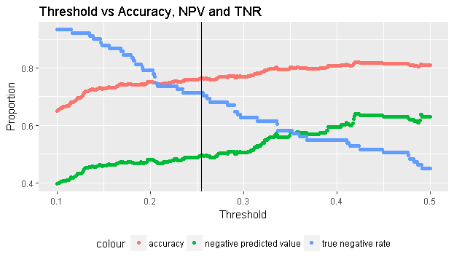
Linear Discriminant Analysis
 |  | No (91) | Yes (298)
LDA | No | 41 | 24
 | Yes | 50 | 274
 |  | No (91) | Yes (298)
LDA | No | 65 | 66
 | Yes | 26 | 232
Threshold 0.5
Threshold 0.25
TNR | 0.45
NPV | 0.63
Accuracy | 0.8
TNR | 0.7
NPV | 0.49
Accuracy | 0.76

Slide 13
NAÏVE BAYES
NB
TRAINING
60% of Data
SELECTION
20% of Data
Logistic
TEST
20% of Data
LDA
TREE

Slide 14
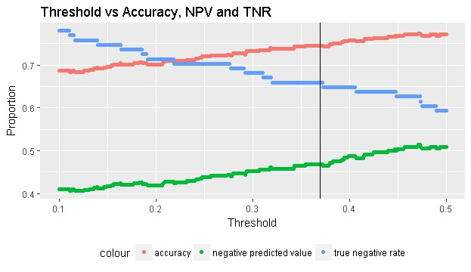
NAÏVE BAYES
 |  | No (91) | Yes (298)
Naïve Bayes | No | 54 | 52
 | Yes | 37 | 246
 |  | No (91) | Yes (298)
Naïve Bayes | No | 60 | 68
 | Yes | 31 | 230
Threshold 0.5
Threshold 0.37
TNR | 0.59
NPV | 0.51
Accuracy | 0.77
TNR | 0.66
NPV | 0.46
Accuracy | 0.74

Slide 15
TREE Models
TREE
BAGGING
BOOSTING
RANDOM FOREST
BIASED/RIGGED TREE
TREE
TRAINING
60% of Data
SELECTION
20% of Data
Logistic
TEST
20% of Data
NB
LDA

Slide 16
Performance Comparison
 |  | No (91) | Yes (298)
TREE | No | 60 | 39
 | Yes | 31 | 259
 |  | No (91) | Yes (298)
BIASED TREES | No | 87 | 63
 | Yes | 4 | 235
 |  | No (91) | Yes (298)
RANDOM FOREST | No | 91 | 0
 | Yes | 0 | 298
TNR | 0.66
NPV | 0.60
Accuracy | 0.82
TNR | 0.96
NPV | 0.58
Accuracy | 0.82
TNR | 1
NPV | 1
Accuracy | 1
Trees | Biased Trees | Random Forest

Slide 17
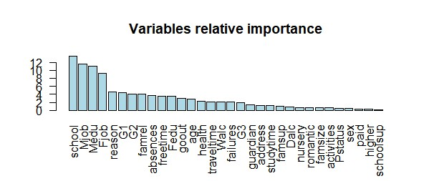
Random Forest

Slide 18
SELECTION
LOGISTIC WITH BACKWARD STEP
LDA
NAÏVE BAYES
RIGGED/BIASED TREE
RANDOM FOREST
NB
Logistic
TREE
TRAINING
60% of Data
LDA
SELECTION
20% of Data
TEST
20% of Data

Slide 19
SELECTION PERFORMANCE
Random Forest has very low TNR
Biased Tree has low NPV in comparison
Logistic, LDA and Naïve Bayes have almost same TNR
Naïve Bayes is better in comparison for both TNR and NPV
Naïve Bayes is selected as the best model for implementation.
 |  | No (29) | Yes (101)
Naïve Bayes | No | 14 | 25
 | Yes | 15 | 76

Slide 20
TEST
NAÏVE BAYES
NB
60% of Data
TRAINING
SELECTION
20% of Data
TEST
20% of Data

Slide 21
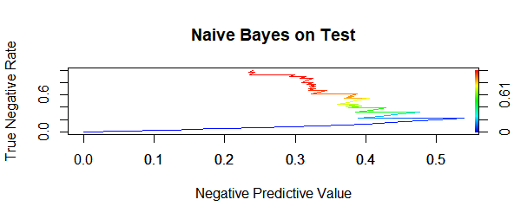
TEST PERFORMANCE
 |  | No (29) | Yes (101)
Naïve Bayes | No | 10 | 24
 | Yes | 19 | 77

Slide 22
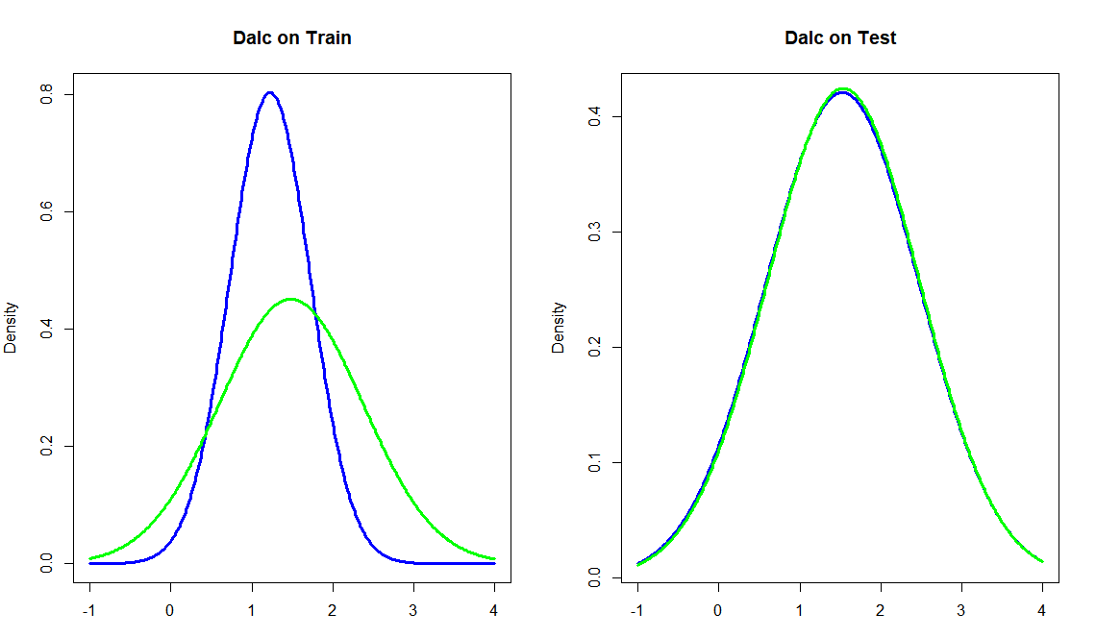
Analyzing the Performance
 | Train |  | Test
Dalc | Mean | SD | Mean | SD
no | 1.226 | 0.497 | 1.527 | 0.947
yes | 1.485 | 0.885 | 1.540 | 0.939
 | Train |  | Test
Reason | home | other | home | other
no | 0.226 | 0.000 | 0.165 | 0.143
yes | 0.152 | 0.141 | 0.289 | 0.101

Slide 23
DISCUSSION
None of the models could find a strong relation between predictors and output.
One Reason could be that the training set is not a true representation of the validation set.
Another reason may be these modeling techniques have assumptions and which were not good for this data to predict internet connectivity.
We can consider statistical interaction between parameters or transformation of predictors.
We can consider changing the ordinal variables into continuous variables and observe how they effect the models.

Slide 24
Questions ?

