Slide 1

Placement Management Website
Front-End Mini Project Presentation
Team Members-
Institution-
PANCHAM VERMA (lead) 20241CSN0047
Presidency University, Bengaluru
RITHIKA P 20241CSN0045
AMAN KUMAR 20241CSN0046
Mohammed Khaif 20241CSN0048

Slide 2
Project Objective
1
Design a responsive website that simplifies the placement process
2
Create an interactive platform for students, recruiters, and placement officers
3
Demonstrate effective use of HTML, CSS, and JavaScript
4
Focus on design clarity, layout, and responsiveness

Slide 3
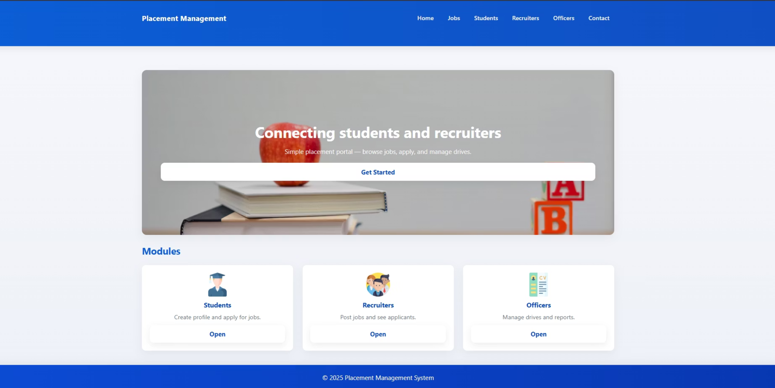
Homepage (web)

Slide 4
Homepage
Clean and simple landing page with navigation bar
Hero section introduces the website purpose
Professional header with easy-to-use menu
Engaging introduction to placement platform
Links to Recruiter, Student, and Officer sections
Fully responsive layout
Works seamlessly on all devices
Clear navigation to all main areas

Slide 5
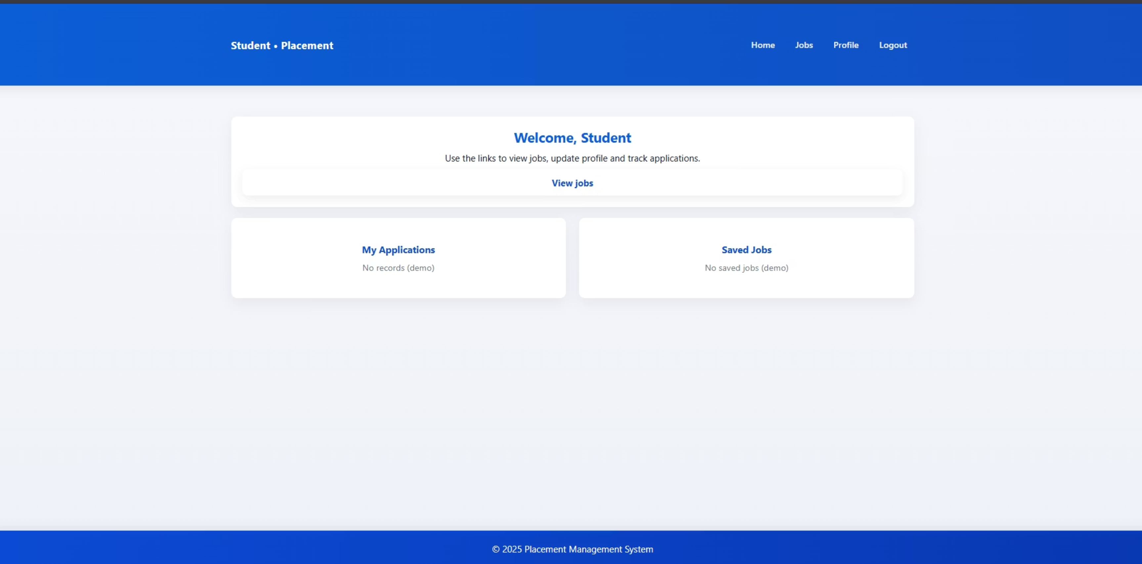
Student Section (web)

Slide 6
Student Section
This section provides students with quick access to all placement activities.
View Jobs
My Applications
Browse and apply for available company openings.
Track submitted job applications and their current status.
Saved Jobs
Profile
View and manage bookmarked opportunities.
Update details, academic information, and eligibility data.

Slide 7
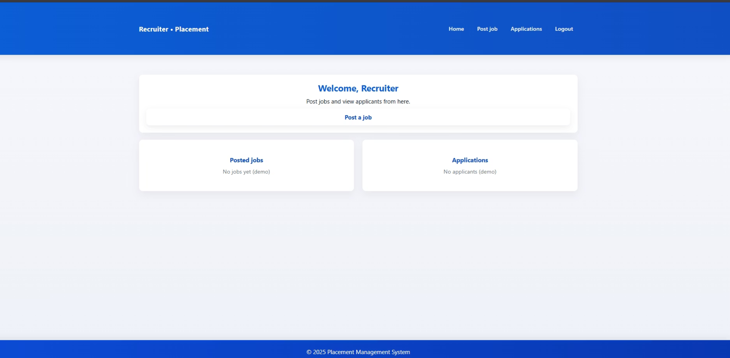
Recruiter Section (web)

Slide 8
Recruiter Section
This section enables recruiters to manage company postings and monitor applications efficiently.
Post Job
View Applicants
Add new openings with job title, description, salary,
and eligibility criteria.
Review and track applications received for each position.
Manage Jobs
Company Profile
Edit or remove existing job postings easily.
Update organization details and contact information.

Slide 9
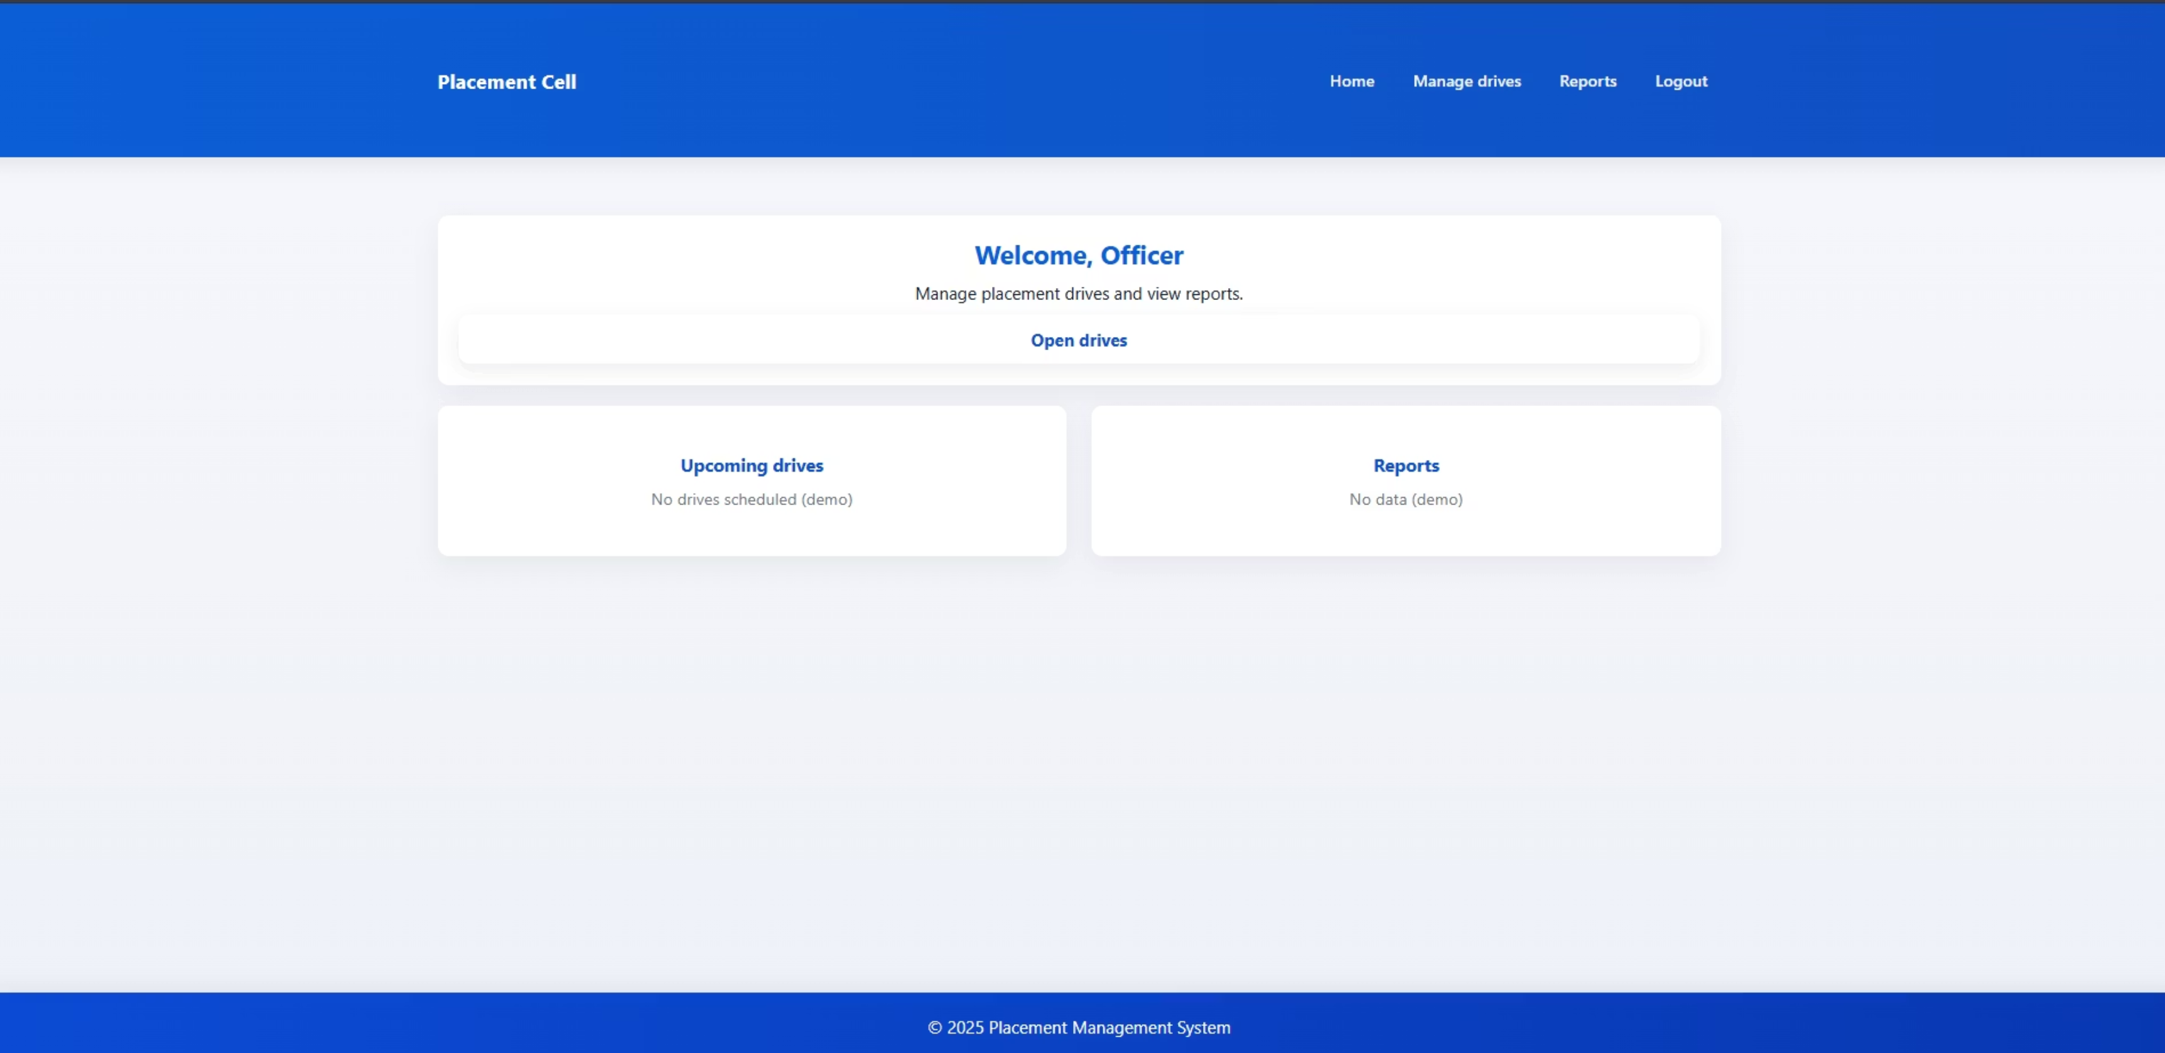
Placement Officer Section (web)

Slide 10
Placement Officer Section
This section allows placement officers to manage placement drives and monitor reports efficiently.
Open Drives
Upcoming Drives
View and manage all active placement drives.
Check details of scheduled company drives.
Reports
Manage Drives
Generate and analyze placement data and statistics.
Create, update, or close placement activities with ease.

Slide 11
Technologies Used
Frontend Technologies
Tools & Hosting
HTML → Defines structure
VS Code for development
CSS → Styling & layout (Flexbox/Grid used)
GitHub Pages for deployment
Canva for UI assets (if used)

Slide 12
Design and User Experience
Responsive Design
Animations
Works on mobile, tablet, and desktop with fluid layouts and adaptive components.
Subtle hover effects and transitions for enhanced interactivity.
Consistent UI
User-Friendly
Unified color palette and typography throughout the entire website.
Simple navigation with clear CTA buttons and intuitive flow.

Slide 13

Future Enhancements
Backend Integration
Add MySQL or Firebase for data storage
User Authentication
Implement secure login systems
Dashboard Analytics
Placement data visualization and reporting
Notifications
Email and SMS notification system

Slide 14

Conclusion & Thank You
A front-end project demonstrating responsive web design and UI skills. Simplifies how students and recruiters interact during placements.
Hosted live at: https://pancham17.github.io/placement-management-site/
Thank You! 🙏

