Slide 1
UNIVERSITY STUDENT
DASHBOARD
A FRONT-END STUDENT MANAGEMENT
SYSTEM

Slide 2
TEAM
POORNIMA PH 20241CSN0024
JEEVESH BISHT 20241CSN0029
THARUN P 20241CSN0024
THOPURI GOWTHAMI 20241CSN0030

Slide 3
PROJECT OBJECTIVE
CREATE A CENTRALIZED STUDENT DETAILS DASHBOARD THAT SIMPLIFIES ADMINISTRATIVE ACCESS
UNIFIED RECORDS – MAINTAIN COMPREHENSIVE STUDENT DATA
SINGLE VIEW – DISPLAY ACADEMIC PERFORMANCE
FUTURE READY – BUILT WITH HTML AND CSS AS A FOUNDATION

Slide 4
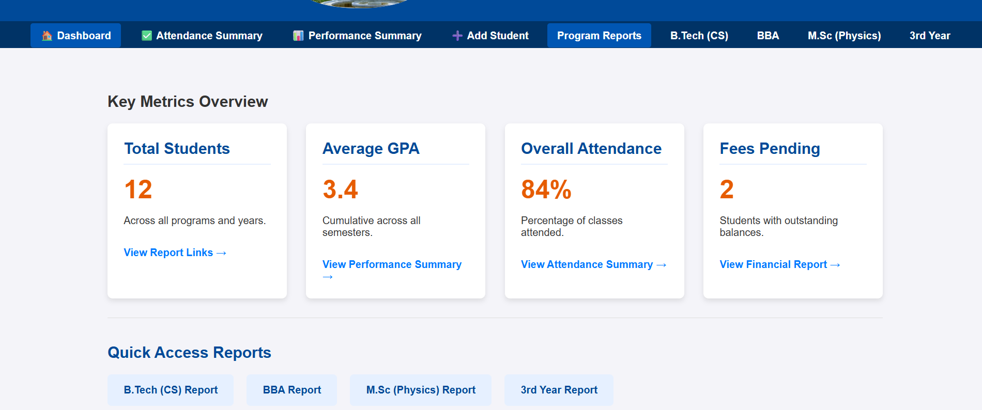
The overview of dashboard

Slide 5
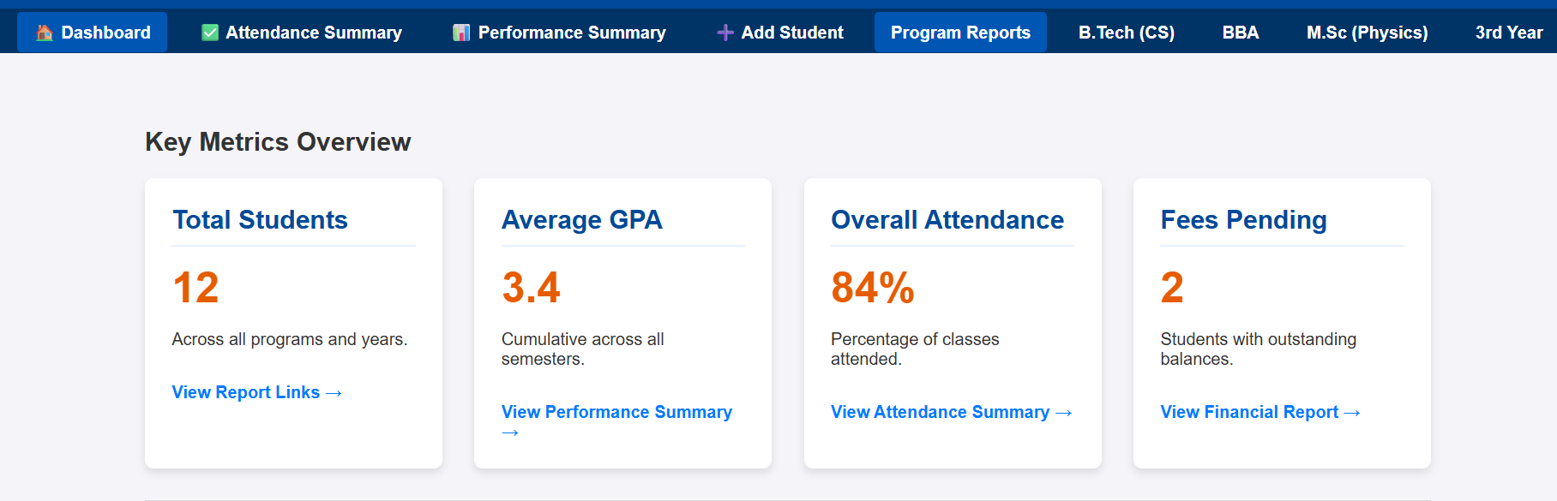
Key features
DASHBOARD OVERVIEW
NAVIGATION BAR
RESPONSIVE DESIGN
UNIVERSITY BRANDING

Slide 6
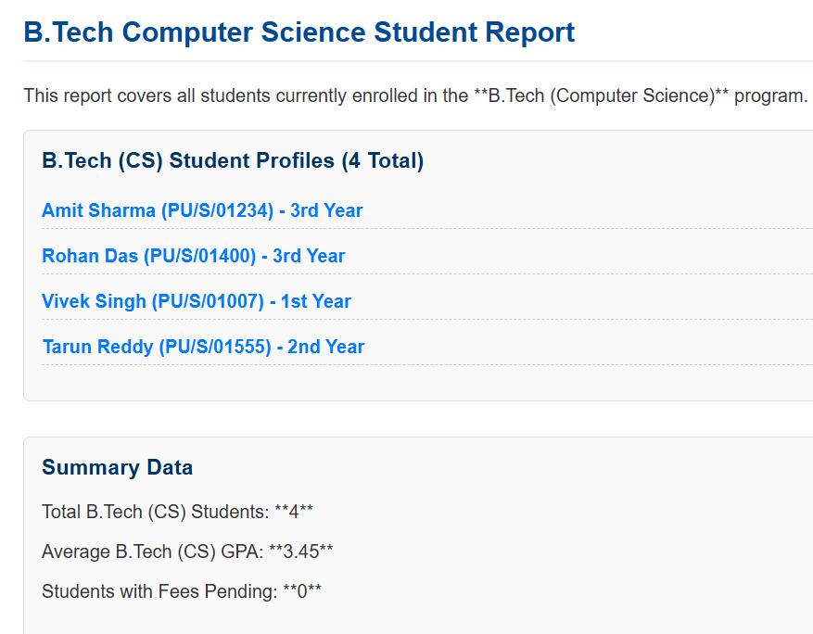
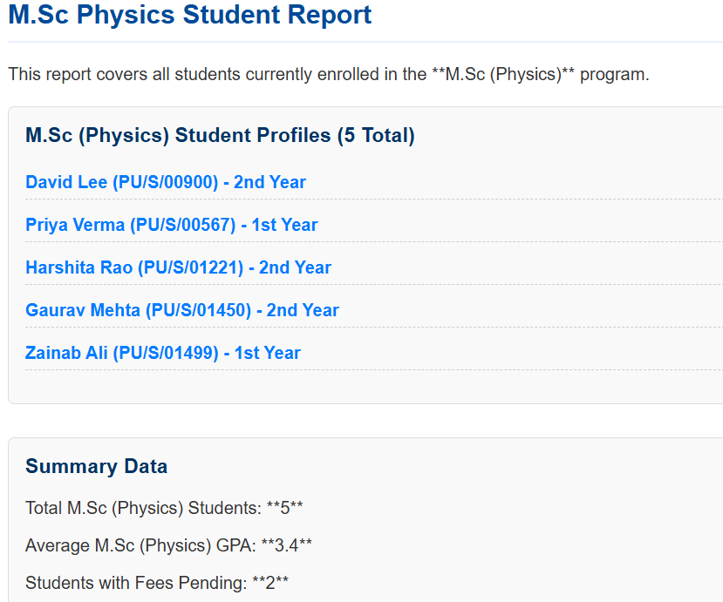
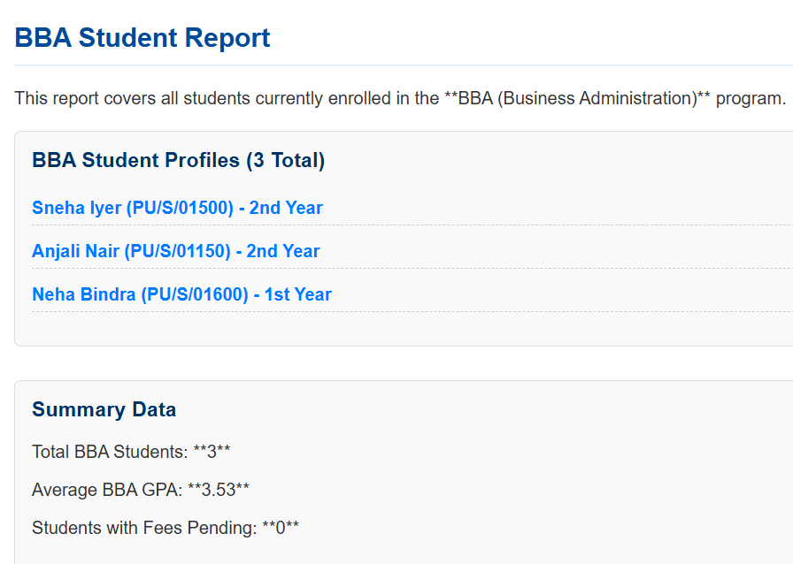
DETAILED STUDENT INFORMATIONS
CORE ELEMENTS :-
<div>
<header>
<nav>
<section>
<ahref>

Slide 7
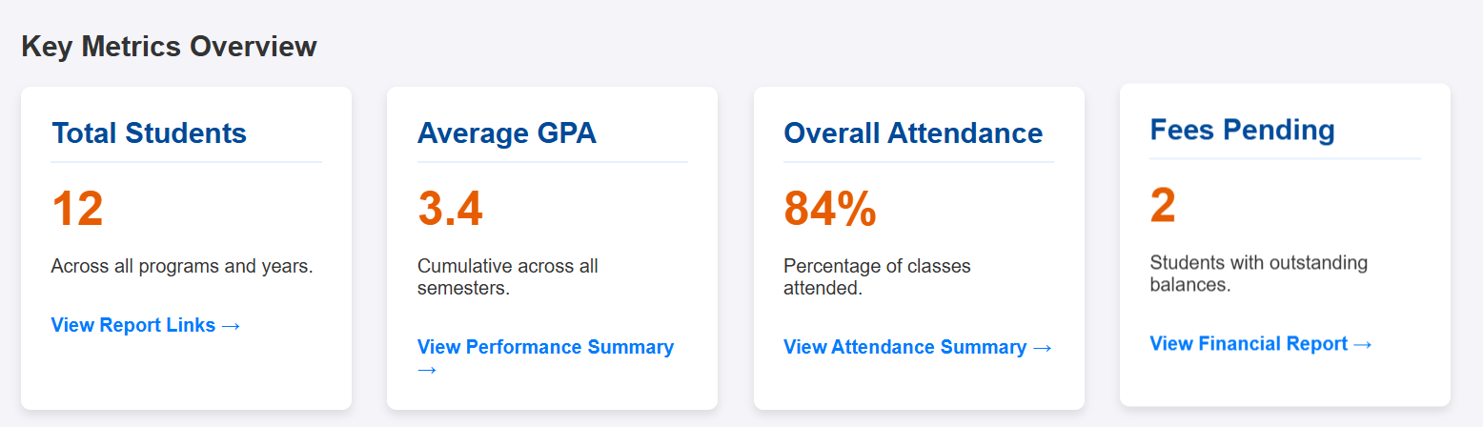
The Dashboard Cards Layout
The Dashboard grid system displays key metrics in individual cards creating a clean scannable layout with CSS grid flexibility and hover animation

Slide 8
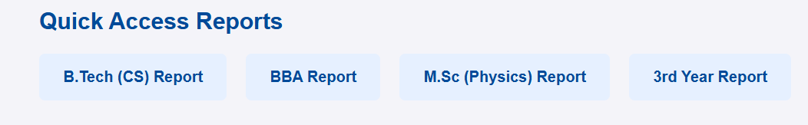
Quick Access Reports
One click access program and year wise reports keeps the dashboard interactive while maintaining simplicity
B Tech CS Report
BBA Report
M Sc Report
3rd Year Report

Slide 9
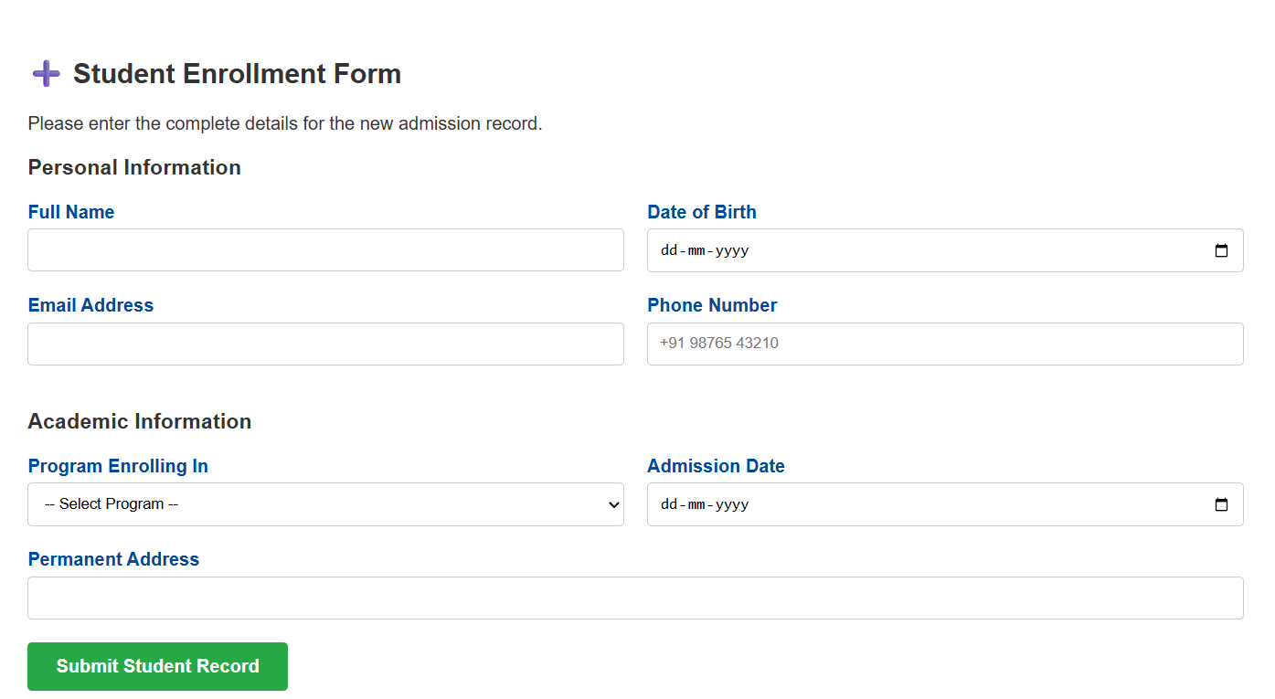
A Student Registration Form
A responsive form helping in to gather student information
Containing responses as
Paragraphs Dates and Radio Buttons

Slide 10
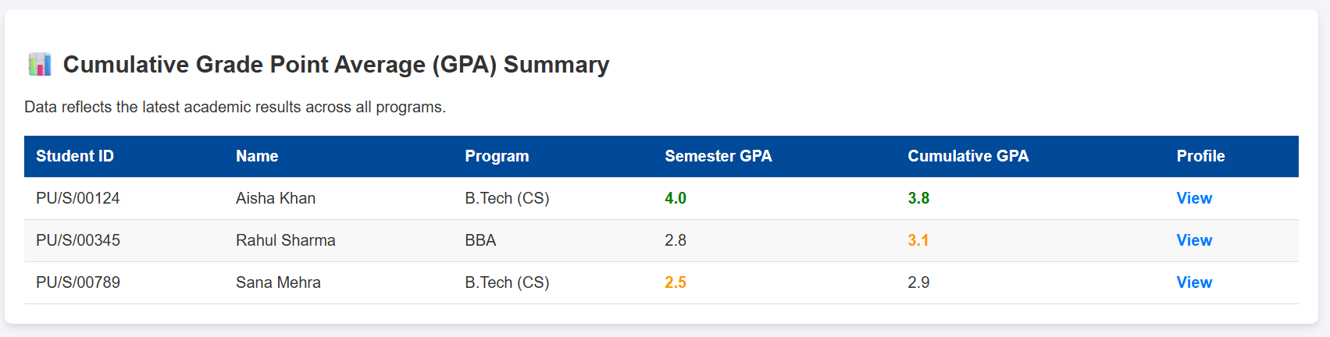
A Cumulative Grade Point Average
A data academic table showing the latest result data
Being updated as SGPA & CGPA
Updated through
<table>
<tr>
<td>

Slide 11
THANK YOU

