Slide 1
Student Intranet:
Empowering students with seamless digital access to academic resources, notices, grades, and personalised learning experiences through a unified platform.

Slide 2
What is a Student Intranet?
A student intranet is a secure, institution-wide digital platform designed exclusively for enrolled students. It serves as a centralised hub where students can access academic materials, institutional announcements, personal academic records, and communicate with peers and faculty members.
Unlike the public university website, an intranet requires authentication through login credentials, ensuring only authorised students access sensitive information such as grades, attendance records, and personal profiles. It creates a private digital ecosystem tailored to the academic community.
Secure Access
Centralised Hub
Personalised Experience
Protected login system for enrolled students only
All academic resources in one place
Customised to individual student needs

Slide 3
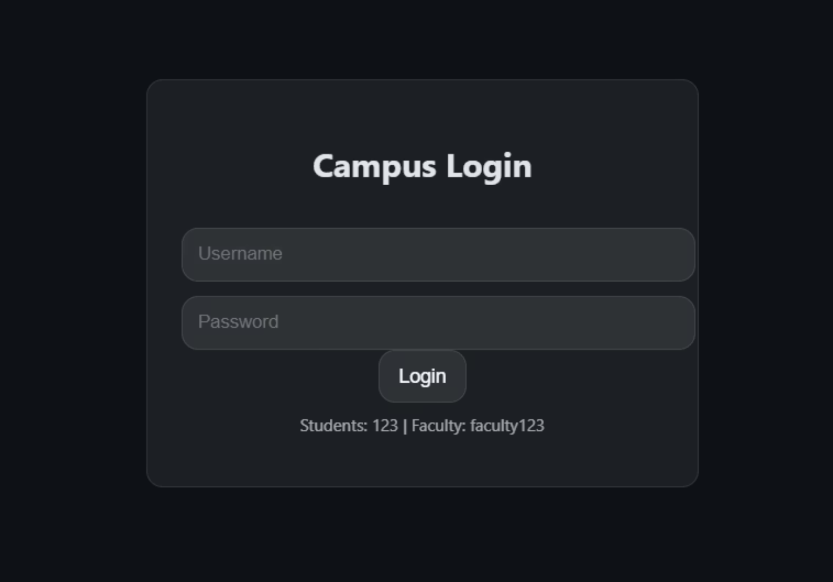
Code explanation: Login UI
This section defines the UI theme and login styling using CSS variables and minimal glass-effect layouts, creating a clean dark interface for the intranet prototype.
:root { --bg:#0e1116; --card:rgba(255,255,255,0.06); --text:#e5e5e5; --accent:#4c8ffd; --border:rgba(255,255,255,0.1); --input:rgba(255,255,255,0.08); --radius:12px; font-family:"Segoe UI",sans-serif;}body{margin:0;background:var(--bg);color:var(--text);}.login-box{ width:350px;margin:120px auto;padding:25px; background:var(--card);border-radius:var(--radius); border:1px solid var(--border);text-align:center;}

Slide 4
Code explanation:Login Screen
This HTML block builds the login screen with username and password fields. It simulates user authentication for students and faculty in the prototype.
<div id="loginPage" class="login-box"><h2>Campus Login</h2><input id="username" placeholder="Username"><input type="password" id="password" placeholder="Password"><button onclick="login()">Login</button><p style="font-size:12px;opacity:0.7">Students: 123 | Faculty: faculty123</p></div>

Slide 5
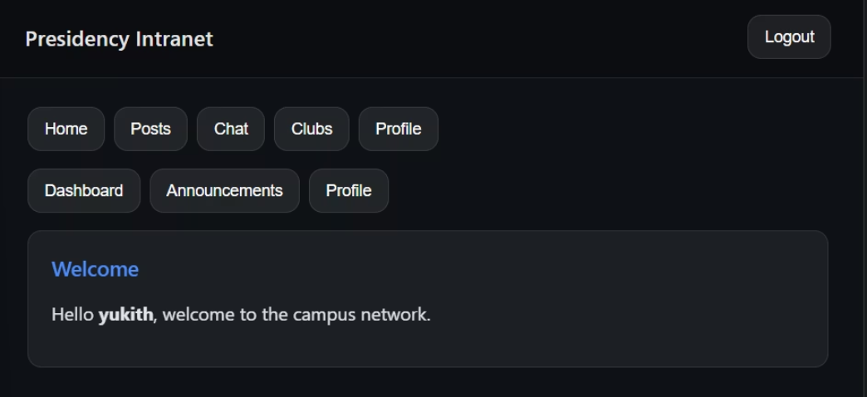
Code explanation: Navigation and Role menu
Navigation and menu buttons are shown here. The interface switches between student and faculty menu options dynamically after login.
<div class="nav"> <h3>Presidency Intranet</h3> <button onclick="logout()">Logout</button></div><div id="studentMenu"> <button onclick="show('home')">Home</button> <button onclick="show('feed')">Posts</button> <button onclick="show('chat')">Chat</button> <button onclick="show('clubs')">Clubs</button> <button onclick="show('profile')">Profile</button></div><div id="facultyMenu" class="hidden"> <button onclick="show('facultyDash')">Dashboard</button> <button onclick="show('announce')">Announcements</button> <button onclick="show('profile')">Profile</button></div>

Slide 6
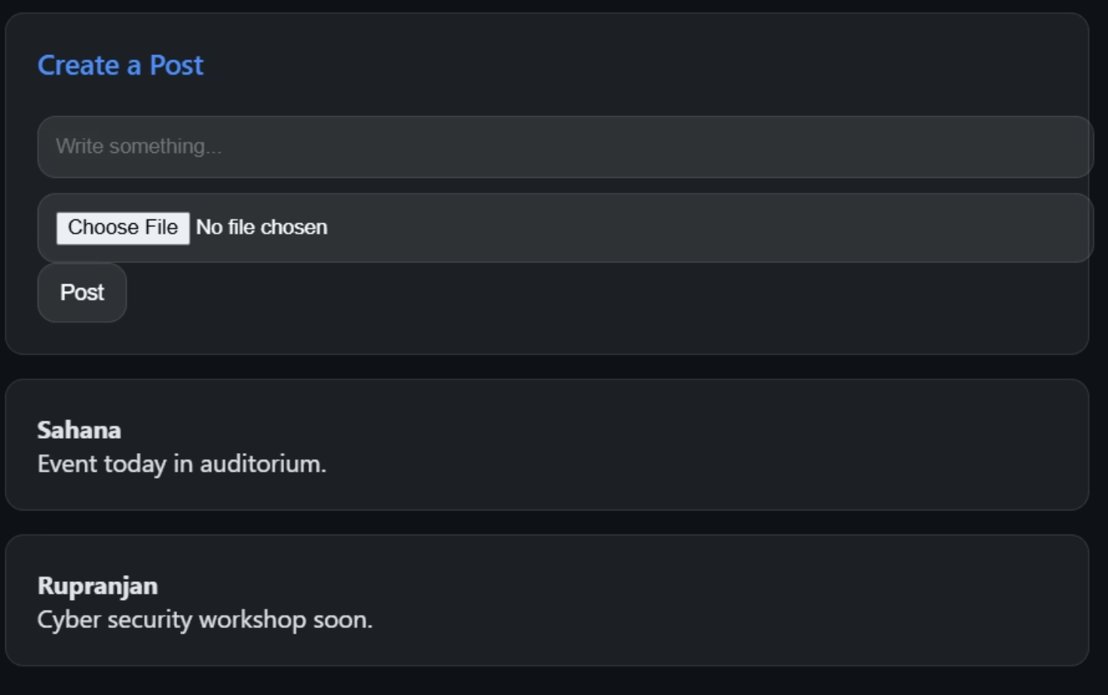
Code explanation: Feed with image upload
This section provides the post creation UI, allowing users to write text, upload images, preview them, and view posts in the campus feed.
<div id="feed" class="hidden section"><div class="card"> <div class="section-title">Create a Post</div> <input id="postText" placeholder="Write something..."> <input type="file" id="postImage" accept="image/*" onchange="previewImage(event)"> <img id="imagePreview" class="feed-image" style="display:none"> <button onclick="addPost()">Post</button></div><div id="postArea"></div></div>

Slide 7
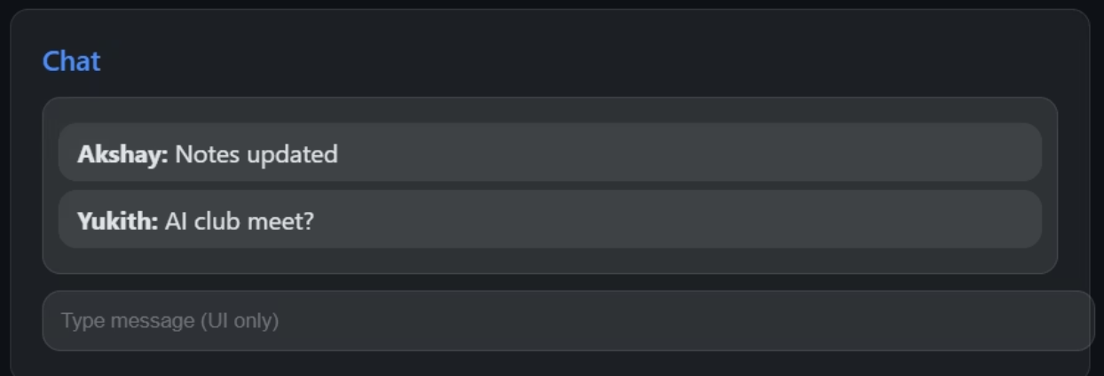
Code explanation: Chats and Club
A static chat interface and clubs listing are demonstrated here. These represent community interaction spaces for students inside the intranet.
<div id="chat" class="hidden section"> <div class="card"> <div class="section-title">Chat</div> <div class="chat-area"> <div class="chat-message"><b>Akshay:</b> Notes updated</div> <div class="chat-message"><b>Yukith:</b> AI club meet?</div> </div> <input placeholder="Type message (UI only)"> </div></div><div id="clubs" class="hidden section"> <div class="card"> <div class="section-title">Clubs</div> AI & Robotics<br>Cyber Security Cell<br>Music Club<br>Literature Society </div></div>

Slide 8
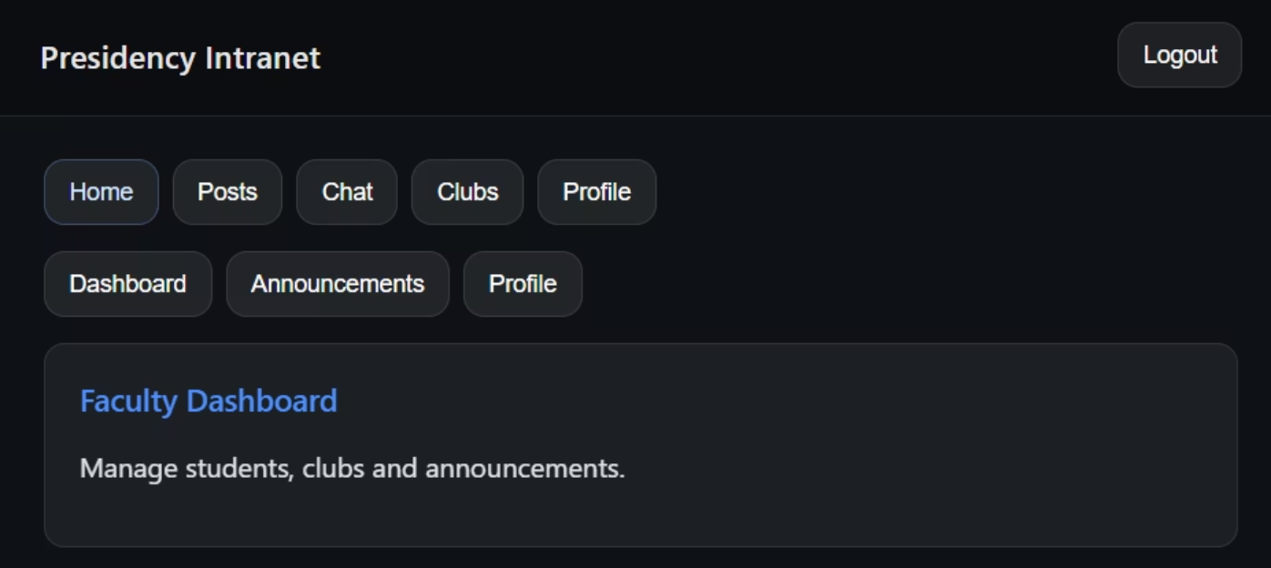
Code explanation:Login & Post Logic (JS)
Basic JavaScript logic handles login validation, role display, and post creation. This is a front-end simulation only, without backend storage.
const users={ akshay:{pass:"123",role:"student"}, yukith:{pass:"123",role:"student"}, sahana:{pass:"123",role:"student"}, rupranjan:{pass:"123",role:"student"}, sunil:{pass:"faculty123",role:"faculty"}};function login(){ let u=username.value.toLowerCase(); if(users[u] && password.value===users[u].pass){ loginPage.classList.add("hidden"); app.classList.remove("hidden"); studentName.textContent=u; pName.textContent=u; roleType.textContent=users[u].role; users[u].role==="faculty" ? (studentMenu.classList.add("hidden"), facultyMenu.classList.remove("hidden")) : (studentMenu.classList.remove("hidden"), facultyMenu.classList.add("hidden")); } else alert("Incorrect login");}function addPost(){ let text=postText.value, imgFile=postImage.files[0]; let card=document.createElement("div"); card.className="card"; card.innerHTML=`<b>${studentName.textContent}</b><br>${text}`; if(imgFile){ let img=document.createElement("img"); img.src=URL.createObjectURL(imgFile); img.className="feed-image"; card.appendChild(img); } postArea.prepend(card);}

