Slide 1
Whisper
ScriptEdge

Slide 2
Introduction
Whisper is an automatic speech recognition (ASR) system trained on 680,000 hours of multilingual and multitask supervised data collected from the web
It has added robustness to accents,background noise and technical sound analysis and modelling.
It has enabled transcription for multiple languages.
OpenAI has sourced it for further application building and development around it.

Slide 3
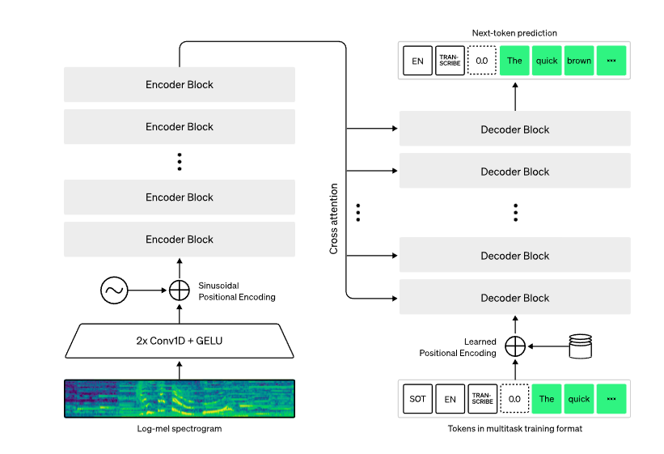

Slide 4
Architecture
It is implemented as encoder-decoder architecture.
It takes in 30-second chunks of audio input and converts into a log-Mel spectrogram
Decoder predicts corresponding text captions.
Special tokens have been added which helps in performing further tasks like language identification, phrase-level timestamps, multilingual speech transcription, and to-English speech translation.

Slide 5
One-third of whisper’s dataset is non-english.
It does a good job on transcribing the audio in its original language or translating to english.
It does a good job in learning speech to text task and has outperform the supervised SOTA on CoVoST2 to English zero-shot.

Slide 6
Whisper’s zero-shot performance across diverse dataset is better because it was trained in that fashion.
It is not fine-tuned on any particular dataset hence it does not beats the LibriSpeech benchmark but when tested on diverse datasets it is better.

