Slide 1
C++ Programming
Post Graduate Diploma in Advanced Computing (PG-DAC)
ACTS, C-DAC Bangalore
Topics Covered:
Introduction to C++
C++ Vs C Programming
Types of Programming Languages
C++ Versions
C++ Program Structiure & Execution
C++ Tokens
Variable Storage Types
Statements

Slide 2
C++
General Purpose Programming Language
Superset of C Programming
Developed by Bjarne Stroustrup at AT&T Bell Laboratory in 1979
Developed for fast speed, low level memory management
High Level Programming Language

Slide 3
Applications of C++
Applications of C++
Operating Systems
Embedded Systems
Application Softwares
Real Time Systems
Gaming Engines
PUBG
CS2
Linux
Windows GUI Based OS Core
Arduino for hardware interaction
Raspberry Pi for hardware interaction
MS Office
Adobe Photoshop
RTOS

Slide 4
Features of C++
Simple
Programs can be broken down into logical parts
Rich library support
Variety of data types
Machine Independent
Can run on any machine
Requires only a suitable compiler
Low-level Access
Access to system resources
Ideal for system-level programming
Enables writing highly efficient code
Minimal processing overhead
One of the fastest high-level languages
Suitable for performance-critical applications
Object-Oriented
Supports OOP features like classes, inheritance, polymorphism
Makes code maintainable and extensible
Well-suited for building large-scale applications
Fast Execution Speed

Slide 5
C++ Vs C Programming
C++ Programming
Multi-paradigm (Procedural + OOP)
C Programming
Procedural language
Supports encapsulation (via classes)
Supports Function & Operator Overloading
Supports Templates
Uses namespaces to avoid name clashes
Close to real world modeling
Used for both system and application level development
No encapsulation
No function/operator overloading
No templates
No namespaces
Low-level, closer to hardware
Mostly used for system programming

Slide 6
TYPES OF PROGRAMMING LANGUAGES
Functional Programming
Based on mathematical functions to perform computation
Eg: Scala, Haskell, and F#.
Procedural Programming
Uses a series of functions / procedures to perform computation
Eg: C, Pascal, Fortran, Ada, and Basic
Object-Oriented programming
Every component of program is considered as object and this is used to perform desired action
Eg: C++ , Java
Scripting Language
Designed for communicating with other programming languages
Eg: Python, JavaScript

Slide 7
C++ Versions
C++98
First standardized version
Introduced STL (Standard Template Library)
Basis for future versions
C++03
Bug fixes and small improvements over C++98
Technical refinement
C++11 (“Modern C++”)
Auto keyword, nullptr
Range-based for loops
Lambda expressions
Smart pointers
C++14
Minor enhancements over C++11
Binary literals, generic lambdas
std::make_unique
Structured bindings
if constexpr, std::optional
Parallel STL algorithms
C++20
Concepts, Coroutines
Ranges library, consteval
Modules (partial support)
C++23
Expanded ranges
Improved constexpr
std::expected, std::flat_map (pending compiler support)
C++17

Slide 8
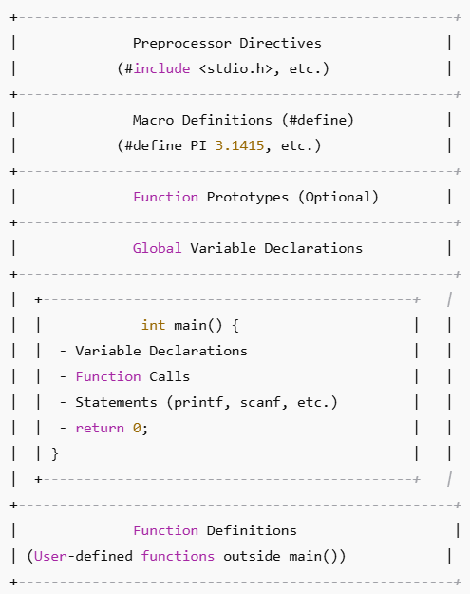
C++ PROGRAM STRUCTURE
Preprocessor Directives
#include <stdio.h> and other header files
Macro Definitions (#define)
Example: #define PI 3.1415
Example: #define SQUARE(x) (x * x)
Function & Class Prototypes (Optional)
Declare functions & Class before use for better readability
Global Variable Declarations
Declare variables used across functions
main() Function (Entry Point)
Declare and initialize variables
Execute logic, function calls, and statements
Return exit status using return 0;
Function Definitions (User-Defined)
Define functions separately for modular programming
Define constants or macros before compilation
Example: int add (int, int);

Slide 9
C++ PROGRAM EXECUTE CYCLE
Writing the Source Code
.CPP File
Preprocessing
The preprocessor expands macros, includes header files, and removes comments.
Compilation
Assembly
The assembler converts assembly code into machine code (binary).
Linking
The linker combines object files and libraries to generate the final executable.
Loading
The OS loads the executable into memory and prepares it for execution.
Execution
Program Termination
The program finishes execution, and memory is deallocated.
The programmer writes a PPC program and saves it with a .cpp extension.
.i File
.s File
The compiler translates preprocessed code into assembly language.
optional based on compiler
.o or .obj File
.exe
Program Loaded into RAM
The CPU runs the program, executing instructions as per logic.

Slide 10
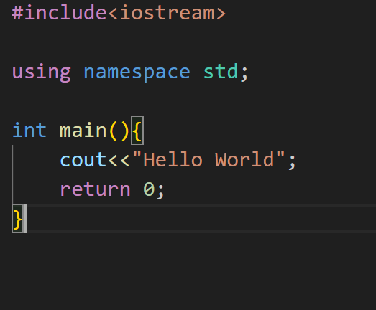
First C++ Program
Program to display text “HelloWorld on Console
cout Is used for display on standard output device (Console)
Namespace std is used for directly utilizing cout from std namespace

Slide 11
C++ TOKENS
Keyword
Reserved words with predefined meanings
if
for
include
Identifier
User-defined names for variables, functions, and arrays
Sum
Result
addNumbers
Literals
Fixed values that do not change during execution
String
Operator
Punctuators
3.142
‘A’
0
Sequence of characters enclosed in double quotes
“PROGRAM”
“FALSE”
symbols that perform operations on variables and values
+
&
<
Characters with special meanings in C
{
.
;

Slide 12
KEYWORDS
C++98 Standard Keywords
auto | double | int | struct
break | else | long | switch
case | enum | register | typedef
char | extern | return | union
const | float | short | unsigned
continue | for | signed | void
default | goto | sizeof | volatile
do | if | static | while
auto | double | int | Struct
Class

Slide 13
IDENTIFIERS
General Rules
Variable Naming
Function Naming
Constant Naming
Macro Naming (#define)
Example:
Structure & Enum Naming
Use meaningful and descriptive names.
Start with a letter or underscore ( _ ), not a number.
Avoid reserved keywords (e.g., int, return).
Use lowercase for variable names (except macros).
Use camelCase or snake_case as per team guidelines.
Use lowercase with underscores (snake_case).
Example: total_sum, student_age.
Use prefixes for clarity (is_, num_, count_).
Example: is_valid, num_students.
Use verbs to describe actions.
Prefer camelCase or snake_case.
Example: calculateArea(), print_result()
Use uppercase with underscores.
Example: MAX_VALUE, PI_VALUE.
Use #define or const.
Use UPPERCASE for macros.
#define MAX_LENGTH 100
#define MIN_VALUE 0
Use PascalCase for types.
enum Color { RED, GREEN, BLUE };
typedef struct StudentData;

Slide 14
LITERALS / CONSTANTS
Integer Literals
Whole numbers (positive, negative, or zero).
Can be decimal (base 10), octal (base 8), or hexadecimal (base 16).
EG:
int decimal = 100; // Decimal
int octal = 012; // Octal (starts with 0)
int hex = 0xA1; // Hexadecimal (starts with 0x)
Floating-Point (Real) Literals
Numbers with a decimal point or exponential notation.
Example:
float num1 = 3.14; // Decimal notation
double num2 = 2.5e3; // Exponential notation (2.5 × 10³)
Character Literals
A single character enclosed in single quotes (‘’).
Example:
char letter = 'A';
char symbol = '#';
String Literals
A sequence of characters enclosed in double quotes ("").
Example:
char name[] = "Hello";
Boolean Literals (C99 & Later)
Represents true (1) or false (0).
Requires <stdbool.h>.
Example:
#include <stdbool.h>
bool isValid = true;
bool isComplete = false;
Escape Sequence Literals
Special characters represented using backslash (\) notation.
Example
printf("Hello\tWorld!\n"); // \t (Tab), \n (Newline)

Slide 15
STRINGS
sequence of characters stored as an array of characters and terminated by a null character ‘\0’
Declaring Strings
Important Points about String
Using Character Array
Using Character Pointer
char *str = "Hello"; // Stored in read-only memory
Explicit Null-Termination
char str[] = "Hello"; // Automatically adds '\0' at the end
char str[] = {'H', 'e', 'l', 'l', 'o', '\0'};
Strings must have a null character (\0) at the end.
Cannot be assigned directly like str1 = str2;, use strcpy().
String manipulation requires <string.h> library.

Slide 16
OPERATORS
Arithmetic Operators (Perform mathematical operations)
+ (Addition) → a + b
- (Subtraction) → a - b
* (Multiplication) → a * b
/ (Division) → a / b
% (Modulus) → a % b (Remainder)
Relational (Comparison) Operators (Compare values)
== (Equal to) → a == b
!= (Not equal to) → a != b
> (Greater than) → a > b
< (Less than) → a < b
>= (Greater than or equal to) → a >= b
<= (Less than or equal to) → a <= b
Logical Operators (Used for Boolean logic)
&& (Logical AND) → (a > 0 && b > 0)
|| (Logical OR) → (a > 0 || b > 0)
! (Logical NOT) → !(a > b)
Bitwise Operators (Operate on binary values)
& (Bitwise AND) → a & b
| (Bitwise OR) → a | b
^ (Bitwise XOR) → a ^ b
~ (Bitwise NOT) → ~a
<< (Left shift) → a << 2
>> (Right shift) → a >> 2
Assignment Operators (Assign values to variables)
= (Assign) → a = 5
+= (Add & assign) → a += 2 (a = a + 2)
-= (Subtract & assign) → a -= 2
*= (Multiply & assign) → a *= 2
/= (Divide & assign) → a /= 2
%= (Modulus & assign) → a %= 2
Increment & Decrement Operators (Increase or decrease values)
++ (Increment) → a++ or ++a
-- (Decrement) → a-- or –a
Ternary Operator (Conditional Operator)
condition ? expr1 : expr2
Special Operators
sizeof (Finds size of variable/type) → sizeof(int)
& (Address-of) → &var
* (Pointer dereference) → *ptr
, (Comma operator) → a = (b = 2, b + 3);

Slide 17
OPERATOR PRECEDENCE
Precedence | Operators | Associativity | Example
1 (Highest) | () [] -> . | Left to Right | array[i], ptr->val
2 | ++ -- (Postfix) | Left to Right | x++, y--
3 | ++ -- (Prefix), + - (Unary), ! ~ | Right to Left | ++x, -y, !flag
4 | * / % | Left to Right | a * b, x / y
5 | + - (Binary) | Left to Right | a + b, x - y
6 | << >> | Left to Right | x << 2, y >> 1
7 | < <= > >= | Left to Right | a < b, x >= y
8 | == != | Left to Right | a == b, x != y
9 | & (Bitwise AND) | Left to Right | a & b
10 | ^ (Bitwise XOR) | Left to Right | a ^ b
11 | ` (Bitwise OR) | Left to Right | a ` b
12 | && (Logical AND) | Left to Right | a && b
13 | ||(Logical OR) | Left to Right | a || b
14 | ?: (Ternary) | Right to Left | x = (a > b) ? a : b;
15 | = += -= *= /= %= | Right to Left | x += 5, y = a * b
16 (Lowest) | , (Comma) | Left to Right | a = 1, b = 2

Slide 18
SHORTHAND OPERATORS
Operator | Description | Example
= | Simple assignment operator. Assigns values from right side operands to left side operand. | C = A + B will assign the value of A + B to C
+= | Add AND assignment operator. It adds the right operand to the left operand and assigns the result to the left operand. | C += A is equivalent to C = C + A
-= | Subtract AND assignment operator. It subtracts the right operand from the left operand and assigns the result to the left operand. | C -= A is equivalent to C = C - A
*= | Multiply AND assignment operator. It multiplies the right operand with the left operand and assigns the result to the left operand. | C *= A is equivalent to C = C * A
/= | Divide AND assignment operator. It divides the left operand with the right operand and assigns the result to the left operand. | C /= A is equivalent to C = C / A
%= | Modulus AND assignment operator. It takes modulus using two operands and assigns the result to the left operand. | C %= A is equivalent to C = C % A
<<= | Left shift AND assignment operator. | C <<= 2 is same as C = C << 2
>>= | Right shift AND assignment operator. | C >>= 2 is same as C = C >> 2
&= | Bitwise AND assignment operator. | C &= 2 is same as C

Slide 19
Variable Storage Types
Automatic
Default storage class for local variables
Scope: Local
Static
Scope: Local
Extern
Register
Scope: Local
Scope: Global
Default Value: Garbage Value
Memory Location: RAM
Lifetime: Till the end of its scope
Default Value: Zero
Memory Location: RAM
Lifetime: Till the end of the program
Default Value: Garbage Value
Memory Location: Register in CPU or RAM
Lifetime: Till the end of its scope
Default Value: Zero
Memory Location: RAM
Lifetime: Till the end of the program.

Slide 20
STATEMENTS
Statements
Expression Statement
Declaration Statement
Control Flow Statement
Looping Statement
Jump Statement
Conditional Statement
break
continue
return
goto
c = a + b
int val = 0
if (a>b){ }
for (ctr=0; ctr<5;ctr++){}

Slide 21
CONDITIONAL STATEMENTS
if
if else ladder
switch case
ternary operator
nested if else
if else

Slide 22
LOOPING STATEMENTS
For Loop
While Loop
Do while loop

Slide 23
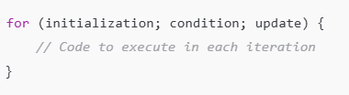
FOR LOOP
Syntax:
Example:
for (int i = 1; i <= 5; i++) {
cout<<i;
}
Components:
Initialization → Sets the loop variable (runs once).
Condition → Checks before each iteration (loop runs if true).
Iteration/Update → Modifies the loop variable after each iteration.

Slide 24
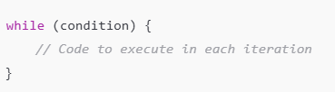
WHILE LOOP
Syntax:
Example:
int i = 1;
while (i <= 5) {
cout<<i;
i++;
}
Components:
Condition → Checks before each iteration (loop runs if true).

Slide 25

DO WHILE LOOP
Syntax:
Example:
int i = 1;
do {
cout<<i;
i++;
} while (i <= 5);
Components:
Condition → Checks before each iteration (loop runs if true).

Slide 26
JUMP STATEMENTS
break
Breaks out of innermost loop from location of break
continue
Continues to next iteration of innermost loop to continue
return
Returns a value from a function
goto
Goes to a statement with a specific label

