Slide 1
C++ Programming
Post Graduate Diploma in Advanced Computing (PG-DAC)
ACTS, C-DAC Bangalore
Topics Covered:
Data Types in C++
Arrays
  1D Array
  2D Array
Search & Sort Operation in Array
Sparse Matrix

Slide 2
Data Types in C++

Slide 3
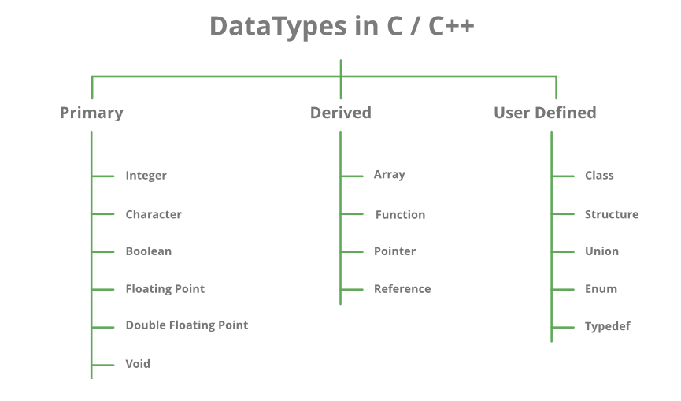

Slide 4
Array
1-D Array

Slide 5
Arrays
a set of homogeneous data items
stored as a common name
contiguous block of memory gets allocated for the array
array is a derived data type
each of the element referenced by an index value
the array indexing starts from 0 ; last element index is 1 less than the size of the array as the index value starts from 0

Slide 6
Use Cases For Array
List of Employees in Organization
Test Scores of a class of students
List of temperatures recorded every hour in a day, or a month, or a year.
List of products and their cost sold by a store

Slide 7
Types of Array
Single Dimension Array
  A list of item can be given one variable name using only one subscript and such a variable is called a single subscripted variable or One- dimensional array
  Example: List
Two Dimensional Array
  Data stored in the form of table is categorized as 2D Array.
  Example: Matrix
Multi Dimensional Array
  More than 2 dimensions.
  Example: JSON objects

Slide 8
Single Dimensional Array
List form of data structure
consists of single dimension
Consider the example of marks scored by student in 6 subjects. This can be represented in array as : float marks[6] where 6 is the size of array marks is name of array and will store float type values.

Slide 9
Array Declaration : 1D Array
Syntax:
datatype array-name[size].
Example:
int arr[5];
Declaration can be optionally done along with the initialization as:
  int arr[5] = {1,2,3,4,5}
Declaration statement provides the type of value it stores, the number of values that can be stored and the size of memory to be allocated for array.

Slide 10
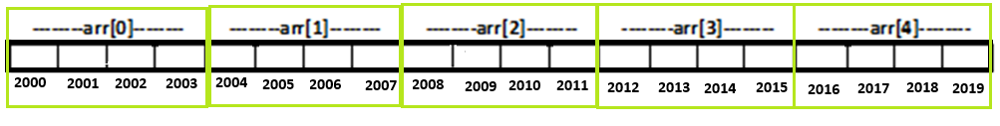
Storage & Access of Array : 1D Array
Consider array:
int arr[5];
Since int type, 2B for each element; total 5 elements then total memory allocated is 5*2 = 10B
Each elements is referenced with its index value as arr[0], arr[1], arr[2], arr[3], arr[4]
Elements are stored in contiguous block assuming from address 2000 to 2009
Each element of array has a default garbage value stored

Slide 11
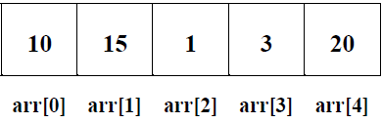
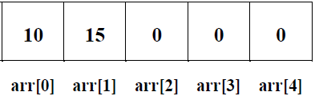
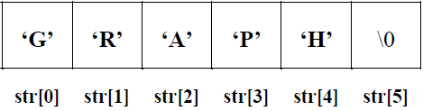
Initialization (Storing Values) of Array: 1D Array
At Compile Time
  Complete array initialization.
    all the locations of an array is assigned with some value during declaration.
    Example: int arr[5]={10,15,1,3,20};
  Partial array initialization.
    few locations from starting location of an array is assigned with some value during declaration.
    Example: int a[5]={10,15};
  Initialization without size.
    size is not specified during the declaration but the values are specified.
    Based on value array size is allocated
    Example: int arr [ ]={10, 15, 1, 3, 20};
  String initialization.
    string is initialized to the array and the data type will be character only.
    Example: char str[ 6 ]="GRAPH";
At Run Time
  Using Loops, of assignment statement for each index, values at run time be initialized as user input.

Slide 12
Operations With Array
Read & Display the array
Inserting element to array
Deleting element from array
Searching element in array
Sorting array

Slide 13
Read & Display Array : 1D Array
int arr[MAX], n, i;
cout<<"Enter the size of the array : ";
cin>>n;
cout<<"\nReading the elements to an array :";
for (i = 0; i < n; i++)
{
  cout<<"\narr[%d] = ", i;
  cin>>arr[i];
}
cout<<"Displaying the %d elements of the array", n;
for (i = 0; i < n; i++)
{
cout<<arr[i];
}

Slide 14
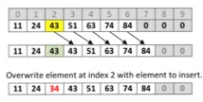
Inserting Element in Array
int arr[MAX], n, i;
int item, pos;
if (pos >= n)
{
  cout<<"\nPosition entered is not valid! Inserting at end of array!";
  pos = n-1;
}
for (int i = n - 1; i >= pos; i--)
arr[i + 1] = arr[i];
n++;
arr[pos] = item;

Slide 15
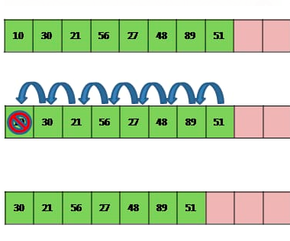
Deleting Element From Array : 1D Array
int arr[MAX], n, i;
int item, pos;
if (pos >= n)
{
  cout<<"\nPosition entered is not valid! Deleting from end of array!";
  pos = n - 1;
}
item = arr[pos];
for (int i = pos; i < n; i++)
arr[i] = arr[i+1];
n--;

Slide 16
Searching Element in 1D Array
Linear Search
  Start from beginning, search by comparing elements one by one
Binary Search
  Find the middle value and keep comparing till either element is found or list exhausted
  List should be sorted for the binary search to be performed

Slide 17
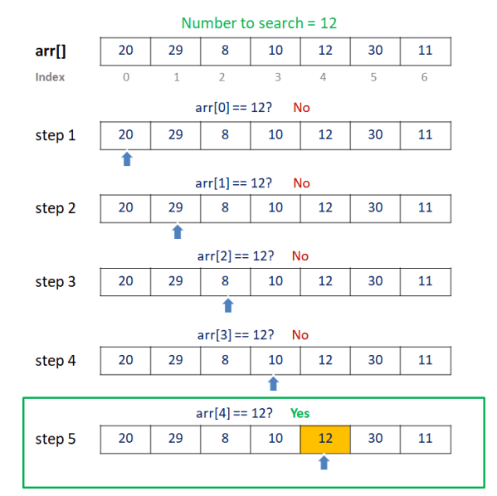
Linear Search
int arr[MAX], n, i, item, pos, isfound = 0;
for (i = 0; i < n; i++)
{
  if (arr[i] == item)
  {
    isfound = 1;
    pos = i;
    break;
  }
}
if (isfound == 1)
{
  cout<<"\nElement found";
}
else
{
  cout<<"\nElement not found";
}

Slide 18
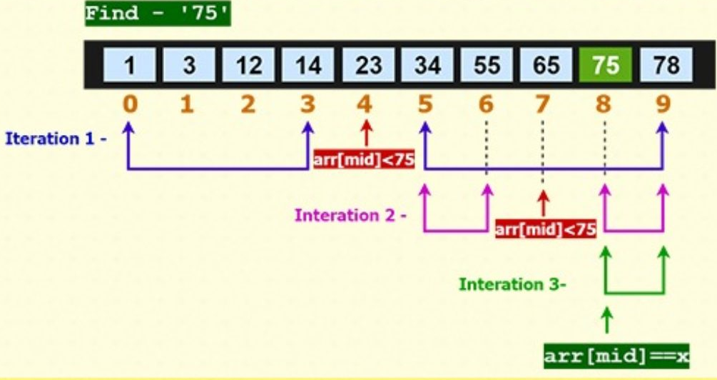
Binary Search
int arr[MAX], n, i, item;
int pos, isfound = 0;
int low, high, mid;
low = 0;
high = n - 1;
do{
  mid = (low + high) / 2;
  if (item == arr[mid])
  {
  isfound = 1;
  pos = mid;
  break;
  }
  else if (item < arr[mid])
  high = mid - 1;
  else
  low = mid + 1;
} while (low <= high);
if (isfound == 1)
  cout<<"\nElement found";
else
  cout<<"\nElement not found";

Slide 19
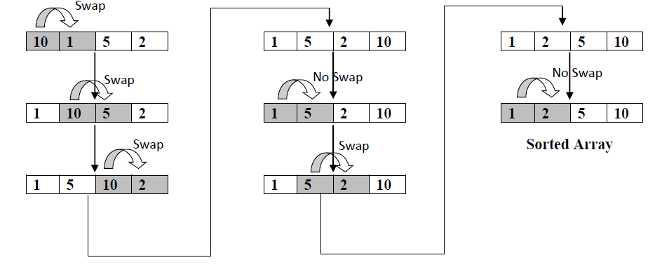
Bubble Sort : 1D Array
int arr[MAX], n, i, j, temp;
cout<<"\nPerforming Bubble Sort";
for (i = 0; i < n - 1; i++)
{
  for (j = 0; j < n - i - 1; j++)
  {
    if (arr[j] > arr[j + 1])
    {
      temp = arr[j];
      arr[j] = arr[j + 1];
      arr[j + 1] = temp;
    }
  }
}

Slide 20
Array
2-D Array

Slide 21
Two Dimensional Array
tabular representation of data in terms of two dimensions namely rows and columns
Each element of the array is accessed by two index values namely rows and columns
Memory allotted for 2D array is a collection of contiguous block of memory of size governed by type and rows and columns in 2D Array
Some examples are working with matrix based operations.
Eg: Marks in 5 subjects for a set of 50 students

Slide 22
2D Array : Declaration
Syntax:
  <datatype> <array-name>[<row-count>][<column-count>];
Size of Memory Block:
  size = sizeof(datatype) * row-count * column-count;
Example:
  int matrix[2][3];
  This consists of 2 rows and 3 columns for elements referred by matrix & stores element of type int. Size of memory allotted : 2 * 3 * 2 = 12Bytes

Slide 23
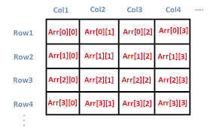
2D Array Representation
Each of the array element is represented by the array name followed by the index value for row and index value of column.
Woking with 2D array involves scrolling across every column for each of the row.
Storage of array in memory can be in Row major or column major form

Slide 24
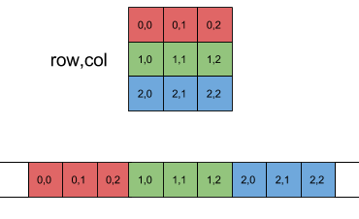
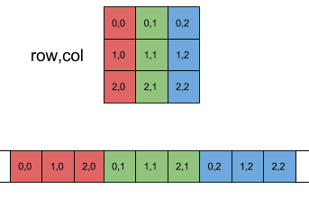
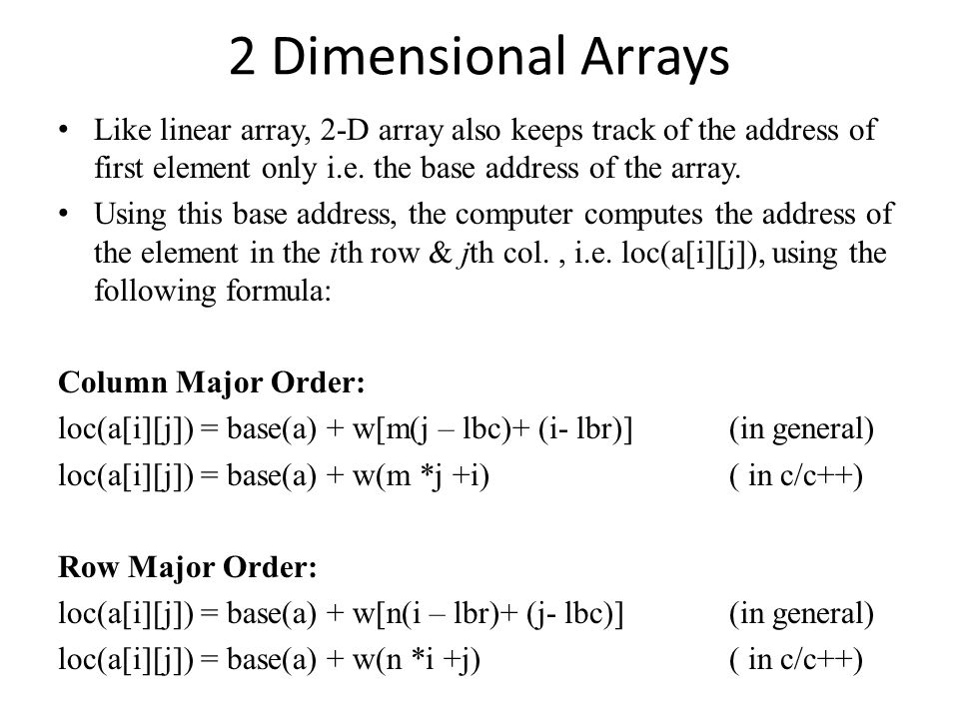
2D Array Storage
Row Major Representation
Column Major Representation
base(a): base address in pointer a ; w: size of each element ; m: total rows in array a ; n: total columns in array a

Slide 25
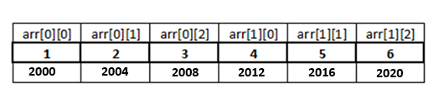
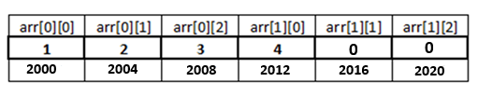

2D Array: Initialization
At Compile Time
  Complete Array Initialization
  int arr[2][3] = {{1,2,3},{4,5,6}};
  int arr[2][3] = {1,2,3,4,5,6};
  int arr[][3] = {1,2,3,4,5,6};
  Partial Array Initialization
  int arr[2][3] = {1,2,3,4};
  int arr[2][3] = {{1,2},{4}};
At Run Time
  Using input statement inside 2 loops (one for row, other for column)

Slide 26
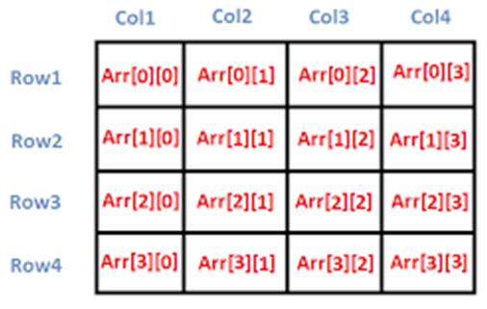
2D Array: Reading and Displaying Elements
int Arr[ROW_MAX][COL_MAX], row, col, i, j;
cout<<"Enter the size of matrix :";
cout<<"\n Rows : ";
cin>>row;//4
cout<<"\n Columns : ";
cin>>col; //4
cout<<"Enter the “<< row*col <<“array elements\n";
for (i = 0; i < row; i++)
{
  for (j = 0; j < col; j++)
  {
    cin>>Arr[i][j];
  }
}

Slide 27
2D Array: Reading and Displaying Elements
int Arr[ROW_MAX][COL_MAX], row, col, i, j;
for (i = 0; i < row; i++)
{
  for (j = 0; j < col; j++)
  {
    cout<<"%d ", Arr[i][j];
  }
  cout<<"\n";
}

Slide 28
Example Programs With 2D Array
Matrix Addition
Matrix Multiplication
Matrix Transpose

Slide 29
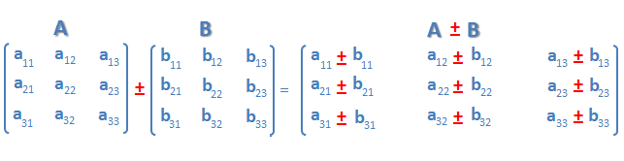
Matrix Addition
if (row1 != row2 || col1 != col2)
{
  cout<<"Matrix Addition Not Possible!";
}
else
{
  for (i = 0; i < row1; i++)
  {
    for (j = 0; j < col1; j++)
    {
      matadd[i][j] = mat1[i][j] + mat2[i][j];
    }
  }
}

Slide 30

Matrix Multiplication
  for (i = 0; i < row1; i++)
  {
    for (j = 0; j < col2; j++)
    {
      matmul[i][j] = 0;
      for (k = 0; k < col1; k++)
      {
        matmul[i][j] += mat1[i][k] * mat2[k][j];
      }
    }
  }

Slide 31
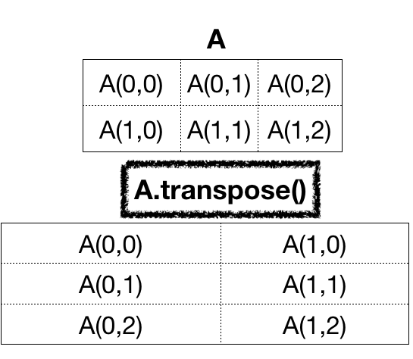
Matrix Transpose
for (i = 0; i < col; i++)
{
  for (j = 0; j < row; j++)
  {
    mattrans[i][j] = mat[j][i];
  }
}

Slide 32
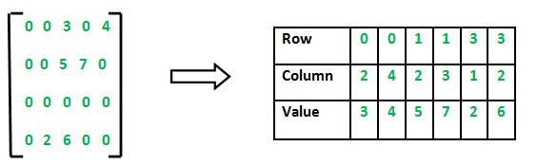
Sparse Matrix
matrix where maximum elements are zero (0)
representing such matrix as a normal array representation in form of rows and columns involves wastage of memory as maximum memory is used storing non essential information.
This kind of matrix can be representation in a different manner using array
Using Normal Matrix Representation
Total Memory Assigned: 4*5* sizeof(int) = 4*5*2 = 40B
Useful Data Space: 6*2 = 12B
Space Wasted: 40B – 12B = 38B

Slide 33
Sparse Matrix Representation
Representation of Sparse Matrix as Array consisting of 3 rows and multiple columns equal to number of non-zero elements

