Slide 1
C++ Programming
Post Graduate Diploma in Advanced Computing (PG-DAC)
ACTS, C-DAC Bangalore
Topics Covered:
Arrays & Functions
Recursive Functions
  Factorial using recursion
  Tower of Hanoi
Typedef
Structures
Unions

Slide 2
Arrays & Functions

Slide 3
Passing Array To Function
Array name is passed as argument
Passed as the pointer to array
Passing array is always call by reference
The formal argument will also behave as a pointer to the array passed as actual argument

Slide 4
Illustration of Passing Array to Function
#include<stdio.h>
int arrSum(int ap[], int nEle);
void main()
{
int ar[5] = { 1,2,3,4,5 };
int sum;
sum = arrSum(ar, 5);
printf("\n Sum of elements of array = %d", sum);
}
int arrSum(int ap[], int nEle)
{
int i, sum = 0;
for (i = 0; i < nEle; i++)
  sum = sum + ap[i];
return sum;
}
ar[0]
ar[1]
ar[2]
ar[3]
ar[4]
1
2
3
4
5
1998
2000
2002
2004
2006
2008
2010
ar
sum
15
-4323
2050
nEle
ap
sum
15
5
2000
0
5000
6000
6050

Slide 5
Retuning Array From Function
Direct return of array is not possible
Return of Array can be achieved indirectly by passing the array that has to be initialized to the function and then returning a void.

Slide 6
Recursive Functions

Slide 7
Recursive Functions
A recursive function is a function that calls itself during its execution. This enables the function to repeat itself several times, outputting the result and the end of each iteration.
every recursive program can be written using iterative methods
recursive calls makes some of the complex programming of iterative methods being solved easily and cleanly.

Slide 8
Recursive Function - Necessary Conditions
Law of Recursion
A recursive function must call itself.
All recursive functions should have a base condition, i.e. a condition where the function stops calling itself
At each recursive call, the function call should be moving towards the base condition.

Slide 9
Types of Recursion
Direct Recursion
  the function directly calls itself
  Eg: a function A directly has in its definition another statement A with different parameter values
Indirect Recursion
  the function A calls another function B which in turn may call back A

Slide 10
Illustration of Recursion
sum = 0
n = 0
sumRec(0)
#include<stdio.h>
int sumRec(int n)
{
  int sum=0;
  if (n == 0)
    return 0;
  else
  {
    sum = n + sumRec(n - 1);
    return sum;
  }
}
void main()
{
  int n = 5, sum;
  sum = sumRec(n);
  cout<<"\nSum of first "<<n<<" numbers is : “<<sum;
}
sum = 1 + 0 = 1
n = 1
sum = 0
n = 1
sumRec(1)
sumRec(1)
sum = 0
n = 2
sum = 2 + 1 = 3
n = 2
sumRec(2)
sumRec(2)
MEMORY STACK
sum = 0
n = 3
sum = 3 + 3 = 6
n = 3
sumRec(3)
sumRec(3)
sum = 0
n = 4
sum = 4 + 6 = 10
n = 4
sumRec(4)
sumRec(4)
sum = 0
n = 5
sum = 5 + 10 = 15
n = 5
sumRec(5)
sumRec(5)
sum = 15
n = 5
sum=-234
n=5
main()
main()

Slide 11
Example Program : Factorial of a number
to find the factorial of a number using recursion.
Eg:
  Computing 5! using function called fact with prototype:
  int fact(int n)
  where
    n is the number for which factorial is getting calculated
  and
    return value is factorial of that number
120
120
5!
fact(5)
= 5 * 24
24
= 5 * 4!
fact(4)
= 4 * 3!
6
= 4 * 6
fact(3)
= 3 * 2!
2
= 3 * 2
fact(2)
= 2 * 1
1
= 2 * 1!
fact(1)
= 1

Slide 12
Example Program: Tower of Hanoi
a mathematical puzzle having three rods and n disks.
Objective: to move the entire stack to another rod, obeying the rules:
  Only one disk can be moved at a time.
  Each move consists of taking the upper disk from one of the stacks and placing it on top of another stack i.e. a disk can only be moved if it is the uppermost disk on a stack.
  No disk may be placed on top of a smaller disk.

Slide 13
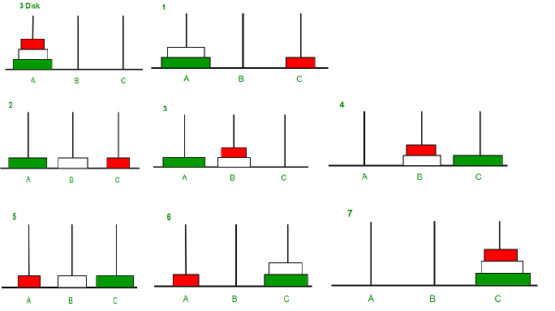
Example Program: Tower of Hanoi

Slide 14
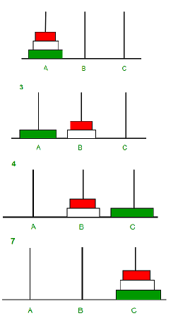
Example Program: Tower of Hanoi
void towerOfHanoi(int n, char src, char dest, char aux)
{
  if(n==1)
    cout<<"\nMoving Disk "<<n<<": From "<<src<<" To "<<dest;
  else
  {
    towerOfHanoi(n - 1, src, aux, dest);
    cout<<"\nMoving Disk "<<n<<": From "<<src<<" To "<<dest;
    towerOfHanoi(n - 1, aux, dest, src);
  }
}

Slide 15
Example Program:
Tower of Hanoi
tower(3,A,B,C)
tower(2,A,C,B)
n=3
n=2
n=1
A -> B
tower(2,C,B,A)
tower(1,A,B,C)
A -> C
tower(1,B,C,A)
A -> B
B -> C
tower(1,C,A,B)
C -> B
tower(1,A,B,C)
C -> A
A -> B
void towerOfHanoi(int n, char src, char dest, char aux)
{
  if(n==1)
    cout<<"\nMoving Disk "<<n<<": From "<<src<<" To "<<dest;
  else
  {
    towerOfHanoi(n - 1, src, aux, dest);
    cout<<"\nMoving Disk "<<n<<": From "<<src<<" To "<<dest;
    towerOfHanoi(n - 1, aux, dest, src);
  }
}

Slide 16
Typedef

Slide 17
Typedef
Another name for a data type an be created using keyword typedef
helps in making code more readable.
Syntax:
typedef existing_type new_name;
Example:
typedef unsigned int uint;

Slide 18
Why typedef
Simplifies long or complex declarations
Improves code clarity
Useful for portability and abstraction

Slide 19
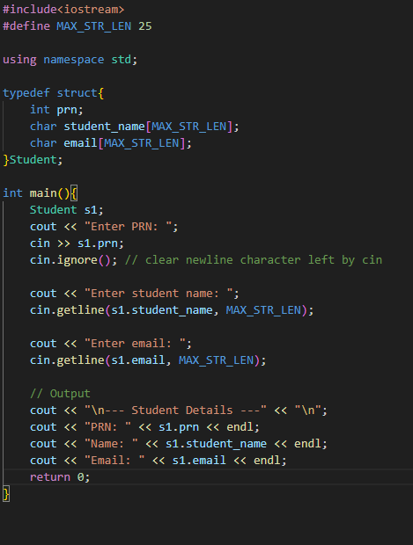
Example: typedef with Structure

Slide 20
Structure in C++

Slide 21
What are Structures
user-defined data type
Groups Related Data Efficiently
Improve code readability
Useful for modeling real-world entities (e.g., Student, Employee)

Slide 22
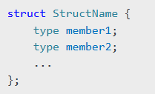
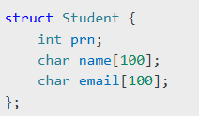
Syntax & Example of Structure
Syntax
Example

Slide 23
Accessing Structure Members
using ‘.’ operator with structure variable
using ‘->’ operator with structure pointer
structure variable / structure pointer is created

Slide 24
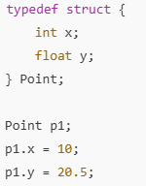
Anonymous Structure
a structure without a name
struct variable should be created at the time of structure definition
usually used along with typedef

Slide 25

Self Referential Structure
a structure that includes a pointer to itself
essential for implementing dynamic data structures like linked lists, trees, and graphs.
Contains at least one member that is a pointer to the same type of structure.

Slide 26
Union

Slide 27
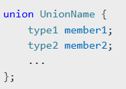
Union Introduction
A union is a user-defined data type similar to a struct.
Unlike structures, all members of a union share the same memory location.
Only one member can contain a value at any given time.
Only one member can be used at a time.
Memory is allocated based on the size of the largest member.
Syntax:

Slide 28
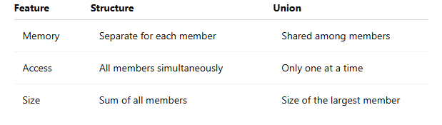
Structure Vs Union

