Slide 1
C++ Programming
Post Graduate Diploma in Advanced Computing (PG-DAC)
ACTS, C-DAC Bangalore
Topics Covered:
OOP Principles
Classes & Objects
Data Members & Member Functions
Access Modifiers
Object Pointers & This Pointer
Inline Function and Class
Array & Class
Static Members & Class
Constructor & Destructor
Dynamic Memory Allocation & Class

Slide 2
Object Oriented Programming

Slide 3
Object Oriented Programming
Abstraction
Encapsulation
Inheritance
Polymorphism
hiding the details and displaying only required information
collection of different kind of information under a single name
inheriting features from base class to derived class
allows functions or methods to behave differently based on the context in which they are called

Slide 4
Classes & Objects

Slide 5
Class
a collection of different types of data members and member functions
Syntax:
  class <ClassName>
  {
  Access Specifier:
  //data member
  //member functions
  };

Slide 6
Objects
an instance for a class
object of the class is created, memory is assigned to object that is collection if memory required for the various elements of the class.
Object Creation
  Local Object
  Global Object

Slide 7
Example Program
class Cls
{
private:
int i;
public:
void init()
{
i = 5;
}
}Obj1;//method 1 of creating global object
Cls Obj2;//method 2 of creating global object
void function(Cls Obj1)//method 1 of creating local object
{
Cls Obj2;//method 2 of creating local object
Obj2.init();
}

Slide 8
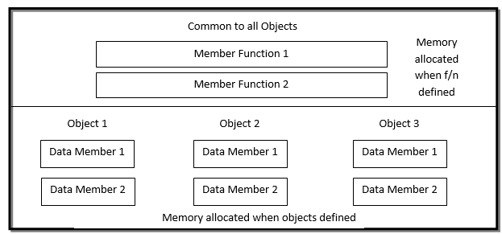
Memory Allocation in Class

Slide 9
Access Specifiers
Private
Accessible directly within member functions of the class.
For other objects, accessed via object name and dot operator.
Not accessible in non-member functions; access only via public methods.
Public
Directly accessible outside the class using object name.
Internally accessed in any class function like regular variables.
Protected
Accessible within member functions using object or directly.
Indirect access in non-member functions via class member functions.

Slide 10
Inline Function and Class

Slide 11
Inline Function in Class
Inline functions are those functions whose function call is replaced by the function definition at the time of compilation.
Member functions of a class can be made inline in two methods:
  by giving inside the class definition
  by outside the class definition using keyword inline
To create an inline function using outside the class definition, keyword inline is appended in the header line of the function definition

Slide 12
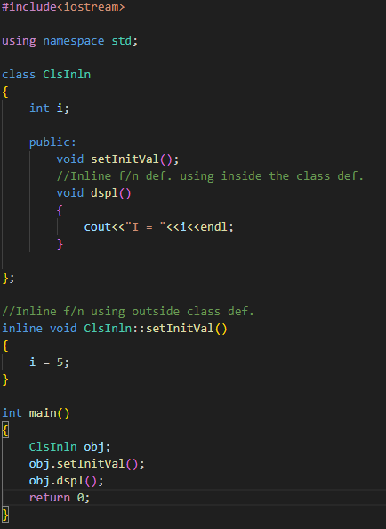
Example: Inline Function & Class

Slide 13
Arrays & Class

Slide 14
Arrays as data member of Class
The array can be a created as a data member of a class.
When an array is created as a public data member, it can be referenced in the non-member function of the class using the object of the class and the membership operator (.).
When accessed in member function of the class, it can be accessed directly without use of any object for the calling object of the member function.

Slide 15
Array of Objects
Arrays can also be created using class types, just like int or char.
Types of Object Arrays
An array of objects is a list where each element is an object of the class.
Each object in the array holds separate memory for all class data members.
Global Array of Objects
Declared outside all functions.
Accessible throughout the entire program.
Local Array of Objects
Declared inside a function.
Accessible only within that function.
Attempting access outside its scope causes undefined symbol errors.

Slide 16
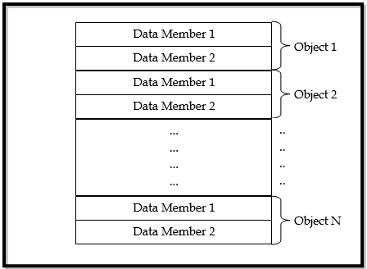
Memory Allocation in Array of Objects

Slide 17
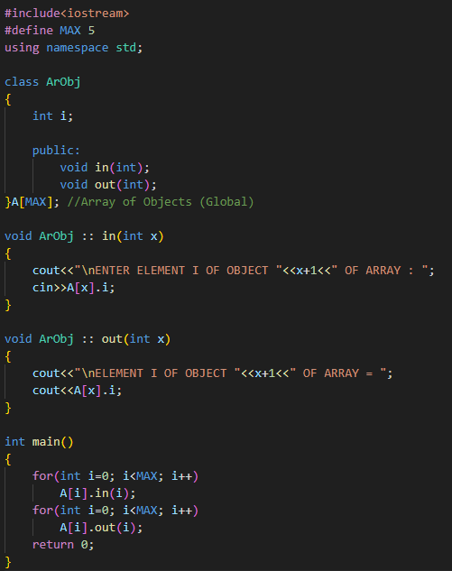
Program for Array of Objects

Slide 18
Static Member Type & Arrays

Slide 19
Static Members in C++
C++ allows both data members and member functions of a class to be declared as static.
Static members are shared among all instances of a class rather than tied to individual objects.

Slide 20
Static Data Members (Class Variables)
Definition:
A static data member belongs to the class, not any one object.
Used when all instances should share a common value.
Key Characteristics:
Initialized to 0 when the first object is created.
Only one copy exists, shared among all objects.
Accessible only within the class, but lifetime lasts entire program.
Declared with static, and defined outside the class.
Initialization at definition is optional.
Uses:
Track number of class instances (e.g., visit counters).
Support for dynamic memory management.

Slide 21
Static Member Functions
Definition:
A static function can access only static members.
Called using class name and scope resolution operator (ClassName::Function()), no object required.
Key Characteristics:
Cannot access non-static members.
Useful for performing actions common to all instances.
Uses:
Manage class-wide data or counters.
Frequently used in memory management scenarios.

Slide 22
Scope of Class & its Members

Slide 23
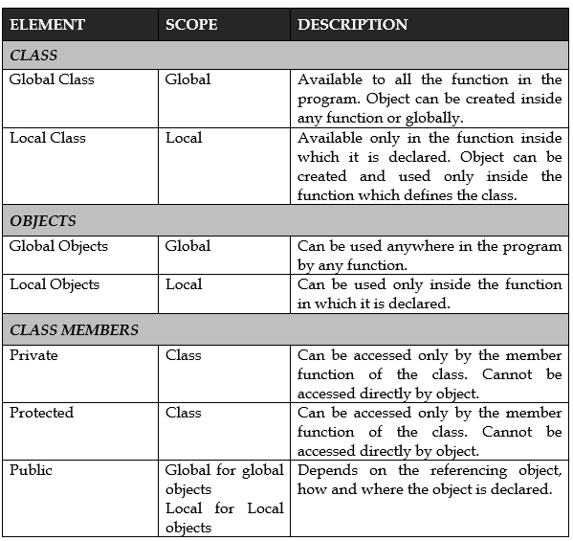

Slide 24
Constructors & Class

Slide 25
Constructors for Class
Constructors are special member functions of the class which is used for the initialization of the various data members of the class.
Whenever object of any class is created, a constructor of that class is invoked by the compiler. If a constructor of the class is not created during programming, the compiler creates a constructor on its own. This constructor initializes all members by zero/null value.

Slide 26
Features of Constructor
They should be declared in the public section of the class.
They are invoked automatically when the objects are created.
The name of the constructor is the same as the name of the class.
They do not have any return types, not even void, and so, they don’t return any value.
They cannot be inherited, though a derived class can call the base call constructor.
They can have default arguments.
These cannot be virtual.
They make implicit calls to the operators new and delete when memory allocation is required

Slide 27
Constructors
Special functions used for object initialization.
Automatically called when object is created.
Three main types:
  Default Constructor
  Parameterized Constructor
  Copy Constructor

Slide 28
Default Constructor
A constructor with no arguments.
Automatically provided if no constructor is defined.
Initializes members to default values (0, NULL).
If any constructor is defined, this must be explicitly declared.

Slide 29
Parameterized Constructor
A constructor with one or more parameters.
Used to initialize members with specific values.
Calling Styles:
  Explicit: ClassName obj = ClassName(val);
  Implicit: ClassName obj(val);

Slide 30
Copy Constructor
Initializes an object from another object of the same class.
Takes a reference to an object of the same class.
Compiler provides one if not explicitly defined.
Examples:
  Copy constructor: Cls C1 = C2; or Cls C1(C2);
  Not a copy constructor: C1 = C2; (assignment)

Slide 31
Dynamic Memory Allocation in Class

Slide 32
Introduction to Dynamic Memory
Memory can be allocated at runtime using new.
Memory can be freed using delete.
Used when the size or number of objects is unknown at compile time.

Slide 33
The new Operator & delete operator
New operator allocates memory on the heap.
Syntax: ClassName* ptr = new ClassName();
Delete operator Deallocates memory created with new.
Syntax: delete ptr;

Slide 34
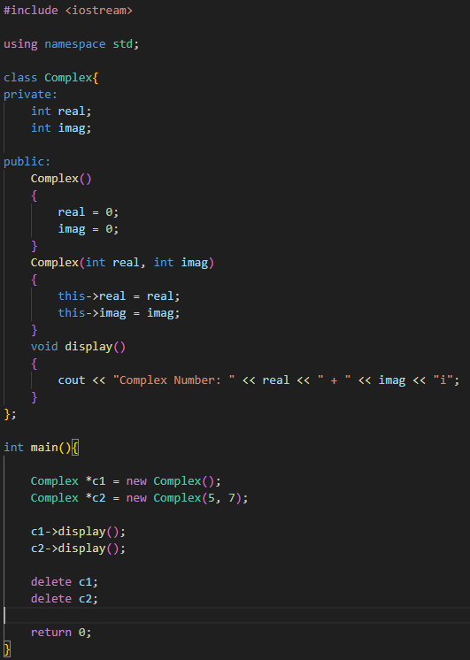
Program to demonstrate new & delete operator

Slide 35
Destructor

Slide 36
Destructor
Destructors are the special member functions of the class which are automatically invoked whenever the object of the class goes out of scope.
The name of the destructor is the same as the name of the class but is preceded with a tilde (~) sign.

Slide 37
Features of Destructor
They are declared in the public section.
They are usually declared after the other member functions.
They are invoked automatically when the objects go out of scope.
They do not have any return types.
They don’t have any arguments.
They cannot be inherited. However the derived class can invoke the base class constructor.
They cannot be overloaded.
They can be declared as virtual.
Destructor can call other member functions

Slide 38
Need for Destructor
During object construction via a constructor, system resources may be allocated (e.g., memory, file handles, network connections).
Examples of resources include:
  Opened files
  Network connections
  Dynamically allocated memory
These allocated resources must be deallocated before the object is destroyed to avoid resource leaks.
A function can be created to manually release resources before destruction, but this requires explicit calling.
Destructor offers an automated solution:
  It is a special member function invoked automatically when an object is destroyed.
  It helps in releasing all acquired resources without requiring manual calls.
  Ensures clean-up of resources like memory, files, and network connections.

