Slide 1
C++ Programming
Post Graduate Diploma in Advanced Computing (PG-DAC)
ACTS, C-DAC Bangalore
Topics Covered:
Inheritance
Virtual Functions, Abstract Class
Polymorphism
Friends to Class
Exception Handling
File Handling

Slide 2
Inheritance

Slide 3
What is Inheritance
Definition
  Inheritance allows creating new classes from existing ones.
  Enables code reuse and extension without modifying the original class.
Terminology
  Base Class (also called Parent, Ancestor, or Superclass):
  The class whose properties are inherited.
  Derived Class (also called Child, Descendant, or Subclass):
  The class that inherits from the base class.
Characteristics
  Derived class inherits all accessible members of the base class.
  Derived class can have its own additional members.
  Base class remains unchanged during inheritance.

Slide 4
Need for Inheritance
🔄 Promotes Reusability
Reduces code duplication — speeds up development, simplifies maintenance, and allows easy extensions.
🔗 Supports Transitivity
Inherited properties can be passed from base class to derived class, and further to other subclasses.
🔁 Express Real-World Relationships
Models natural hierarchies like “is-a” relationships (e.g., Dog is a Animal).

Slide 5
Visibility Modes
Visibility mode controls how members of a base class are inherited into a derived class.
It defines the access level (scope) of the inherited members in the derived class.
There are three types of visibility modes:
  Public
  Private
  Protected

Slide 6
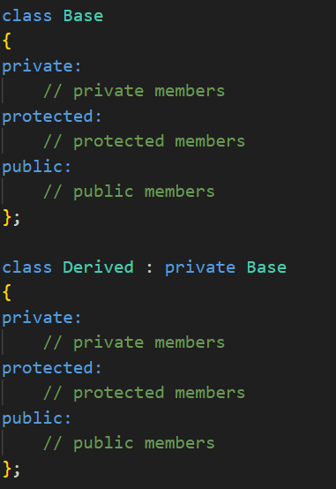
Private Visibility Mode
class Base
class Derived
private:
//private members
private:
//private members
protected:
//protected members
protected:
//protected members
public:
//public members
public:
//public members

Slide 7
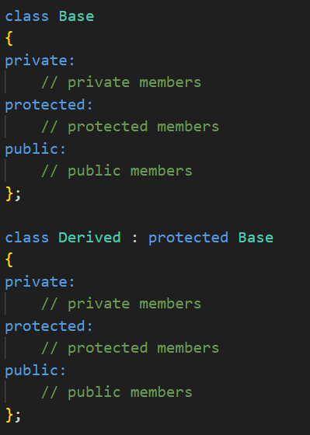
Protected Visibility Mode
class Base
class Derived
private:
//private members
private:
//private members
protected:
//protected members
protected:
//protected members
public:
//public members
public:
//public members

Slide 8
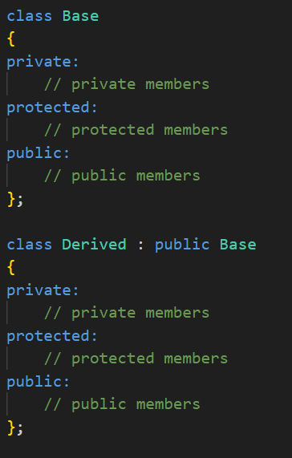
Public Visibility Mode
class Base
class Derived
private:
//private members
private:
//private members
protected:
//protected members
protected:
//protected members
public:
//public members
public:
//public members

Slide 9
Types of Inheritance
Single Inheritance
Multiple Inheritance
Multi-level Inheritance
Hierarchical Inheritance
Hybrid Inheritance
Inheritance

Slide 10
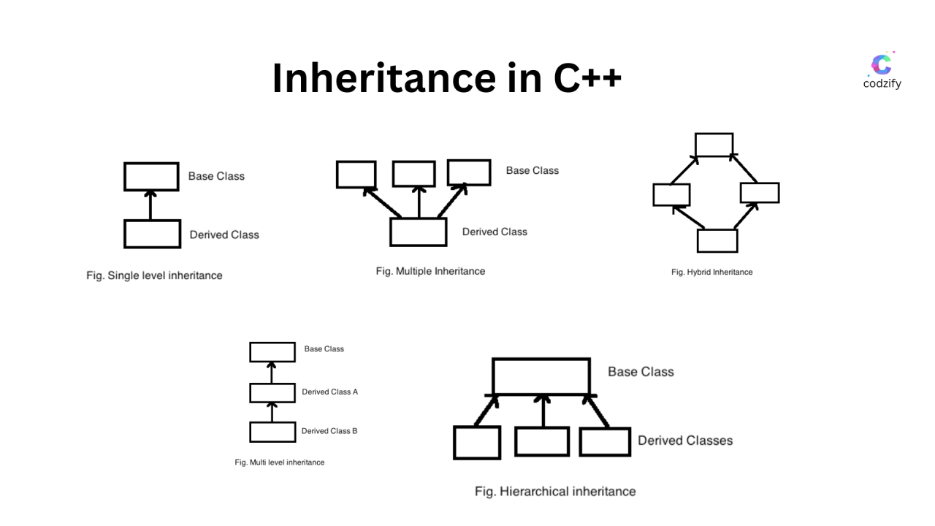
Image Source: https://www.linkedin.com/pulse/mastering-inheritance-c-types-examples-explained-manish-methani-npvmc/

Slide 11
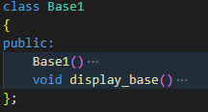
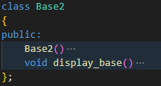
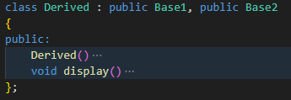
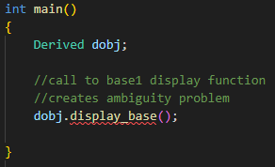
Ambiguity Problem in Multiple Inheritance
In multiple inheritance, if two or more base classes have functions with the same name and signature, and the derived class does not override that function, an ambiguity error occurs.
The compiler cannot decide which version of the function to use when called from a derived class object.
This ambiguity occurs only if:
  The function is not overridden in the derived class.
  The base classes have functions with identical signatures.
If the derived class defines its own version of the function, that version is called by default — eliminating ambiguity.
Solution: Adding base class name while calling function with scope resolution operator

Slide 12
Virtual Base Class

Slide 13
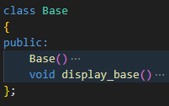
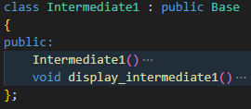
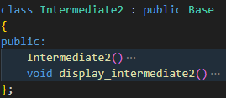
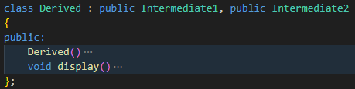
Ambiguity Problem in Multipath Inheritance
Multipath Inheritance is a complex form of inheritance where a class is derived by combining:
  Multilevel Inheritance
  Multiple Inheritance
  Hierarchical Inheritance
the same base class may appear more than once in the inheritance chain.
leads to ambiguity, such as multiple copies of base class members being inherited
Solution: Virtual Base Class

Slide 14
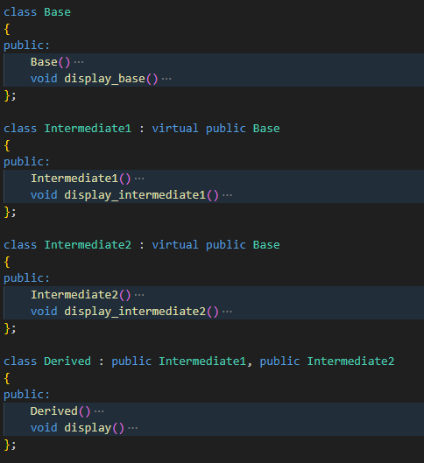
Virtual Base Class
To prevent duplication of the base class's members in case of multipath inheritance, virtual base class / virtual inheritance is used.
This ensures that only one shared instance of the base class is inherited by all derived classes.
The virtual keyword is used while declaring inheritance.
Virtual inheritance ensures data consistency and eliminates ambiguity when accessing base class members.

Slide 15
Constructors, Destructors in Inheritance

Slide 16
Constructor & Destructor Call in Case of Inheritance
Constructor Call
Destructor Call
Order of Constructor Calls
  Base class constructors are always called before derived class constructors.
  The constructor call follows the hierarchy from top (base) to bottom (derived).
Default Constructor
  If no constructor is specified in derived class, the base class default constructor is called automatically.
Parameterized Constructor
  The derived class must explicitly call the base class's parameterized constructor using an initializer list.
Multi-level Inheritance
  Constructors are called in the order of inheritance, i.e. Base → Intermediate → Derived.
Constructor Call with Multiple Inheritance
  All base class constructors are called in the order of their declaration regardless of the order in the initializer list.
Destructors are called in reverse order of construction:
  The most derived class's destructor is called first.
  Base class destructors are called last.
Destructor order ensures proper cleanup:
  Resources acquired by derived classes are released before base class resources.
  Prevents memory/resource leaks and undefined behavior.

Slide 17
Pointer & Inheritance

Slide 18
Object Pointer
Pointer to an object of the class
Elements of the class are accessed using indirection operator “->”
Eg:
  class Cls{
  public:
  void function();
  };
  Cls O;
  Cls *OP = &O;
  OP->function();

Slide 19
Object Pointer in Inheritance
Both the base & Derived class Pointer can be created.
Derived class pointer can point only to the derived class object.
Base class pointer can point to both the base class as well as derived class object.
Base class pointer pointing to derived class object can only call for base class members that are inherited in derived class.

Slide 20
Virtual Functions

Slide 21
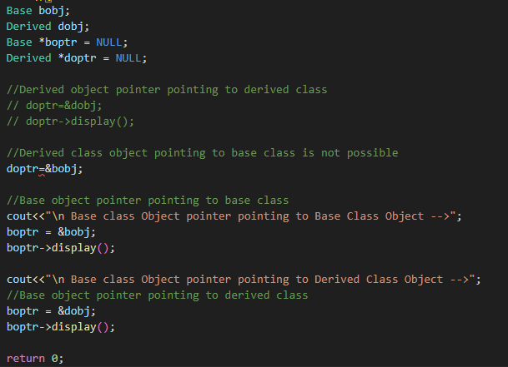
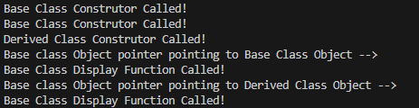
Object Pointer with IInheritance
Base Class object pointer always calls base class display function irrespective of object it is pointing to (function overriding)
Solution: Virtual Function

Slide 22
Virtual Function
Virtual functions are created to decide at run time which function is to be called .
Decision is made based on which class object the base class pointer is pointing.
If the base class pointer is pointing to base class object then function definition of base class is used and if the base class pointer is pointing to derived class object then function definition of derived class is used.
Virtual function are created in base class by appending keyword “virtual” in function declaration in class.

Slide 23
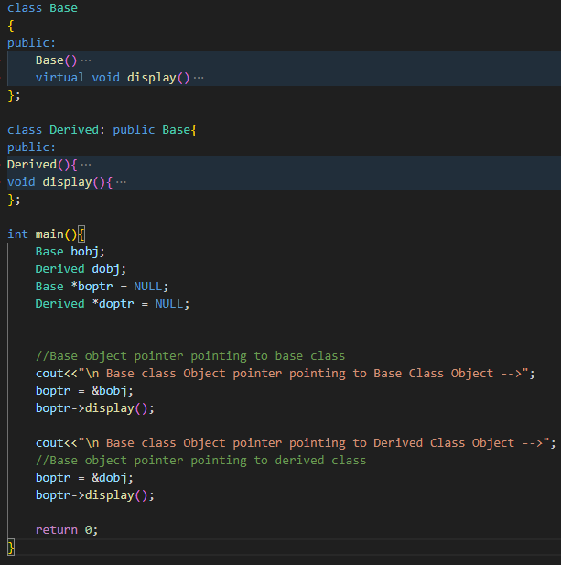
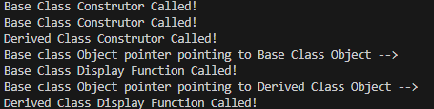
Virtual Function Implementation

Slide 24
Properties of Virtual Function
Created in the base class
Cannot be static.
Accessed using object pointer.
Cannot be a friend.

Slide 25
Friends to Class

Slide 26
Friends to Class
friends to class are non-member components for a class that can access the private data members of a class
friends to a class can either be a function or a class itself.
declared as friend using the keyword friend in the class definition
defined outside the class
can be a friend to multiple classes

Slide 27
Forms of Friend Implementations with Class
Friend Function of a Class
Friend Function with Multiple Classes
Friend Class
Friend Member Function

Slide 28
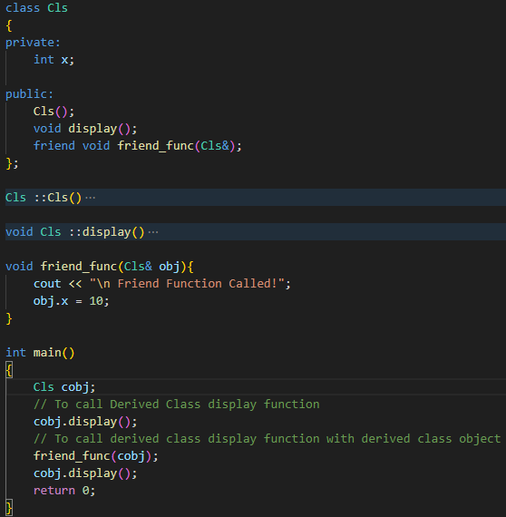
Friend Function to Class
A non-member function declared as friend inside a class.
Can access the private and protected members of that class.

Slide 29
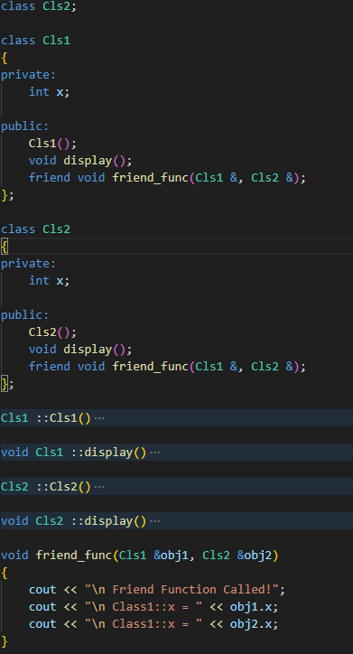
Friend Function to Multiple Class
A single friend function declared in two or more classes.
Can access private members of all classes it is declared friend of.
Useful for operations involving more than one class.

Slide 30
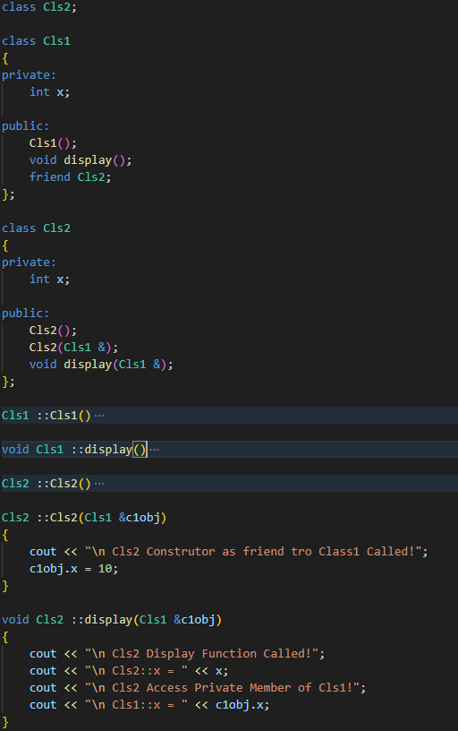
Friend Class
All member functions of one class become friends of another class.
Can access all private and protected members of the target class.

Slide 31
Function of 1 class as a friend to another class
A specific member function of one class declared as a friend in another class.
Only that function (not the whole class) can access private members.

