Slide 1

E-COMMERCE PLATFORM FOR FARMERS
Project Guide:
Prof. S. P. Ingale
Presented By:
Anurag Gangane
Jayesh Kavitkar
Akshay Uparikar
Himani Kale
DEPARTMENT OF COMPUTER SCIENCE & ENGINEERING PROF. RAM MEGHE INSTITUTE OF TECHNOLOGY & RESEARCH, BADNERA

Slide 2
TABLE OF CONTENTS
Introduction
Problem Statement
Solution
Key Features of Project
Data Flow Diagram of Project
Software Requirement
Results
Conclusion
References

Slide 3
INTRODUCTION
Agricultural industry lacks effective communication between farmers and large companies.
Platform aims to bridge communication gap with direct channel for interaction.
Integrated chatting system enables real-time communication between users.
Entire selling and purchasing process is conducted online.

Slide 4
Existing System | Proposed System
Local Farmers markets Direct-to-consumer sales Wholesale Markets Middlemen | Addressing Communication Gap Integrated Chatting system Empowerment of farmers Record of Communication Enhanced Communication Features

Slide 5
PROBLEM STATEMENT OF PROJECT
Elimination of Intermediaries
Financial Empowerment
Empowering Local Economies
Reduced communication Barrier

Slide 6
SOLUTION
Direct farmer-to-consumer connection bypasses middlemen.
Farmers gain control and establish relationships with customers.
Real-time chat facilitates data sharing and transparency.
Platform invigorates local economies and promotes rural development.

Slide 7
KEY FEATURES OF PROJECT
Streamlined Communication
Empowerment of Farmers
Enhanced Transparency
Increased Efficiency
Reduced Information Asymmetry

Slide 8
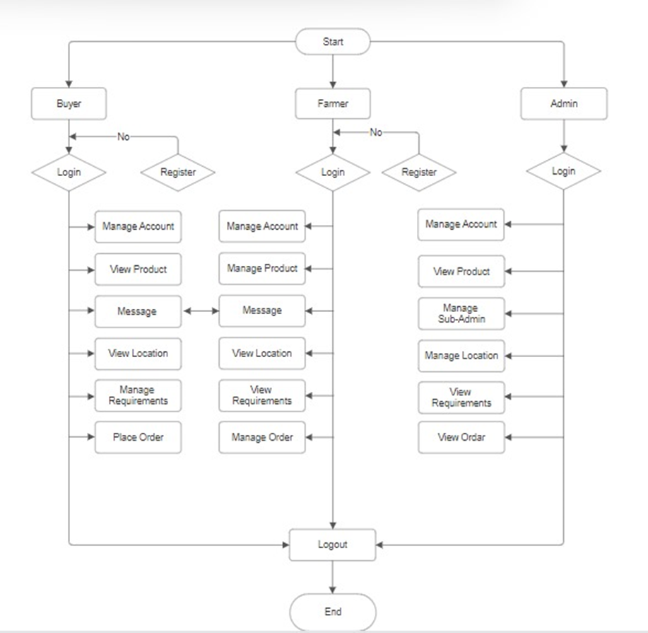
DATA FLOW DIAGRAM OF PROJECT
Data Flow Diagram Of Project

Slide 9
SOFTWARE REQUIREMENT
Operating System : Windows XP/7/8/8.1/10 or Linux
User Interface : HTML, CSS
Server-side Scripting : PHP Script
Client-side-Scripting : Java Script
Programming Language : PHP
Web Applications : Xampp Server
IDE/Workbench : Net Beans
Database : MySQL
Server Deployment : Apache

Slide 10
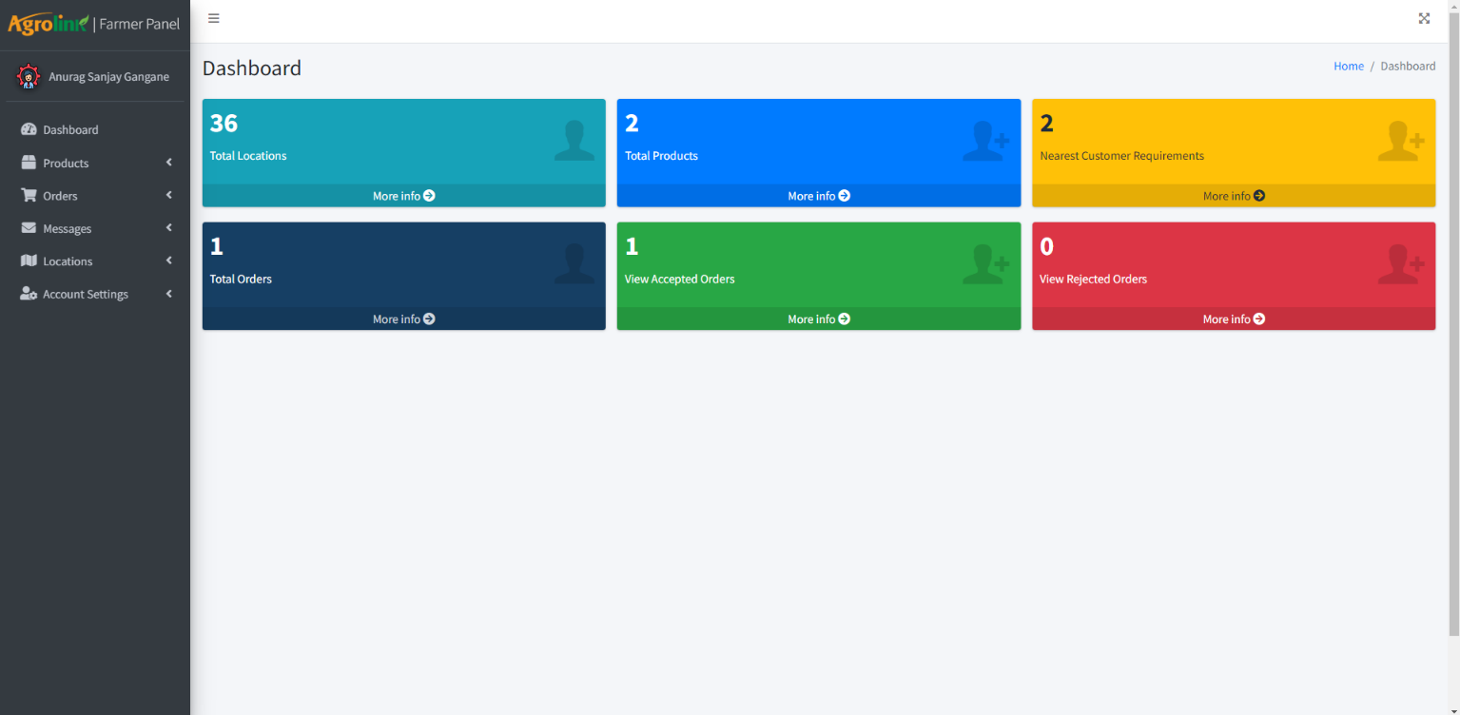
Farmer Panel Window Dashboard
RESULTS

Slide 11
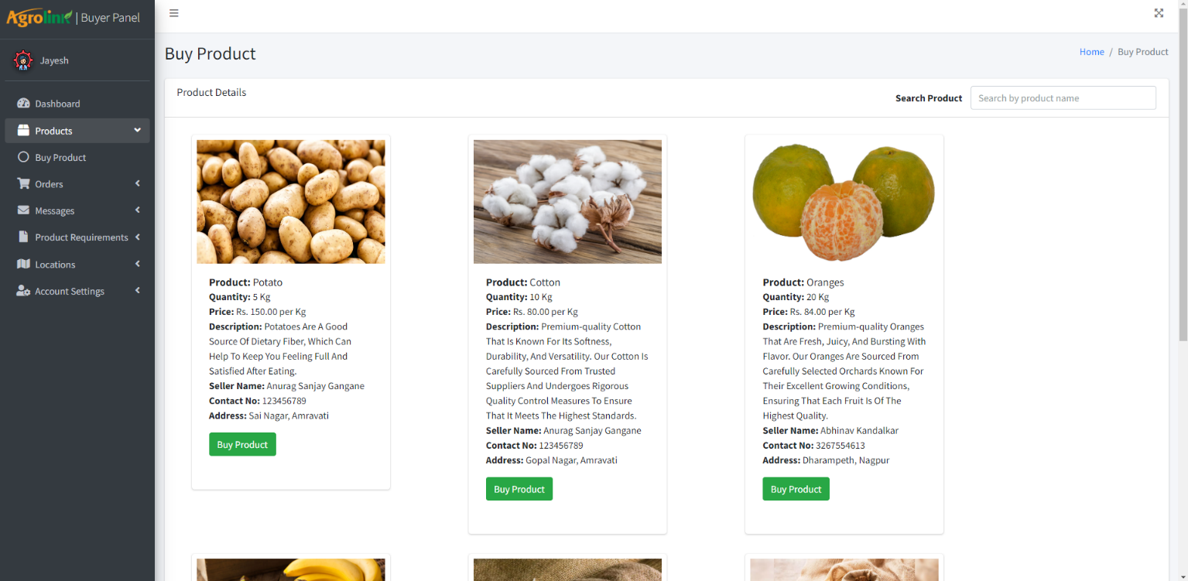
Product Window

Slide 12
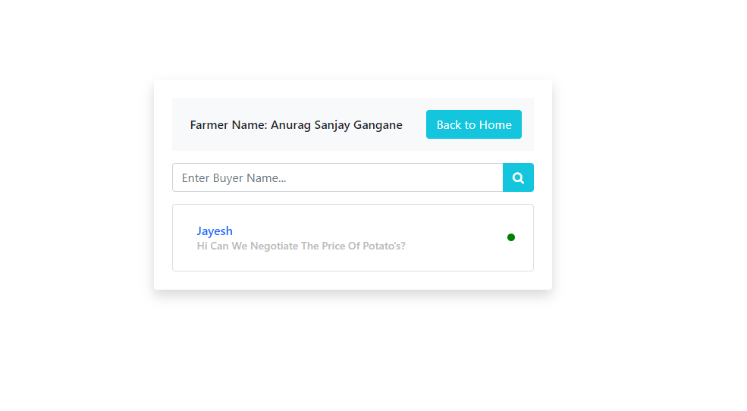
Chatting System Interface

Slide 13
CONCLUSION
The proposed e-commerce platform with integrated chat functionality represents a significant step towards empowering farmers and transforming the agricultural sector. By eliminating intermediaries and facilitating direct communication between farmers and buyers, the platform enhances market access, negotiation power, and transparency. Leveraging technologies such as PHP and MySQL, the project offers a scalable and secure solution to address the challenges faced by farmers. Through streamlined communication and efficient deal closures, the platform aims to create a more equitable marketplace for agricultural products. Overall, this initiative underscores the potential of technology to drive inclusive growth and sustainable development in the agricultural sector.

Slide 14
REFERENCES
Emerging Trends of E-Commerce in India: An Empirical Study” by Shetter in International Journal of Business and Management Invention in 2018.
Peter Namisko and Moses Aballo, “Current status of agriculture and Global Trends” in International Journal of Science and Research Volume 2 Issue 7,2013.
A study of Segments Contribution: E-commerce growth in India” by Mahipal in Academy of marketing Studies Journal in 2018.
E-Commerce in agri-food sector: a systematic literature review” by Yiwu Zeng, Fu Jia, Lia Wan and Hongdong Guo in the International Food and Agriculture Management Review on 26 February 2017.
Kalia, P., Kaur, N. & Singh, T. (2017). E-commerce in India: Evolution and revolution of online retail. Mobile Commerce: Concepts, Methodologies, Tools and Applications, 2, 736-758.
“The impact of e-commerce on agro-food marketing: the case of agricultural cooperatives, firms and consumers in Crete”, Baourakis G., M. Kourgiantakis and A. Migdalas 2002.

Slide 15
Thank You!

