Slide 1
Self Learning Project
Predicting Cardiovascular Disease Using Machine Learning
By Akshay Pawar
Google Colab:
https://colab.research.google.com/drive/1HjvMucCxpchitAhvJUCy6nxnq5WFojE9?usp=sharing
Github:
https://github.com/akshayuta/Self-Learning-assignment
Notes:
Welcome to this tutorial on predicting cardiovascular disease using machine learning. We will explore how to analyze medical data and train a predictive model to assess cardiovascular risk.

Slide 2
Why This Dataset?
Sourced from Kaggle: Cardiovascular Disease Dataset
Real-world medical examination data.
Includes both objective and subjective features.
Helps in predicting heart disease risks effectively.
Notes:
This dataset is a great choice because it contains real-world medical data collected during patient examinations. It provides a mix of objective, examination-based, and subjective information, allowing us to build a well-rounded predictive model for cardiovascular disease risk.

Slide 3
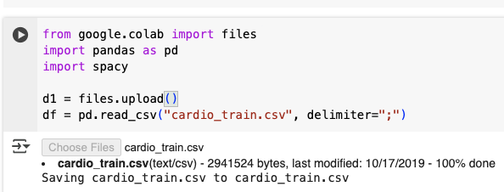
Dataset Overview
Objective Features:
  Age (in days, converted to years).
  Height (cm), Weight (kg), Gender.
Examination Features:
  Systolic & Diastolic Blood Pressure.
  Cholesterol & Glucose levels (categorized as Normal, Above Normal, Well Above Normal).
Subjective Features:
  Smoking, Alcohol Intake, Physical Activity.
Target Variable:
  cardio: Presence (1) or Absence (0) of cardiovascular disease.
Notes:
The dataset is structured with objective features like age and height, examination features like blood pressure, and subjective features like smoking habits. The target variable tells us whether a person has cardiovascular disease.

Slide 4
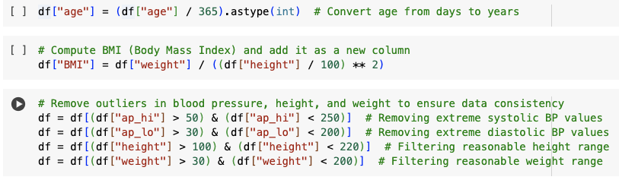
Data Preprocessing
Convert age from days to years.
Remove outliers in BP, height, and weight.
Compute BMI.
Encode categorical variables.
Standardize numerical features.
Notes:
To ensure a clean dataset, we preprocess by removing outliers, encoding categorical variables, and standardizing numerical data for better model performance. BMI is computed using weight and height to provide additional insights into obesity levels.

Slide 5
Visualizing the Data
Histogram of age distribution.
Boxplot of systolic BP by cardiovascular disease.
BMI distribution by cardiovascular disease.
Cholesterol level distribution visualization.
Scatter plot of systolic vs. diastolic BP.
Notes:
Visualizing data helps us understand distributions and relationships between features. Higher BP is often associated with cardiovascular disease. The scatter plot shows systolic and diastolic blood pressure variations, and BMI distribution helps identify obesity-related cardiovascular risks.

Slide 6
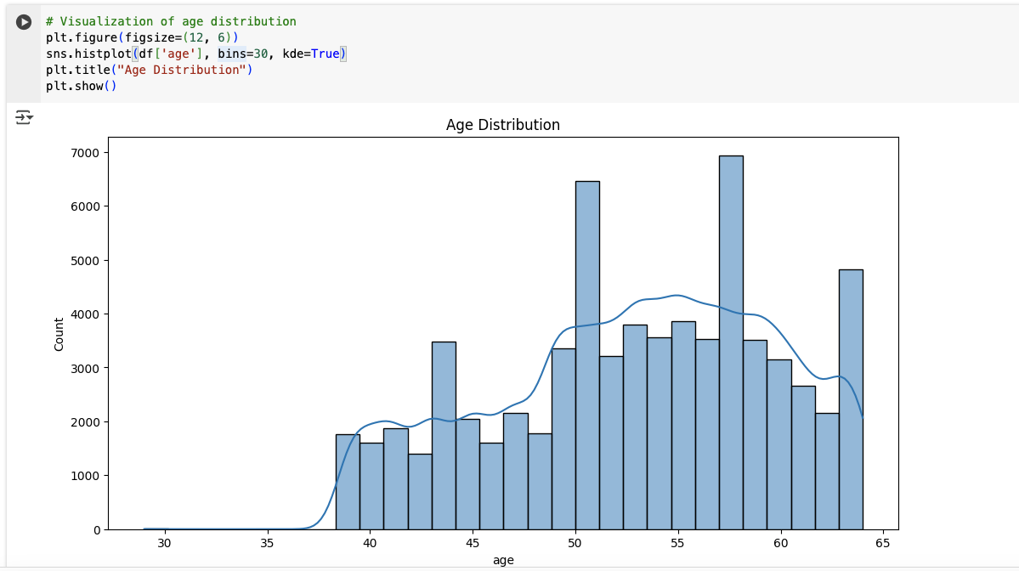
Histogram of age distribution.
Notes:
Histogram of age distribution.

Slide 7
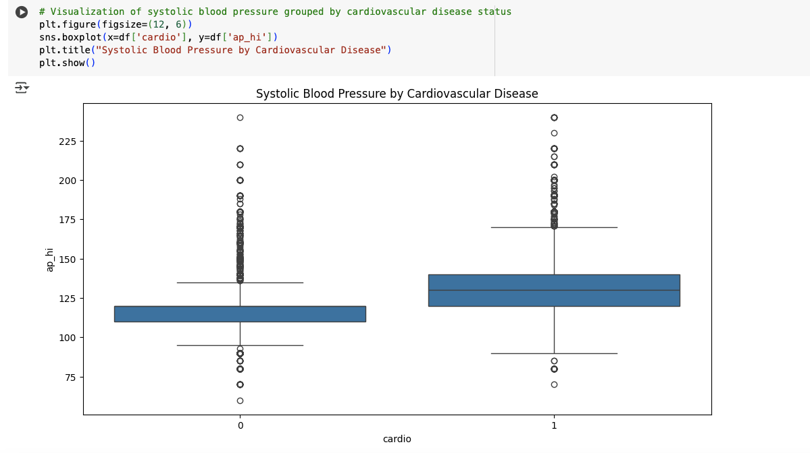
Boxplot of systolic BP by cardiovascular disease.
Notes:
Boxplot of systolic BP by cardiovascular disease.

Slide 8
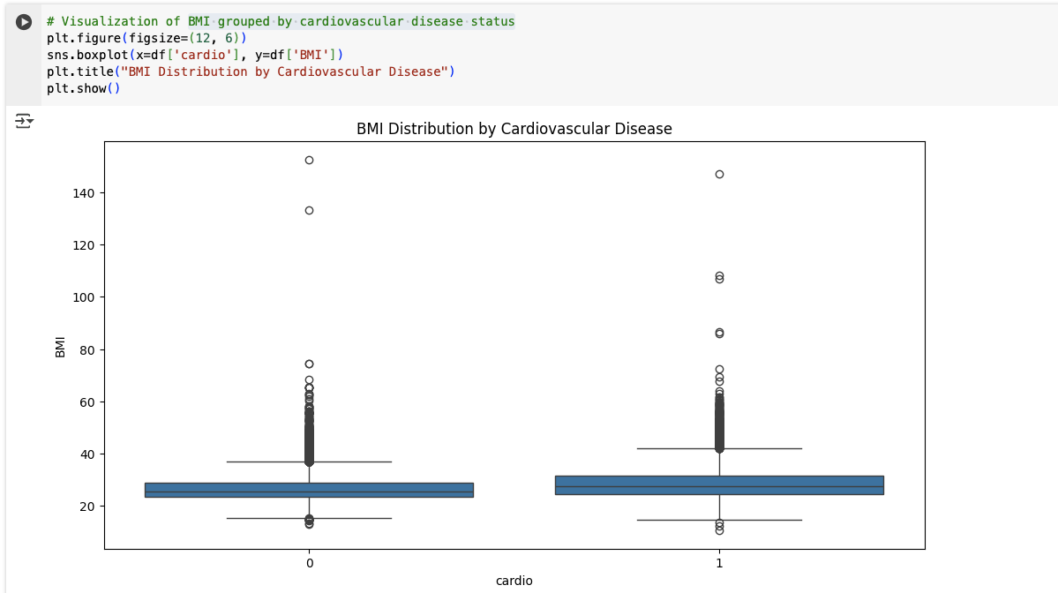
Boxplot of BMI grouped by cardiovascular disease.
Notes:
BMI distribution by cardiovascular disease.

Slide 9
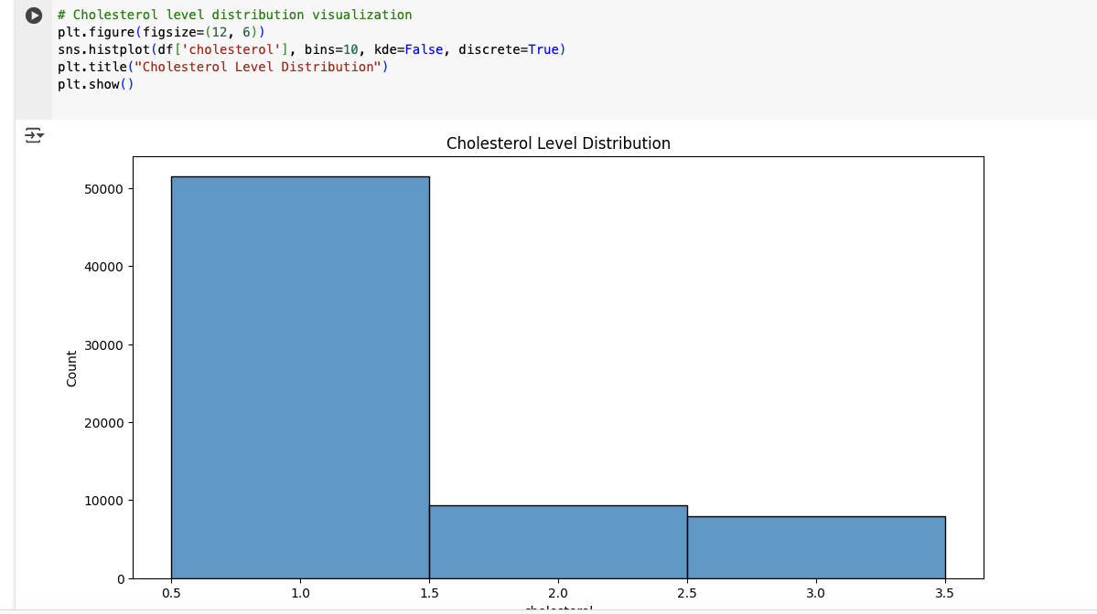
Cholesterol level distribution visualization
Notes:
Cholesterol level distribution visualization.

Slide 10
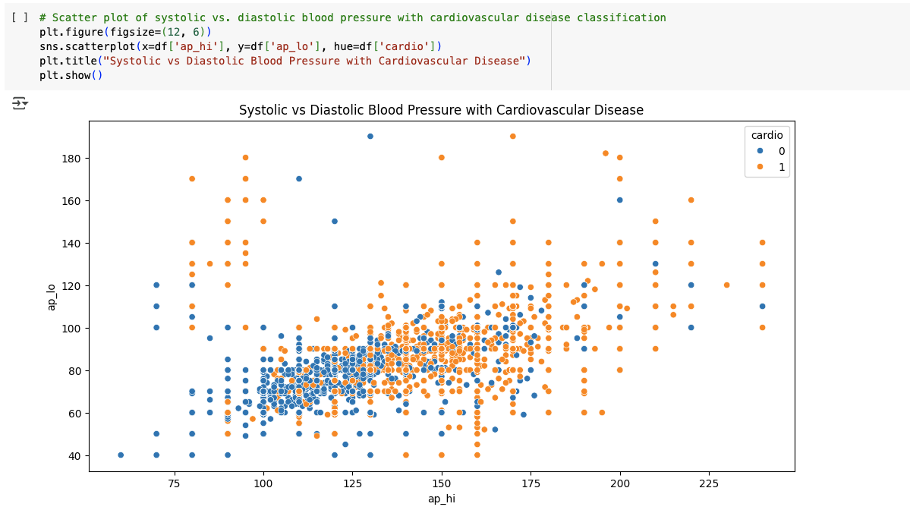
Scatter plot of systolic vs. diastolic BP.
Notes:
Scatter plot of systolic vs. diastolic BP.

Slide 11
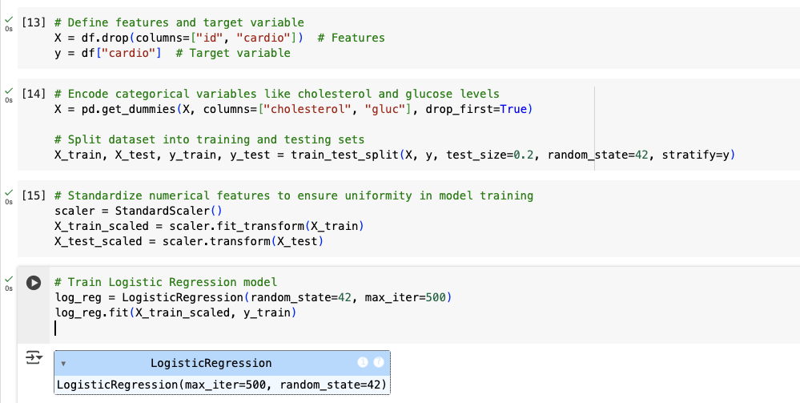
Model Selection & Training
Train Logistic Regression and Random Forest models.
Compare accuracy and classification reports.
Notes:
We train two Logistic Regression model for interpretability and Random Forest model. Standardization is applied to ensure numerical stability in model training.

Slide 12
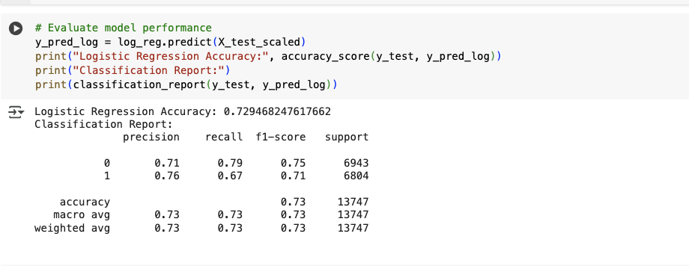
Model Evaluation
Accuracy, Precision, Recall, F1-score.
Logistic Regression: 73% accuracy.
Notes:
Model evaluation helps us assess performance. Logistic Regression is slightly better in this case and is preferred for its interpretability.

Slide 13
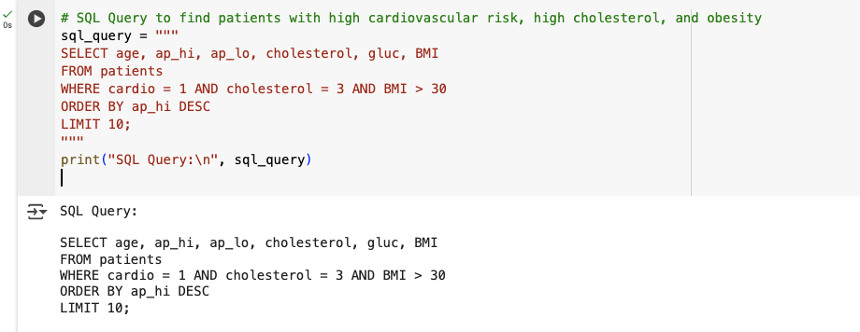
SQL Query Example
Find patients with high cardiovascular risk, high cholesterol, and obesity.
Notes:
Model evaluation helps us assess performance. Logistic Regression is slightly better in this case and is preferred for its interpretability.

Slide 14
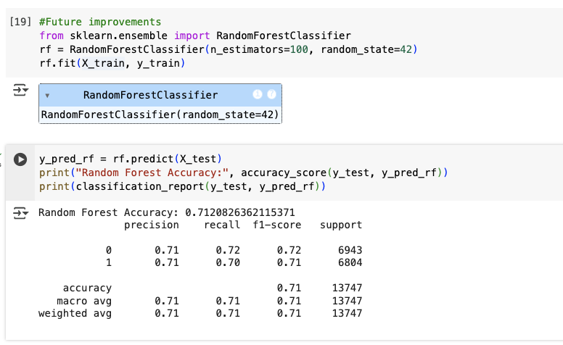
Conclusion
Successfully built a predictive model.
Importance of data preprocessing.
Future improvements: More advanced ML models like Random Forest.
Notes:
This tutorial covered dataset preparation, visualization, model training, and evaluation. Future improvements could include more complex models such as Random Forest or Neural Networks and feature engineering techniques to improve predictive accuracy.

Slide 15

THANK YOU
Notes:
Thank you

