Slide 1
Visualization of small molecule docking with transcription factors

Slide 2
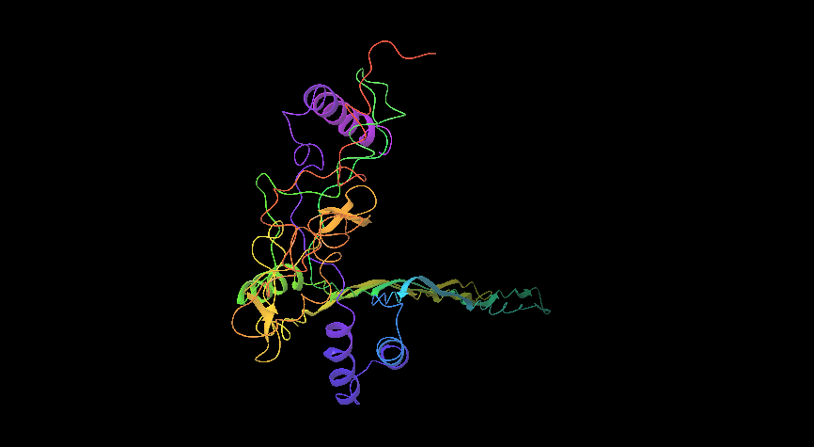
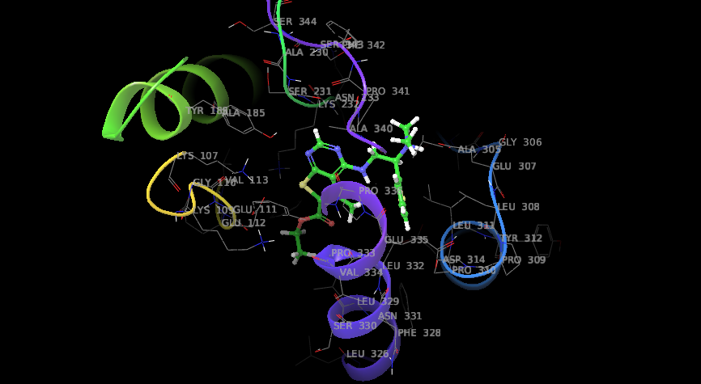
Os01g0224100
Sl no | Title | Entry ID | Docking score
1 | ZINC01824866 | 13514 | -7.056
2 | ZINC13512135 | 13515 | -6.9
3 | ZINC01735747 | 13516 | -6.879
4 | ZINC13588698 | 13517 | -6.745
5 | ZINC00185679 | 13518 | -6.697
AP2 domain containing protein (Os01g0224100)
Binding with 2-[(6-methyl-2,3,4,9-tetrahydro-1H-carbazol-1-yl)amino]ethanol (ZINC01824866)

Slide 3
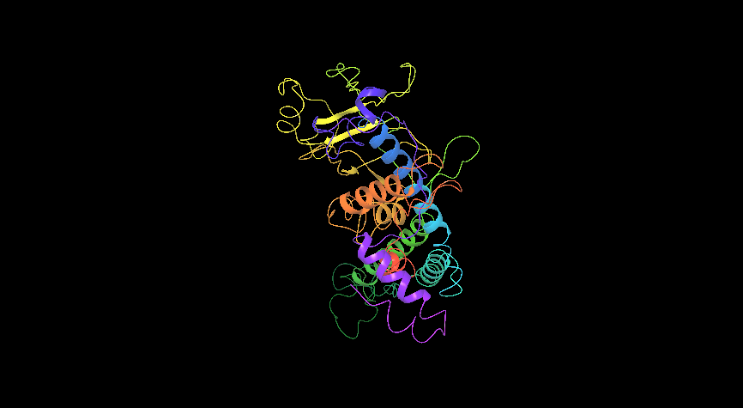
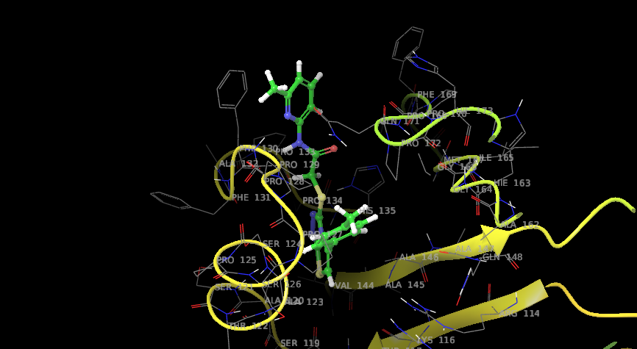
Os09g0455200
Sl no | Title | Entry ID | Docking score
1 | ZINC19702752 | 26716 | -7.984
2 | ZINC03847659 | 26717 | -7.731
3 | ZINC02038513 | 26718 | -7.648
4 | ZINC00901972 | 26719 | -7.647
5 | ZINC00297421 | 26720 | -7.637
HSF-DNA containing domain (Os09g0455200)
Binding 3-Oxo-2,3-dihydro-1H-pyrazolo[4,3-c]quinoline-8-carboxylic acid (ZINC19702752)

Slide 4
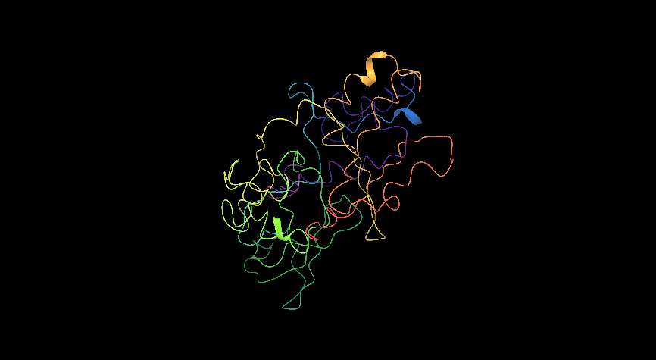
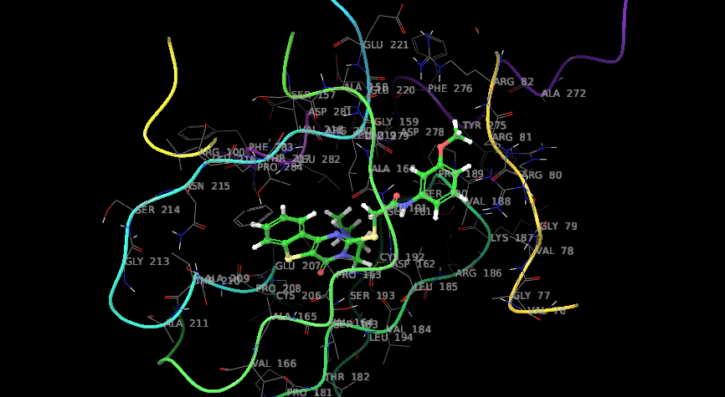
Os01g0657400
Sl no | Title | Entry ID | Docking score
1 | ZINC13516175 | 13514 | -8.521
2 | ZINC02558198 | 13515 | -7.676
3 | ZINC04899521 | 13516 | -7.649
4 | ZINC00142398 | 13517 | -7.639
5 | ZINC00077278 | 13518 | -7.622
Binding with 1-methyl-1H-indole-2,3-dione 3-thiosemicarbazone (ZINC13516175)
Protein containing AP2 domain (Os01g0657400)

Slide 5
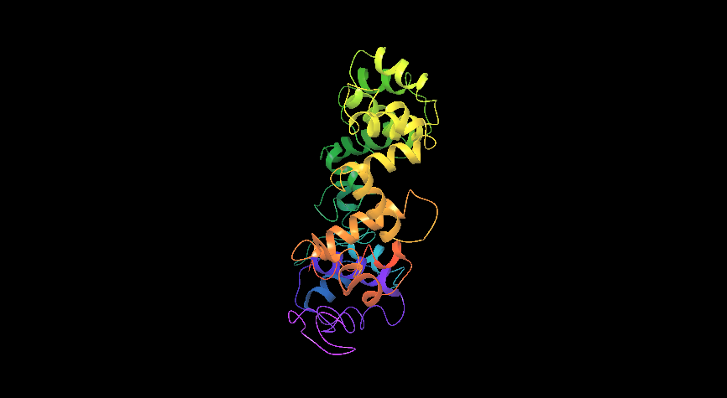
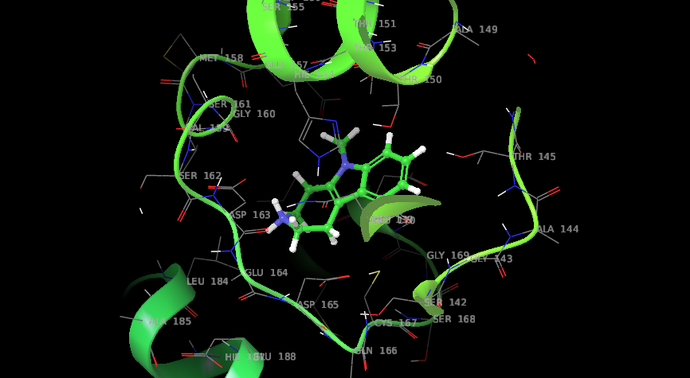
Os01g0302500
Sl no | Title | Entry ID | Docking score
1 | ZINC06067123 | 29220 | -6.79
2 | ZINC03850772 | 29221 | -6.725
3 | ZINC00056657 | 29222 | -6.657
4 | ZINC00200993 | 29223 | -6.503
5 | ZINC00374964 | 29224 | -6.424
Homeobox domain containing protein(Os01g0302500)
Binding with LS-133790 (ZINC06067123)

Slide 6
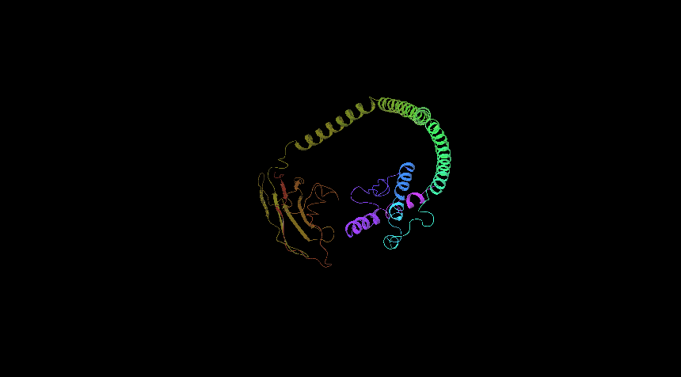
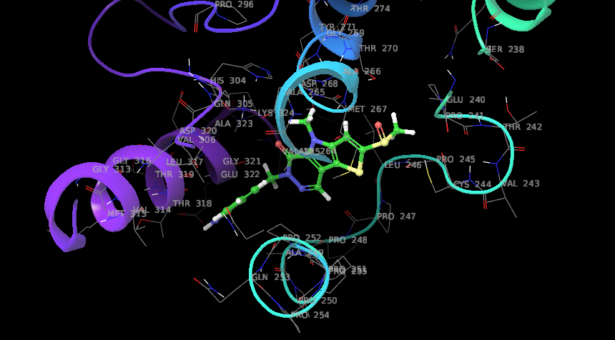
Os01g0625300
Sl no | Entry Name | Formula | Docking score
1 | ZINC01871556 | 13514 | -7.597
2 | ZINC13516175 | 13515 | -7.538
3 | ZINC00193842 | 13516 | -7.417
4 | ZINC02508265 | 13517 | -7.398
5 | ZINC14614807 | 13518 | -7.37
Binding with 1-Hydroxymethyl-tetrahydro-beta-carboline-3-carboxylic acid (ZINC01871556)
HSF-DNA binding protein (os01g0625300)

Slide 7
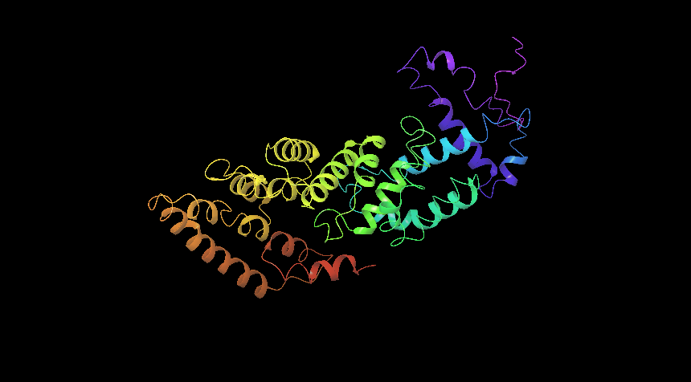
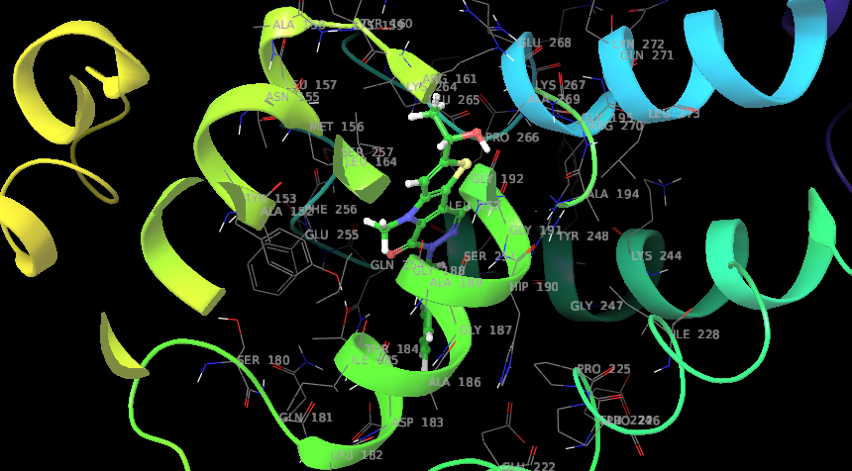
Os07g0129700
Sl no | Title | Entry ID | Docking score
1 | ZINC35458064 | 26765 | -7.891
2 | ZINC00149855 | 26766 | -7.593
3 | ZINC00241993 | 26767 | -7.59
4 | ZINC02128966 | 26768 | -7.516
5 | ZINC04098855 | 26769 | -7.453
Homeobox domain containing domain (Os07g0129700)
Binding hydroxy(trimethyl)BLAHcarboxylic (ZINC35458064)

Slide 8
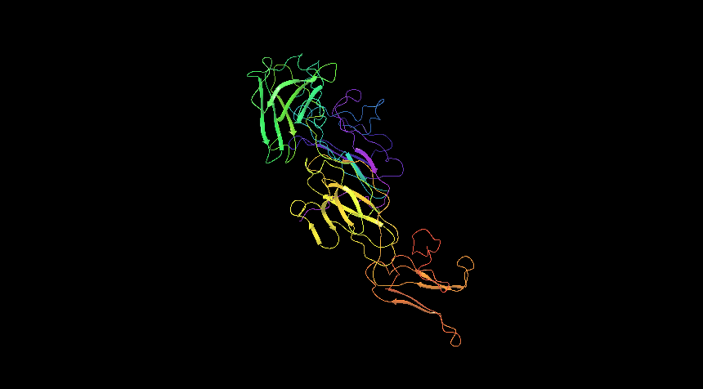
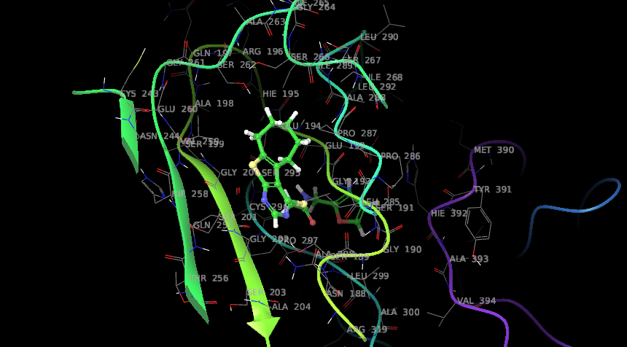
Os09g0526600
Sl no | Title | Entry ID | Docking score
1 | ZINC13508258 | 13514 | -8.306
2 | ZINC13516175 | 13515 | -8.172
3 | ZINC00896081 | 13516 | -7.932
4 | ZINC00032354 | 13517 | -7.837
5 | ZINC13829304 | 13518 | -7.681
HSF-DNA containing domain (Os09g0526600)
Binding (2S)-2-amino-3-(1H-imidazol-4-yl)propanehydrazide (ZINC13508258)

Slide 9
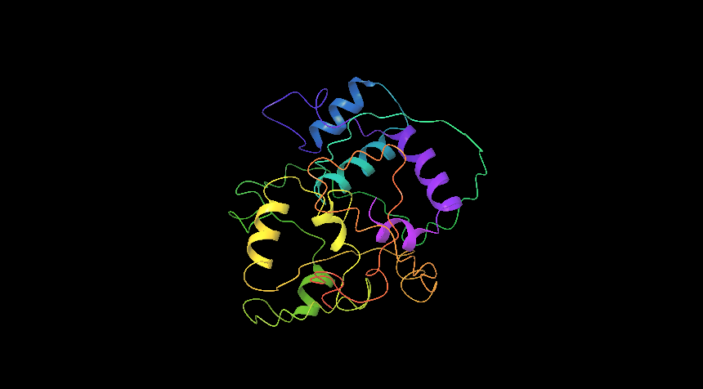
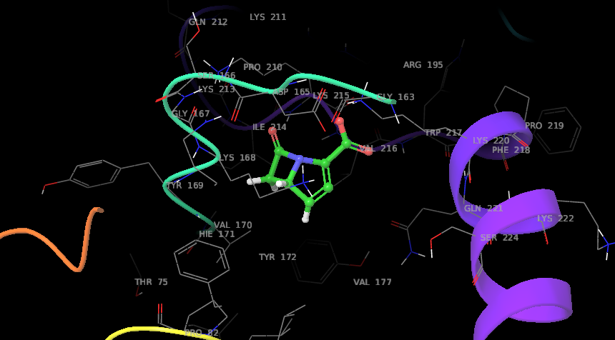
Os03g0769800
Sl no | Title | Entry ID | Docking score
1 | ZINC03852246 | 26436 | -7.715
2 | ZINC04349874 | 26437 | -7.567
3 | ZINC04349879 | 26438 | -7.565
4 | ZINC08740049 | 26439 | -7.454
5 | ZINC18127213 | 26440 | -7.306
Homeobox domain containing protein (Os03g0769800 )
Binding with bicyclo[6.1.0]nonane-9,9-dicarboxylic (ZINC03852246)

Slide 10
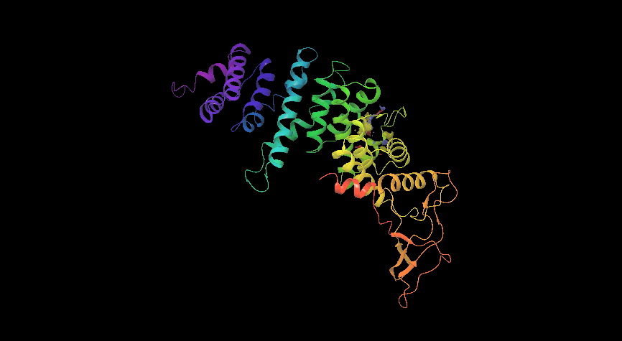
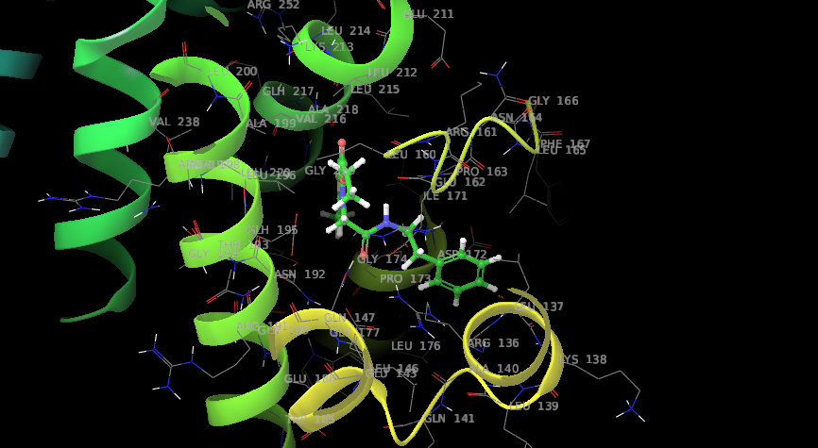
Os04g0637000
Sl no | Title | Entry ID | Docking score
1 | ZINC05425566 | 13514 | -8.107
2 | ZINC00403086 | 13515 | -8.094
3 | ZINC68604642 | 13516 | -7.892
4 | ZINC00260352 | 13517 | -7.881
5 | ZINC08553156 | 13518 | -7.856
Binding with Guanidine,N-1H-benzimidazol-2-yl- (ZINC05425566)
Transcription factor TGAL6 (Os04g0637000 )

Slide 11
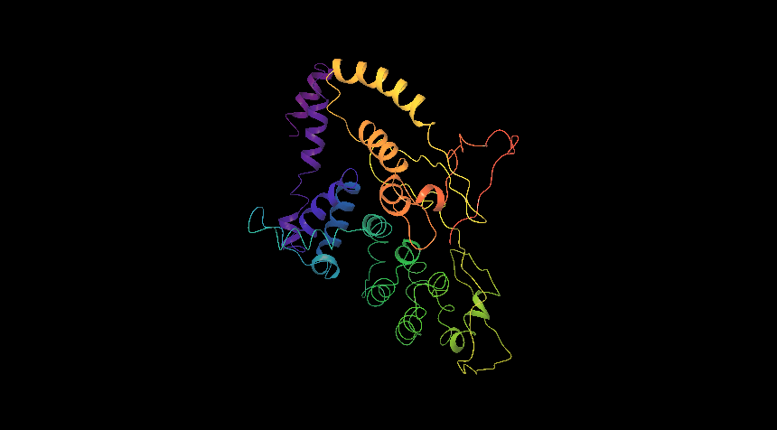
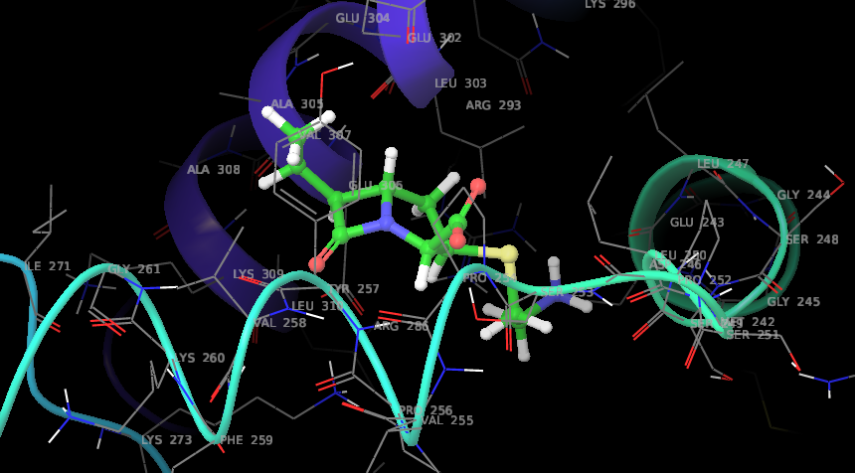
Os02g0766700
Sl no | Title | Entry ID | Docking score
1 | ZINC00901392 | 25840 | -6.563
2 | ZINC00057058 | 25841 | -6.435
3 | ZINC02583632 | 25842 | -6.384
4 | ZINC68606211 | 25843 | -6.375
5 | ZINC04348885 | 25844 | -6.372
bZIP transcription factor 23 (Os02g0766700)
Binding with 2-(1H-Indol-2-yl)ethanamine(ZINC00901392)

Slide 12
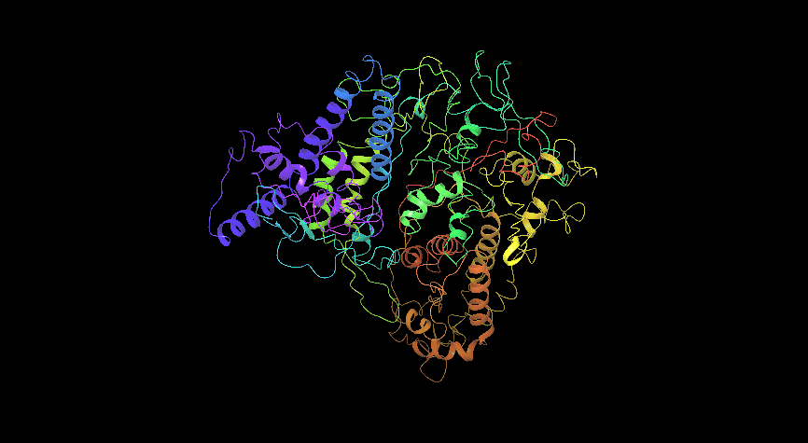
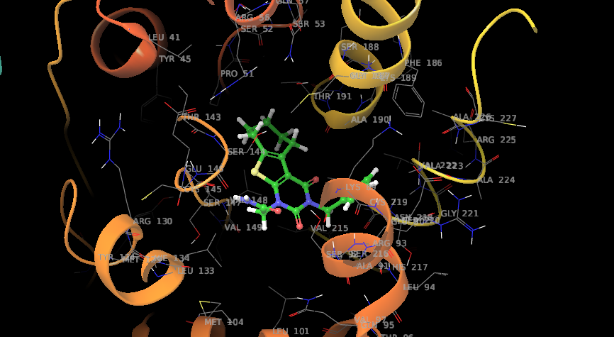
Os12g0612700
Sl no | Title | Entry ID | Docking score
1 | ZINC06061643 | 39119 | -7.835
2 | ZINC00399545 | 39120 | -7.56
3 | ZINC03852717 | 39121 | -7.543
4 | ZINC13516175 | 39122 | -7.512
5 | ZINC00085488 | 39123 | -7.467
HSF-DNA containing domain (Os12g0612700)
Binding 3-amino-4-anilino-4-oxo-butanoic(ZINC06061643)

Slide 13
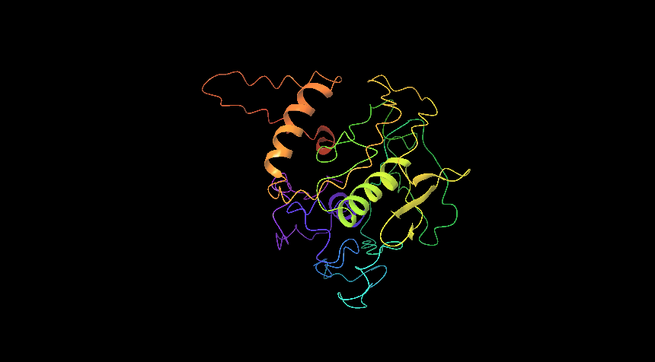
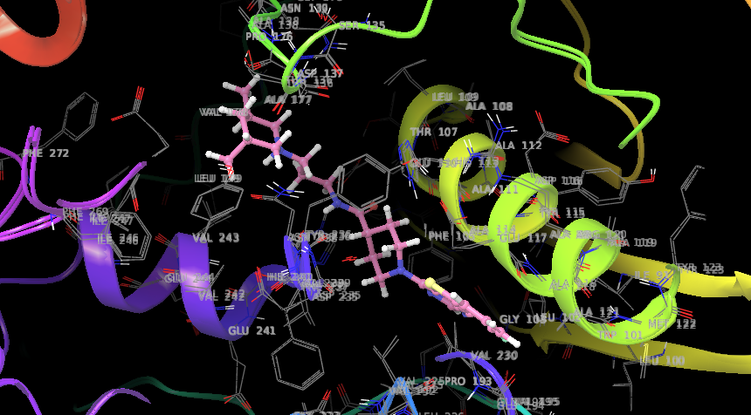
Os01g0165000
Sl no | Title | Entry ID | Docking score
1 | ZINC15673032 | 13514 | -7.708
2 | ZINC00967921 | 13515 | -7.668
3 | ZINC13481200 | 13516 | -7.667
4 | ZINC03847878 | 13517 | -7.619
5 | ZINC04234544 | 13518 | -7.565
Binding 2-[(4aS,9aR)-6-oxo-2,3,4,4a,5,8,9,9a-octahydro-1H-pyrido[4,3-d]azepin-7-yl]acetamide(ZINC15673032)
Dehydration-responsive element-binding protein 2A (Os01g0165000)

Slide 14
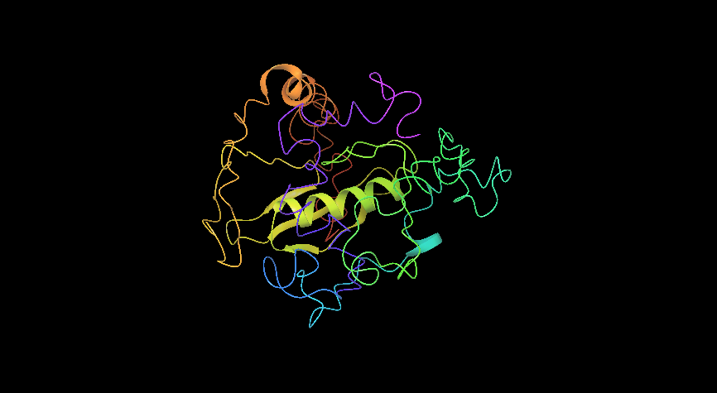
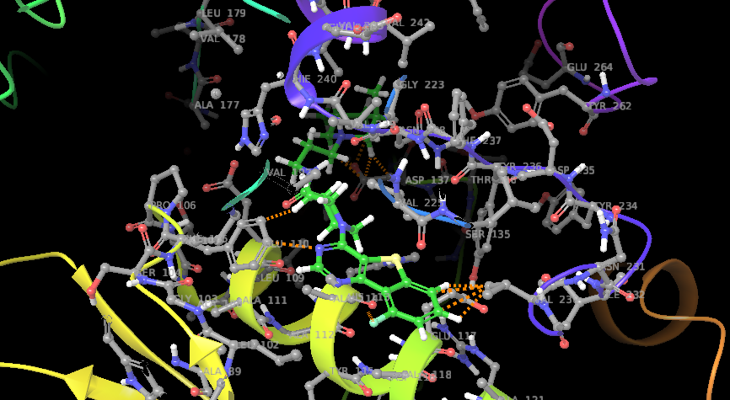
Os01g0734000
Sl no | Title | Entry ID | Docking score
1 | ZINC00142398 | 26648 | -7.547
2 | ZINC19942853 | 26649 | -7.373
3 | ZINC13543134 | 26650 | -7.365
4 | ZINC03781686 | 26651 | -7.246
5 | ZINC00039103 | 26652 | -7.115
Binding with C-(2,3-Dimethyl-1H-indol-5-yl)-methylamine(ZINC00142398)
WRKY23 (os01g0734000 )

Slide 15
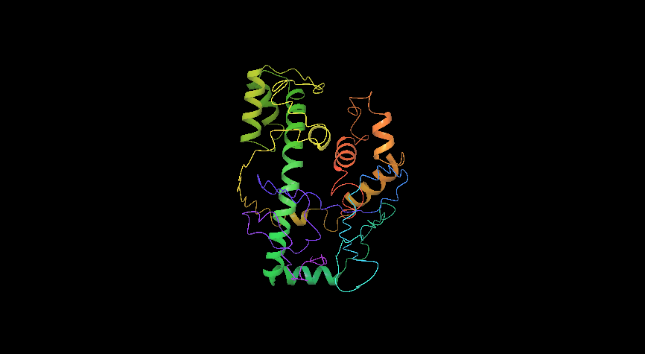
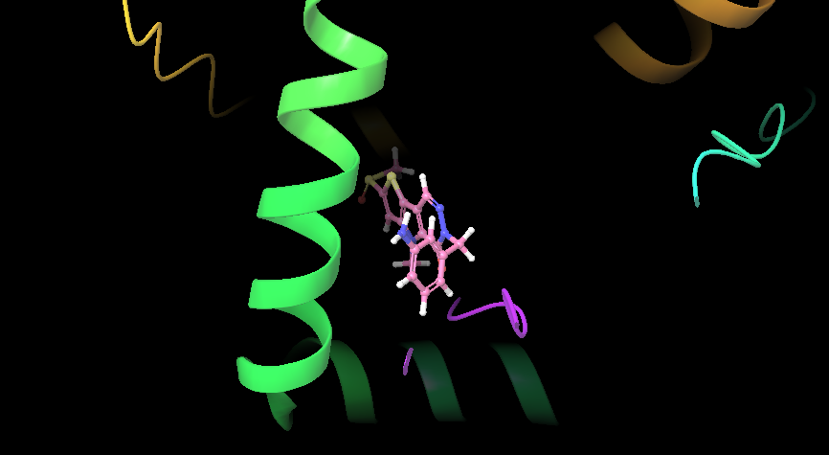
Os06g0140700
Sl no | Entry Name | Formula | Docking score
1 | ZINC00000757 | 13514 | -7.311
2 | ZINC00077278 | 13515 | -7.291
3 | ZINC04899521 | 13516 | -7.253
4 | ZINC00120144 | 13517 | -7.11
5 | ZINC14591882 | 13518 | -7.043
Binding with N,1-dimethyl-4,5,6,7-tetrahydro-1H-indazol-3-amine(ZINC00000757)
Homeobox leucine zipper protein (Os06g0140700)

Slide 16
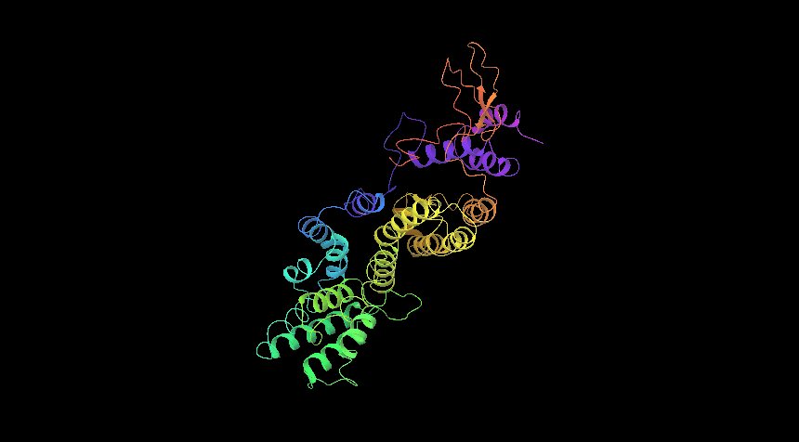
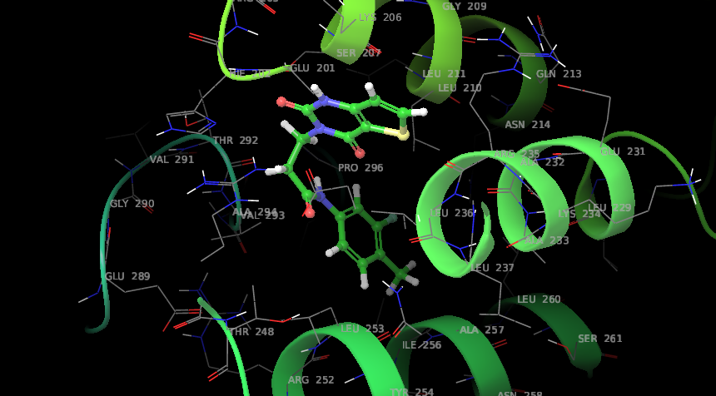
Os06g0245900
Sl no | Entry Name | Formula | Docking score
1 | ZINC00039103 | 13514 | -6.864
2 | ZINC24717761 | 13515 | -6.855
3 | ZINC06067123 | 13516 | -6.748
4 | ZINC32223363 | 13517 | -6.675
5 | ZINC00335289 | 13518 | -6.668
EF2 family transcription factor protein(Os06g0245900)
Binding 2,2',4,4'-Tetrahydroxybenzophenone (ZINC00039103)

