Slide 1

A DEEP LEARNING APPROACH TO SOLVE LINEAR PROGRAMMING PROBLEMS

Slide 2
TEAM MEMBERS
Polathala Bhavana – 230041026 Vangapally Pranava Reddy – 230041037 Veeramalla Akshay - 230041039

Slide 3
NEURAL NETWORKS
Neural networks consists of layers of interconnected nodes, or "neurons," that work together to process data, learn patterns, and make predictions
Key Components:
Neurons (Nodes): Basic units of computation that receive input, apply a transformation (usually a weighted sum and an activation function), and pass the result to the next layer.
Layers:
Input Layer : Receives the raw input data.
Hidden Layers : Intermediate layers where the actual computation takes place. Neural networks can have one or more hidden layers.
Output Layer : Produces the final result.
Weights: Each connection between neurons has an associated weight that determines the importance of the input. During training, these weights are adjusted to minimize the error in predictions.
Activation Function: A mathematical function applied to the neuron's output to introduce non-linearity, enabling the network to learn complex patterns (e.g., tanh).

Slide 4
Training Process:
Forward Propagation: The input data is passed through the network layer by layer, and the output is computed.
Loss Function: Measures how far the network's output is from the desired output.
Backpropagation: A method used to update the weights by propagating the error back through the network, using optimization techniques

Slide 5
OVERVIEW OF THE CODE
Libraries: PyTorch is used to define the neural network, optimize it, and solve differential equations; Matplotlib is used to visualize the training loss.
Constants: The problem constants (c, A, and b) define the system dynamics and constraints.
Neural Network: A 2-layer feedforward network is implemented with Tanh activation, taking a scalar input t and producing a 5-dimensional output (representing [x1, x2, x3, x4, u]).
True Dynamics: The equations for the true dynamics (dx/dt and du/dt) are derived using c, A, and b with constraints applied via torch.clamp to ensure non-negativity.

Slide 6
Loss Function: Mean Squared Error (MSE) is used to minimize the difference between the network's predicted dynamics and the true dynamics.
Optimizer: The Adam optimizer adjusts the model’s weights to reduce the loss, with a learning rate of 0.001.
Step Size: The state variables y are updated iteratively using Euler’s method, with a small step size, to approximate the solution.
Training Loop: The network is trained for 5000 iterations, updating the parameters, computing loss, and refining predictions.
Visualization: A plot of the loss over iterations is generated to monitor the training progress and convergence.

Slide 7
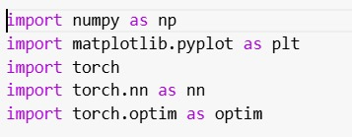
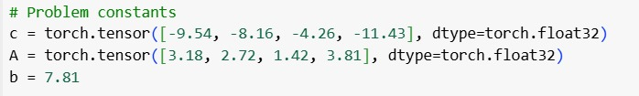

Consider the following specific LP problem
$\min_{x}$-9.54 $x_{1}$-8.16 $x_{2}$-4.26 $x_{3}$-11.43 $x_{4}$
s.t
3.18 $x_{1}$+2.72 $x_{2}$+1.42 $x_{3}$+3.81 $x_{4}$≤ 7.81
numpy: Used for numerical computations.
matplotlib.pyplot: For plotting graphs (used to visualize the loss after training).
torch: The core PyTorch library, which provides tensor computations (similar to NumPy)
torch.nn: A PyTorch module to define and use neural network layers, activation functions, and loss functions.
torch.optim: Contains optimization algorithms like SGD, Adam, etc., used for training neural networks.
These constants define the underlying differential equations that describe the dynamics of the system.

Slide 8
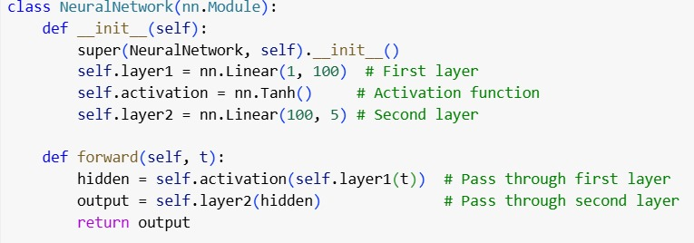
nn.Module: The base class for all neural networks in PyTorch.
self.layer1: A fully connected (linear) layer with:
Input: 1 dimension (scalar input t).
Output: 100 dimensions (hidden layer features).
self.activation: A Tanh activation function. It maps inputs to values in the range [-1, 1] and introduces non-linearity into the model.
self.layer2: Another fully connected layer with:
Input: 100 features from the hidden layer.
Output: 5 values (representing [x1, x2, x3, x4, u]).
The forward method defines how the input passes through the network:
The input t (a scalar) is passed to layer1.
The output of layer1 is transformed by the Tanh activation.
The transformed result is passed to layer2 to get the final output.

Slide 9
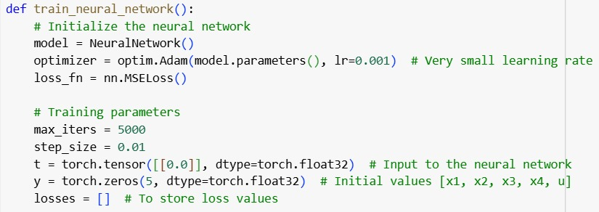
model = NeuralNetwork(): Creates an instance of the NeuralNetwork class.
optim.Adam(model.parameters(), lr=0.001): Adam optimizer is used to minimize the loss function with a learning rate of 0.001.
loss_fn = nn.MSELoss(): The Mean Squared Error (MSE) is a loss function compares the predicted dynamics (dy/dt) with the true dynamics.
max_iters: The number of training iterations (epochs).
step_size:
t: Input to the neural network, initialized to 0.0.
y: A 5-dimensional tensor representing initial values for [x1, x2, x3, x4, u].
losses: A list to store loss values for visualization.
determines how much the state variable y changes in each iteration

Slide 10
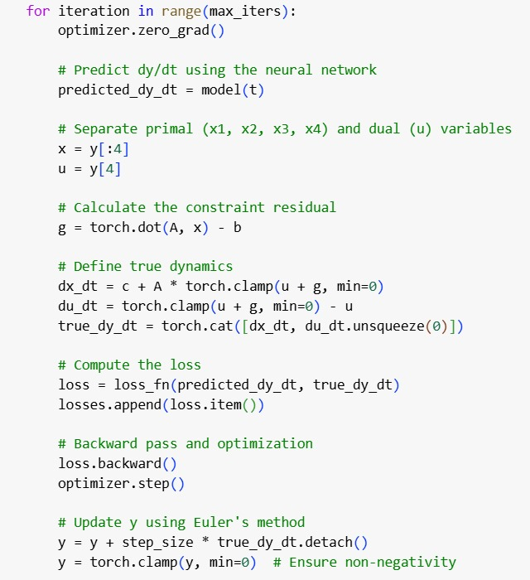
optimizer.zero_grad(): Clears gradients from the previous iteration.
predicted_dy_dt = model(t): The neural network predicts the rate of change (dy/dt) at the current time step t.
x = y[:4]: Extracts the first 4 state variables [x1, x2, x3, x4].
u = y[4]: Extracts the dual variable u.
g = torch.dot(A, x) - b: Calculates the constraint residual g, which depends on the dot product of A and x, minus b.

Slide 11
dx_dt: Defines the rate of change for the state variables.
Combines the constant c with a term proportional to A and the clamped value of (u + g).
du_dt: Defines the rate of change for the dual variable u.
Clamps (u + g) to ensure it’s non-negative, then subtracts u.
torch.cat([dx_dt, du_dt.unsqueeze(0)]): Combines dx_dt and du_dt into a single tensor representing the true dynamics.
loss_fn(predicted_dy_dt, true_dy_dt): Calculates the difference between the predicted and true dynamics.
losses.append(loss.item()): Stores the loss value for visualization later.
loss.backward(): Computes gradients for all model parameters.
optimizer.step(): Updates the model parameters using the Adam optimizer.
y = y + step_size * true_dy_dt.detach(): Updates y using Euler’s method.
torch.clamp(y, min=0): Ensures that all state variables remain non-negative.

Slide 12
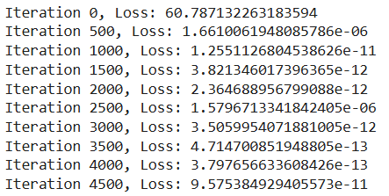
Loss values for every 500 iterations

Slide 13
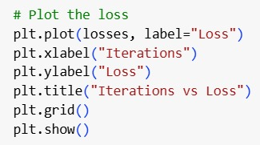

plt.plot(losses): Plots the loss values against the iteration number.
plt.xlabel, plt.ylabel, plt.title: Add labels and title for better visualization.
plt.grid(): Adds grid lines for clarity.
plt.show(): Displays the plot.
Calls the function to start training the neural network and visualize the loss.

Slide 14
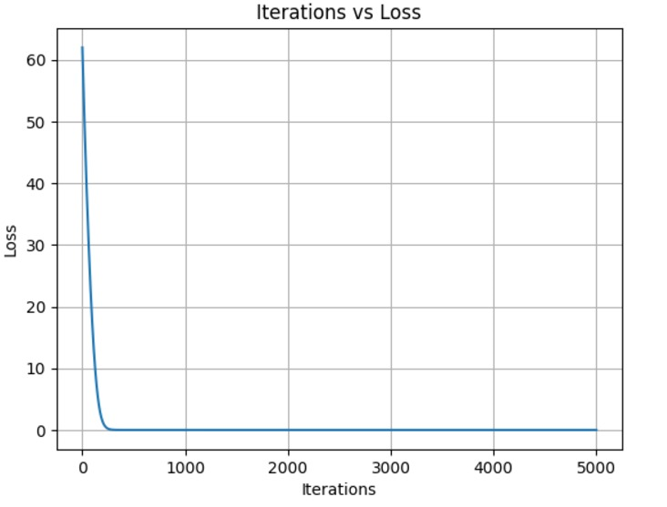
At the beginning (iteration 0), the loss is very high (around 60). This indicates the model's initial predictions are far from the true dynamics.
The near-zero loss at the end demonstrates that the neural network successfully approximated the true differential equations.
The shape of the curve indicates good optimization (Adam optimizer effectively minimized the loss), and no overfitting is evident from the graph since the loss doesn't increase after stabilizing.

Slide 15

Thank You!

