Slide 1
TARGET mailing
Team Superlatives:
Divya Jayaprakash
Akshay Venkatesh Sumant Kekre
Sainanditha Venkatesh Venkatasubramaniyan

Slide 2
DIRECT MAILING - What and Why??
Direct Mail is a form of advertising that allows businesses to communicate straight to its customers
Offer / Announcement/ Promotions sent to a physical address
People Notice (And Act On) It!!
98% of consumers bring their mail for shopping
92% of shoppers say they prefer direct mail for making purchasing decisions
Direct mail household response rate is at 5.3% (compared to .2% mobile, .1% email, .1% social media, and .02% internet display)

Slide 3
Identifying Audience – Whom to mail??
Trashers
Heavy Users
Likely Customers
Switching Clients

Slide 4
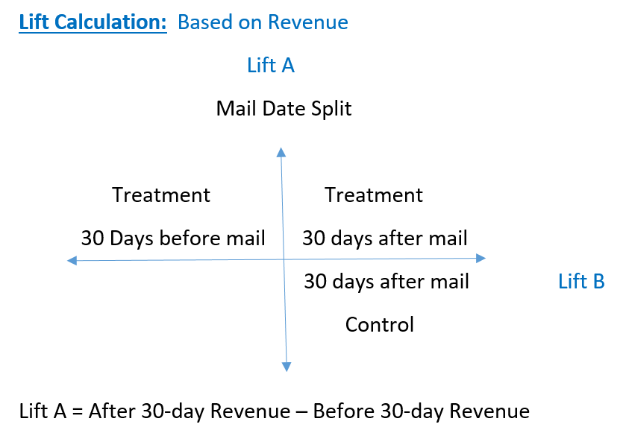
TYPE I : Before and After Promotion
What is the lift in revenue to dominos ?!!
In the 30day span after mailing when compared to
the 30day span before mailing?

Slide 5
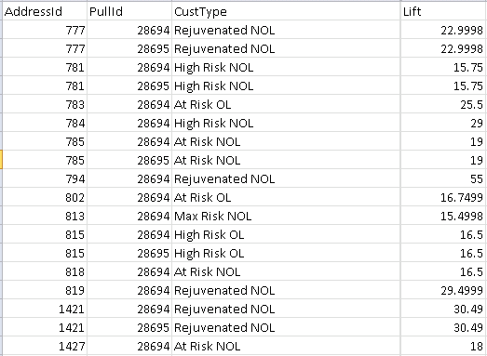
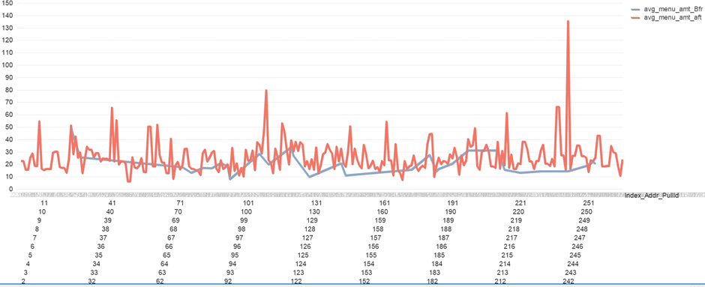
TYPE I : Before and After Promotion
People with positive lift are our interest group.
Still not a
‘respondent’!

Slide 6
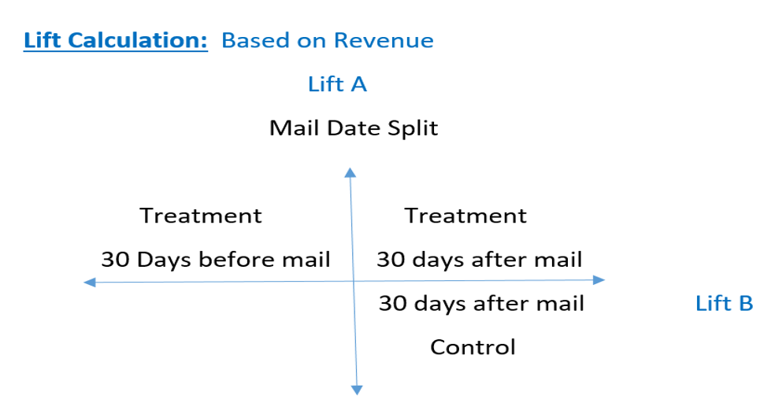

Even Had the MAIL NOT been SENT, Customer might have bought pizza !?
+ve Lift B -> Mailed person is influenced by the mail

Slide 7


TYPE II : WITH and WITHOUT Promotion
Forming Matched Control Group: ppi, household member count and date mailed & not mailed
BASKETS
1. High Earning Big Families
(PPI>Threshold PPI; Household member count > Threshold HMC)
2. High Earning Small Families
(PPI>Threshold PPI; Household member count < Threshold HMC)
3. Low Earning Big Families
(PPI<Threshold PPI; Household member count > Threshold HMC)
4. Low Earning Small Families
(PPI<Threshold PPI; Household member count < Threshold HMC)
For each date basket,
Threshold (variable) = Mean (Median of variable in Mailed Group, Median of variable in Control Group)
A Group of People mailed
on a particular date
A Group of People NOT mailed on the same date

Slide 8


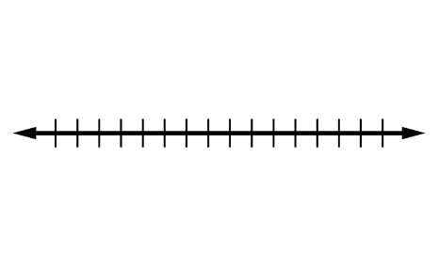
What if An address in control group today was sent a mail within next 30 days?? – No more a pure control!!
Given a (Not) Mailed Date for an individual, ensured that he did not receive a Mail within next 30 days
Small proportion of such people
Suppressed all the transactions of such address ids – to maintain RFM integrity
30 day frame After Not Mailed Date

Slide 9
NET LIFT MODEL
Marketing Campaign
Treatment
Control
Purchased
Not Purchased
Purchased
Not Purchased

Slide 10
Net lift Model of Differential Score Type: Logit
To predict response based on the incremental lift shown by a person in the presence of the mail
SCORE = P(Purchase | Offer) – P(Purchase | No offer)
Each Address Id in the Treatment group is matched to a basket in Control group based on demographics and mailed dates (to capture seasonality effects)
Logistic Regression Model to predict ‘Response’ for the merged file of Mail and Control population
The probabilities are then subtracted to get the score of each AddressId.

Slide 11
Variables Used for Regression
Demographics: PPI, Household member count, level of cooking interest, sports interest, internet usage, credit card usage
Past Buying Behaviour:
Recency Score: Based on the predefined customer type (New, Frequent, risk, Lost)
Frequency: Past 3-month time frame
Monetary: Avg. Menu Amount, past 3-month time frame
Transaction Variables: Such as Avg. Number of breads, sides and drinks ordered
Interaction Factors: ppi*number of children, ppi*lhi_cooking
Marketing spend

Slide 12
Regression
For mailed and control people,
Y – Variable:
Is_Lift = 1, Avg Menu Amt before 30 days > Avg Menu Amt before 30 days
Is_Lift = 0, Avg Menu Amt before 30 days <= Avg Menu Amt before 30 days
After coding Y-variable, Y= 0 observations are more than Y = 1 observations.
Under sampling of Y=0 stratum
Oversampling of Y=1 stratum
Identifier Variable: MC
MC = 1, Mailed Observation
MC = 0, Control Observation
Logit Model Build:
Y = X-variable+ Indicator*(X-Variables);

Slide 13
Assumptions of OUR Net Lift Model
Demographic Characteristics are same:
Matching control and Treatment on three attributes.
Mailed-Not Mailed Date, Household member count and PPI
Observable Marketing Variables are same:
Evaluating lift in below scenarios:
Before and after mail date
With and without mail (after mail date)
Other than the considered mail, they all are exposed to no promotions or same promotions.

Slide 14
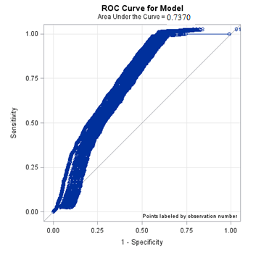
LOGIT FOR MAILED group
ROC CHARACTERISTICS
CONFUSION MATRIX
MAILED |  | Actual
Accuracy : 73.86% |  | No Response | Response
Predicted | No Response | 29428 | 33594
 | Response | 2582 | 72792
Prediction:
Then, the pool of mailed and control dataset was fed to the already built model for generating the probability of showing positive lift

Slide 15
INTERPRETATIONS
Predictor | Odds ratio Estimate
No. of adults | 0.965
Average Drinks Ordered | 1.288
Average Before – 3- month- Menu Amount | 0.884
One more adult
=> 4% decrease in positive lift
odds
1 more Drink preferred
=> 28% increase in positive lift
odds
1 more $$ spent in last 3 months
=> 12% decrease in positive lift
odds

Slide 16
INTERPRETATION : Interaction TERMS
Predictor | Odds ratio Estimate
Occupancy Count *M | 1.022
Average Recency_score*M | 0.884
One more Occupant
=> 2.2% increase in positive lift
odds
1 more point increase on Average Recency Score
=> 12% decrease in positive lift
odds

Slide 17
SCORING : BASED on incremental probability
Score = P(Positive Lift | Offer) – P(Positive Lift | No offer)
Based on this, people in every Market Sector have been ranked.
Zip Codes having 75+ address ids of positive scores have been filtered in accordance to the Postal Regulations

Slide 18
Advantages and boundaries of the Net Lift Model
ADVANTAGES
Propensity Model - Only gives the gross purchase rate after mailing
Net lift model - The incremental impact of marketing campaign
BOUNDARIES
There should be at least one basket in the control that matches with the mailed address. Only then the incremental lift can be calculated.
In any time-frame considered, an address cannot be in both mailed and the control basket
This model does not capture the nature of the mail being sent. The model can only predict response based on buying behaviour and demographics.

Slide 19
Approach II :
Running separate regressions for mailed and control
Without the interaction factor Indicator*(X-variables)
Calculated the incremental probability for each mailed person
We observed that the probability was similar to the earlier approach but little higher. No significant difference.

Slide 20
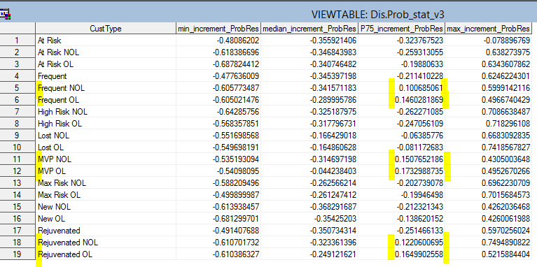
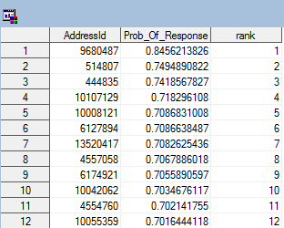
Who are our target customers?
Scoring a list Address Ids in Each Market Sector
Finding which category of customers are good respondents

Slide 21
Data Insights -which category of customers are good respondents?!
Which are the best market sectors for target mailing?
MVP (4-8 week recency)
Rejuvenated(4 week recency)
Frequent (4-8 week recency with more purchase)
Which are sectors of negligible response?
NEW OL and NEW NOL
Max Incremental Probability of Response = 0.42
75th percentile are -0.13 and -0.21

Slide 22
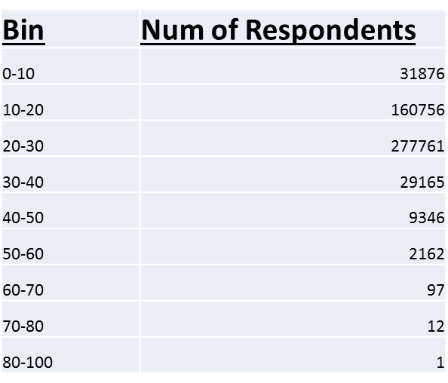
DECILE GRAPH INTERPRETATION

Slide 23
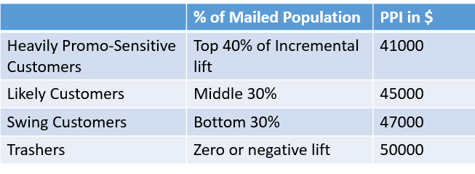

RESPONDENT CLUSTERS
Incremental Probability of Response | NET Actual Respondents
40% | 1.7%
Whilst the Risk and Rejuvenated customers are more in the first three clusters, the new , lost and High Risk customers fall in TRASHER cluster

Slide 24


Executive Summary
Address Ids that rank at the top in each market sector shall be mailed
MVP , Rejuvenated and Frequent customer sectors are sensitive to mail promotions
People with less PPI falling into these sectors shall be our special targets
We really appreciate the dramatic feet of data analysis with which we could answer the underlying marketing question of who are good mail respondents!

