Slide 1
Question Answering System using Word2Vec and GloVe
CIS 600 Applied Natural Language Processing,
Akshay Shirahatti SUID: 341001392
Rahul Parande SUID: 904792531
Yugmi Bhatt SUID: 918182440
Sakshi Sheth SUID: 703086135
Yash Patel SUID: 517958851

Slide 2
INTRODUCTION
We are developing an advanced Natural Language Processing (NLP) system tailored for the efficient retrieval of most similar answer to the asked questions. Our system integrates state-of-the-art NLP techniques to transform the way queries are answered. These techniques include
Word2Vec: Neural network-based model.
Generates high-dimensional vectors to represent words.
Captures semantic similarities between words.
GloVe (Global Vectors for Word Representation):
Combines global word co-occurrence statistics with local context.
Produces word embeddings with linear relationships.

Slide 3
SIGNIFICANCE
Our project leverages advanced NLP techniques to revolutionize information retrieval across key sectors like job recruitment, customer service, and education. Here's the impact:
Streamlined Job Applications: By integrating our system with chatbots, applicants can access instant and accurate answers about job roles, company policies, and the application process. This not only makes the job application process smoother but also more transparent.
Enhanced Customer Support: Our system rapidly provides accurate responses to frequently asked questions, greatly reducing the burden on customer support teams. This efficiency boost improves customer satisfaction by ensuring that queries are resolved quickly and accurately.
Increased Operational Efficiency: Automating the retrieval of FAQs allows businesses to handle customer inquiries without manual intervention, streamlining operations and reducing costs associated with customer service.
Improved User Experience: Fast and relevant responses enhance user engagement and retention.

Slide 4
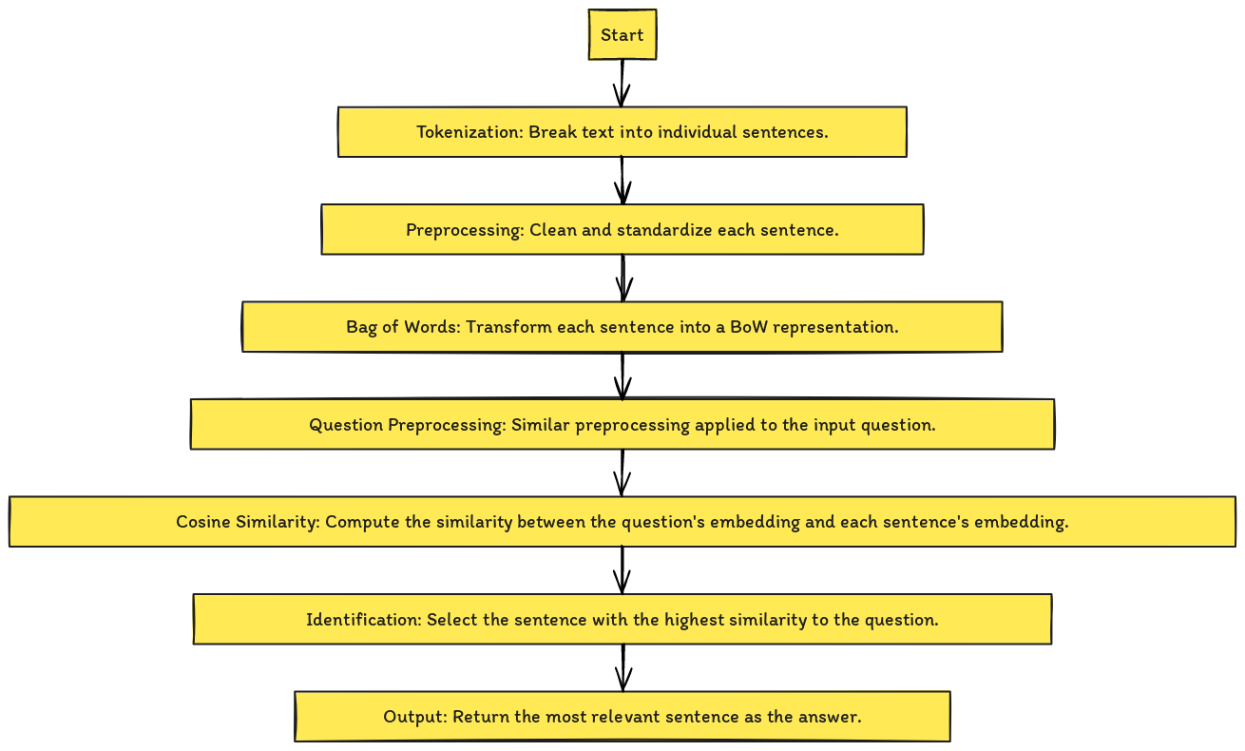
WORKFLOW

Slide 5
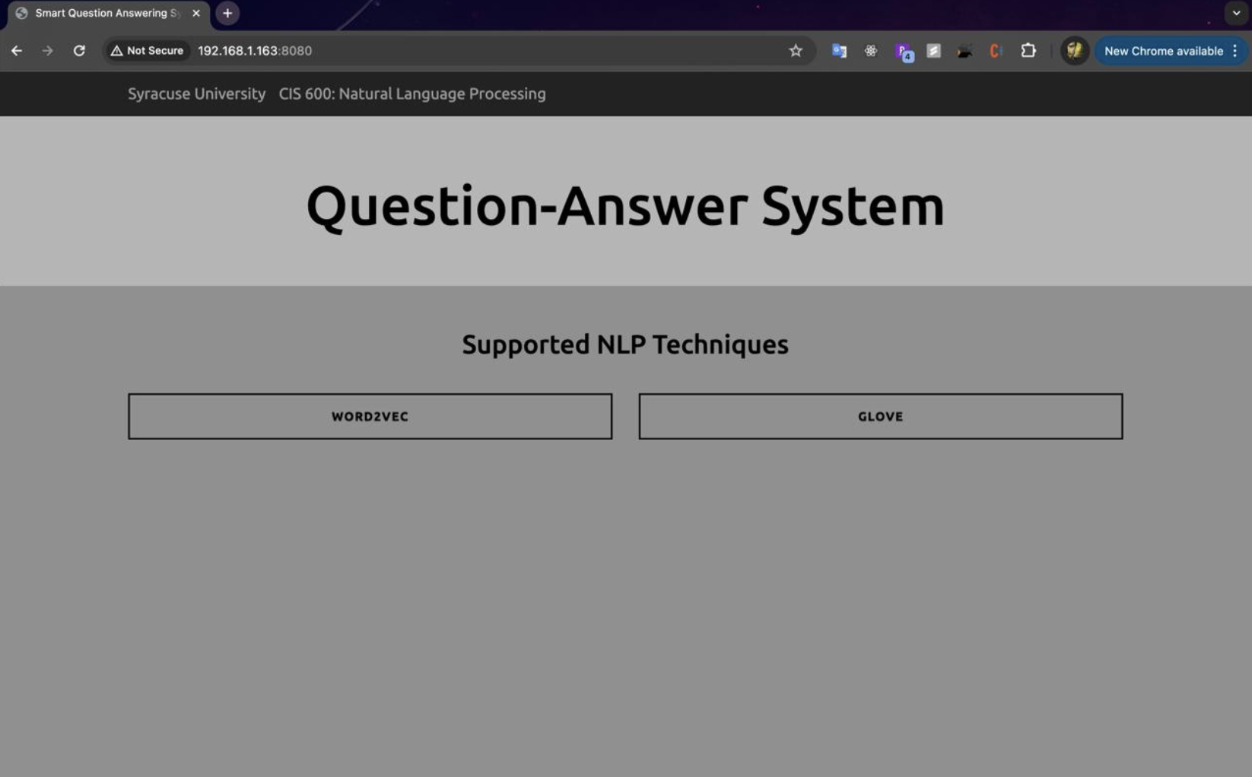
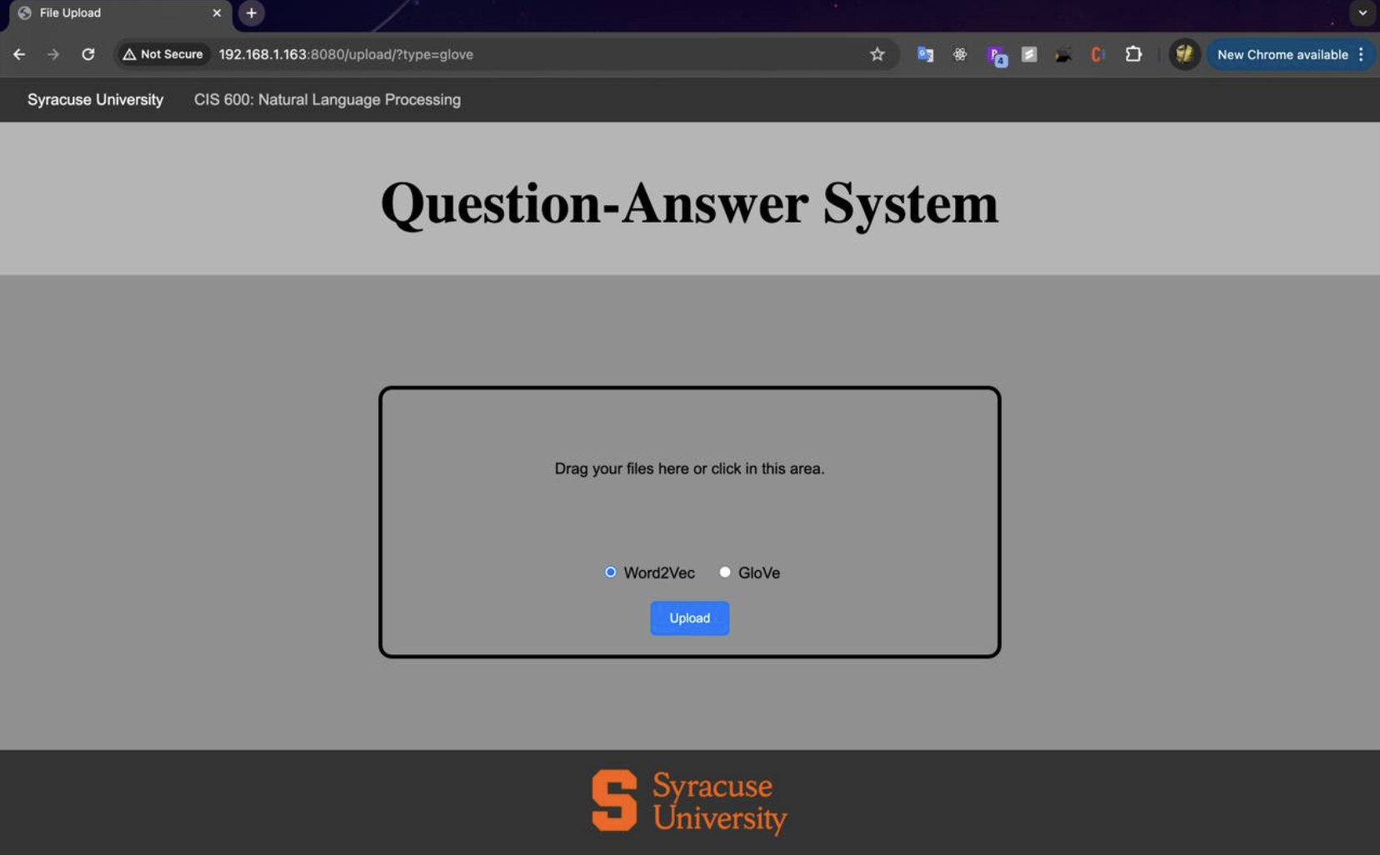
RESULTS:
We have developed a Flask application which serves as a question-answering system that allows users to upload PDF documents and ask questions about the content of those documents.

Slide 6
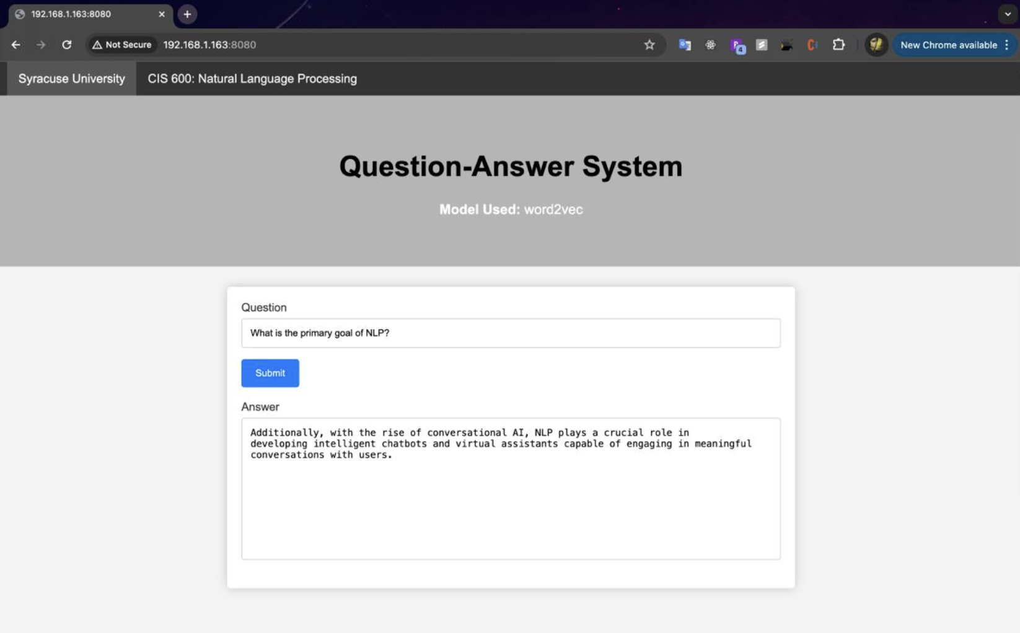
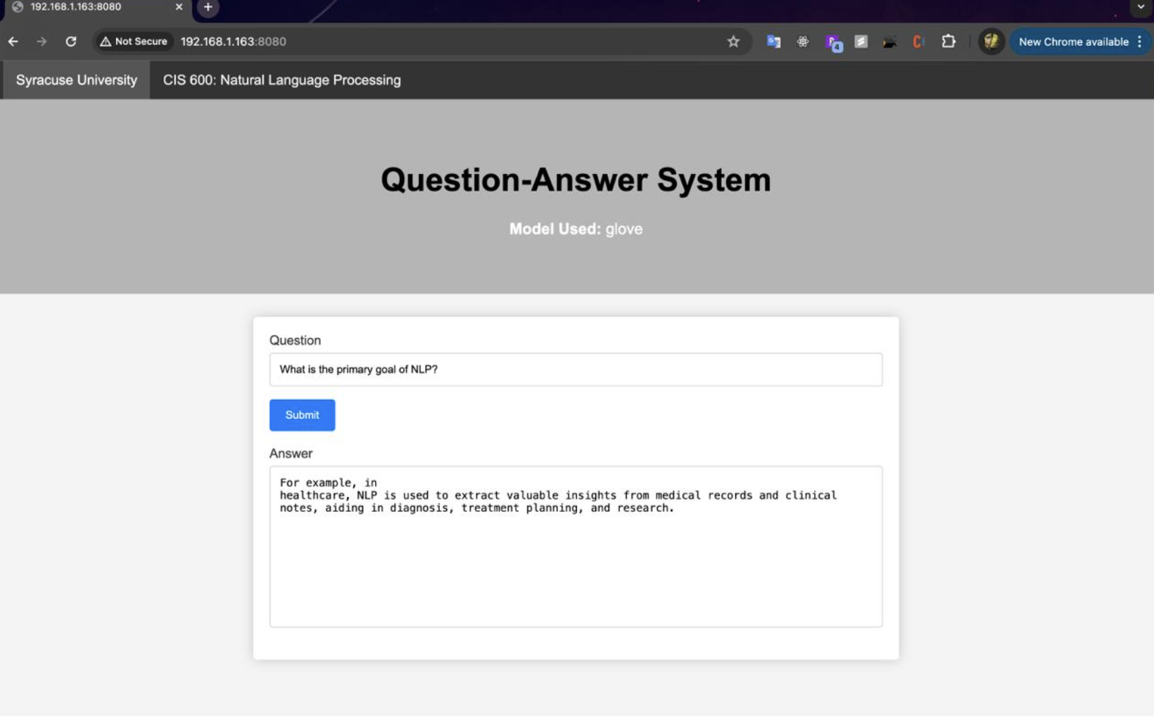
RESULTS:

Slide 7
CONCLUSION
Our project demonstrates the successful implementation of a NLP system using the Word2Vec and GloVe embedding technique for FAQ retrieval.
Through meticulous text preprocessing, word embedding, and cosine similarity calculation, we've developed a robust system capable of efficiently retrieving relevant answers to user queries from a frequently asked questions.
The project showcases the significance of NLP in automating processes, improving operational efficiency, and enhancing user experience across various domains such as job applications, customer support, and business analytics.

Slide 8
FUTURE SCOPE
Advanced Embedding Techniques: Explore advanced word embedding models such as FastText, or contextual embeddings like BERT and ELMO to enhance semantic understanding and improve the accuracy of FAQ retrieval.
Integration with Chatbots: Integrate the FAQ retrieval system with chatbot platforms to automate responses and facilitate seamless interaction with users across different communication channels, enhancing user engagement and satisfaction.
Personalization and Recommendation: Implement personalized recommendation systems based on user interactions and feedback to deliver tailored FAQ responses, enhancing user satisfaction and engagement.
Multi-modal Data Handling: Extend the system's capabilities to handle multi-modal data sources, including text, images, and audio, enabling more comprehensive and rich FAQ responses tailored to user needs.

Slide 9
THANK YOU !!

