Slide 1
INFO5100:Final Project
AIR Pollution and Health monitor system using iot
Presented by :Akshay Nakhawa(nuid 001665873)

Slide 2
Problem Statement
This project aims to use data to monitor and manage air quality of the city and also study its impact on public health. Also, provides citizens and government a real time access to pollution levels in the city.
Objectives
Provide Indoor and Outdoor Pollution Levels in different neighbor hoods of the city.
Compute indoor pollution level to resident of each house in the city.
Provide Asthma inhaler usage in the city statistics according to area and timeframe.
Provide a mechanism to curb pollution in polluted areas.

Slide 3
Proposed Solutions
A dashboard for city’s mayor to observe -
average indoor and outdoor pollution in each of the areas
Asthma Inhaler sensor usage according to area
Average vital signs according to the area
A dashboard for citizens to observe-
In house pollution levels
Personal vital sign history/Asthma Inhaler usage summary
Pollution Control Role to curb pollution by simulating sensor data samples.
Simulating sensor data through scheduler.

Slide 4
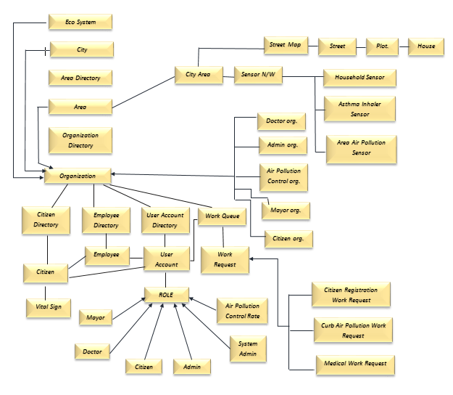
Object Model

Slide 5
Key Entities
Roles-
Mayor Role
System Admin Role
Admin Role
Air Pollution Control Role
Citizen Role
Doctor Role

Slide 6
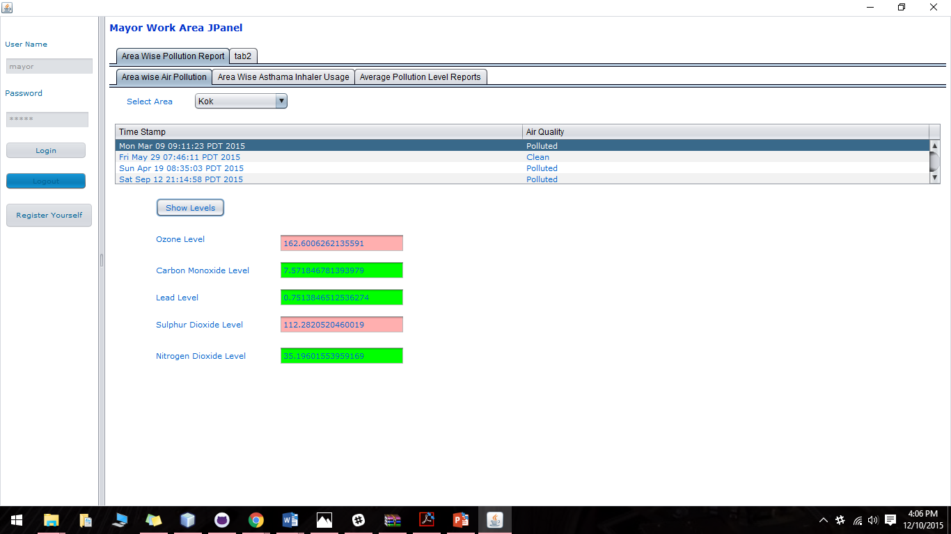

Slide 7
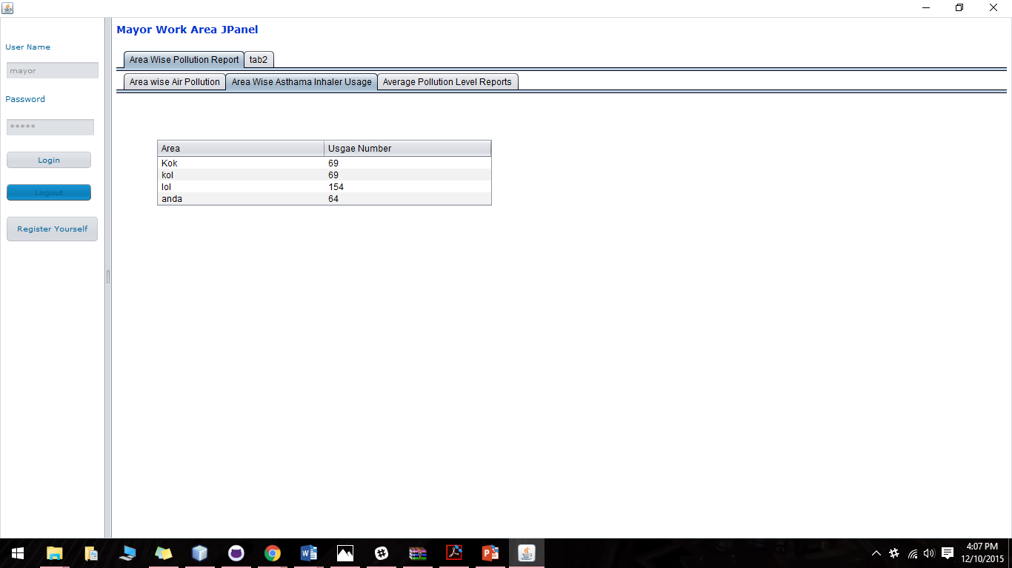

Slide 8
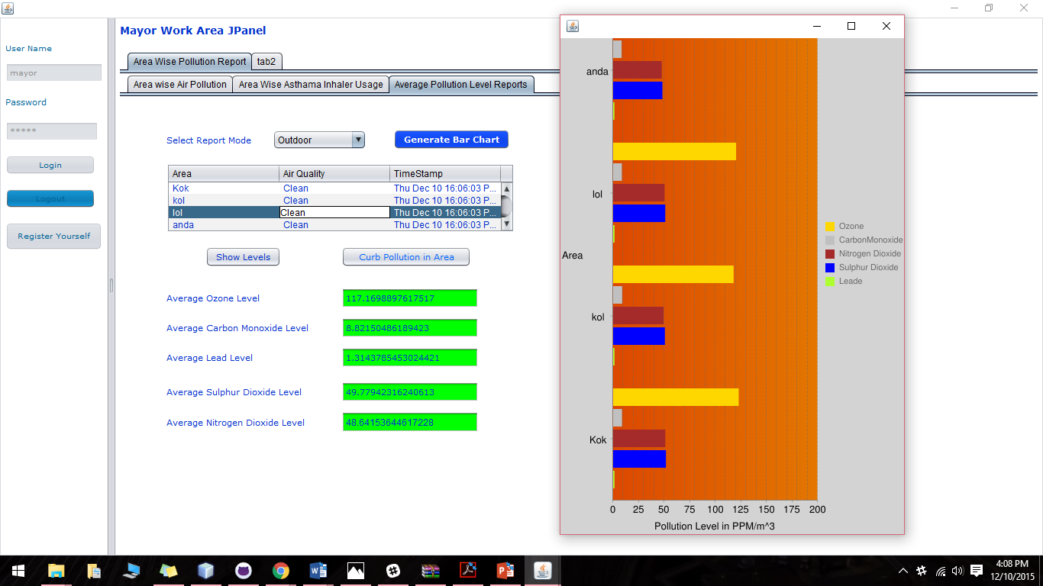

Slide 9
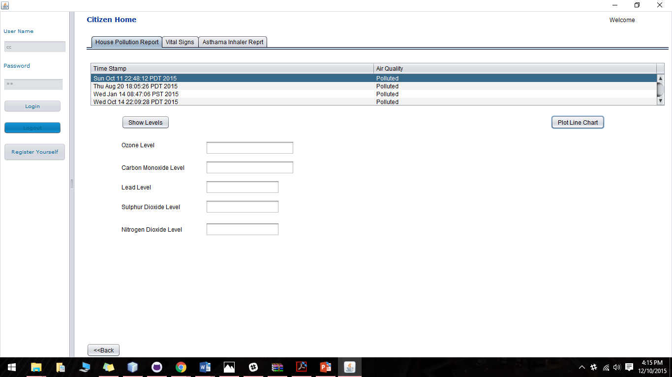

Slide 10
