Slide 1
Intro to Javascript

Slide 2
What is Javascript?
a lightweight programming language ("scripting language")
used to make web pages interactive
insert dynamic text into HTML (ex: user name)
react to events (ex: page load user click)
get information about a user's computer (ex: browser type)
perform calculations on user's computer (ex: form validation)

Slide 3
Linking to a JavaScript file: script
<script src="filename" type="text/javascript"></script> HTML
script tag should be placed in HTML page's head
script code is stored in a separate .js file
JS code can be placed directly in the HTML file's body or head (like CSS)
but this is bad style (should separate content, presentation, and behavior

Slide 4
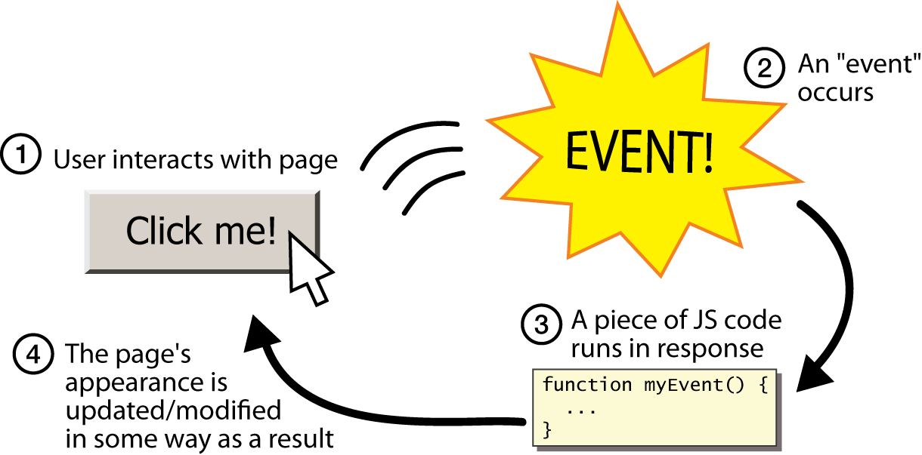
Event-driven programming
split breaks apart a string into an array using a delimiter
can also be used with regular expressions (seen later)
join merges an array into a single string, placing a delimiter between them

Slide 5
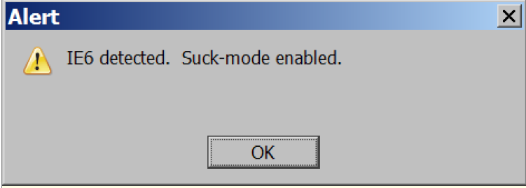
A JavaScript statement: alert
alert("IE6 detected. Suck-mode enabled."); JS
a JS command that pops up a dialog box with a message

Slide 6
Buttons
<button>Click me!</button> HTML
button's text appears inside tag; can also contain images
To make a responsive button or other UI control:
choose the control (e.g. button) and event (e.g. mouse 1. click) of interest
write a JavaScript function to run when the event occurs
attach the function to the event on the control
Notes:
Reset is not working here! Debug! test1.html

Slide 7
JavaScript functions
function name() {
statement ;
statement ;
...
statement ;
} JS
function myFunction() {
alert("Hello!");
alert("How are you?");
} JS
the above could be the contents of example.js linked to our HTML page
statements placed into functions can be evaluated in response to user events

Slide 8
Event handlers
<element attributes onclick="function();">... HTML
<button onclick="myFunction();">Click me!</button> HTML
JavaScript functions can be set as event handlers
when you interact with the element, the function will execute
onclick is just one of many event HTML attributes we'll use
but popping up an alert window is disruptive and annoying
A better user experience would be to have the message appear on the page...

Slide 9
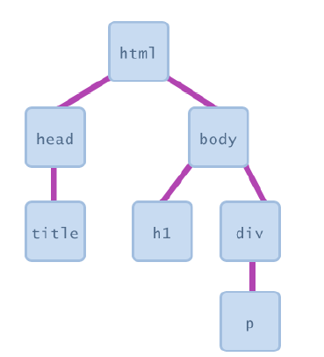
Document Object Model (DOM)
most JS code manipulates elements on an HTML page
we can examine elements' state
e.g. see whether a box is checked
we can change state
e.g. insert some new text into a div
we can change styles
e.g. make a paragraph red

Slide 10
Accessing elements: document.getElementById
var name = document.getElementById("id");
JS
<button onclick="changeText();">Click me!</button>
<span id="output">replace me</span>
<input id="textbox" type="text" /> HTML
function changeText() {
var span = document.getElementById("output");
var textBox = document.getElementById("textbox");
textbox.style.color = "red";
} JS
Notes:
span.innerHTML = textBox.value;

Slide 11
Accessing elements: document.getElementById
document.getElementById returns the DOM object for an element with a given id
can change the text inside most elements by setting the innerHTML property
can change the text in form controls by setting the value property

Slide 12
Changing element style: element.style
Attribute | Property or style object
color | color
padding | padding
background-color | backgroundColor
border-top-width | borderTopWidth
Font size | fontSize
Font famiy | fontFamily

Slide 13
Variables
var name = expression; JS
var clientName = "Connie Client";
var age = 32;
var weight = 127.4; JS
variables are declared with the var keyword (case sensitive)
types are not specified, but JS does have types ("loosely typed")
Number, Boolean, String, Array, Object, Function, Null, Undefined
can find out a variable's type by calling typeof

Slide 14
Number type
var enrollment = 99;
var medianGrade = 2.8;
var credits = 5 + 4 + (2 * 3); JS
integers and real numbers are the same type (no int vs. double)
same operators: + - * / % ++ -- = += -= *= /= %=
similar precedence to Java
many operators auto-convert types: "2" * 3 is 6

Slide 15
Comments (same as Java)
// single-line comment
/* multi-line comment */ JS
identical to Java's comment syntax
recall: 4 comment syntaxes
HTML: <!-- comment -->
CSS/JS/PHP: /* comment */
Java/JS/PHP: // comment
PHP: # comment

Slide 16
Special values: null and undefined
var ned = null;
var benson = 9;
// at this point in the code,
// ned is null
// benson's 9
// caroline is undefined JS
undefined : has not been declared, does not exist
null : exists, but was specifically assigned an empty or null value
Why does JavaScript have both of these?

Slide 17
if/else statement (same as Java)
if (condition) {
statements;
} else if (condition) {
statements;
} else {
statements;
}
JS
identical structure to Java's if/else statement
JavaScript allows almost anything as a condition

Slide 18
for loop (same as Java)
var sum = 0;
for (var i = 0; i < 100; i++) {
sum = sum + i;
} JS
var s1 = "hello";
var s2 = "";
for (var i = 0; i < s.length; i++) {
s2 += s1.charAt(i) + s1.charAt(i);
}
// s2 stores "hheelllloo" JS

Slide 19
while loops (same as Java)
while (condition) {
statements;
} JS
do {
statements;
} while (condition); JS
break and continue keywords also behave as in Java

Slide 20
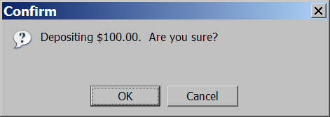
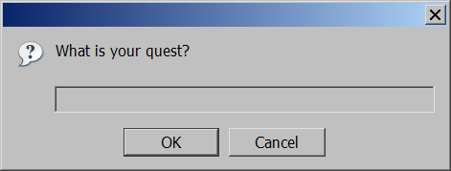
Popup boxes
alert("message"); // message
confirm("message"); // returns true or false
prompt("message"); // returns user input string JS

Slide 21
Arrays
var name = []; // empty array
var name = [value, value, ..., value]; // pre-filled
name[index] = value; // store element JS
var ducks = ["Huey", "Dewey", "Louie"];
var stooges = []; // stooges.length is 0
stooges[0] = "Larry"; // stooges.length is 1
stooges[1] = "Moe"; // stooges.length is 2
stooges[4] = "Curly"; // stooges.length is 5
stooges[4] = "Shemp"; // stooges.length is 5 JS
Notes:
two ways to initialize an array
length property (grows as needed when elements are added)

Slide 22
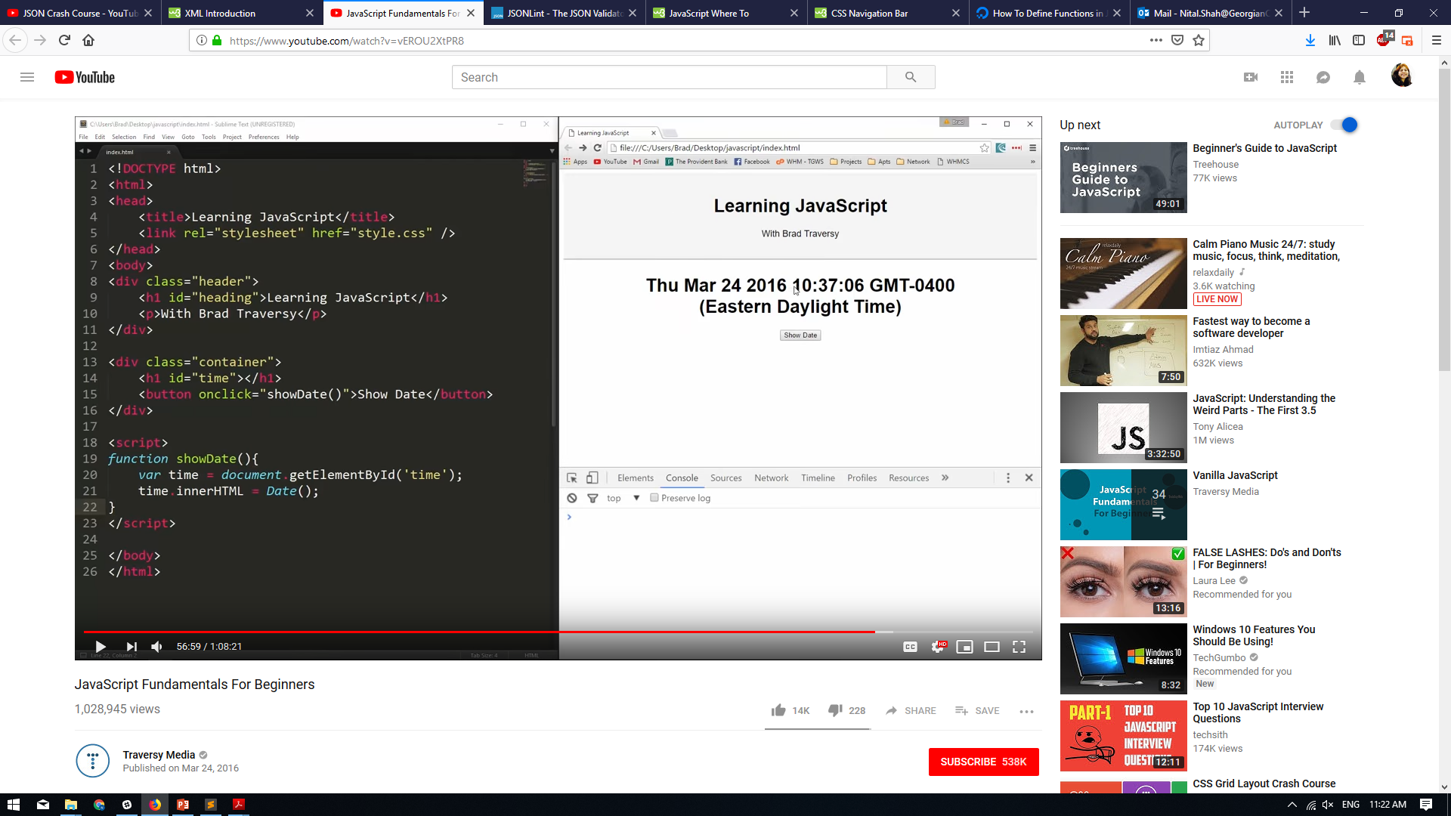
The innerHTML property returns the HTML content (inner HTML) of an element.

