Slide 1

PS11 | DATA SCIENCE & ANALYTICS
Reorder list | illustrative
StockSense
Milk
Order 38 L
CRITICAL
Bread
Order 30 pcs
HIGH
The Right Stock. At the Right Time.
Biscuits
Order 3 packs
HIGH
AI-Powered Demand Forecasting & Smart Reordering for Small Retailers
Rice
Order 10 kg
MEDIUM
Cooking Oil
Order 0 L
LOW
Problem Statement: PS11
Domain: Data Science & Analytics
Team: Nexora
Abirami T, Banumathi M, Akshaya B, Abishri M
Notes:
1

Slide 2
Every Wrong Order Costs Money
Small retailers order from memory, intuition or basic sales records, not data.
Fast mover: Milk
Slow mover: Biscuits
EMPTY SHELF: lost sales, lost customers
EXCESS STOCK: cash locked, expiry risk
1
Stockouts
2
Overstocking
3
Expiry risk
Fast movers run out before the next delivery.
Slow movers tie up working capital.
Short-life items expire before they sell.
Notes:
2

Slide 3
Meet StockSense
1
2
3
4
5
Inputs
Data processing
Demand forecasting
Inventory risk
Ranked reorder list
›
›
›
›
Sales history
Current stock
Lead time
Shelf life
Clean and aggregate
Flag outliers
Product-level demand over lead time
Usable and incoming stock
Expiry, stockout
Quantity and priority per product
Key outputs
Predicted demand until next delivery
Recommended reorder quantity
Urgency and stockout risk
Shelf-life and expiry warnings
Prioritised purchasing list
Notes:
3

Slide 4
From Raw Sales Data to Smarter Decisions
1
2
3
4
DATA INPUT
DATA PREPARATION
DEMAND FORECAST
REORDER OPTIMIZATION
Upload sales CSV (product, date, quantity, price). Enter stock, lead time and shelf life.
Fix missing values, aggregate by product and day, flag unusual spikes.
Estimate demand over the lead-time window with baseline methods; compare models where data allows.
Compare demand with usable and incoming stock, apply shelf-life limits, size orders, rank by urgency.
CSV
Clean
Forecast
Rank
Notes:
4

Slide 5
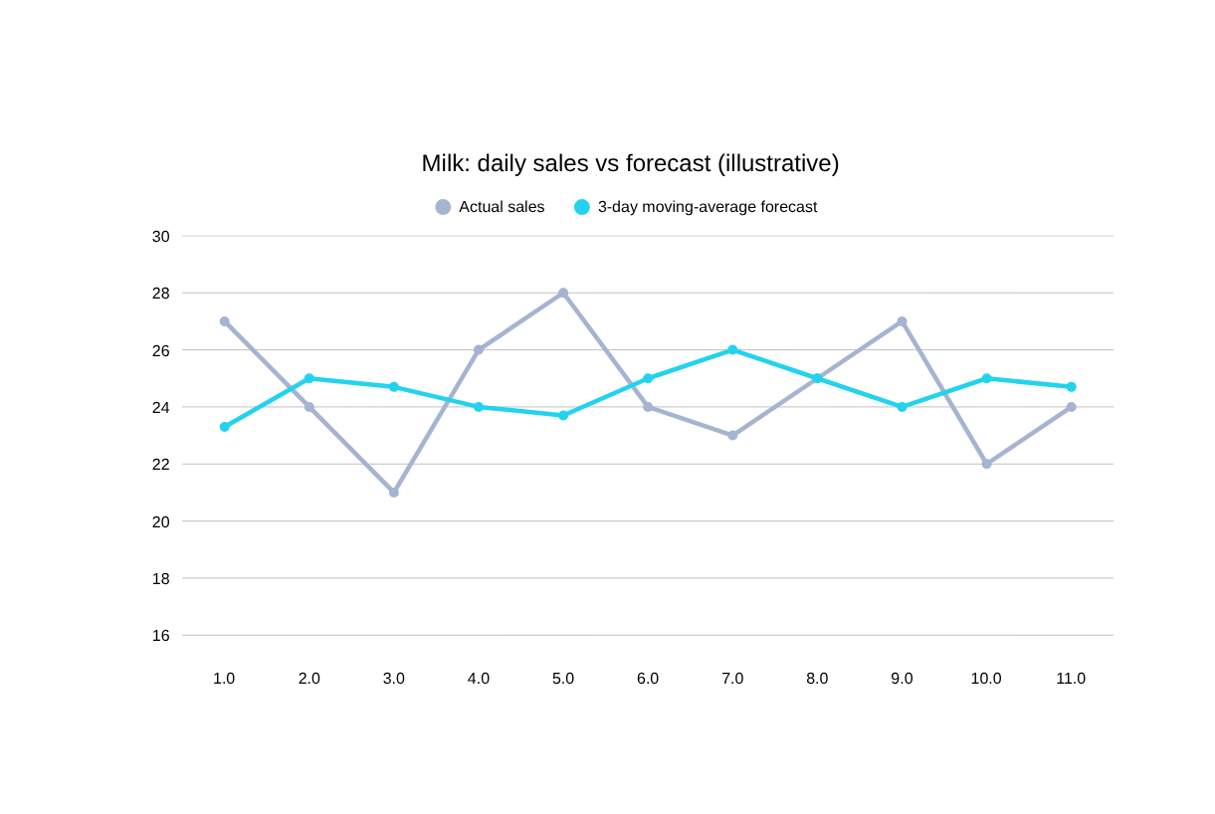
Forecast Demand. Optimize Every Order
Core formulas
Lead-time demand = daily forecast x lead time
Target stock = demand over (lead time + review period) + safety stock
Order = max(0, target - usable stock - incoming stock)
Validate with MAE / WAPE on held-out days. Start with moving-average or seasonal-naive baselines; use advanced models only when data supports them.
Notes:
5

Slide 6
Not Just Predictions. Clear Decisions
Product | Current Stock | Forecast Demand | Lead Time | Recommended Order | Priority | Warning
Milk | 18 L | 48 L | 1 day | 38 L | Critical | Stockout before delivery
Bread | 60 pcs | 90 pcs | 1 day | 30 pcs | High | Capped by 2-day shelf life
Biscuits | 55 packs | 80 packs | 2 days | 35 packs | High | Cover under 4 days
Rice | 170 kg | 150 kg | 3 days | 10 kg | Medium | Small top-up
Cooking Oil | 105 L | 84 L | 4 days | 0 L | Low | No order needed
Notes:
6

Slide 7
Beyond Basic Inventory Tracking
Capability | Manual ordering | Basic inventory software | StockSense
Historical sales analysis | - | ✓ | ✓
Product-level demand forecasting | - | - | ✓
Lead-time-aware reorder advice | - | - | ✓
Shelf-life-aware quantity planning | - | - | ✓
Ranked purchase priorities | - | Basic alerts | ✓
Actionable order quantities | - | Partial | ✓
Seasonal and advanced models | - | - | Planned
Notes:
7

Slide 8
Built for Practical Retail Intelligence
Retailer
Web dashboard
Flask backend
Forecasting engine
Optimization module
Ranked results
›
›
›
›
›
Prototype scope
Proposed future integrations
  CSV upload and validation
  Configurable stock, lead time, shelf life
  Forecast generation (Pandas, NumPy baselines)
  Ranked reorder table with CSV download
  SQLite local storage
  POS and billing data sync
  Supplier ordering portals
  Cloud database, multi-user access
  Advanced time-series models
Python
Pandas / NumPy
Scikit-learn
Flask
SQLite
HTML / CSS / JS
Plotly
8
Notes:
8

Slide 9
Turning Better Predictions into Better Decisions
Validation plan
FORECAST ERROR
STOCKOUT RATE
  Predict held-out historical sales
  Measure forecast error (MAE / WAPE)
  Compare recommended orders with historical stock outcomes
  Track stockouts, excess stock, expiry waste, cost
  Test across product categories and demand patterns
WAPE / MAE
Fewer stockouts
Planned evaluation
Planned evaluation
EXPIRY WASTE
INVENTORY TURNOVER
Less waste
Faster turns
Planned evaluation
Planned evaluation
9
Notes:
9

Slide 10
Make Every Reorder Count
  Predict product demand
  Calculate practical reorder quantities
  Respect delivery times and shelf life
  Prioritise with transparent risk signals
Reorder list | illustrative
Milk
Order 38 L
CRITICAL
Bread
Order 30 pcs
HIGH
Phase 1
Phase 2
Phase 3
Phase 4
CSV forecasting and reorder list
Seasonality and supplier constraints
POS integration, budget-aware ordering
Multi-store analytics, advanced models
Thank You | Team Nexora
10
Notes:
10

