Slide 1
BLUE STOCK FINTECH
Indian Mutual Fund Industry
Analysis & Business Intelligence Capstone
Final Presentation — ETL, Analytics & Power BI Dashboard
Akshay
Data Analyst Intern — Bluestock Fintech
Team: Ayashvardhan793, Mohangowtham124
BLUE STOCK FINTECH | Mutual Fund Analysis Capstone
1

Slide 2
THE BRIEF
Problem & Objective
The Problem
The Objective
India's mutual fund industry spans 40+ schemes across 10 fund houses with no single, unified view of performance, risk, and investor behaviour.
Investors and analysts need to compare funds on more than headline returns — risk-adjusted performance, drawdown, and cost all matter.
Raw scheme codes and category labels can go stale as SEBI regulation evolves (e.g. the 2018 recategorization), creating silent data-quality risk.
Build a clean, validated star-schema pipeline from 10 raw sources to a single analytical database.
Quantify performance and risk for all 40 schemes: CAGR, Sharpe, Sortino, Alpha/Beta, VaR/CVaR, max drawdown, and a composite Fund Score.
Deliver a self-serve, four-page Power BI dashboard so stakeholders can explore industry, performance, and investor trends without touching code.
BLUE STOCK FINTECH | Mutual Fund Analysis Capstone
2

Slide 3
FOUNDATIONS
Data Sources
A synthetic dataset of 40 schemes, deliberately calibrated against real AMFI industry benchmarks — directionally realistic at the aggregate level.
AMFI
mfapi.in
Synthetic Generator
Benchmark Indices
Industry benchmark calibration — SIP inflows, folio counts, category classifications
Live/historical NAV data-fetch API used during ETL for scheme-level NAV history
~33,000 investors: SIP / lumpsum / redemption transactions, demographics, geography
Nifty 50, Nifty 100, category benchmarks for relative performance & Alpha/Beta
Scope: 40 schemes (Equity + Debt) • ~4.4 years NAV history • 12 states, T30/B30 city tiers • 2022–2026
BLUE STOCK FINTECH | Mutual Fund Analysis Capstone
3

Slide 4
PIPELINE
Architecture
10 Raw CSV
Sources
Clean &
Transform
Star Schema
SQLite DB
Analytics &
Power BI
NAV, transactions,
fund master, industry metrics
pandas: null/dupe checks,
AMFI code standardisation
bluestock_mf.db
dim_fund, dim_date + 3 facts
EDA, performance/risk
metrics, 4-page dashboard
Star Schema Detail
Validation Layer
dim_fund — AMFI code, scheme, house, category, plan, risk
dim_date — single shared calendar table across all facts
fact_nav, fact_transactions, fact_industry_metrics
10 SQL queries against the schema, incl. a CTE + LAG() window function for period-over-period AUM change
Cross-checked independently against the pandas EDA phase
BLUE STOCK FINTECH | Mutual Fund Analysis Capstone
4

Slide 5
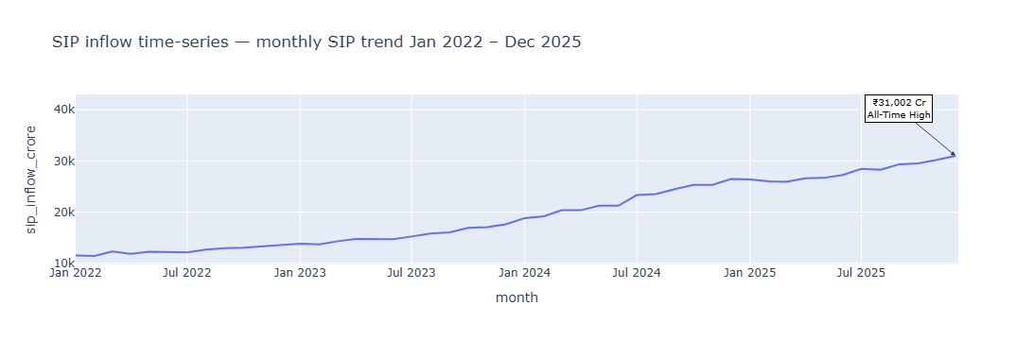
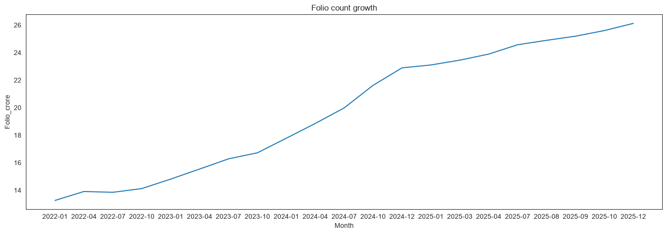
EXPLORATORY ANALYSIS • 1 OF 2
Industry Growth Signals
₹31,002 Cr
Monthly SIP inflow all-time high (Dec 2025) — nearly tripled from ~₹11,000 Cr in Jan 2022, with no major reversals.
26.12 Cr
Investor folios by Dec 2025 — nearly double the 13.26 Cr recorded in Jan 2022, with growth accelerating sharply from mid-2024.
SBI MF leads AUM every year 2022–25, ~1.3x the next-largest house (ICICI Prudential).
BLUE STOCK FINTECH | Mutual Fund Analysis Capstone
5

Slide 6
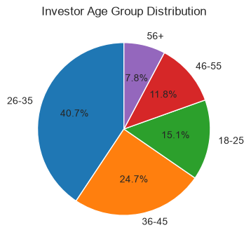
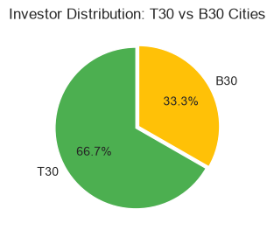
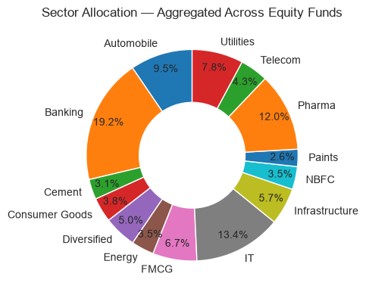
EXPLORATORY ANALYSIS • 2 OF 2
Who Invests, and Where
26–35 age group dominates (40.7%); SIP medians are similar across ages, but high-value outliers (₹40k–60k) appear in every group.
T30 metro cities hold 66.7% of investors vs. 33.3% B30 — penetration is still metro-concentrated.
Banking (19.2%), IT (13.4%) and Pharma (12.0%) make up nearly 45% of aggregated equity holdings.
66.7%
of investors are in T30 metro cities
BLUE STOCK FINTECH | Mutual Fund Analysis Capstone
6

Slide 7
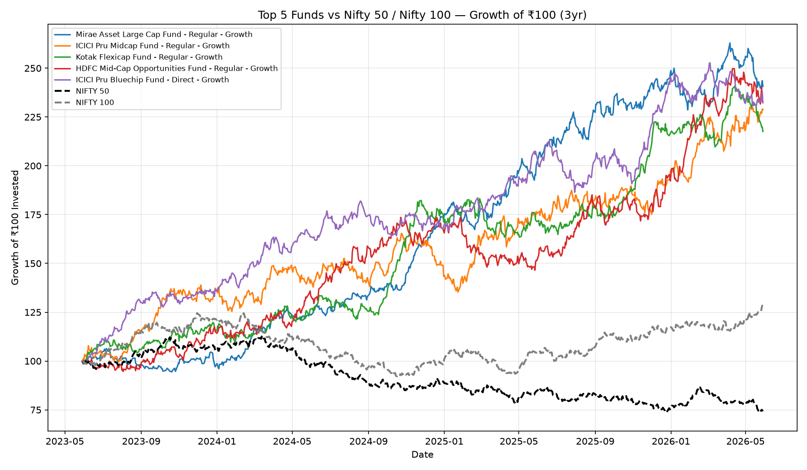
PERFORMANCE ANALYTICS • 1 OF 2
Top-Ranked Funds by Composite Score
Fund Score blends CAGR, Sharpe ratio, Alpha, expense ratio & max drawdown into one 0–100 ranking.
Rank | Scheme | 3yr CAGR | Sharpe | Max DD | Score
1 | Mirae Asset Large Cap Fund | 34.0% | 1.46 | -11.3% | 86.25
2 | ICICI Pru Midcap Fund | 31.8% | 1.19 | -18.2% | 82.25
3 | Kotak Flexicap Fund | 29.6% | 1.32 | -13.0% | 82.00
4 | HDFC Mid-Cap Opportunities Fund | 32.4% | 1.10 | -16.2% | 80.75
5 | ICICI Pru Bluechip Fund (Direct) | 32.5% | 1.04 | -12.6% | 80.00
Top 5 funds vs. Nifty 50 / Nifty 100 — all five outperformed both benchmarks over the 3-year window.
Note: Beta values cluster near zero across all 40 schemes — a known artifact of the synthetic data generation, not a real-market signal.
BLUE STOCK FINTECH | Mutual Fund Analysis Capstone
7

Slide 8
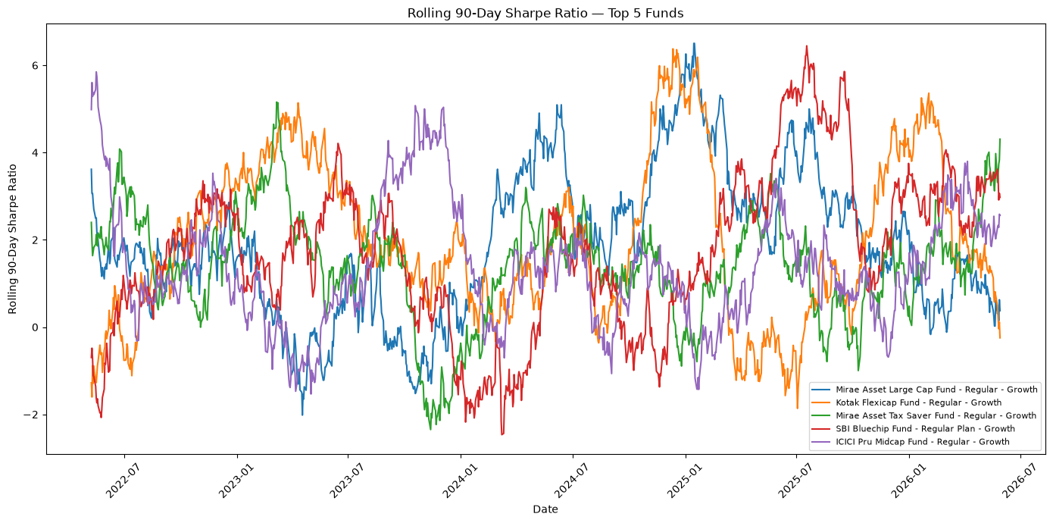
PERFORMANCE ANALYTICS • 2 OF 2
Risk: Drawdown, VaR & Rolling Sharpe
-52.6%
Largest max drawdown (SBI Small Cap Fund) — the 5 worst drawdowns in the dataset are all Small Cap equity schemes.
-2.69% / -3.24%
95% daily VaR / CVaR, SBI Small Cap Fund (Direct) — highest downside risk of all 40 schemes, consistent with its own “Very High” risk tag.
Rolling 90-day Sharpe ratio, top 5 funds — a cyclical, wave-like pattern (roughly -2 to +6) rather than a single sustained trend.
Debt/liquid schemes sit at the opposite extreme: Kotak Liquid Fund and ICICI Pru Liquid Fund both show max drawdown under -0.15%.
BLUE STOCK FINTECH | Mutual Fund Analysis Capstone
8

Slide 9
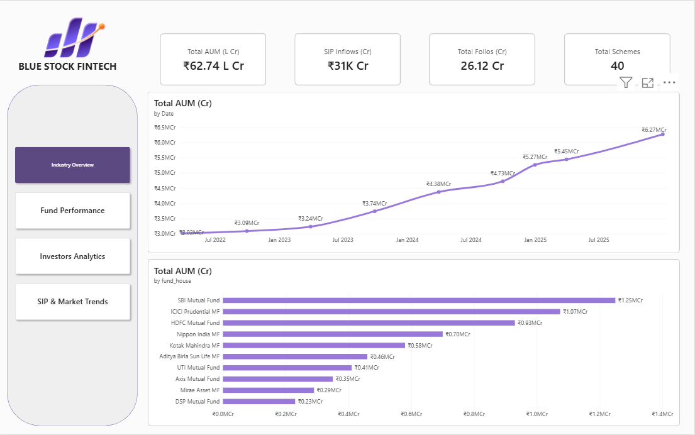
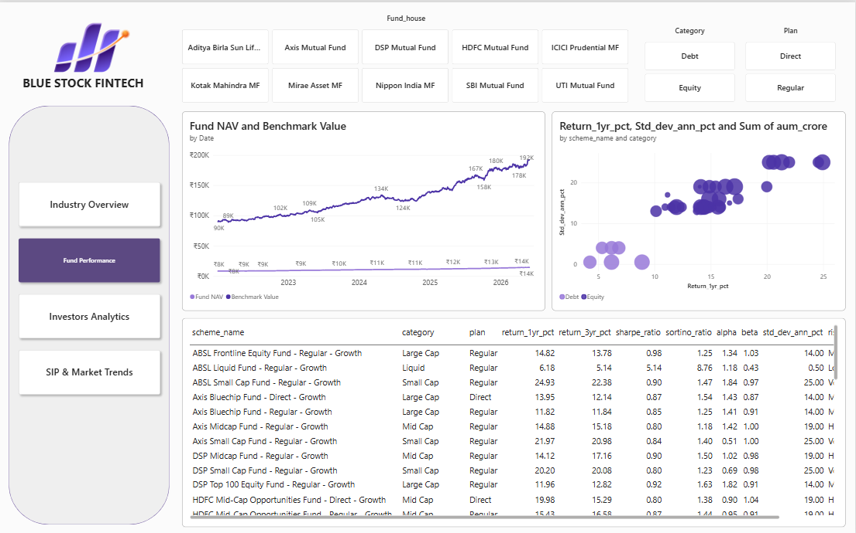
POWER BI DASHBOARD • 1 OF 2
Industry Overview & Fund Performance
Page 1 — Industry Overview
Page 2 — Fund Performance
₹62.74 L Cr AUM • ₹31K Cr SIP inflows • 26.12 Cr folios • 40 schemes — plus an interactive risk/return scatter and full scheme-level metrics table, built on a single shared dim_date model.
BLUE STOCK FINTECH | Mutual Fund Analysis Capstone
9

Slide 10
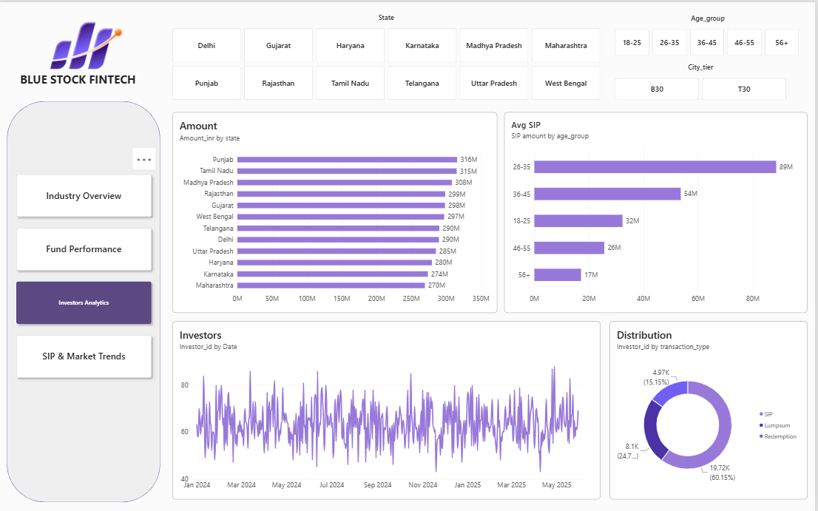
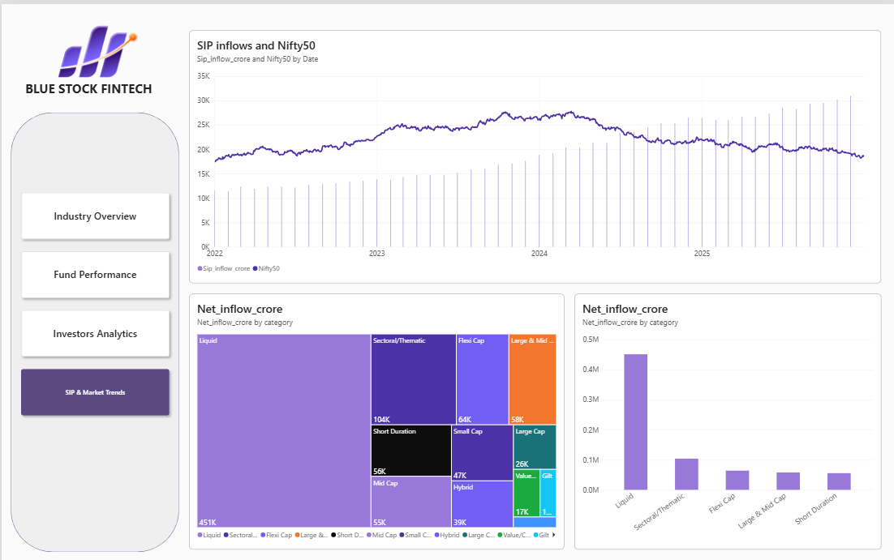
POWER BI DASHBOARD • 2 OF 2
Investor Analytics & SIP / Market Trends
Page 3 — Investor Analytics
Page 4 — SIP & Market Trends
State, age-group and city-tier slicers drive investor demographics; a combined SIP-inflow-vs-Nifty-50 view and category net-inflow charts confirm Liquid funds dominate inflows industry-wide.
BLUE STOCK FINTECH | Mutual Fund Analysis Capstone
10

Slide 11
BRINGING IT TOGETHER
Key Findings
01
02
03
Mirae Asset Large Cap Fund leads
Small caps carry outsized risk
Liquid funds dominate inflows
Score 86.25/100 — 34.0% 3yr CAGR, 1.46 Sharpe, contained -11.3% drawdown.
All 5 largest drawdowns (to -52.6%) and highest VaR/CVaR are Small Cap schemes.
4–8x every other category, every month, in the Apr 2024–Mar 2025 window.
04
05
06
SIPs & folios nearly tripled / doubled
Metro concentration persists
SEBI 2018 recategorization caught early
₹11K→₹31K Cr monthly SIP; 13.26→26.12 Cr folios, 2022–2025.
T30 cities hold 66.7% of investors despite SEBI's B30 push.
5 of 6 supplied scheme codes were pre-2018 names — flagged to mentor.
BLUE STOCK FINTECH | Mutual Fund Analysis Capstone
11

Slide 12
Thank You
Questions & discussion welcome.
Akshay — Data Analyst Intern, Bluestock Fintech
github.com/aksheyei/Mutual-Fund-Analysis
BLUE STOCK FINTECH | Mutual Fund Analysis Capstone
12

