Slide 1
CS 331 COMPUTER NETWORKS · 2026-27 SEMESTER 1 · PROJECT 16
Mini-Katran: High-Performance L4 Load Balancing with eBPF and XDP
A small load balancer that runs inside the Linux kernel, compared with the usual user-space way
Team T020
Akshit Chhabra (24110026) · Bhavay Goyal (24110070) · Devarshi Savalgi (24110103) · Kunal Chandola (24110176)
September 2026

Slide 2
Problem Statement & Objectives
The problem
Objectives (from the brief)
• A load balancer takes traffic sent to one public address (the VIP) and spreads it over several backend servers.
• All packets of one TCP connection must keep going to the same backend.
• A load balancer written as a normal program only sees a packet after the kernel has processed it and copied it to user space. At 10 Gbit/s that is about a microsecond per packet, and the kernel work becomes the bottleneck.
• Katran (Facebook) does the forwarding inside the network driver, in an eBPF program at the XDP hook, before any of that happens.
• Build a simple user-space L4 load balancer as the baseline
• Build the XDP version: parse Ethernet / IPv4 / TCP, keep connection state in eBPF maps, pick a backend with consistent hashing
• Rewrite the destination, recompute the L3 / L4 checksums, forward without leaving the kernel
• Compare the two on the same testbed and explain the difference
Mini-Katran: L4 load balancing with eBPF and XDP · CS 331 · Team T020
1 / 6

Slide 3
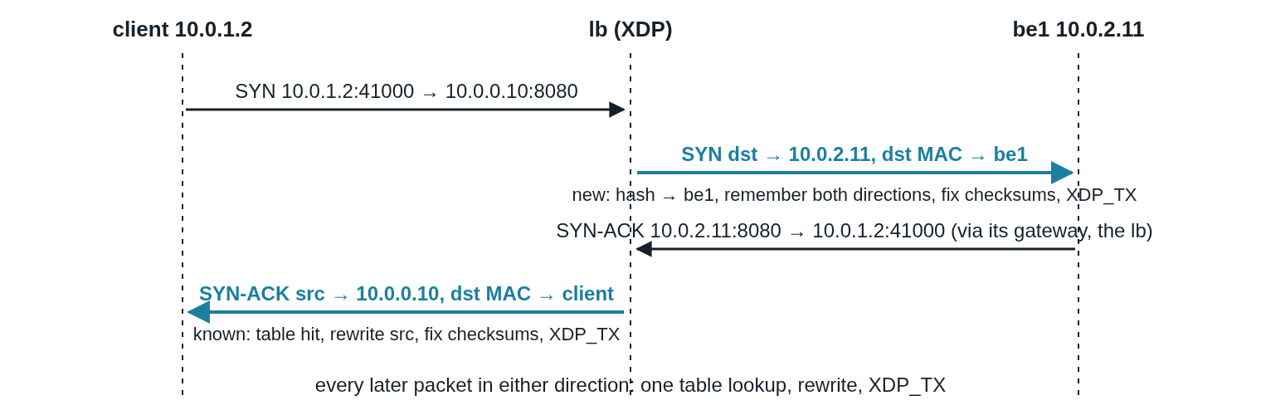
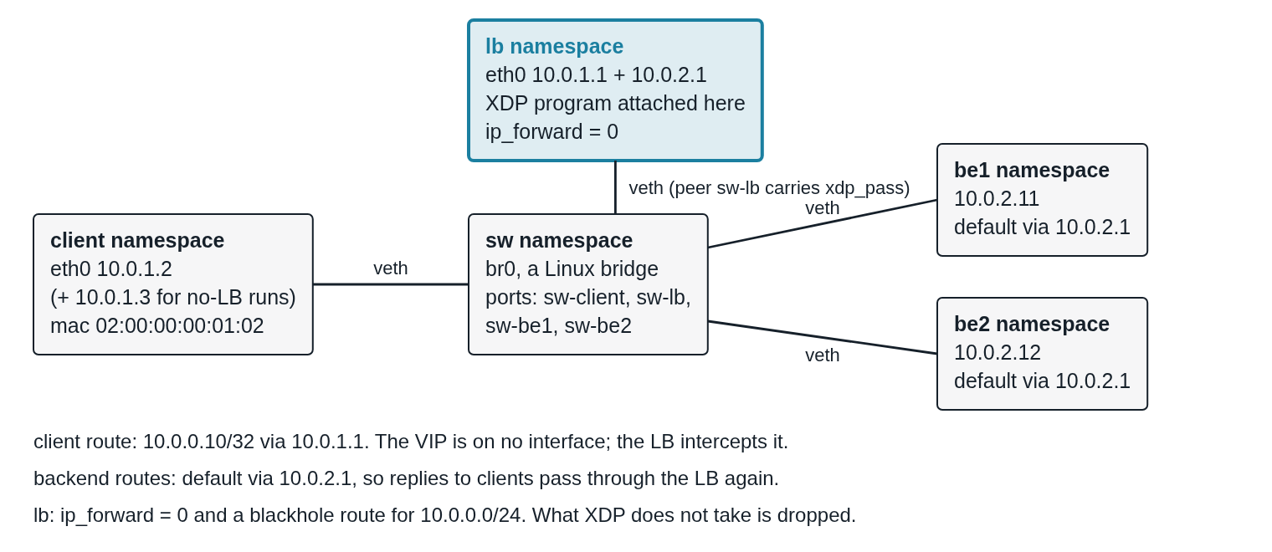
Architecture / Mechanism
What happens to each packet
• Read the Ethernet, IP and TCP headers
• Known connection? A map in the kernel remembers which backend it went to
• New connection? Hash the client onto a ring of backends (consistent hashing: adding or removing a backend moves few connections)
• Rewrite the destination IP and MAC to the backend, fix the IP and TCP checksums
• Send it straight back out of the same interface (XDP_TX)
• Replies come back through the LB and get their source set back to the VIP
Control plane
• A small user-space tool loads the program and fills its maps with the VIP and the backends
Mini-Katran: L4 load balancing with eBPF and XDP · CS 331 · Team T020
2 / 6

Slide 4
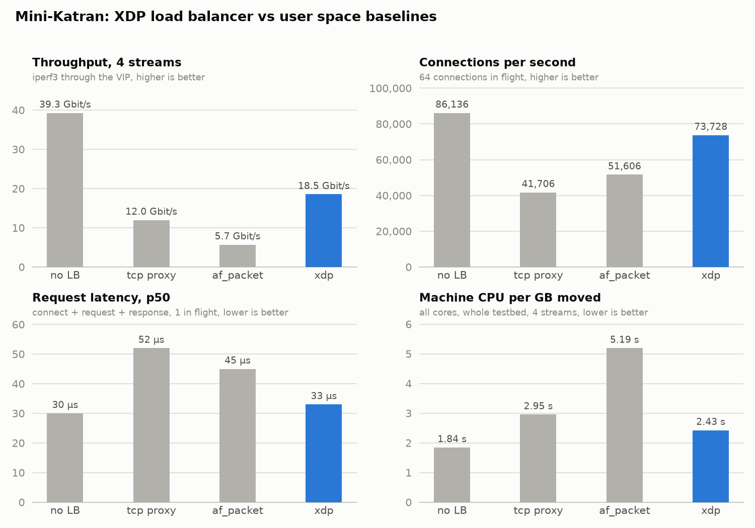
Evaluation
mode | throughput, 4 streams (Gbit/s) | connections / s | request latency p50 (µs) | machine CPU per GB (s)
no load balancer | 39.3 | 86,136 | 30 | 1.84
TCP proxy (user space) | 12.0 | 41,706 | 52 | 2.95
raw socket forwarder (user space) | 5.7 | 51,606 | 45 | 5.19
XDP | 18.5 | 73,728 | 33 | 2.43
Reading it
• Throughput: the proxy is one process on one core and stays at 12 Gbit/s. XDP spreads over the interface's queues: 1.5×
• Connections per second: 1.8× the proxy
• Latency: XDP adds 3 µs to a request, the proxy adds 22 µs
• CPU per GB: XDP is the closest to running no load balancer at all
• Same testbed for every row, 5 s tests, 3 repetitions, median
Mini-Katran: L4 load balancing with eBPF and XDP · CS 331 · Team T020
3 / 6

Slide 5
Extensions & Issues Fixed
Beyond the brief
Issues we hit and fixed
• A second baseline: the same forwarding logic on a raw socket in user space, so the only difference to XDP is where the code runs
• A benchmark script and an end-to-end smoke test that run every mode the same way
• Adding or removing a backend while traffic is running, with existing connections carrying on
• Sending packets back out of a veth did nothing until the other end of the pair also had an XDP program attached
• Throughput did not grow with more streams until the virtual interfaces were given more than one queue
• Our benchmark tools had bugs of their own: a test server spinning at 100% CPU, results drifting with the laptop's temperature. Fixed, and every number re-measured
Mini-Katran: L4 load balancing with eBPF and XDP · CS 331 · Team T020
4 / 6

Slide 6
Non-Functional Testing Parameters
Performance
Scalability
• Throughput, connections per second, request latency and CPU cost
• Each measured against a no-load-balancer run on the same testbed, so the load balancer's own cost is visible
• XDP throughput grows with more streams and more interface queues: 11.4 → 18.5 Gbit/s at 4 streams going from 1 to 8 queues
• The single-process proxy stays at 12 Gbit/s however many streams
Reliability
Reproducibility
• Smoke test on every mode: requests reach both backends, a 10 MB download has the right MD5, iperf3 and the connection test run
• A backend removed in the middle of a transfer: the transfer keeps going, new connections go to the remaining backend
• 3 repetitions with the modes interleaved, CPU frequency pinned, median reported
• Results agree within a few percent between runs; the raw data and the scripts are in the repo
Mini-Katran: L4 load balancing with eBPF and XDP · CS 331 · Team T020
5 / 6

Slide 7
Challenges Faced
• Learning eBPF from zero. The kernel only accepts a program it can prove is safe, so every read from the packet needs a bounds check and loops are out. It takes a while to stop fighting that.
• Virtual interfaces are not real NICs. Sending back out, the number of queues and packet ordering all behave differently on veth, and each of those showed up first as a wrong number rather than an error.
• Telling a problem in the program from a problem in the testbed. Running the same test with no load balancer at all settled it more than once.
• Benchmarking on a laptop. Heat, background load and our own test tools changed the numbers before we found out why.
Mini-Katran: L4 load balancing with eBPF and XDP · CS 331 · Team T020
6 / 6

