Slide 1
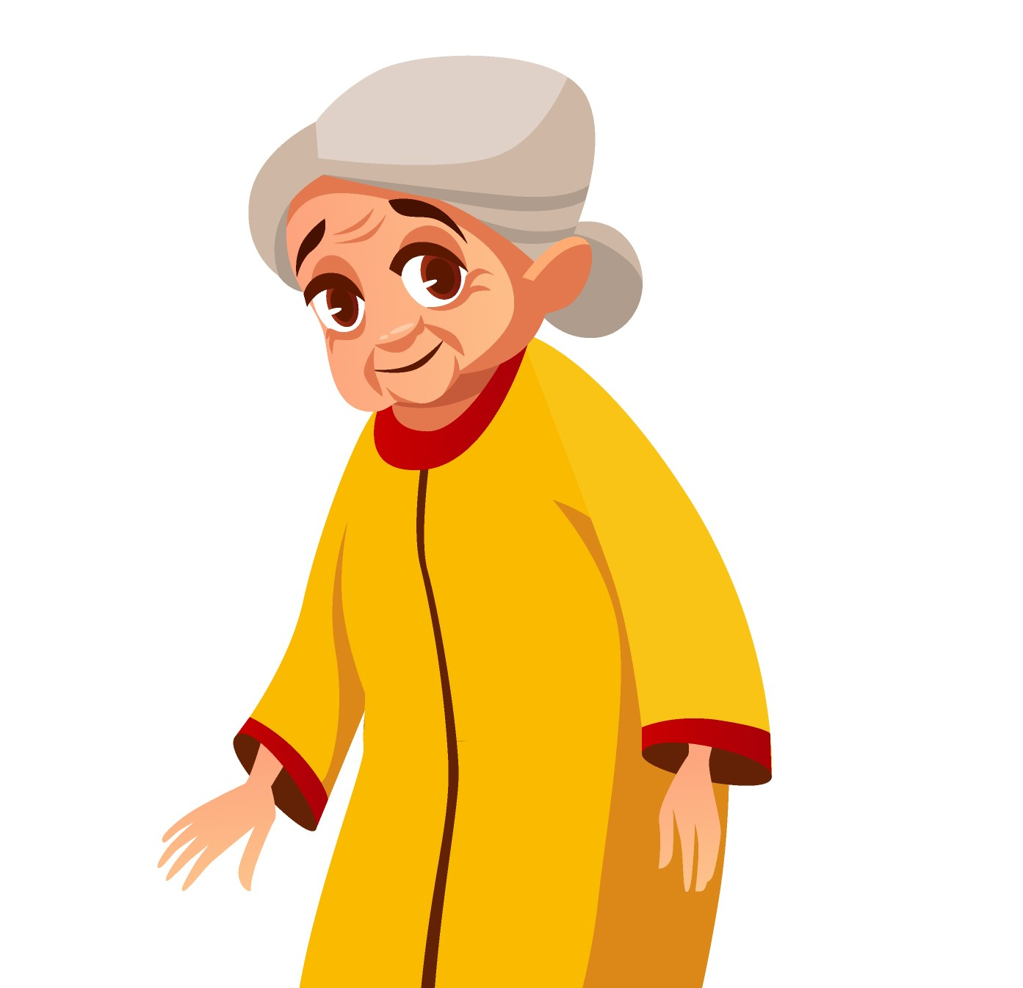
“I love spending time with my family and it gives me pleasure to feed them the food I cook”
Goals
To help the underprivileged
Give her children the comfort she did not receive herself
Leave a colourful legacy
Frustrations
Due to old age she cannot visit family often
Unable to understand app interfaces
Name : Mrs. Sharma
Age:
Education:
Hometown:
Family:
Occupation:
68
10th Class
Delhi
2 Children, 1 grand-child
Homemaker
Mrs. Khanna is a homemaker who spends her day watching new receipes on YouTube and trying them out. She is unable to understand the app interfaces and therefore cannot use a lot of apps. She wants to cook food and send it to her extended family that lives across town.

Slide 2
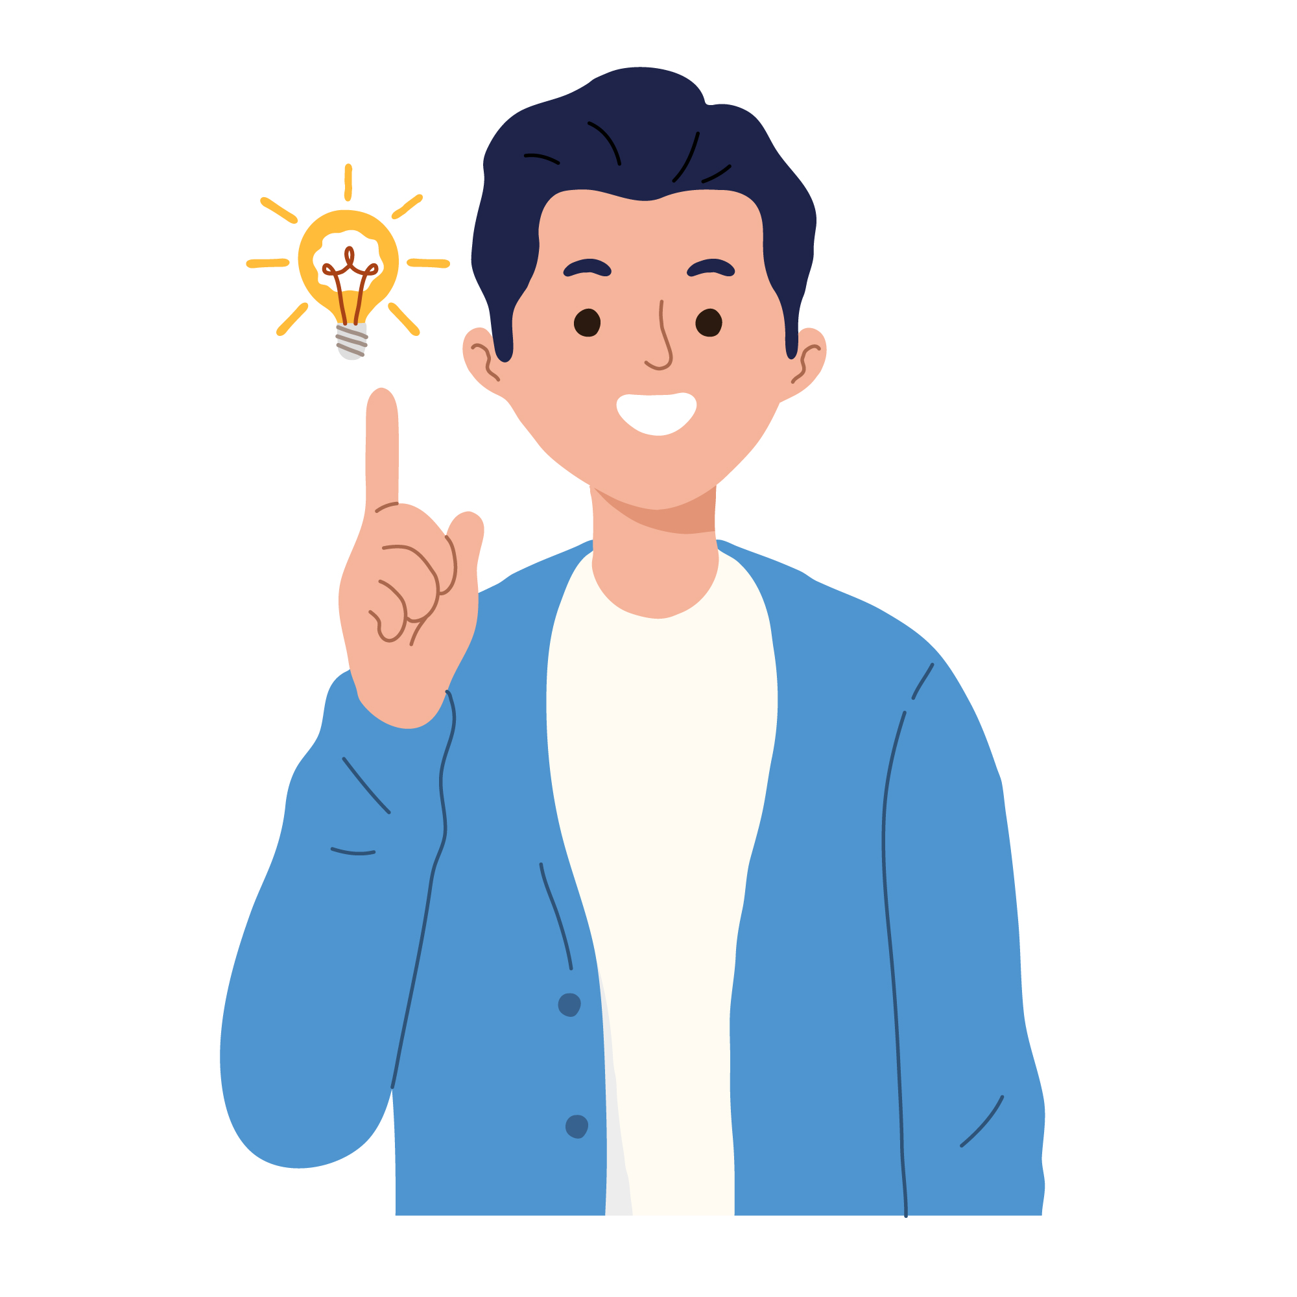
“Passionate about technology and I love to try our all the new products that I can”
Goals
Getting his graduate degree
Founding a start-up in the education sector
Working with an NGO to find out-of-the-box solutions.
Frustrations
Worries about the status of his privacy
Unable to manage time efficiently
Needs a cheaper way to transport books and similar items
Name : Sazal
Age:
Education:
Hometown:
Family:
Occupation:
19
Undergraduate
Kanpur
Lives alone in hostel
Student
Sazal is an undergraduate majoring in Computer Science. He is an advocate for privacy and is currently also working on his startup idea. He needs to frequently courier books and stationery to his friends that live inside a 20km radius but is bound by time.

