Slide 1
TA Contest
INFO 6205 PSA
Lesson 2: Intractability II (P, NP, NP Hard, and NP-complete)
Akshit Kallepalli
002771603

Slide 2
Introduction
Computational complexity is a branch of theoretical computer science that studies the resources, particularly time and space, required to solve computational problems.
It aims to understand the inherent difficulty of problems and classify them based on their solvability and resource consumption.
The classification helps us identify the boundaries of efficient computation and the limits of what can be feasibly solved within a reasonable timeframe.
This presentation will delve into four important complexity classes: P, NP, NP-Hard, and NP-Complete.

Slide 3
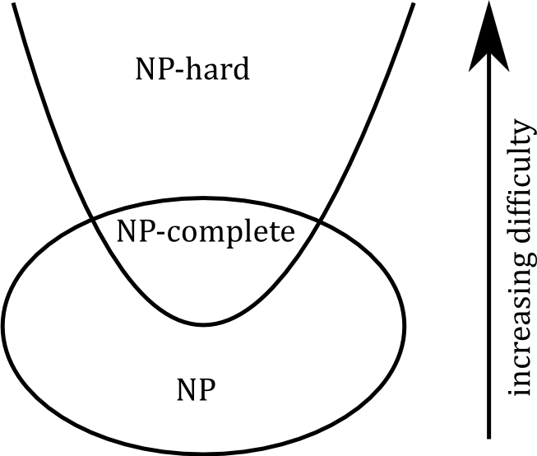
Complexity Classes Overview
Complexity classes are sets of computational problems with similar properties and resource requirements.
Four fundamental complexity classes under discussion:
P: Contains problems solvable in polynomial time by a deterministic Turing machine.
NP: Encompasses problems where the correctness of a solution can be verified in polynomial time.
NP-Hard: Consists of problems that are at least as hard as the hardest problems in NP.
NP-Complete: Subset of NP-Hard problems that are also in NP.

Slide 4
P (Polynomial Time)
1. Efficient Solvability in P:
Problems in P are known for their efficient solvability.
A problem is in P if a deterministic Turing machine can solve it in polynomial time.
2. Polynomial Time Complexity:
Polynomial time complexity signifies an algorithm's time requirement.
It scales polynomially with the input size of the problem.
3. Practical Solvability:
P problems are practically solvable for moderate input sizes.
Solving P problems is feasible within acceptable time limits.
4. Examples of P Problems:
Sorting a list of numbers efficiently falls under P.
Searching for an element in an array is a P problem.
Basic arithmetic operations, like addition and multiplication, are P problems.

Slide 5
NP (Nondeterministic Polynomial Time)
1. NP Complexity Class: Verification of Solutions
NP includes problems with verifiable solutions in polynomial time.
Solutions are validated by deterministic Turing machines.
2. Nondeterministic Turing Machines
Nondeterministic models explore multiple paths simultaneously.
Hypothetical concept aiding theoretical analysis.
3. Efficient Solution Verification
NP problems allow for efficient solution confirmation.
Proposed solutions are checked for correctness in polynomial time.
4. Examples:
Traveling Salesman Problem (TSP)
Boolean Satisfiability Problem (SAT)
Tower of Hanoi

Slide 6
NP-Complete
1: NP-Complete Problems
Subset of NP problems.
Equally hard as NP-Hard problems.
Key to understanding feasible vs. infeasible tasks.
2: Significance
Vital in computer science, logistics, manufacturing.
Model complex decision-making and optimization.
Despite difficulty, approximations and heuristics are sought.
3: Examples
Boolean Satisfiability Problem (SAT).
Traveling Salesman Problem (TSP) on metric graphs.
Knapsack Problem (decision version).

Slide 7
NP-Hard
1. NP-Hard Problems Overview
NP-Hard problems are as hard as the hardest problems in NP class.
May not belong to NP, lacking efficient verification algorithms.
Poses computational challenges and lacks known polynomial-time solutions.
2. Significance and Complexity
NP-Hard problems are encountered across various fields.
Often used to model optimization and decision-making scenarios.
Despite challenges, efforts continue to find efficient solutions or approximations.
3. Examples:
Traveling Salesman Problem (TSP)
Knapsack Problem
Graph Coloring Problem

Slide 8
P vs. NP Problem
1. Central Question:
Is P = NP or P ≠ NP?
2. Positive Solution (P = NP):
Polynomial-time verifiers imply polynomial-time algorithms.
Revolutionary impact on problem-solving efficiency.
Breakthroughs in cryptography and optimization.
3. Negative Solution (P ≠ NP):
Problems exist that are hard to solve but easy to verify.
Fundamental limits to certain computational tasks.
4. Significance:
Fundamental in theoretical computer science.
Deep implications for algorithmic complexity.
5. Millennium Prize Problem:
One of the seven unsolved problems.
Offers a million-dollar reward for a solution.
Illustrates its importance in mathematics and computer science.

Slide 9
NP Hard vs. NP Complete
Relationship
Every NP-Complete problem is NP-Hard, but not every NP-Hard problem is NP-Complete.
Example: NP-Hard
Problem: Traveling Salesman Problem (TSP)
TSP is NP-Hard because it's at least as difficult as any problem in NP.
Solutions can be verified in polynomial time, but finding the optimal solution efficiently is challenging.
Example: NP-Complete
Problem: Knapsack Problem
Knapsack Problem is NP-Complete, implying its solutions could lead to solutions for many other problems in NP.
It's a special subset of NP-Hard problems with implications for the broader class NP.

Slide 10
Applications
Job Scheduling:
Optimizing resource utilization through efficient allocation.
Network Data Packet Routing:
Ensuring efficient transmission by making informed routing decisions.
Resource Allocation for Projects:
Effective distribution of resources to maximize project outcomes.
Addressing NP-Complete Problems:
Tackling complex problems with elusive efficient solutions.

Slide 11
Quiz Questions

Slide 12
Question 1:
Which of the following statements are true about the P complexity class? (Select all that apply)
A) Problems in P can be solved by a deterministic Turing machine in polynomial time.
B) P stands for "Polynomial time."
C) If a problem is in P, it is also in NP.
D) P = NP has been proven to be true.
Correct Answer: A, B, C

Slide 13
Question 2:
Select the correct statements about the NP complexity class: (Select all that apply)
A) NP stands for "Nondeterministic Polynomial time."
B) Problems in NP can only be solved using exponential time algorithms.
C) If a problem is in NP, it can be verified in polynomial time on a deterministic Turing machine.
D) NP-complete problems are a subset of NP problems.
Correct Answer: A, C, D

Slide 14
Question 3:
Which of the following correctly define an NP-hard problem? (Select all that apply)
A) An NP-hard problem is solvable in polynomial time by a deterministic Turing machine.
B) NP-hard problems are a subset of NP problems.
C) Reducing an NP-complete problem to an NP-hard problem preserves computational complexity.
D) NP-hardness is a measure of a problem's computational difficulty, even compared to other NP problems.
Correct Answer: B, C, D

Slide 15
Question 4:
Which of the following statements accurately describe an NP-complete problem? (Select all that apply)
A) An NP-complete problem can be solved by a nondeterministic Turing machine in polynomial time.
B) Every problem in NP can be reduced to an NP-complete problem in polynomial time.
C) NP-complete problems are considered to be among the hardest problems in NP.
D) If an NP-complete problem is solved in polynomial time, then P = NP.
Correct Answer: B, C

Slide 16
Question 5:
Which of the following are characteristics of an NP problem? (Select all that apply)
A) An NP problem can be solved by a deterministic Turing machine in polynomial time.
B) The solution to an NP problem can be verified in polynomial time.
C) If an NP problem can be solved in polynomial time, then P = NP.
D) NP problems are a subset of P problems.
Correct Answer: B, C

Slide 17
Thank you

