Slide 1


Human Activity Recognition with CNN + LSTM
By:
Alok Murali
Rishi Bhargav
Shreyas Muniraju
Akshitraj C
Anchit Tushar Bhat

Slide 2
About the Project
Classifying Human Activities from Video Data

Slide 3
Project Overview
Thisprojectimplements adeeplearningmodeltorecognize human activities from video data, specifically classifying videos into
walking, running, and falling.
Video Input
Deep Learning Model
Activity Classification
Processing raw video data.
Hybrid CNN + LSTM for recognition.
Categorizing actions like walking, running, falling.

Slide 4
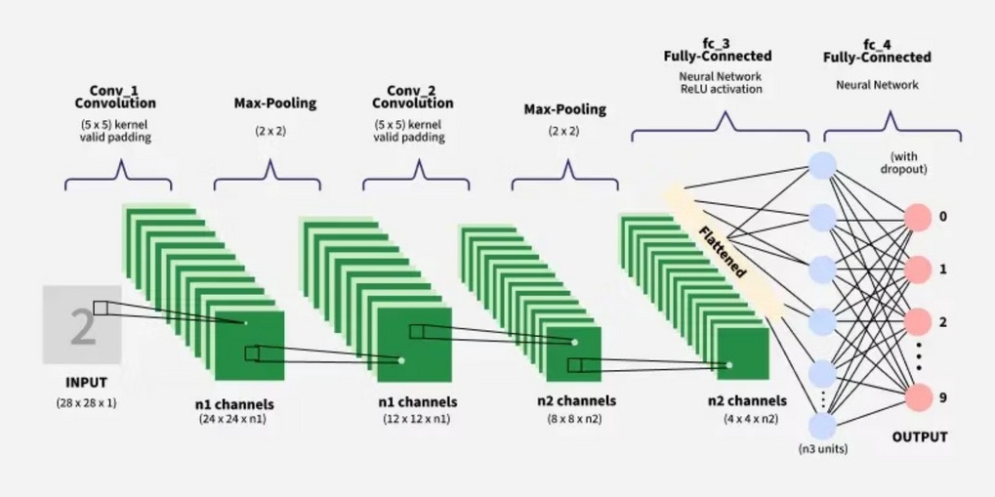
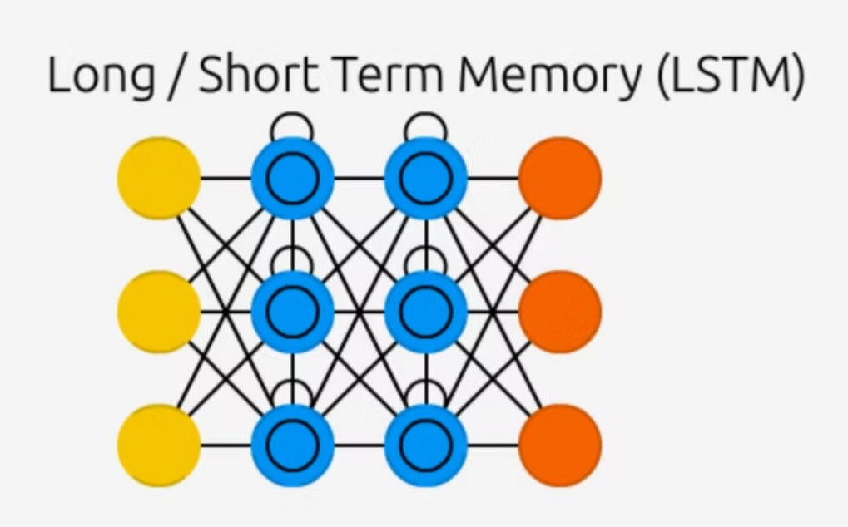
Our Hybrid Model: CNN +LSTM
The core of our approach combines a Convolutional Neural Network (CNN) with a Long Short-Term Memory (LSTM) network for robust activity recognition.
CNN (ResNet-18)
LSTM
A pre-trained ResNet-18 model acts as a feature extractor. For each video frame, the CNN analyzes the image to extract key spatial features, understanding posture and objects.
The sequence of features extracted from all frames is fed into an LSTM network. The LSTM understands temporal patterns, analyzing how features change over time to recognize the overall action.

Slide 5
Tech Stack & Requirements
Tools for Development & Performance

Slide 6




Software Requirements
Programming Language
Python
Deep Learning Framework
PyTorch
Libraries
Environment
OpenCV(video processing)
GoogleColab(forGPU acceleration)
Scikit-learn (dataset splitting) NumPy (numerical operations)

Slide 7

Hardware Requirements
GPU (Recommended)
AGraphicsProcessing Unit (GPU) is highly recommended for training the
deep learning model. It drastically reduces training time compared to a standard CPU.
Our project was developed using an NVIDIA T4 GPU on Google Colab,
significantly accelerating the training process.

Slide 8

Dataset & Preprocessing
Our project utilized a publicly available dataset from Kaggle. This dataset was essential for the initial data preprocessing steps, which included preparing the video frames for input into our CNN + LSTM model.
Additionally, we need to upload example videos to the model to help it predict the video.

Slide 9
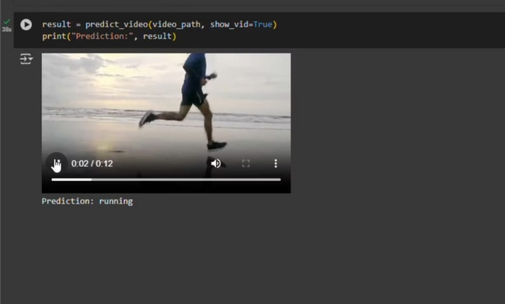
Results: Model Performance
Themodelsuccessfullyclassifiesvideosinto "walking," "running," and "falling" categories.
Feature Extraction
Model Training
Prediction
The final trained model processes new video files and outputs activity predictions.
System effectively processes videos, extracting high-level features from each frame using ResNet- 18 CNN.
LSTM classifier trained on feature sequences, optimizing to minimize errors and validating performance on unseen data.
Accuracy depends on dataset diversity and size. Performance can be improved by training on larger, more varied datasets for better real-world generalization.

Slide 10
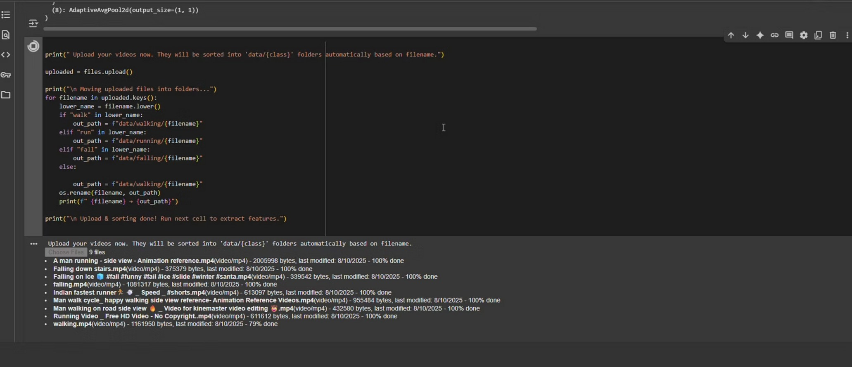
Screenshots

Slide 11

Example of the prediction

Slide 12
GitHub Repository
Find the full project code and documentation on our GitHub:https://github.com/shreyaskm51/Human-Activity-Recognition-with-CNN-
LSTM/tree/aiml-collab-file

Slide 13
Thank You

