Slide 1
AI-Driven Cloud Monitoring & Threat Detection System
Phase-1 Prototype + Complete System Roadmap

Slide 2
Problem Statement
Cloud environments generate massive logs every second.
Traditional signature-based systems fail against zero-day attacks.
Modern threats exploit misconfigurations, IAM abuse, and unusual activity.
Need: Real-time, ML-driven detection pipeline for cloud security.

Slide 3
Phase-1 Prototype (Completed)
Local JSON logs simulating CloudTrail data.
End-to-end anomaly detection using Isolation Forest.
Feature extraction: timestamp, user behavior, event patterns, IP heuristics.
Real-time dashboard using Streamlit.
Outputs: anomalies.csv + dashboard visual alerts.

Slide 4
Why CloudTrail is Essential
CloudTrail records every action performed in AWS (API calls, IAM changes, logins).
It is the single source of truth for cloud security monitoring.
Provides real, continuous audit logs required for ML pipelines.
Allows detection of privilege escalation, unusual activity, resource tampering.
⚠️ BUT CloudTrail free retention lasts only 90 days.
Enabling it now would waste the free period before Phase-2/3 development.
Hence: CloudTrail intentionally not enabled at Phase-1.

Slide 5
Final Architecture (End Goal, 6 Months)
CloudTrail → S3 (Raw Logs)
MSK / Kinesis → Real-time Ingestion
Lambda / Spark Streaming → Preprocessing & Feature Extraction
SageMaker → ML Model Hosting (Isolation Forest, Autoencoder, LSTM)
OpenSearch / Grafana → Security Operations Dashboard
SNS / SOAR → Automated Response (alerting, user isolation, IP blocks)

Slide 6
Full Final Cloud Workflow (Explained)
1. CloudTrail collects all AWS actions and writes logs to S3.
2. Kafka/Kinesis streams logs in real-time for processing.
3. AWS Lambda/Spark converts logs → features for ML models.
4. SageMaker hosts the ML models (unsupervised + supervised).
5. Streamlit/OpenSearch dashboards visualize anomalies.
6. SNS/Slack/Email sends real-time incident alerts.
7. SOAR automates response (IAM quarantine, IP block, EC2 isolation).

Slide 7
Machine Learning Models (Final System)
1. Isolation Forest → anomaly detection on structured logs.
2. Autoencoder → detect unseen patterns using reconstruction loss.
3. LSTM → detect suspicious sequences of commands or events.
4. XGBoost → classify known attack signatures and behaviors.
Hybrid Model = Best of supervised + unsupervised + sequence learning.

Slide 8
Phase-2 (Cloud Integration)
Enable CloudTrail (timed with development).
Build ingestion: S3 + Kafka or Kinesis.
Deploy preprocessing using Lambda/Spark.
Connect pipeline to real-time dashboard.
Start collecting real AWS logs for ML retraining.

Slide 9
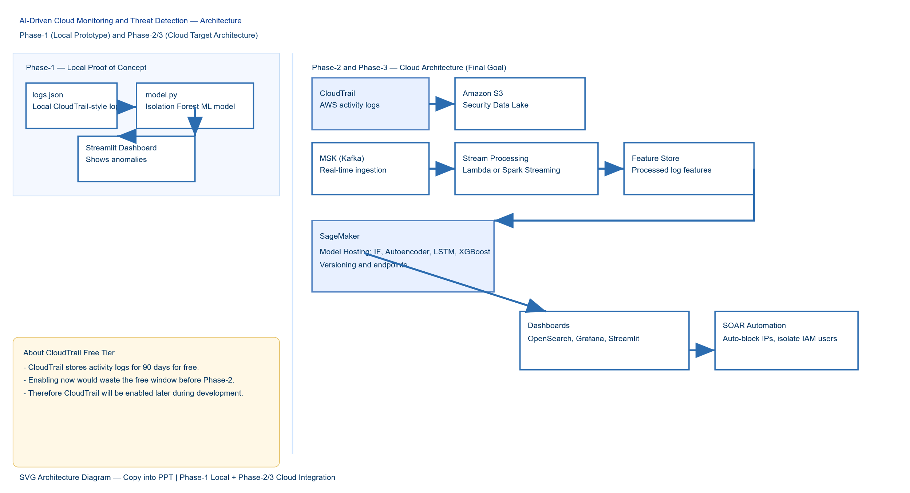
Architecture

Slide 10
Phase-3 (Scalable Enterprise System)
Deploy ML model as SageMaker endpoint.
Add LSTM & Autoencoder models for deeper detection.
Integrate with SOAR for automatic incident response.
Add IAM Threat Analytics, Behavior Modeling, Alert Prioritization.

Slide 11
Final Notes
Phase-1 successfully proves the ML pipeline.
AWS cloud integration is planned with cost optimization in mind.
CloudTrail intentionally delayed to avoid wasting 90-day free tier.
Final system will be real-time, scalable, and enterprise-ready.

