Slide 1
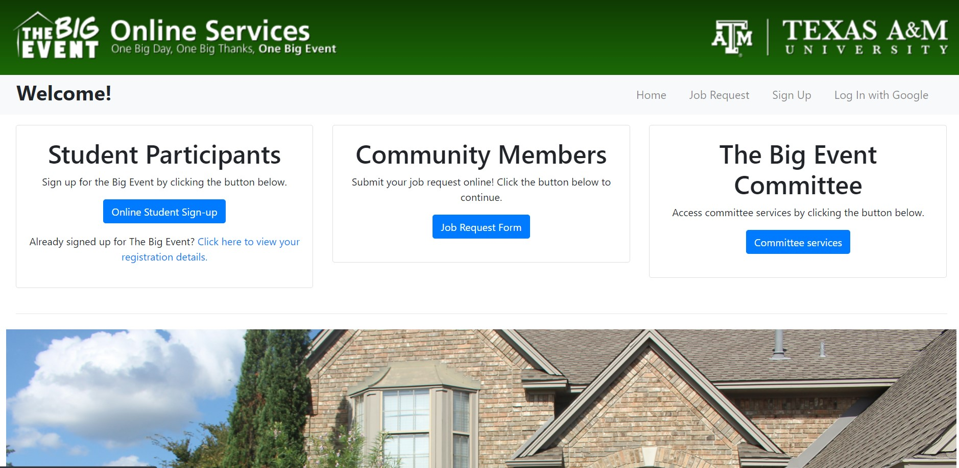
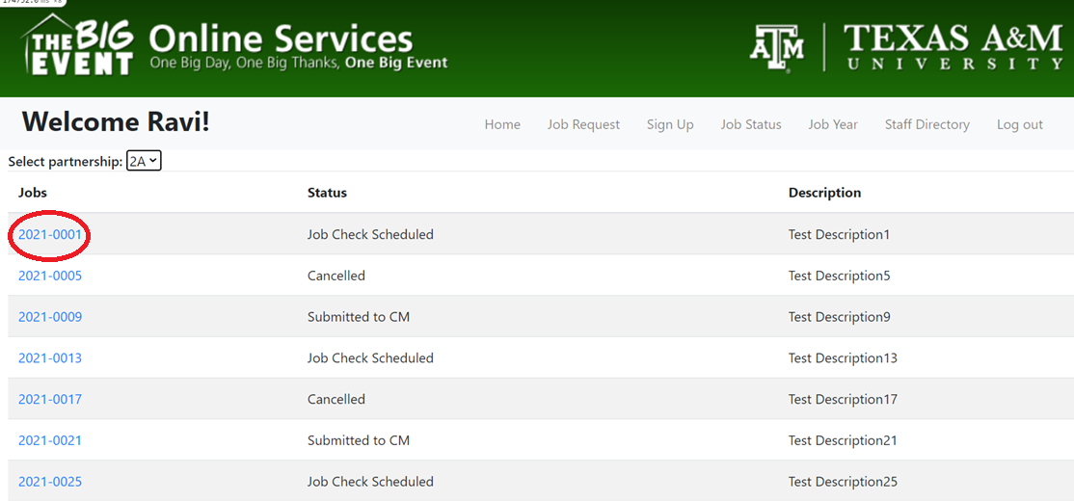


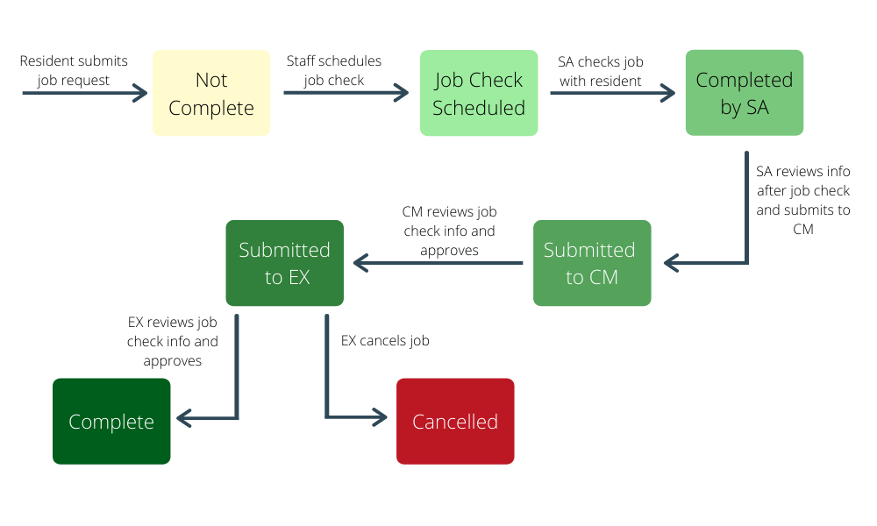
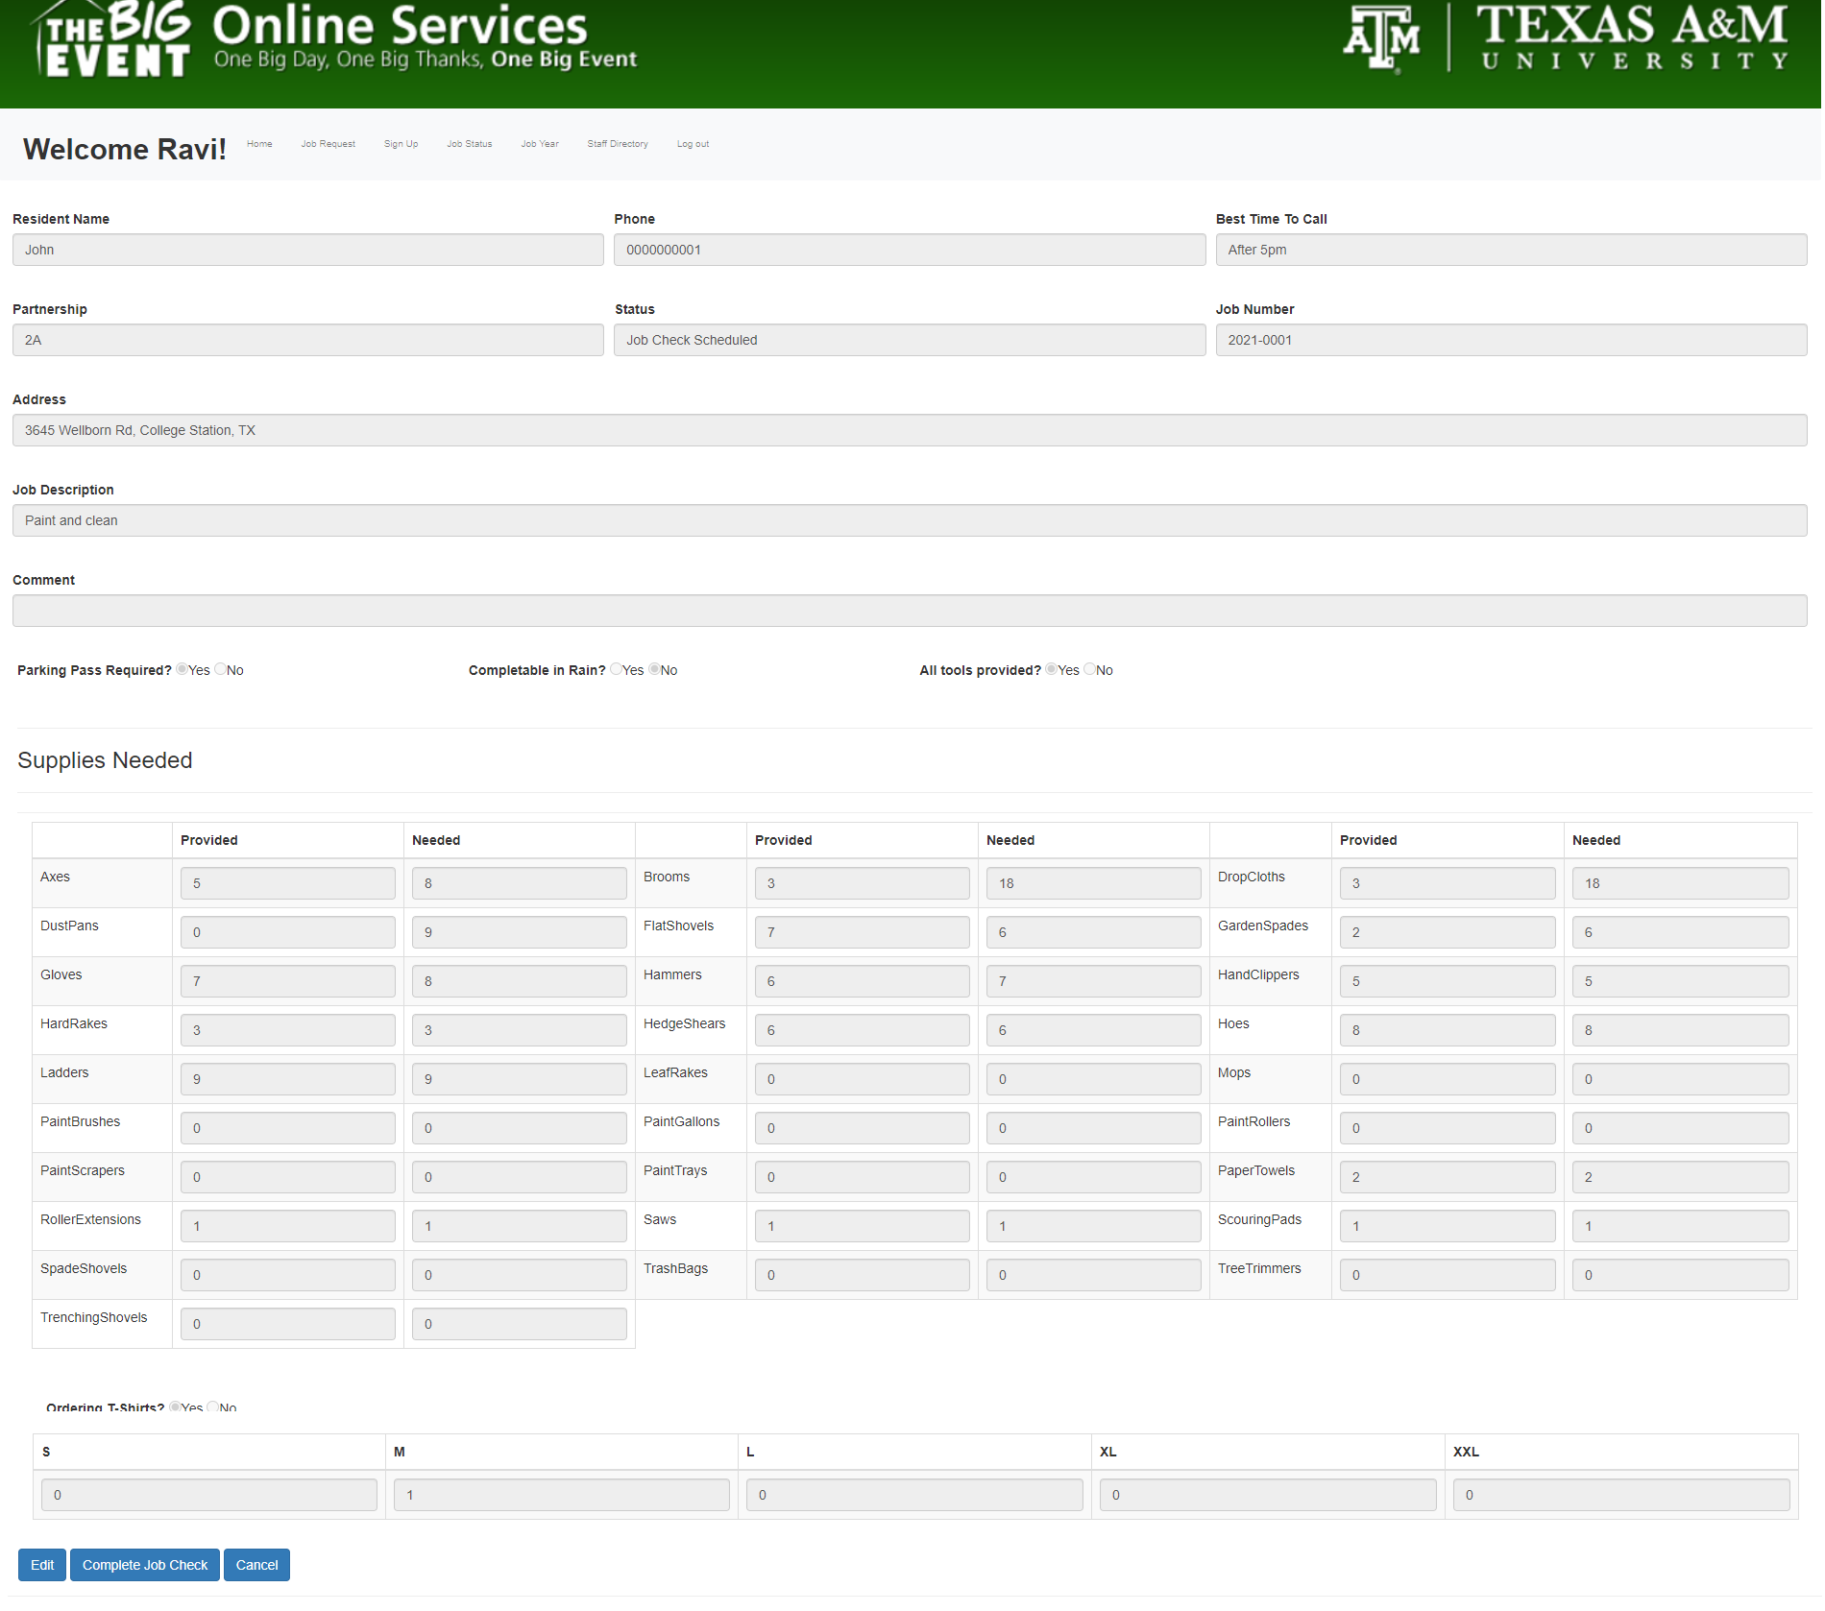
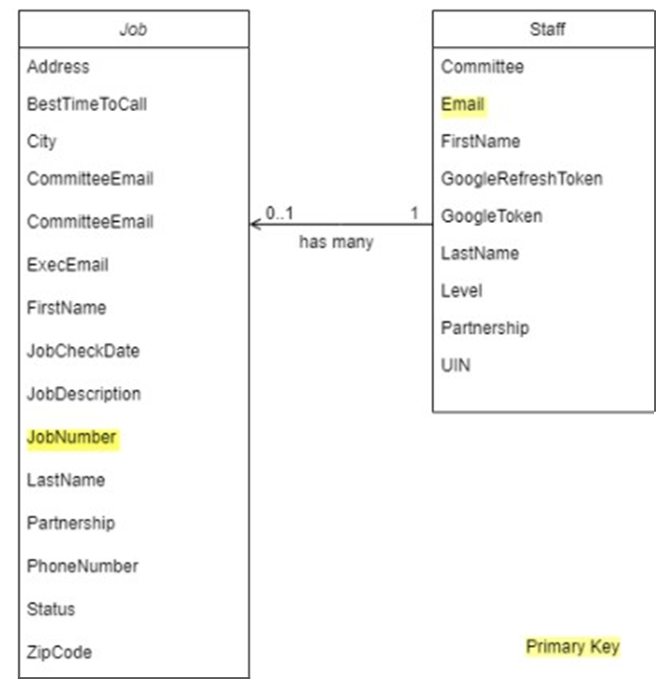
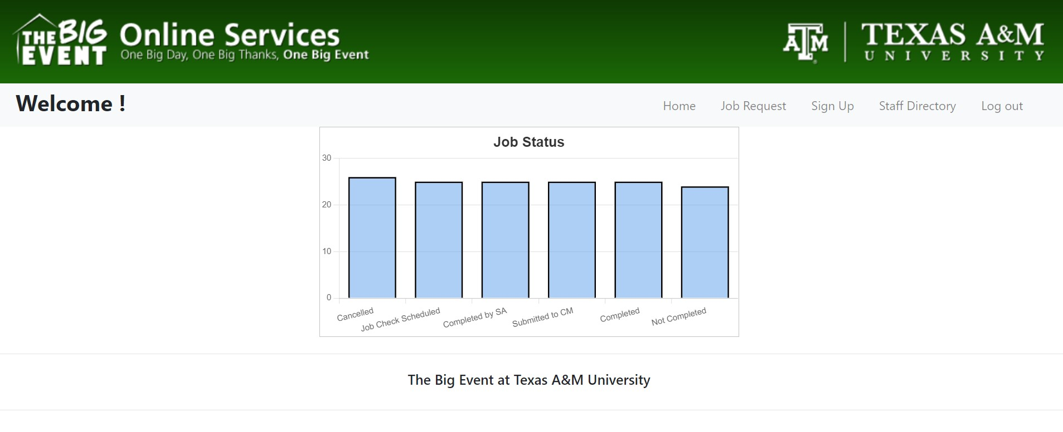
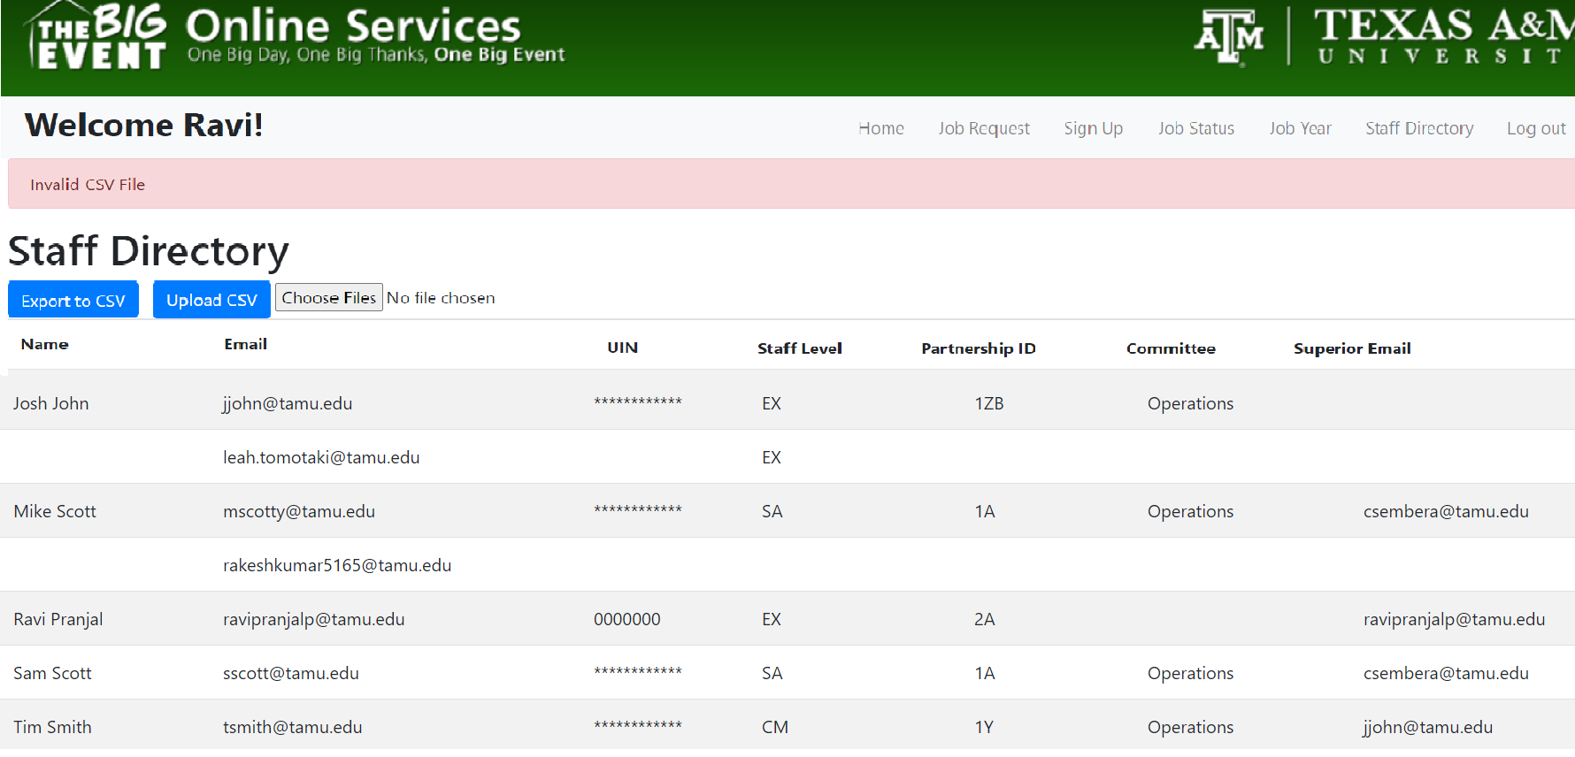
THE BIG EVENT
Ankit Garg, Akshit Kharbanda, Christian Smith, Leah Tomotaki, Rakesh Kumar Sanath Kumar Kadaba, Ravi Pranjal
Texas A&M University
Introduction
Design
The current Big Event website is managed by TAMU IT, but the goal is to eventually move towards owning the website themselves, starting with this Job Check Management System.
Here we attempt to make their internal staff website so it can interact with their iOS app through a NoSQL Google Firestore database allowing staff members to view the status of and information about their assigned job checks and update the job with new information from residents.
Our product will also allow executive officers and committee members to verify the job check information after the staff officers submit the data through the iOS app or our application
Landing Page:
Users are directed here before logging in and after logging in with the page adjusted for the appropriate staff level permission
Software Stack
Assigned Jobs:
Upon following the “Committee Services” link, staff members will see a list of their assigned job checks. They view other partnerships’ jobs through the dropdown menu.
Development: Ruby on Rails
Testing: Cucumber/RSpec
Deployment: Heroku
https://github.com/akshit04/big_event
https://big-event-online.herokuapp.com/
Job Status Flow
Job Details:
Users may select a job to view the details. They can edit these fields and submit to their superior officer, or if executive, mark as completed or cancelled.
Database Design
NoSQL Google Firestore Database
The database will be updated by CSV files from staff directory and job information obtained from an external site. This was done to allow The Big Event to continue using their existing site while transitioning to our application
Job Status:
Executive staff members can view a graphical summary of the statuses of all jobs for the current year.
Challenges
Integration of Ruby on Rails with Google Firestore database because Ruby ActiveRecord does not support NoSQL
Delays in testing due to incompatibilities between Cucumber and Google Firestore
Staff Directory:
Executive staff members can view the entire staff directory stored in the Firestore DB and manage the content by uploading and exporting CSV files. CSV files are validated before being uploaded.
Software Engineering Lessons
How to collaborate with a customer using Agile principles through regular meetings and demos after every iteration
The importance of Behavior Driven Design / Test Driven Design due to the delays in testing
Conclusion
This project will be ongoing and will provide the foundation for The Big Event to transition away from their current application to a self-owned internal staff management system.

