Slide 1
TEAM-14

Slide 2
PROBLEM STATEMENT

Slide 3
PROBLEM STATEMENT
Network Congestion
in Telecom Industry

Slide 4
DECIPHERING
THE
PROBLEM STATEMENT

Slide 5
DECIPHERING THE PROBLEM STATEMENT
Network congestion has been one of the most significant issues faced by the modern telecom industry. It leads to a decrease in quality or complete failure of services because of over burdening of the network with data. Dealing with congestion is one of the most significant issue faced by the market players of telecom industry. Its solution involves analyzing the data.

Slide 6
APPROACH

Slide 7
APPROACH
Data visualization (Understanding the data since it supervised learning).
Preprocessing (Columns manipulated, Graphs plotted, Normalizing the data).
Applying the code (as understood from the preprocessing and some basic code were applied).
Ensemble the result from the different techniques/codes
Calculating MCC and accuracy.

Slide 8
DATA VISUALISATION

Slide 9
DATA VISUALISATION
Visualizing the data through naked eyed i.e. if possible checking for any relations.
Plotting heat maps for the data to check for any relationships in the data.
As no relationships were visualized from the heat maps, so we plotted box plots for different congestion type and different features present in the data.

Slide 10
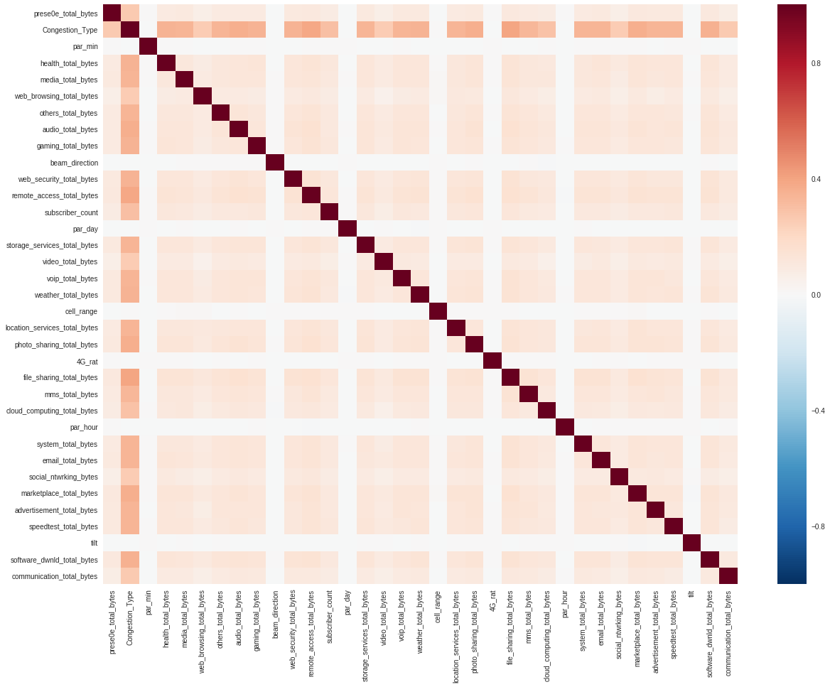

Slide 11
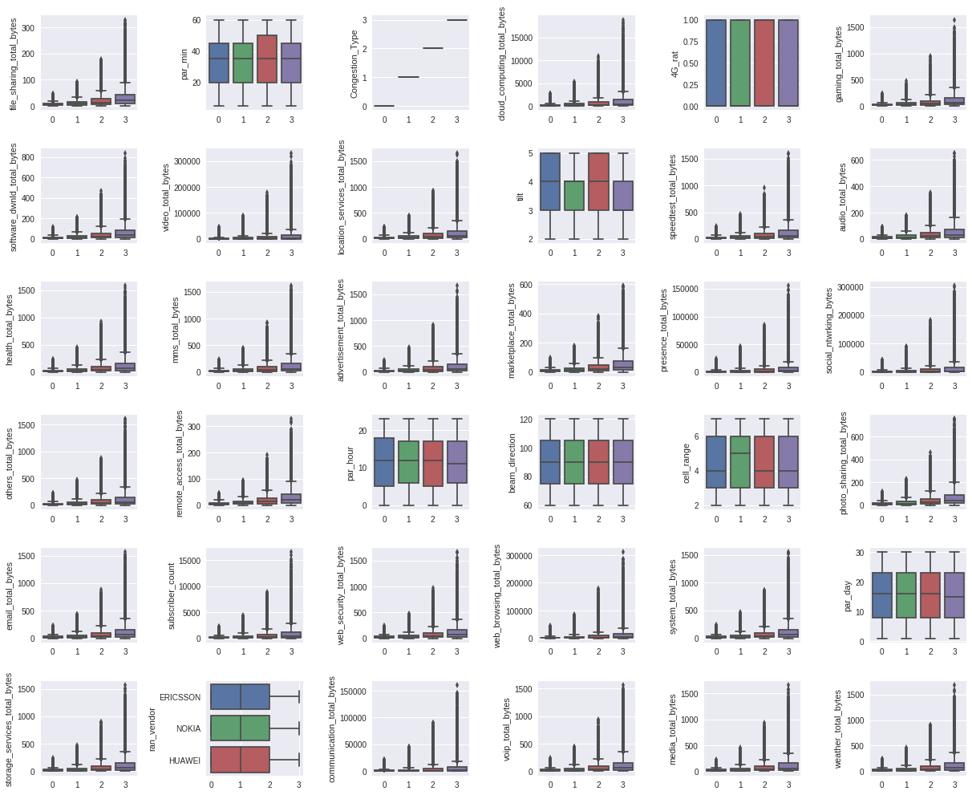

Slide 12
PRE-PROCESSING

Slide 13
PRE-PROCESSING
Columns signifying year, month and cell name were removed because of the insignificance in prediction of the final class of congestion.
For dimensional reduction of data t-SNE (t-Distributed Stochastic Neighbor Embedding) was plotted for the data.
Data was normalized to make it a better fit for possible models.

Slide 14
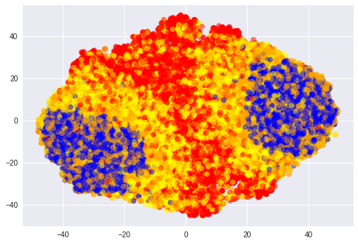
BLUE-NO CONGESTION
YELLOW-4G BACKHAUL CONGESTION
ORANGE-3G BACKHAUL CONGESTION
RED-4 RAN CONGESTION

Slide 15
APPLICATION OF CODE

Slide 16
APPLICATION OF CODE
A bit of correlation was observed from t-SNE, here we can see that the points containing NC (No Congestion) , 3G_BACKHAUL_CONGESTION, 4G_RAN_CONGESTION, 4G_BACKHAUL_CONGESTION were segregated .
So we thought of using SVC as it also works on same way.

Slide 17
APPLICATION OF CODE
contd.
A Support Vector Machine (SVM) is a discriminative classifier formally defined by a separating hyperplane. In other words, given labeled training data (supervised learning), the algorithm outputs an optimal hyperplane which categorizes new examples. In two dimensional space, this hyperplane is a line dividing a plane into two parts wherein each class dimensional lay in either side.

Slide 18
APPLICATION OF CODE
contd.
It has been found that neural networks works quite robustly in classification tasks. So, we applied MLPClassifier on the preprocessed data.
As, it can approximate any continuous function well for a given hidden layer.
A ​multilayer perceptron​ (MLP) is a class of feedforward artificial ​neural network​. An MLP consists of, at least, three layers of nodes: an input layer, a hidden layer, and an output layer. Except for the input nodes, each node is a neuron that uses a nonlinear activation function​.

Slide 19
APPLICATION OF CODE
contd.
Next, we also tried Naive Bayes.
Initial intuition behind using Naive Bayes was the conditional independence of the available features. This was implied from the ​correlation plot ​between all the features.

Slide 20
ENSEMBLING
After getting a (near satisfactory) results from the above 3 we tried a hybrid approach.
In order to capture various features such as non-dependency (​Naive Bayes​) as well as subtle features from weaker algorithms ( ​SVC and MLP Neural Networks​) and various nuances from different activation functions such as ReLU ​ensembling ​was incorporated.

Slide 21
RESULT

Slide 22
RESULT
The accuracy obtained through ensembling is 0.79.
The MCC obtained through ensembling is 0.7176.

Slide 23
THANK YOU !

