Slide 1

Advance Database Management Term Project
TOPIC- MOVIE DATA WAREHOUSE
MADE BY- AKSHITA JAIN

Slide 2
WORKFLOW
WHAT IS DATAWAREHOUSE?
EXTRACTING DATA
TRANSFORMING DATA
CREATING A DATABASE AND TABLES
LOADING THE TRASFORMED DATA IN THE DATABASE
STAR SCHEMA
DATA MIGRATION
DATA SYNCHRONIZATION
QUERYING DATA FOR SPECIFIC RECORDS
WHAT IS ETL?

Slide 3
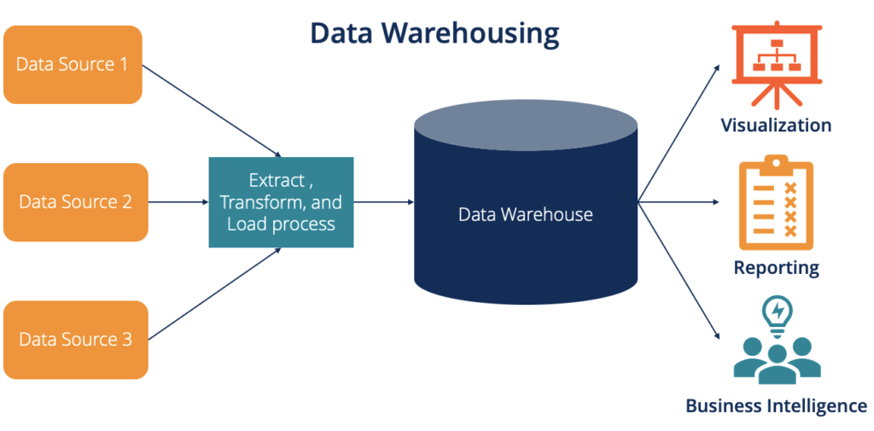
What is data warehouse?
A data warehouse is a centralized repository that aggregates structured data from various sources, such as databases, business applications, or external data feeds. It is designed for query, analysis, and reporting, enabling organizations to derive insights from large volumes of historical data.

Slide 4
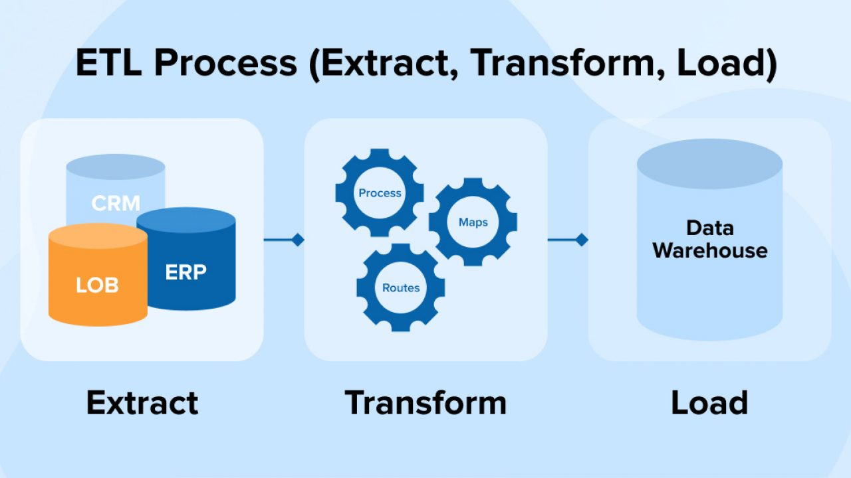
WHAT IS ETL?
ETL stands for "Extract, Transform, Load," a process commonly used in data integration and data warehousing to move and transform data from various sources to a destination, typically a data warehouse.
ETL is a critical process in business intelligence, data analytics, and reporting, enabling organizations to consolidate, cleanse, and standardize data from disparate sources for meaningful insights.

Slide 5
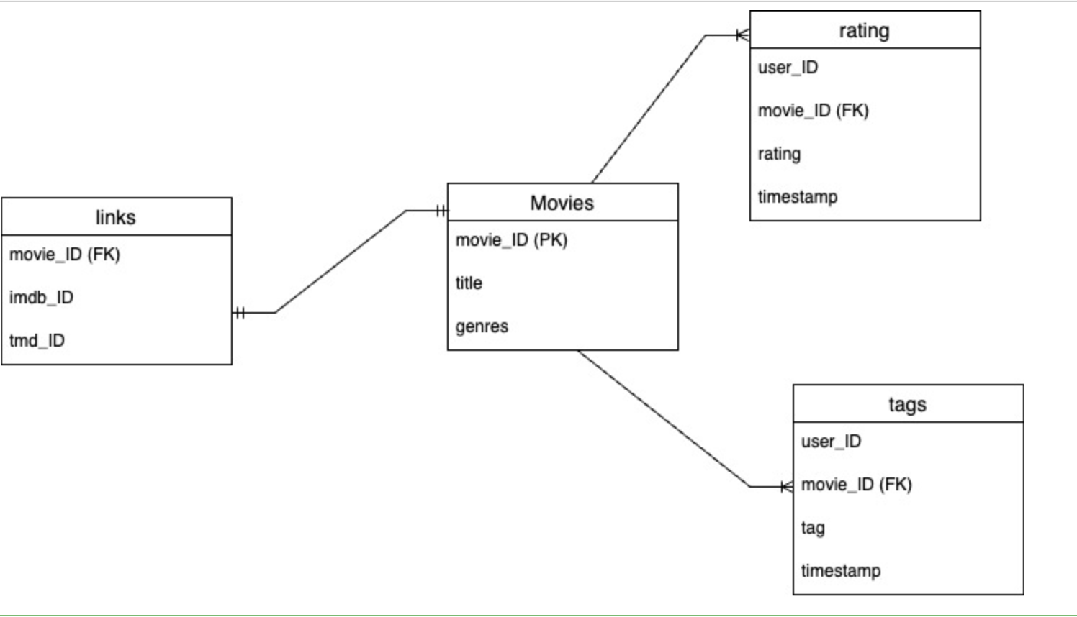
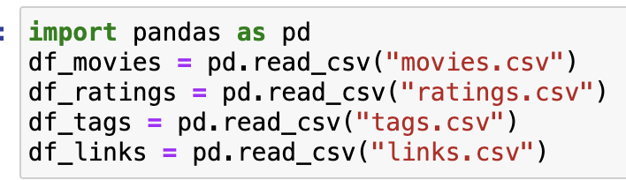
1.EXTRACTION
The first step in the ETL process is extracting data from various sources.
Data Sources: We have extracted four datasets: movies, links, tags, and ratings. These datasets are likely stored as CSV files , then imported in Python.

Slide 6
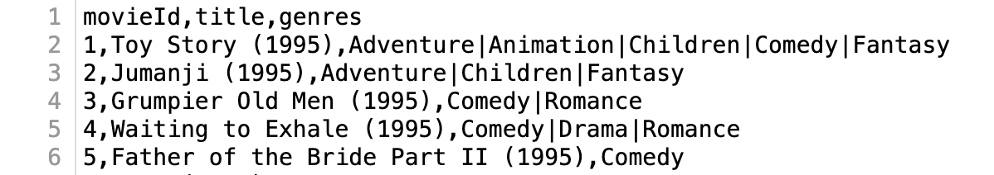
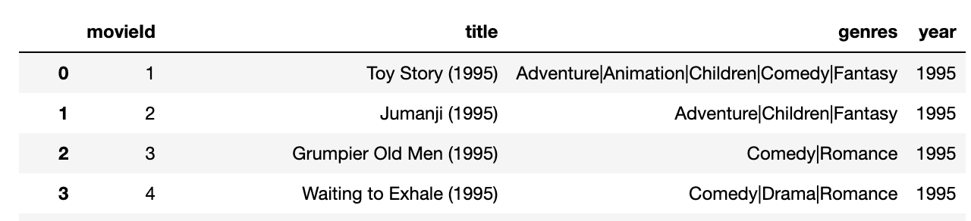
2. TRANSFORMATION
This step involves cleaning, validating, and restructuring the extracted data to fit the desired schema or format. It involves converting date formats, handling null values, merging or splitting columns.
Before transforming
After transforming

Slide 7
3. LOADING
The final step in the ETL process is loading the transformed data into a structured storage system which forms the basis of the data warehouse.
1. Choosing a Storage System:- SQLITE
2. Loading Data into the DataBase:
-created four tables in an SQLite database named Movies.db. the tables represent different aspects of a movie system, such as movie details, user ratings, tags, and external links.
Movies
movieId (PK)
Titles
Genres
year
Ratings
userId
movieId
Rating
timestamp
Links
movieId
ImdbId
tmdbId
Tags
movieId
userId
Tag
timestamp

Slide 8
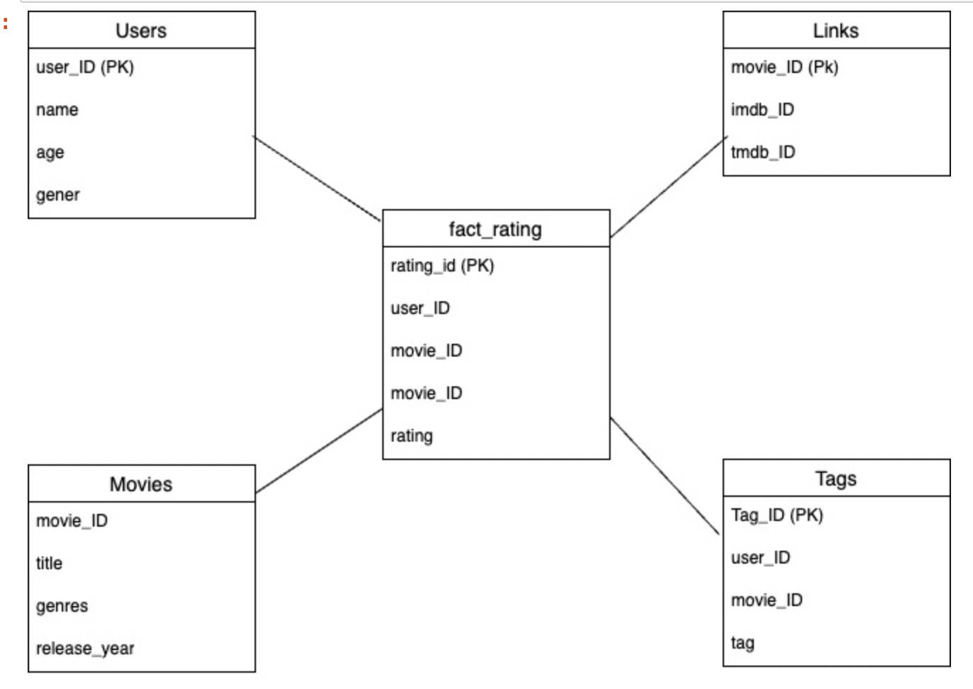
STAR SCHEMA
creation of a star schema in a SQLite data warehouse named datawarehouse.db
Fact Table:
A central fact_ratings table is created
This table contains information such as rating_id (the primary key), userId, movieId, rating. Foreign keys are used to establish relationships with dimension tables, ensuring data consistency and referential integrity.
Dimension Tables:
Dimension Users
Dimension Movies:
Dimension Tags
Dimension Links:

Slide 9
Data Migration from Source to Data Warehouse
1.Database Connections:
wo separate connections are established: one to the source Movies.db and another to the target datawarehouse.db.
2. Fetching Data from the Source:
A SQL SELECT query retrieves data from the movies table (movieId, title, genres, and year) in the source database.
3.Inserting Data into the Target:
A SQL INSERT INTO query is defined to insert data into the dimension_movies table in the target database.
4. Validation and Data Verification:
A SQL query retrieves the first 5 records from the dimension_movies table to confirm that data has been successfully inserted.

Slide 10
Data Synchronization for Data Warehouse
1. .Database Connections:
Connects to both the source Movies.db and the target datawarehouse.db.
2. Fetching and Inserting Movie Data:
Fetches data from the movies table in the source database, including movieId, title, genres, and year and stores in stored in movies_data.
Inserts or replaces the fetched data into the dimension_movies table in the data warehouse.
This approach ensures that if a record with the same movieId exists, it will be replaced with the updated information.
3. Data Synchronization:
Inserts each row from movies_data into the dimension_movies table in the data warehouse.
Commits the changes to persist the data.
4. Error Handling:
Includes a try-except block to catch and report any SQLite errors during the data synchronization process.
If an error occurs, it outputs the error message along with the data causing the error for troubleshooting.
Output:

Slide 11
Why This Synchronization is Needed?
Data Consistency:
Synchronizing data ensures that the target data warehouse reflects the latest information from the source database.
Data Integration:
Integrating data from various sources into a data warehouse allows for comprehensive analysis and reporting.
Business Intelligence:
Up-to-date data in the warehouse is essential for accurate business intelligence insights and decision-making.

Slide 12
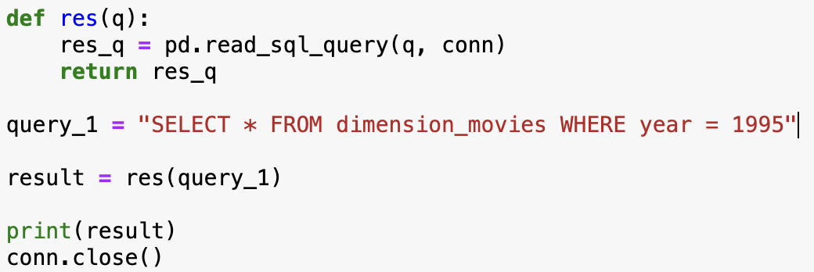
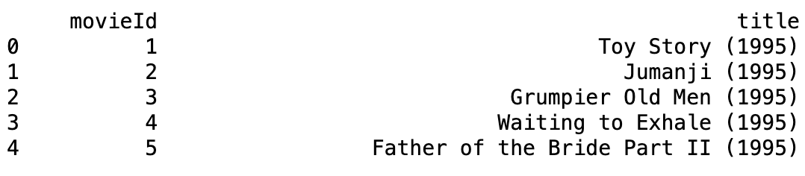
Querying Data Warehouse for Specific Records
This code snippet demonstrates how to query an SQLite data warehouse and retrieve specific records based on a defined condition
Output

Slide 13
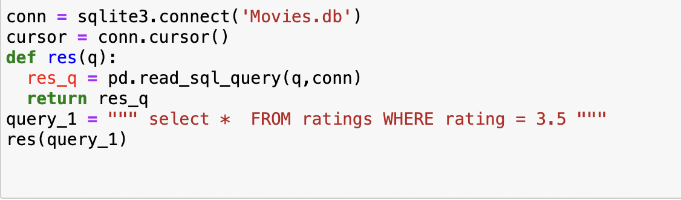
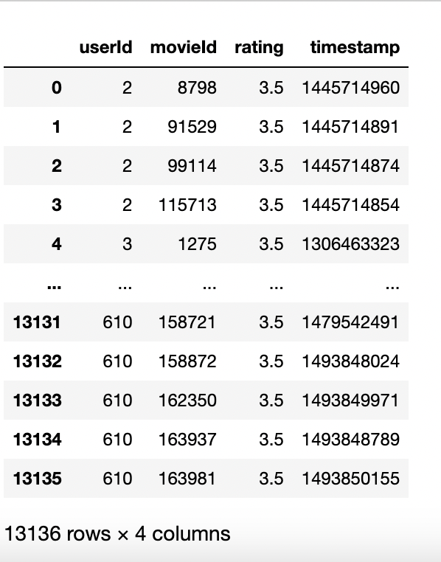
ANOTHER EXAMPLE
OUTPUT:

Slide 14


