Slide 1
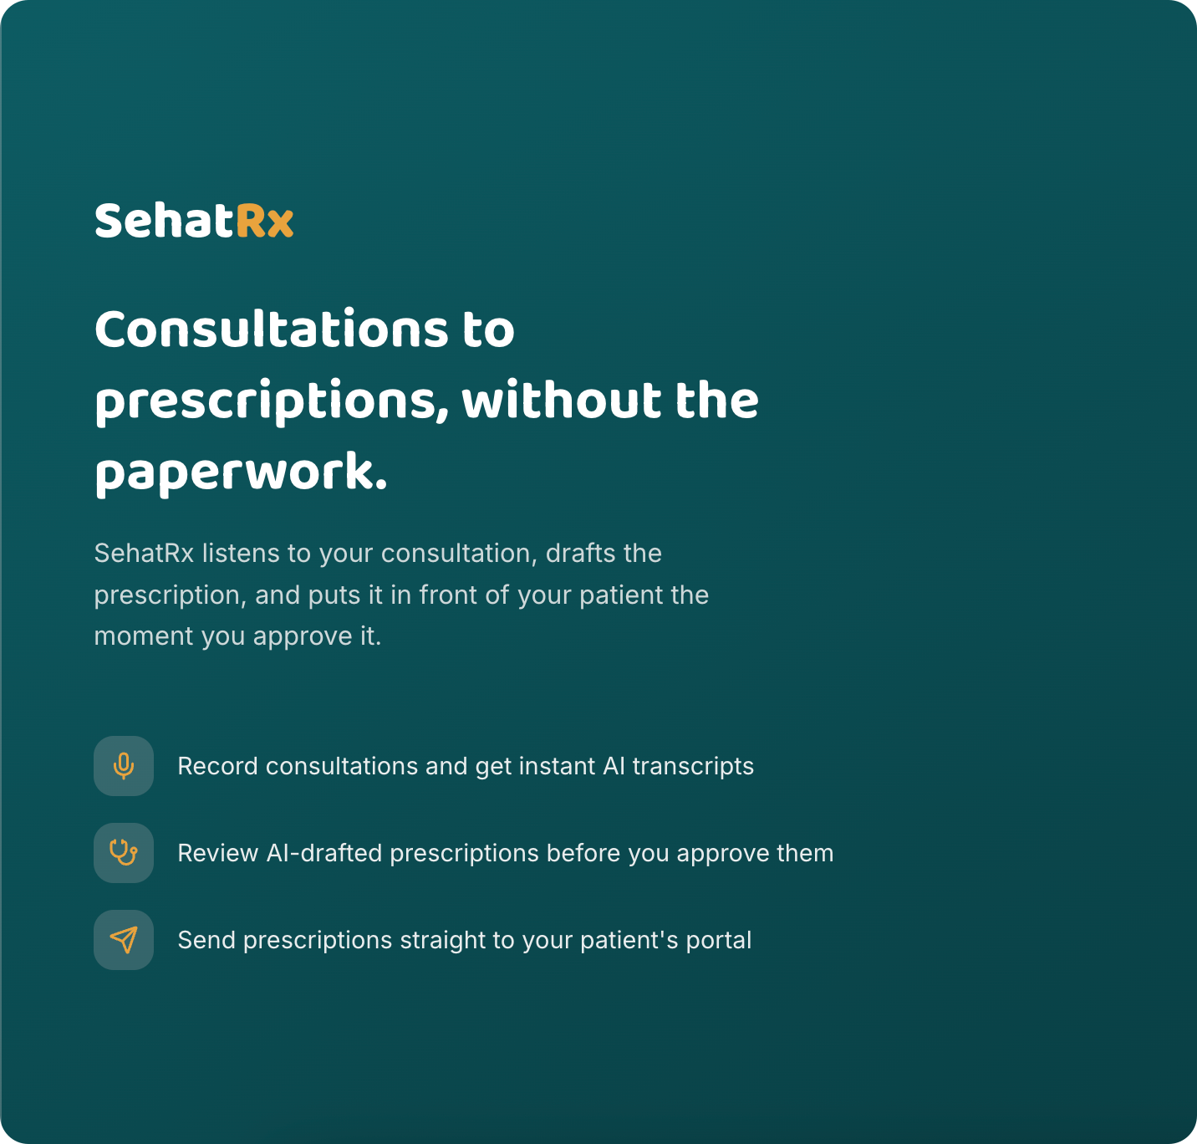
SehatRx
Turns a doctor's voice into a ready prescription — instantly.
An AI prescription app, built for real Indian clinics
Akshita Jain · AI Engineer
Notes:
Title slide. SehatRx: an AI-powered consultation-to-prescription app for Indian clinics.

Slide 2



The Problem
40–60
Paperwork is eating doctors' time
patients seen by
one doctor, every day
Handwritten and hard to read
Every prescription is written by hand, fast, and often only the pharmacist can read it.
Prescriptions get lost
Paper slips go missing, get torn, or end up as a blurry photo on someone's phone.
Many patients are left out
A lot of elderly patients can't read English well, and plenty don't even have an email address.
Notes:
Sets up the real-world problem: doctor time, illegible/lost prescriptions, and patients underserved by typical apps.

Slide 3



How It Works
Just talk. The app does the rest.
1
2
3
4
→
→
→
Doctor talks
AI listens
AI writes it up
Instantly delivered
A normal conversation with the patient, nothing typed.
Turns the conversation into text — Hindi, English, or both.
Fills in a clean, organized prescription automatically.
Patient sees it the second the doctor approves it.
Notes:
The core pipeline: voice -> Whisper transcription -> GPT-4o-mini structured drafting -> doctor approval -> instant patient delivery.

Slide 4



Why This Isn't Just Another AI Demo
Three things that actually matter to the people using it
The doctor just talks
No typing mid-consultation. For someone seeing 40+ patients a day, that's real time back.
Speaks the way people here do
Hindi, English, or a natural mix of both — not just the English half of the sentence.
Nothing gets lost
Live on the patient's phone the second it's sent, and a family member can see it too.
Notes:
The three USPs: talk-not-type, Hindi/Hinglish native transcription, instant reliable delivery with family access.

Slide 5



A Real Bug That Changed the Design
Found by actually using the app, not a hypothetical
01
02
03
The problem
What I found
The real fix
→
→
A patient's own prescription was missing from their account after the doctor sent it.
The same patient existed as two separate records: one made by the doctor, one from sign-up.
Removed the old verification-code system. Now the app matches by phone or email first, so one person is always one record.
Notes:
The claim-code / duplicate patient record bug: root-caused and fixed by removing claim codes for phone-or-email matching with dedup at intake.

Slide 6


AI Where It Helps. Not Where It's Risky.
For health and safety checks, a tested checklist beats an AI guess
Used AI for
Did NOT use AI for
Turning speech into text
Writing the structured prescription
Translating it into Hindi
Checking drug-allergy conflicts
Checking dangerous drug combinations
A small, fixed checklist instead — instant, free, and it never makes something up.
Notes:
The deliberate anti-hallucination decision: allergy/drug-interaction checks use curated lookup tables, not an LLM call, because a confident wrong answer is worse than none.

Slide 7



Made for Indian Clinics, Not a Template
Every design choice traces back to a real patient, not a feature checklist
Hindi & English
Read out loud
Every prescription is available in both languages, automatically.
Patients who can't read still get the full instructions, spoken.
Family access
No email needed
A caregiver can be linked in to see a relative's prescriptions too.
A phone number alone is enough to sign up and stay in touch.
Notes:
Localization and accessibility features: bilingual output, TTS listen, caregiver access, phone-based identity.

Slide 8








Built With
A simple, proven stack — not novelty for its own sake
React
FastAPI
PostgreSQL
OpenAI Whisper + GPT-4o-mini
JWT Auth
Vercel
AWS EC2
PDF + Audio Output
Notes:
Stack: FastAPI/SQLAlchemy/Alembic/Pydantic backend, React/Vite frontend, Postgres, Whisper + GPT-4o-mini, WeasyPrint PDFs, Vercel + AWS EC2.

Slide 9


Live, Tested, and Actually Used
Every bug on this deck was found by using the real app
41
Live
2
automated tests
passing
on the internet
right now
real bugs found
and fixed after launch
Notes:
Proof of shipped, tested, real-world software: 41 pytest tests, live production deployment, two documented production bugs fixed.

Slide 10




See It for Yourself
No sign-up needed — demo accounts are ready to go
Live Demo
sehatrx.vercel.app
GitHub
github.com/akshita270/sehatrx
Read the Write-Up
medium.com/@jakshita770
Akshita Jain · AI Engineer · jakshita770@gmail.com
Notes:
Closing CTA slide with live demo, GitHub, Medium article, and contact info.

