Slide 1


Slide 2

Show time is a movie booking system developed using C.
It lets you choose your choice of :
▪ Movie ▪ Cinema ▪ Time ▪ Cost ▪ Seat
It generates the bill and prints ticket receipt.

Slide 3

CONCEPTS USED
FUNCTIONS
ARRAY
STRINGS
LOOPS
POINTERS
TERNARY OPERATOR
IF ELSE
FILE HANDLING
COLOUR ON CONSOLE
RANDOM FUNCTION
MALLOC

Slide 4

DEMO

Slide 5

FUNCTIONS
take_input
to take input in valid range
from user.
takes min and max of range.
returns int value in range.
fill_seats
use random function to fill seats.
sets value to 0 or 1.
print_seats
print 2D array to represent seats.
0 -> green ‘–’ -> available.
1 -> red ‘X’ -> not available.
2 -> yellow ‘O’ -> selected.

Slide 6

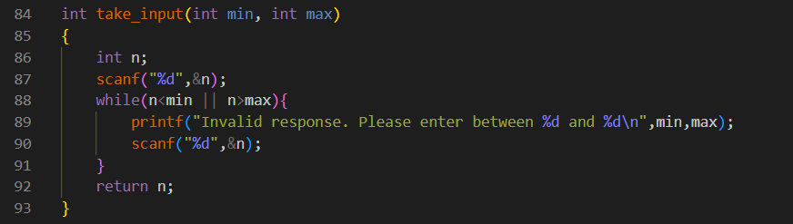
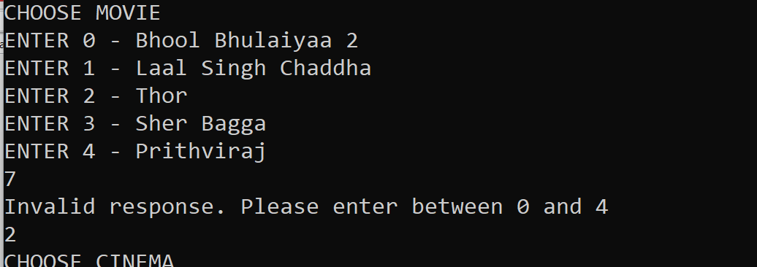
CODE
OUTPUT

Slide 7
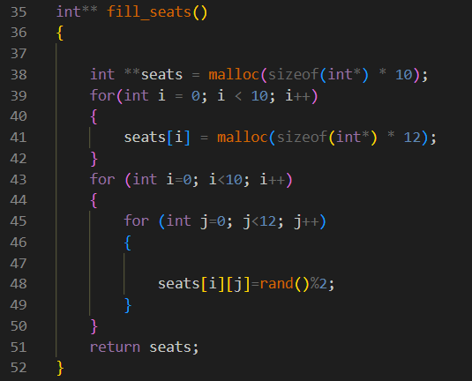
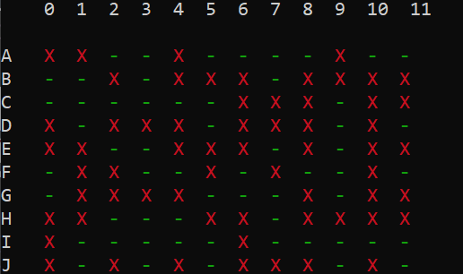
CODE
OUTPUT

Slide 8

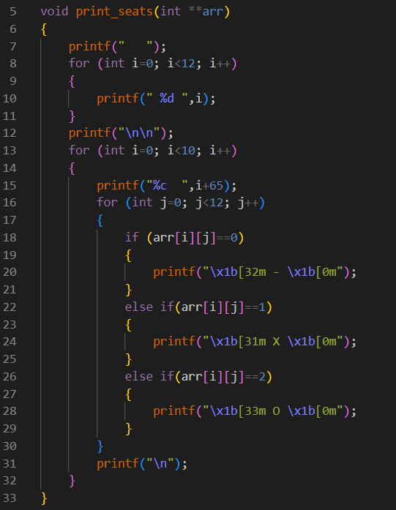
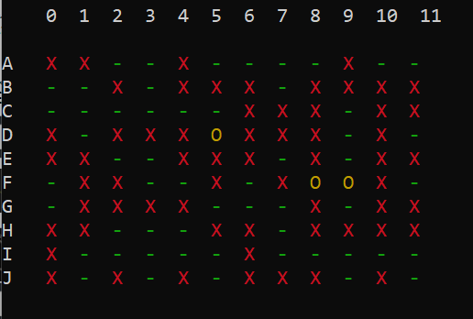
OUTPUT
CODE

Slide 9

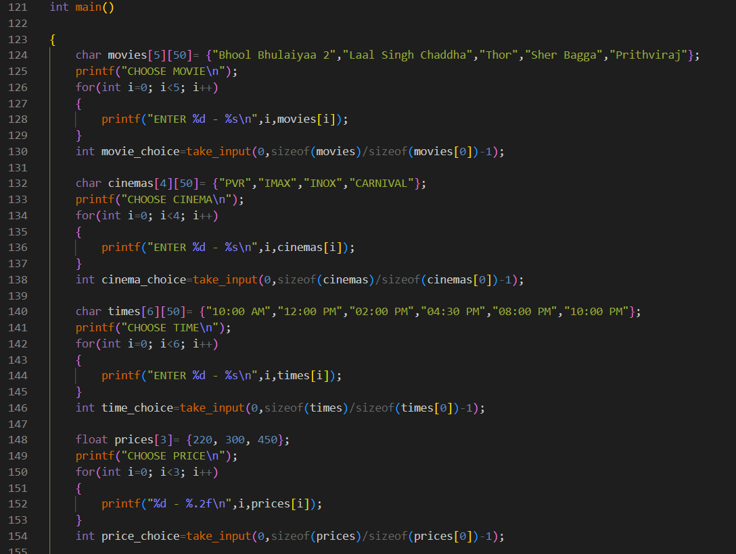

Slide 10
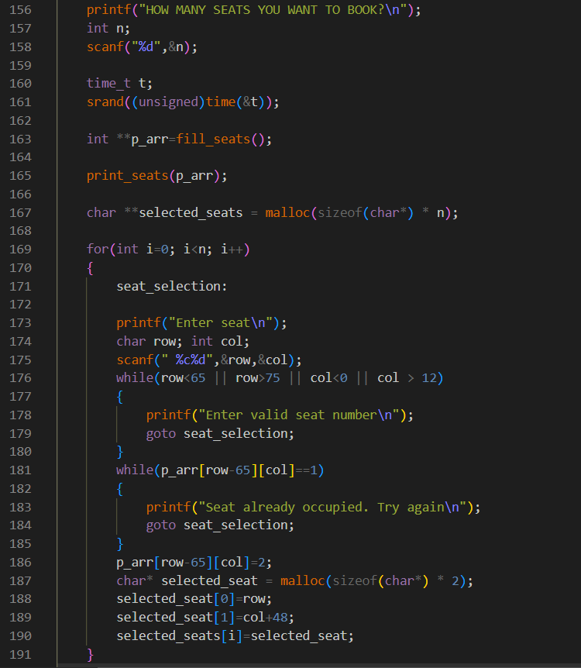

Slide 11
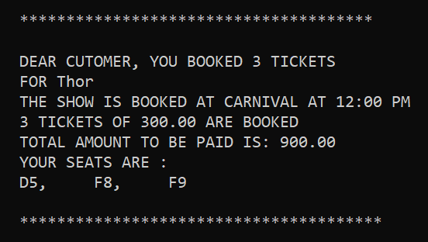
generate_bill
prints ticket on terminal.
takes in all entered choices by user.
calculates total amount.
print_bill
works similar to generate_bill.
saves ticket in txt file.
writes in file.

Slide 12
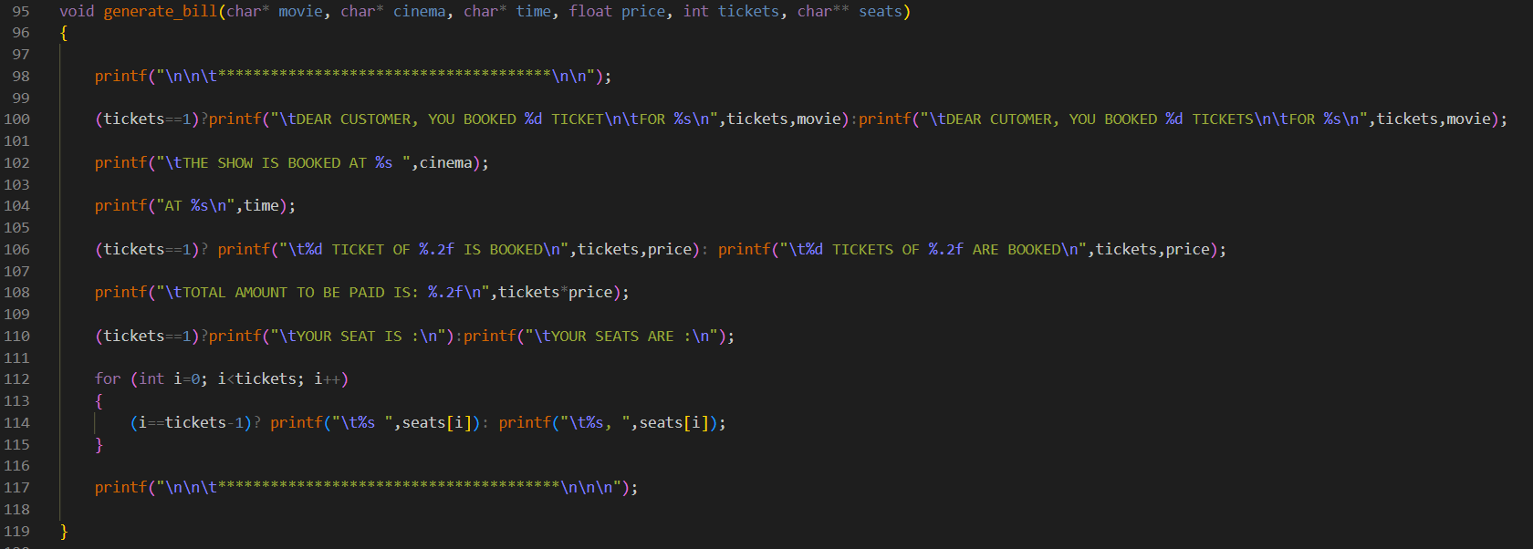
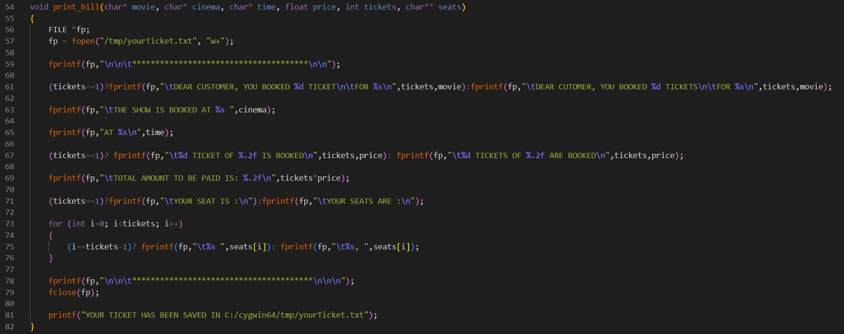

Slide 13
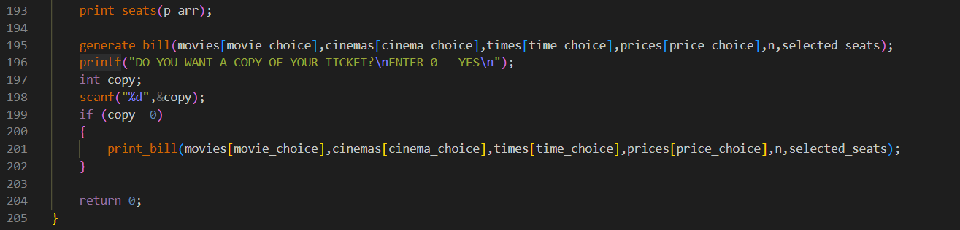

Slide 14

THANK YOU

