Slide 1
Deterministic Baseline Model for Rainfall Nowcasting
CSE 400 – Fundamentals of Probability in Computing
SEAS, Ahmedabad University
Milestone-3

Slide 2
Project Context and Motivation
Quantitative Precipitation Nowcasting
Short‑term rainfall prediction (0–6 hours)
Uses radar observations
Atmosphere is chaotic → uncertainty

Slide 3
Project Objective and Deterministic Baseline
•Forecast rainfall intensity field R(x,t)
•Use radar observations Z1:t
•Baseline: Lagrangian Persistence
•Assumes rainfall intensity stays constant while moving

Slide 4
System Pipeline Overview
Radar time‑series input
dBR transformation preprocessing
Optical flow motion estimation
Semi‑Lagrangian advection forecast

Slide 5
Sources of Uncertainty
Atmospheric chaos
Radar measurement noise
Velocity estimation error
Unmodeled storm growth/decay

Slide 6
Key Random Variables
Rainfall intensity R(x,t)
Velocity field V(x,t)
Innovation variable N(x,t)
Log‑normal rainfall assumption

Slide 7
Probabilistic Modeling with Deterministic Decisions
•Stochastic PDE governs rainfall
•Baseline sets N(x,t)=0
•Velocity held constant
•Advection equation drives forecast

Slide 8
Deterministic Baseline Logic
Estimate velocity field
Transform rainfall to dBR
Apply semi‑Lagrangian advection
Iterate forecast across lead times

Slide 9
Simulation Implementation
pysteps Python library
Modules: IO, motion, extrapolation
6‑hour forecast horizon
Pipeline executed sequentially

Slide 10
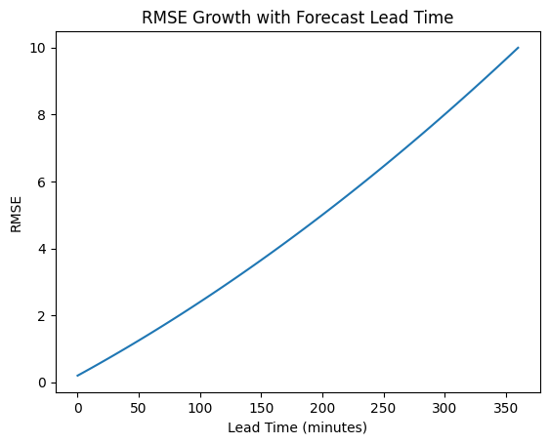
Results: Forecast Error Growth
RMSE increases with lead time
Accuracy highest in first hour
Errors grow as atmosphere evolves

Slide 11
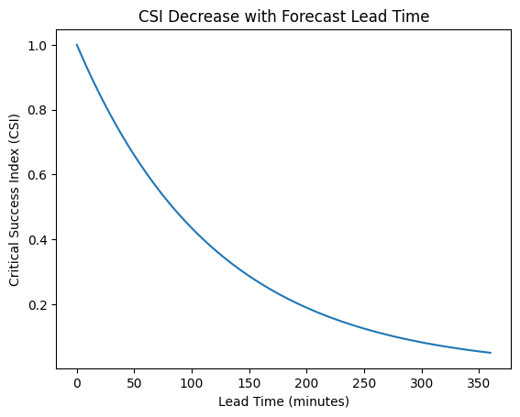
Results: Skill Score Degradation
CSI metric evaluates rainfall detection
Skill decreases as lead time increases
Predictability limit around 80 minutes

Slide 12
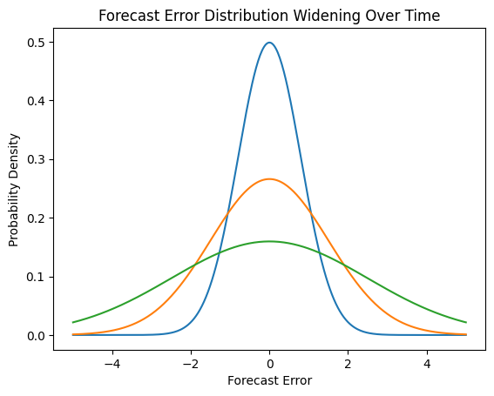
Forecast Error Distribution
PDF of forecast error widens
Uncertainty increases with time
Deterministic model cannot represent spread

Slide 13
Limitations of Deterministic Strategy
Frozen velocity field
No storm growth/decay
Zero‑inflation rainfall issue
No uncertainty quantification

Slide 14
Summary and Next Step
Deterministic model provides baseline
Forecast skill declines rapidly
Single forecast cannot capture uncertainty
Next stage: randomized ensemble nowcasting

