Slide 1
Randomized Algorithm for Precipitation Nowcasting
CSE 400 – Fundamentals of Probability in Computing
SEAS, Ahmedabad University
Milestone-4

Slide 2
Project Context and Motivation
Project: Precipitation Nowcasting
Domain: Radar-based rainfall forecasting
Objective: Predict future rainfall field
Weather systems are uncertain
Deterministic models ignore variability

Slide 3
Deterministic Baseline Overview
Lagrangian persistence model
Rainfall advected using velocity field
No randomness → single forecast
Limitations:
->No uncertainty modeling
->Ignores storm growth/decay
->Errors increase over time

Slide 4
System Pipeline Overview
Radar data → preprocessing
Motion estimation
Advection step (decision rule)
Forecast generation
Evaluation metrics

Slide 5
Sources of Uncertainty
Radar measurement noise
Motion estimation errors
Atmospheric variability
Intensity changes over time

Slide 6
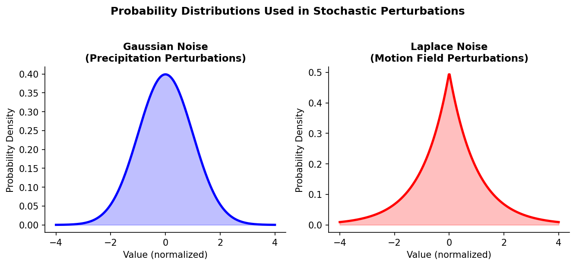
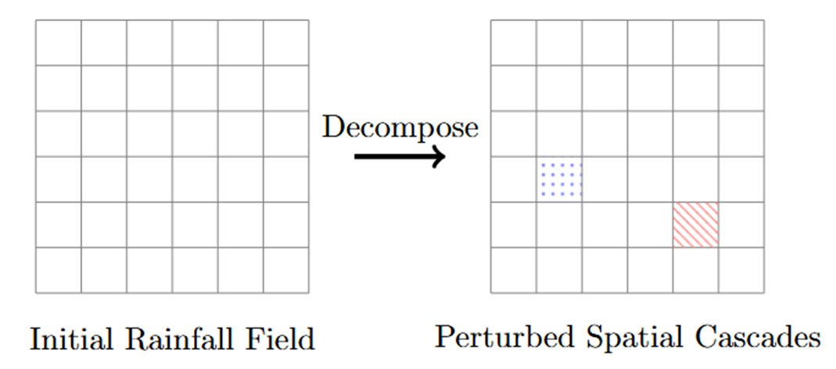
Random Variables in the System
Velocity field perturbation
Rainfall intensity variation
Noise variables introduced
Distributions:
->Gaussian (intensity)
->Laplace (motion)

Slide 7
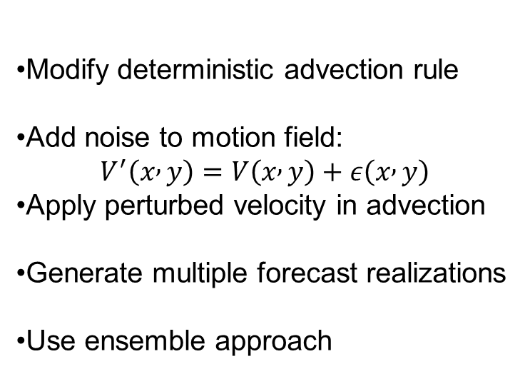
Randomized Algorithm Design
Modify deterministic advection rule
Add noise to motion field: $V^{′}\left(x , y\right)=V\left(x , y\right)+ε\left(x , y\right)$
Apply perturbed velocity in advection
Generate multiple forecast realizations
Use ensemble approach

Slide 8
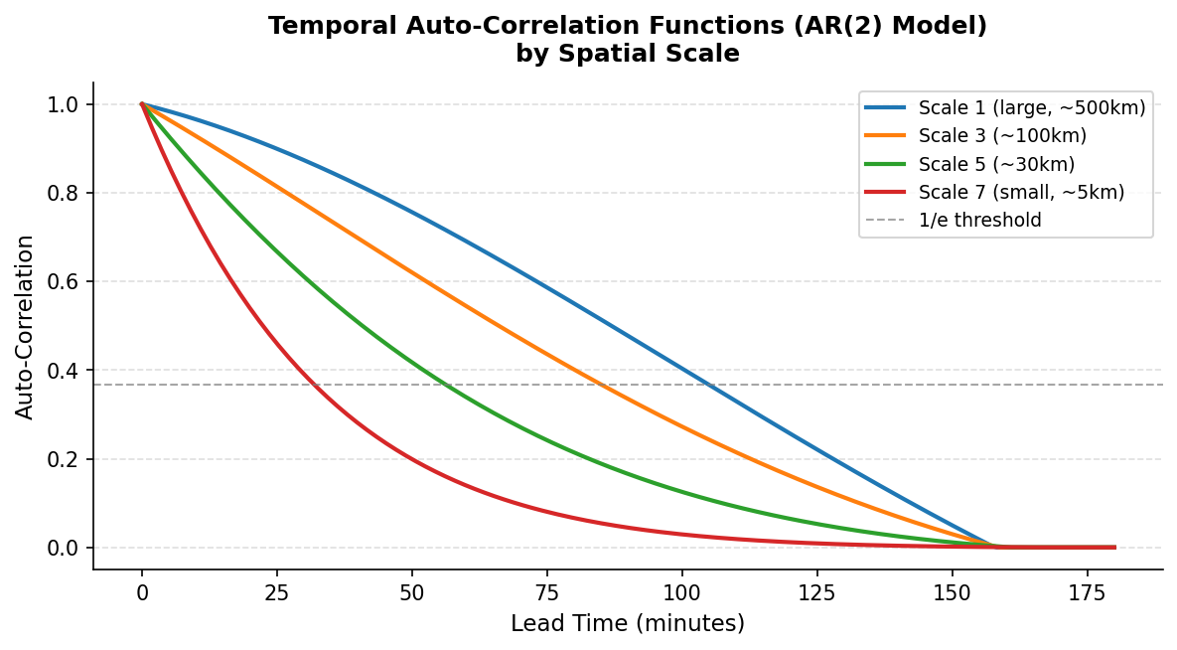
Probabilistic Reasoning Behind the Algorithm
Weather systems are stochastic
Randomness captures variability
Ensemble reduces prediction bias
Improves robustness
Avoids overconfident predictions

Slide 9
Implementation of the Randomized Strategy
Step 1: Input radar rainfall field
Step 2: Estimate motion field
Step 3: Sample noise (Gaussian / Laplace)
Step 4: Perturb motion field
Step 5: Perform advection
Step 6: Repeat for multiple runs
Step 7: Aggregate outputs (mean / spread)

Slide 10
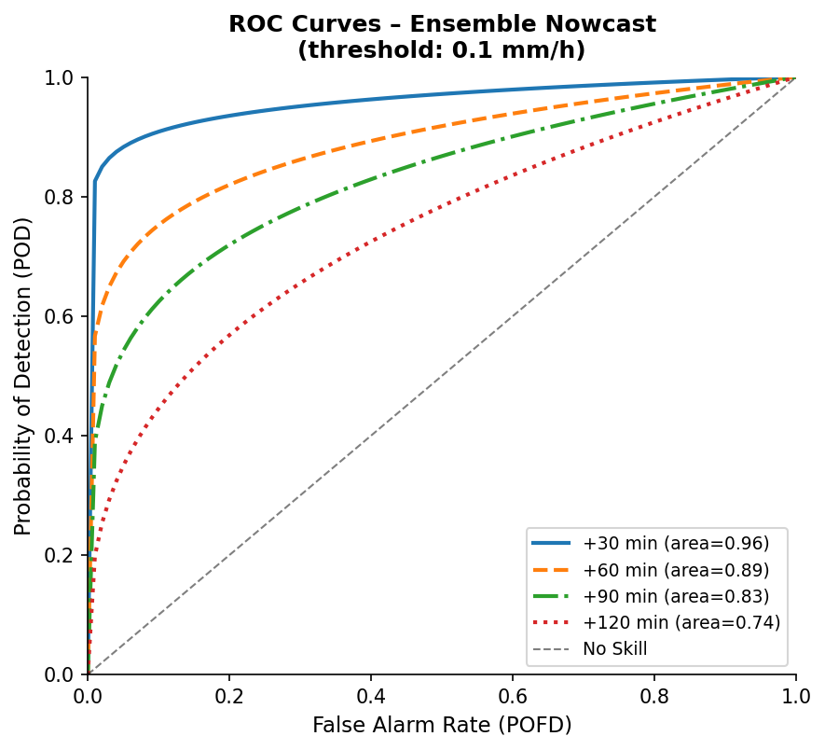
Evaluation Metrics
Mean Squared Error (MSE)
RMSE / MAE
Reliability
Ensemble spread

Slide 11
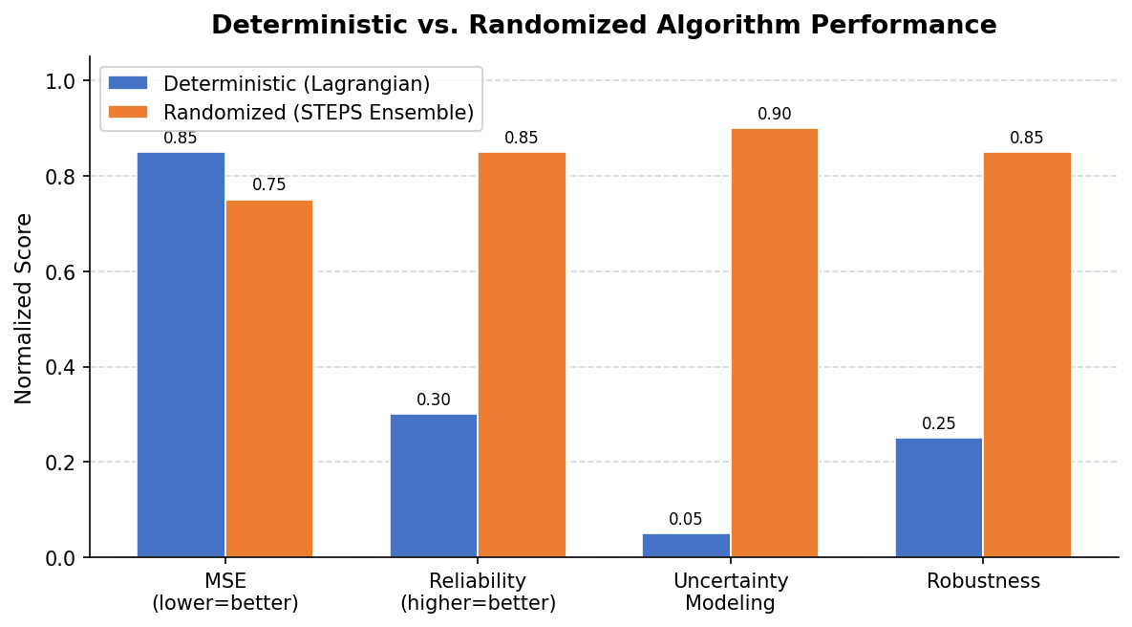
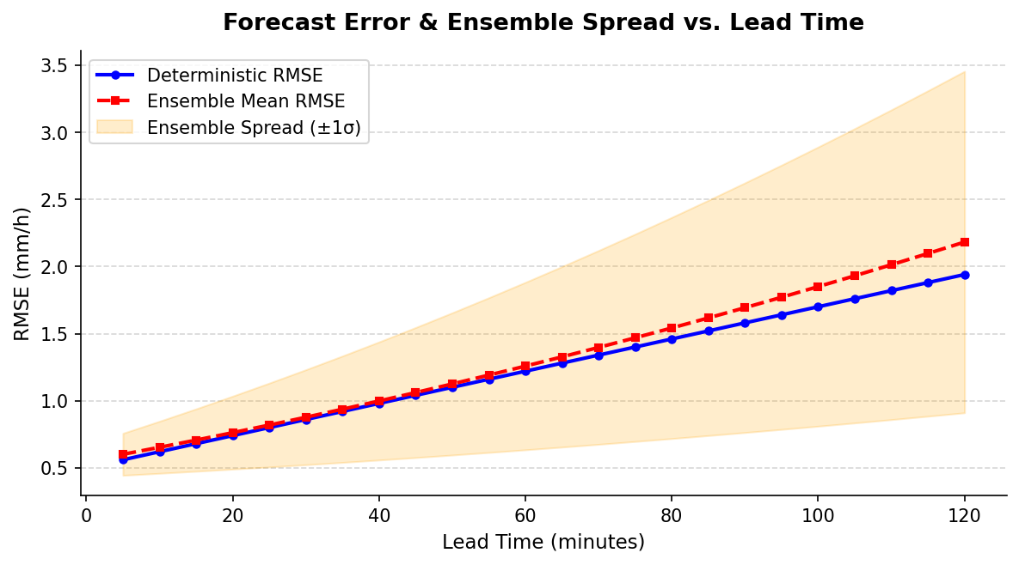
Comparative Results
Deterministic:
->Higher accuracy (short-term)
->No uncertainty
Randomized:
->Better reliability
->Captures variability
->Improved robustness

Slide 12
Key Insights
Randomization improves realism
Ensemble gives better understanding
Trade-off: accuracy vs reliability
Useful for uncertain systems
Strong improvement over baseline

