Slide 1
Probabilistic Precipitation Nowcasting
CSE 400 – Fundamentals of Probability in Computing
SEAS, Ahmedabad University
Milestone-2

Slide 2
Problem Statement
Deterministic atmospheric models fail due to chaos
Error grows unbounded for lead time τ > 0
QPN requires probabilistic formulation
Goal: Construct continuous predictive PDFs

Slide 3




Probabilistic Reformulation
Define probability space:
Spatial domain:
Time horizon:
Objective:

Slide 4

The Foundational Triad Model
Three interacting random fields:
R(x,t) – Rainfall intensity
V(x,t) – Advection vector field
N(x,t) – Stochastic innovation

Slide 5


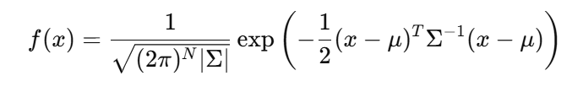
Log-Normal Transformation
Raw rainfall is skewed.
Transform:
Multivariate Gaussian PDF:

Slide 6

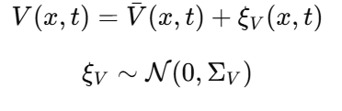
Advection Field Modeling
Optical Flow PDE:
But ill-posed → structural uncertainty.
Model:

Slide 7


Spatially Correlated Innovation
White noise destroys coherence.
Instead:
Isotropic covariance:
where h=∣∣x−x′∣∣

Slide 8


Discrete State Transition
From SPDE to discrete form:
Markov Property:

Slide 9

Temporal Memory (AR(2))
Noise evolution:
Ensures:
Stationarity
Mesoscale memory

Slide 10



Spectral Simulation (FFT)
Direct covariance sampling:
Instead use Wiener–Khinchin:
Complexity:

Slide 11
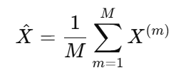

Monte Carlo Ensemble
Generate M i.i.d. trajectories
Estimator:
By WLLN:

Slide 12
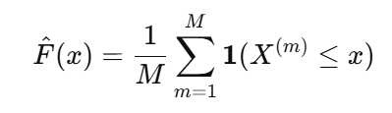
PDF & CDF Evolution
Monte Carlo gives empirical:
PDF → histogram
CDF →
Variance increases with τ.

Slide 13

Chebyshev Bound
Generate M i.i.d. trajectories
Forecast uncertainty expands over time.

Slide 14
Limitations
Frozen advection field
Stationary noise
Zero-inflation anomaly
Gaussian tail limitations
FFT boundary artifacts

Slide 15
Future Work
Stochastic V(x,t)
Heteroscedastic covariance
Tobit censoring model
Extreme Value calibration
Domain padding for FFT

Slide 16
Conclusion
Rainfall modeled as stochastic dynamic field
Continuous predictive PDFs
Ensemble-based uncertainty quantification
Computationally tractable via FFT + Monte Carlo
Probabilistic modeling enables robust risk assessment.

