Slide 1

IES COLLEGE OF TECHNOLOGY, BHOPAL
AI MEETING INTELLIGENCE SYSTEM
Smarter Meetings, Real-Time Translation, and Automated Summary Dashboard
Minor Project Presentation | 6th Semester
Branch: Computer Science & Engineering
Project Team: Minor Project CSE Group

Slide 2
Introduction: The Problem & The Solution
⚠️ THE PROBLEM
• Meeting Clutter & Time Waste: Conversations lack structure, and precious hours are spent on side discussions without meeting their goals.
• Forgotten Details: Key details, metrics, or announcements shared on calls are forgotten by 80% of participants within 24 hours.
• Poor Action Item Tracking: Tasks are mentioned verbally but not logged or explicitly assigned, leading to missed deadlines.
• Manual Transcription Burnout: Taking detailed minutes of meetings manually is exhausting, inaccurate, and takes hours after the call.
💡 THE AI SOLUTION
• AI Copilot Assistant: Automatically listens, tracks, and extracts insights from your meeting in the background.
• Real-Time Speech-to-Text: Provides live transcription using speech recognition algorithms directly in the browser.
• Smart Summarization: Generates concise, context-aware bullet points and overall engagement scores instantly when the session ends.
• Automated Action-Item Assignment: Recognizes tasks and assignees, assigning them deadlines and saving them to a dashboard database.

Slide 3
Technical Architecture & System Flow
🛠️ TECHNOLOGY STACK
✔ Frontend Layer: Vite + React.js, Web Speech API (transcription), HTML5 Canvas WebRTC (P2P stream routing)
✔ Backend Core: Node.js & Express.js server, Socket.io duplex channels, JWT Auth
✔ Database Layer: MongoDB + Mongoose schemas, with local JSONDB fallback for server resilience
✔ AI Summarization: Google Gemini Developer API (Natural Language Processing for agendas and summaries)
🔄 ARCHITECTURE DATA PIPELINE
React Client
(Browser)
Node Backend
(Socket.io)
AI Summarizer
(Gemini API)
Persistence Layer
MongoDB or JSON Database Fallback
Flow Description: Speech input is captured at the client, pushed dynamically via Socket.io to the server. The server tracks live durations, sends transcripts to the Gemini API on close, and persists results safely to MongoDB or local JSON files.

Slide 4
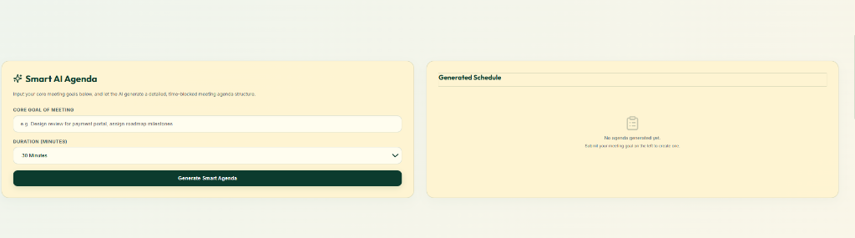
Prototype UI: Smart AI Agenda Generation
📋 INTERFACE ELEMENT: AI AGENDA BUILDER
• Core Goal input: Users type specific project goals (e.g., 'design review for payment portal, roadmap milestones'). • Duration Dropdown: Allows selection of meeting length (30m, 1h, etc.) to calculate time slots. • Automatic Agenda Schedule: Generates a checklist showing the exact chronological agenda items (Project Update, Discuss Roadmap, etc.).

Slide 5
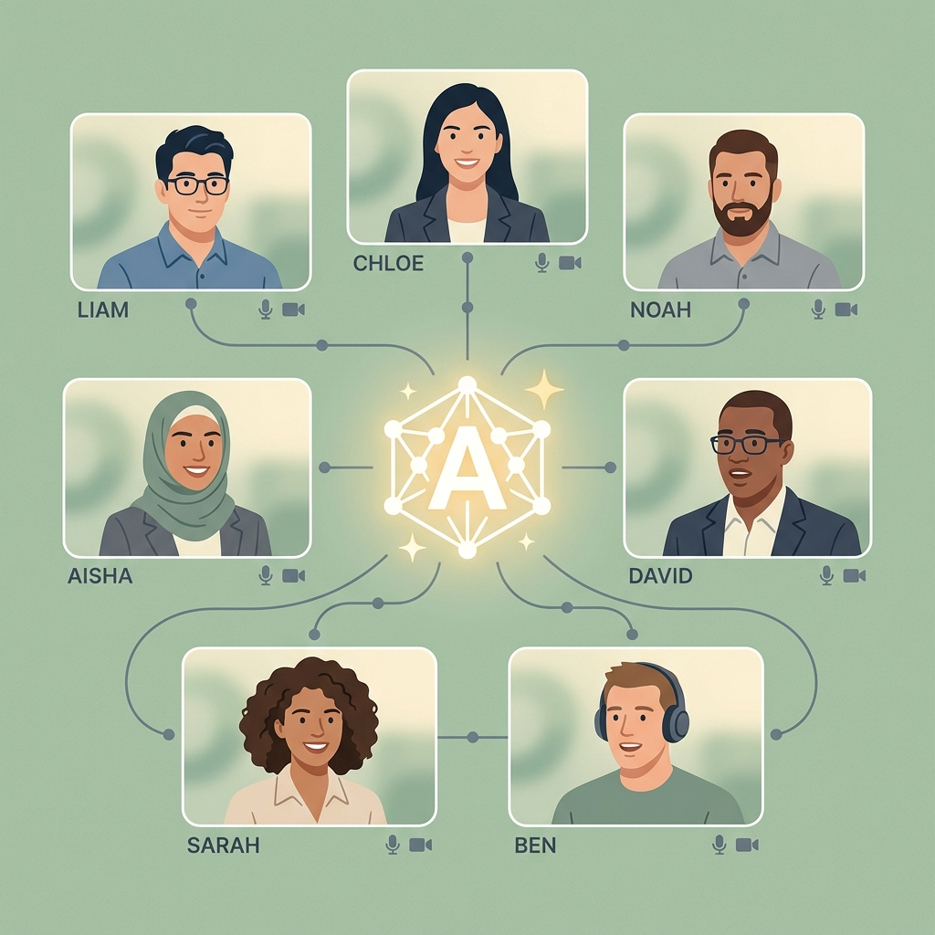
Prototype UI: Meeting Room & AI Hub Connections
💻 MEETING ROOM NETWORK DESIGN
✔ Central AI Core Hub: Transcribes speech from multiple call feeds and pipes them instantly into closed captioning modules.
✔ Real-Time Speaking Balance: Detects who is speaking (Liam, Chloe, Noah, Aisha, David, Sarah, Ben) and log stats to the server.
✔ WebRTC Peer Connections: Utilizes canvas rendering to project participant video feeds dynamically, minimizing delay.
✔ Socket State Synchronization: Synchronizes microphone and camera hardware changes instantly across all participant views.

Slide 6
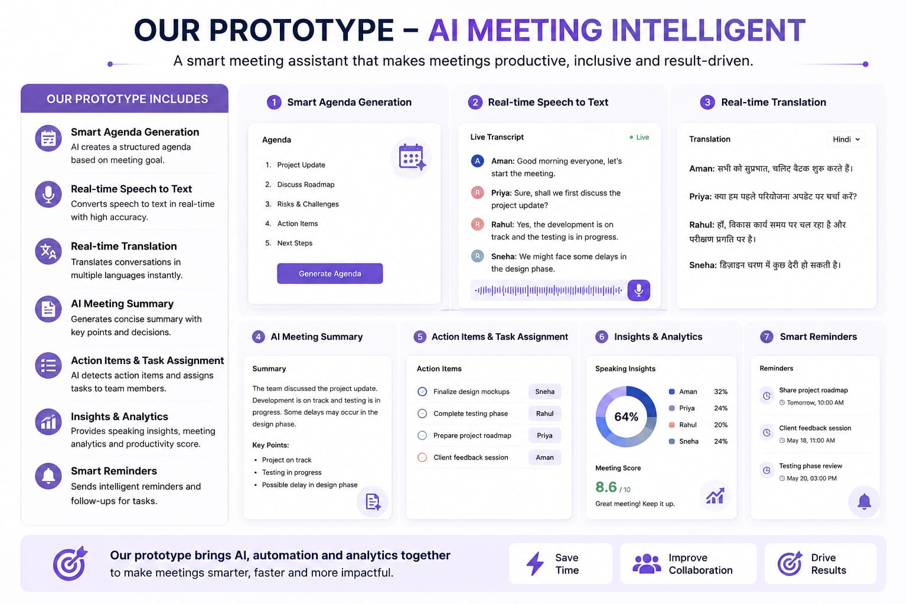
System Prototype: Integrated Components Overview
💡 SYSTEM CAPABILITY INDEX
• Real-Time Speech-to-Text: HTML5 speech recognition logs transcripts in real-time.
• Multi-Language Translation: Translates speech logs into Hindi, Spanish, French instantly.
• AI Meeting Summary: NLP-driven context parsing creates bulleted summaries & next steps.
• Insights & Speaking Analytics: Calculates speaking share percentages and meeting quality scores.

Slide 7
Core Capabilities & System Uniqueness
🚀 CORE FEATURES
• Voice-to-Chat Transcription: Converts spoken words to clean text logs inside a chatbox dynamically using HTML5 Speech APIs.
• Smart NLP Agenda Generator: Analyzes the main goals of the meeting and automatically structures a draft agenda.
• AI Summaries & Action Items: Builds a bulleted summary of key decisions, points, and extracted checklist tasks after meeting close.
• Real-Time Speech Translation: Instantly translates incoming voice transcriptions to target languages (Hindi, Spanish, French).
⭐ UNIQUE ADVANTAGES
• Dual-Layer Chrome Extension: Integrates natively with Google Meet/Zoom, scraping and syncing real-time states invisibly to the app.
• Hardware Toggle Tracking: Analyzes User-Agent states and keeps a precise log of how many times a user switches mic/camera.
• Inclusive Collaboration Analytics: Tracks speaking percentage balance and alerts hosts if certain participants are ignored.
• Zero-Config JSONDB Fallback: If MongoDB fails, the system self-heals by dynamically routing database queries to local JSON files.

Slide 8
Benefits, User Impact & Economic Value
👤 BENEFIT TO THE USER
✔ Save 30-40% Time Per Call: Eliminates minutes writing, manual summaries, and the need to follow up with users directly after meetings.
✔ 100% Accountability: Extracted action items are saved with clear owners and due dates, ensuring tasks are not lost.
✔ Seamless Communication: Real-time voice translation allows multi-lingual teams to interact comfortably without language barriers.
✔ Enhanced Focus: Teams can focus entirely on the discussion rather than multitasking between listening and note-taking.
📈 MACRO-ECONOMIC VALUE
✔ Reduces Corporate Waste: Unproductive meetings cost billions globally. AI summaries reduce meeting overload and save corporate billing hours.
✔ Accelerates Business Cycle: Action items auto-assigned are completed faster, cutting down project turnaround time and accelerating product delivery.
✔ Facilitates Global Sourcing: Language translation unlocks global workforce potential, allowing companies to collaborate and hire without local constraints.
✔ SaaS Scalability & High ROI: Minimal server compute overhead coupled with highly optimized API usage delivers scalable tech with massive return on investment.

Slide 9
System Architecture & Meeting Data Workflow
1. Active Call (Google Meet / Zoom)
2. Scrape CC (DOM content parser)
3. Socket Hub (Socket.io duplex sync)
4. AI Summary (Gemini API NLP parsing)
5. DB Sync (MongoDB / JSONDB)
💻 TECHNICAL WORKFLOW DESCRIPTION
• Chrome Extension DOM Scraper: Runs script bridges on active Google Meet or Zoom tabs to scrape mic/camera statuses and transcribe closed captions (CC).
• WebSocket Event-driven Hub: Socket.io relays events (`toggle-media`, `speech-transcribed`) instantly to the Node.js backend to record participation analytics.
• AI NLP Summary & JSON Storage: When the session is closed, the backend sends the transcript to the Gemini NLP engine, maps tasks to assignees in Mongoose Schema, and stores them in local JSONDB files/MongoDB.

