Slide 1
Image Segmentation using Otsu’s Method
By-
Abhinav Garg (101303004)
Akshit Arora(101303012)
Akul Gupta(101303013)
Anmoldeep Singh(101303027)

Slide 2
Otsu’s Thresholding Method
(1979)
Based on a very simple idea: Find the threshold that minimizes the weighted within-class variance.
This turns out to be the same as maximizing the between-class variance.
Operates directly on the gray level histogram [e.g. 256 numbers, P(i)], so it’s fast (once the histogram is computed).

Slide 3
Problem
It is important in picture processing to select an adequate threshold of grey level for extracting objects from their background. Before Otsu, A variety of techniques have been proposed in this regard. In an ideal case, the histogram has a deep and sharp valley between two peaks representing objects and background, respectively, so that the threshold can be chosen at the bottom of this valley. However, for most real pictures, it is often difficult to detect the valley bottom precisely, especially in such cases as when the valley is flat and broad, imbued with noise, or when the two peaks are extremely unequal in height, often producing no traceable valley.

Slide 4
Otsu’s: Assumptions
Histogram (and the image) are bimodal.
No use of spatial coherence, nor any other notion of object structure.
Assumes stationary statistics, but can be modified to be locally adaptive. (exercises)
Assumes uniform illumination (implicitly), so the bimodal brightness behavior arises from object appearance differences only.

Slide 5
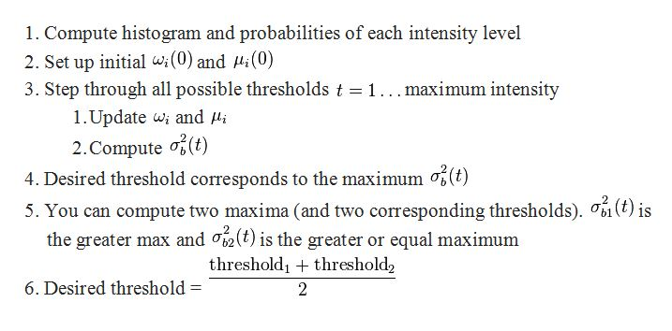
Algorithm Used

Slide 6
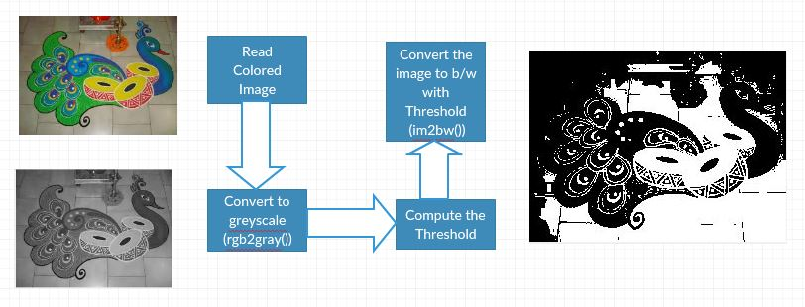

Slide 7
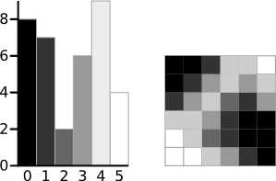
A 6-level greyscale image and its histogram

Slide 8
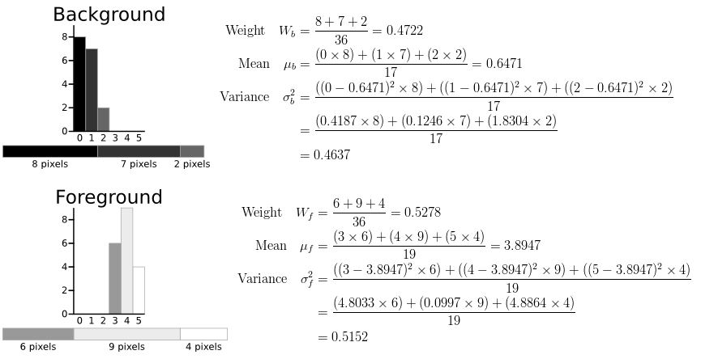


Slide 9
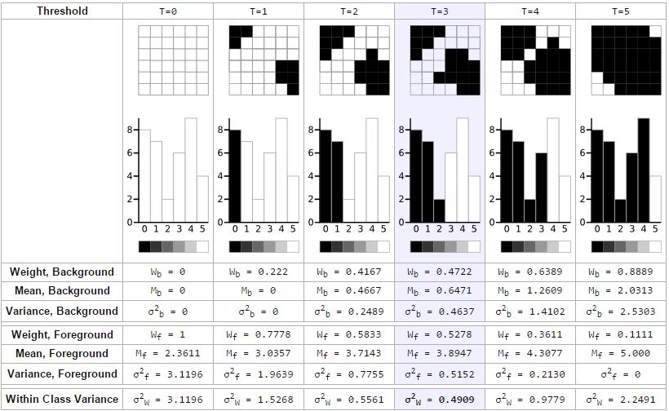

Slide 10
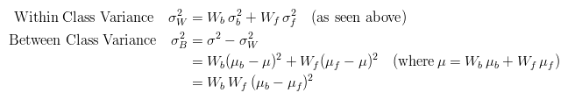
A Faster Approach
Threshold | T=0 | T=1 | T=2 | T=3 | T=4 | T=5
Within Class Variance | σ²_{W} = 3.1196 | σ²_{W} = 1.5268 | σ²_{W} = 0.5561 | σ²_{W} = 0.4909 | σ²_{W} = 0.9779 | σ²_{W} = 2.2491
Between Class Variance | σ²_{B} = 0 | σ²_{B} = 1.5928 | σ²_{B} = 2.5635 | σ²_{B} = 2.6287 | σ²_{B} = 2.1417 | σ²_{B} = 0.8705

Slide 11
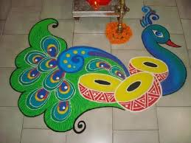
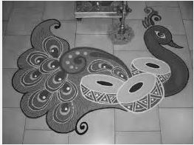
Outcomes
Input:
RGB2GRAY

Slide 12
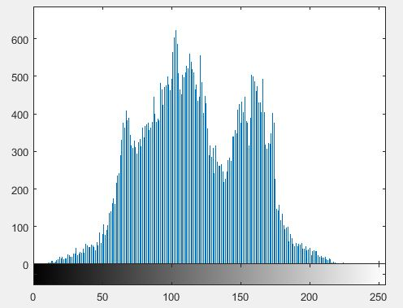
Histogram of gray image

Slide 13
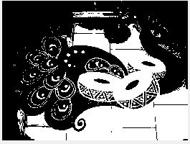
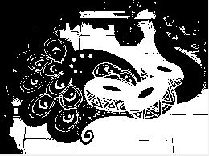
Output of Manual Thresholding
Output using Graythresh function (Otsu’s Method)

Slide 14
Conclusion
A method to select a threshold automatically from a gray level histogram has been derived from the viewpoint of discriminant analysis. This directly deals with the problem of evaluating the goodness of thresholds. The range of its applications is not restricted only to the thresholding of the gray-level picture, such as specifically described in the foregoing, but it may also cover other cases of unsupervised classification in which a histogram of some characteristic (or feature) discriminative for classifying the objects is available. Taking into account these points, the method suggested in this correspondence may be recommended as the most simple and standard one for automatic threshold selection that can be applied to various practical problems.

Slide 15
Achievements
Pattern recognition: Pattern recognition involves study from image processing and from various other fields that includes machine learning (a branch of artificial intelligence).
Video processing: A video is nothing but just the very fast movement of pictures. The quality of the video depends on the number of frames/pictures per minute and the quality of each frame being used.

Slide 16
Achievements
Medical Applications: The need for accurate segmentation tools in medical applications is driven by the increased capacity of the imaging devices. Common modalities such as CT and MRI generate images which simply cannot be examined manually, due to high resolutions and a large number of image slices.
Object Detection: Object detection is a computer technology related to computer vision and image processing that deals with detecting instances of semantic objects of a certain class (such as humans, buildings, or cars) in digital images and videos.

Slide 17
References
http://web-ext.u-aizu.ac.jp/course/bmclass/documents/otsu1979.pdf
https://en.wikipedia.org/wiki/Otsu%27s_method
http://in.mathworks.com/help/images/examples/correcting-nonuniform-illumination.html
https://youtu.be/i1wAoIDar48

