Slide 1



Global Warming
Project Members
Akshit Arora
Geofrey Mercado
Nikhil Chullipparambil
Sam Deschampss

Slide 2
Contents
Motivation & Summary Slide
Questions & Data
Data Cleanup & Exploration
Data Analysis
Discussion
Post Mortem
Questions

Slide 3
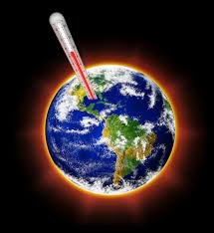
Hypothesis
Countries globally are experiencing a change(increase) in temperature due to growth in urbanization, industrialization and depleting forest cover.

Slide 4


Questions?
How much has surface temperature changed over the past few years?
Which factors can be considered that may be impacting the “rise in temperature”?
Which countries should be accounted for in the study?
Data
We found the average monthly temperatures for countries from the early 1900s to 2013 on Kaggle.com.
We referred to the world population csv, in order to short-list countries (top 5) according to population.
From World Bank Group website, we used the csv file which contained data on CO2 emission, Air Pollution, and Forest cover percentage by country.

Slide 5
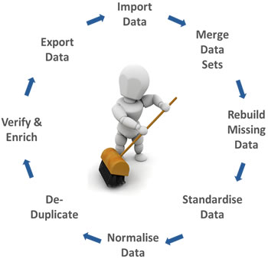
Data Cleaning & Exploration

Slide 6
Read Population.csv file, convert it to a dataframe and short-list 5 most populated countries
Read Temperature.csv, convert it to a dataframe
The time period was in a time format so had to convert it into years (presentable format)
All our data points had different start and end-year so, to maintain consistency we considered a time-period, 1960 to 2013 for our analysis
Temperature data was exhaustive. Extracted data from year 1960 to 2013 and for short-listed countries.
Made it dynamic, passing the country list and number of countries as argument
Calculating Relative temperature, taking 1960 for each country as zero and calculating difference in temperature taking 1960 as the base year.
World Development Index csv had exhaustive list of countries and factors. Selected factors to be considered for our study and the converted those factors into a dictionary of dataframe

Slide 7
Data Analysis
We plotted factors such as Air Pollution, CO2 emission, forest cover percentage for each country)
We tried to understand the trend of average temperature and relative temperature for countries under study
We used different types(scatter, bar, bubble) of graphs to understand the impact of factors considered

Slide 8
Findings
The major factor that impacts global warming is CO2 emission. Other two factors considered in our study PM 2.5 (air pollution) and Forest Cover percentage have remained almost constant in the period of study, hence, seems to have negligible affect in rise in temperature.
From the data, we can analyze that US and China have the highest CO2 emission per capita and have also witnessed the highest change in temperatures since 1960.

Slide 9
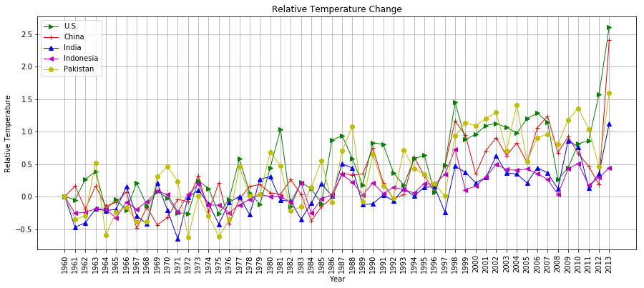
After 1997, the relative temperature for all the countries have been >0 and highest for US followed by China.

Slide 10
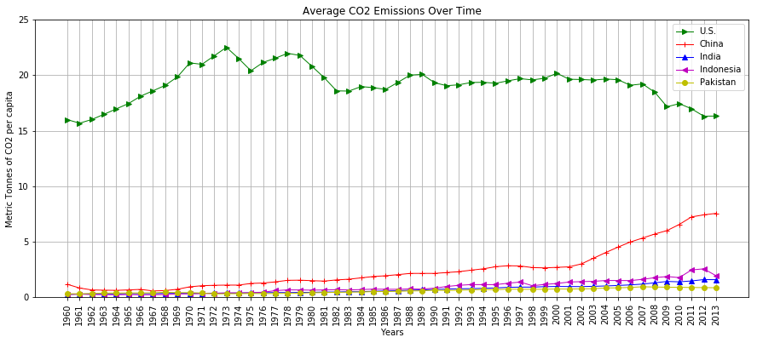
US emits the highest metric tons of CO2 per capita among all countries. Although in the past few years, the trend is decreasing but for China and India it has been increasing.

Slide 11
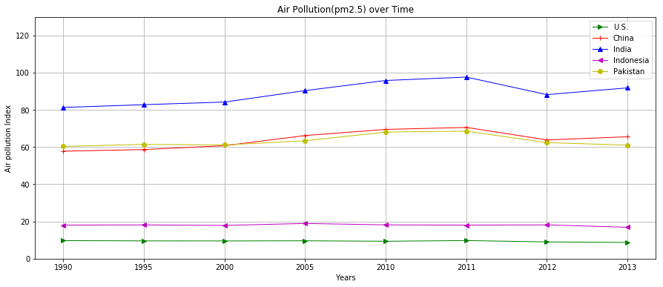

Slide 12
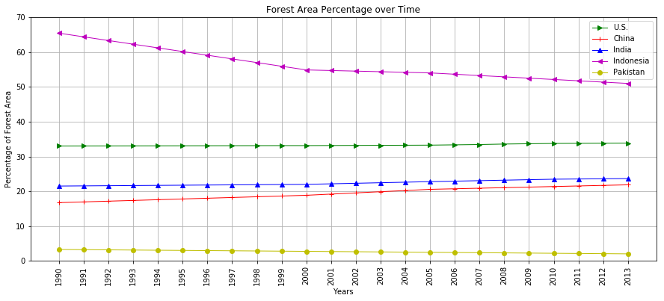

Slide 13
Challenges/ Post Mortem
We operated under the assumption that the most populated countries are the major contributors for global warming, and ignored less populous countries. Given more time we could have evaluated all.
Finding data for temperature was more difficult than we assumed. The apis that we found were mostly limited to current temperature or temperature of the last few weeks.
We had constraints regarding what data we had access to. We would have been able to analyze better if we had data from early 1900’s to the present, or even earlier if possible.
Based on our data visualizations we can gather that average surface temperature will continue to increase if co2 emissions are not curbed. Highly developed countries in terms of industry like China and the U.S. are particularly culpable.

Slide 14


