Slide 1
Media & Technology - real time data of YouTube and its content creators

Slide 2
Introduction
This project is based on the Media & Technology industry, where I analyzed real‑time YouTube data of different content creators.
The goal was to understand how various factors like subscribers, views, uploads, and earnings differ across countries and categories. Using the dataset provided, I explored patterns and relationships to gain insights into what drives success on YouTube.
This helped me learn how data can reveal trends in digital media and audience engagement.
Using the lectures from multiple videos I have completed this project using Google Colab.

Slide 3
Steps taken
Loaded the YouTube dataset in Python using pandas.
Cleaned missing and invalid data for accurate results.
Converted columns like subscribers, views, and earnings into numeric format.
Explored data using descriptive statistics and visualizations.
Found top channels, categories, and countries based on subscribers and views.
Checked correlations between subscribers, views, uploads, and earnings.
Analyzed growth trends in subscribers gained in the last 30 days.
Compared country‑level factors like population, education, and unemployment.
Visualized results using bar charts, scatter plots, and boxplots.

Slide 4
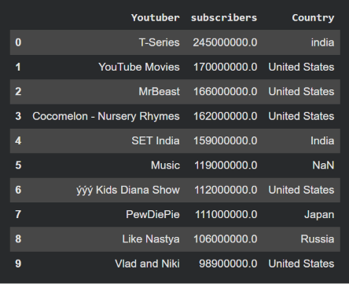
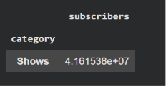
Questions solved
What are the top 10 YouTube channels based on the number of subscribers?
Which category has the highest average number of subscribers?

Slide 5
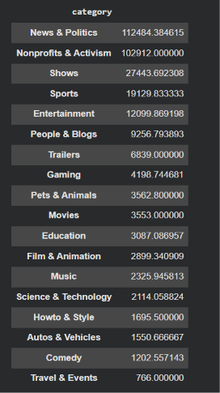
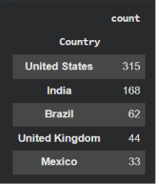
How many videos, on average, are uploaded by YouTube channels in each category?
What are the top 5 countries with the highest number of YouTube channels?

Slide 6
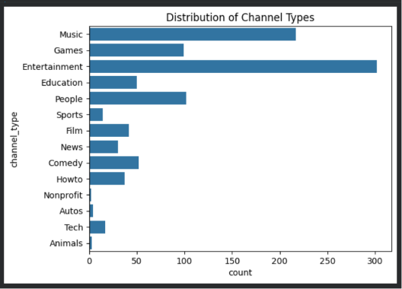
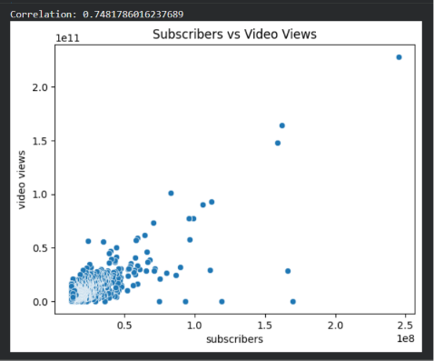
What is the distribution of channel types across different categories?
Is there a correlation between the number of subscribers and total video views for YouTube channels?

Slide 7
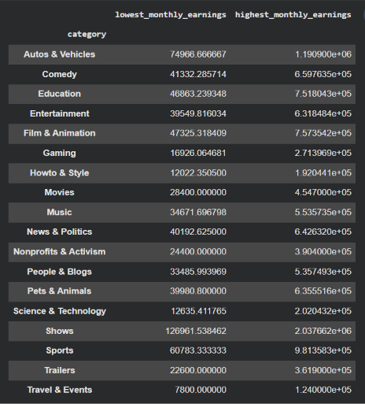

How do the monthly earnings vary throughout different categories?
What is the overall trend in subscribers gained in the last 30 days across all channels?

Slide 8
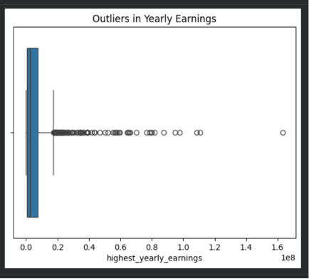
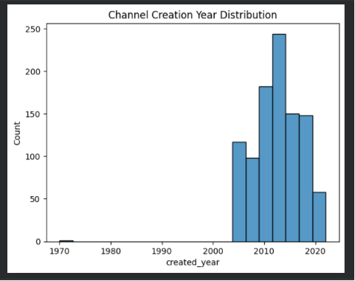
Are there any outliers in terms of yearly earnings from YouTube channels?
What is the distribution of channel creation dates? Is there any trend over time?

Slide 9
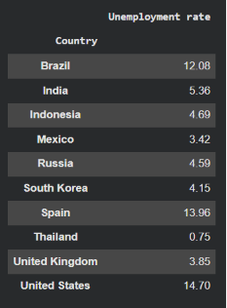

Is there a relationship between gross tertiary education enrollment and the number of YouTube channels in a country?
How does the unemployment rate vary among the top 10 countries with the highest number of YouTube channels?

Slide 10

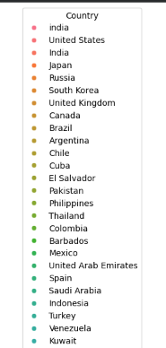
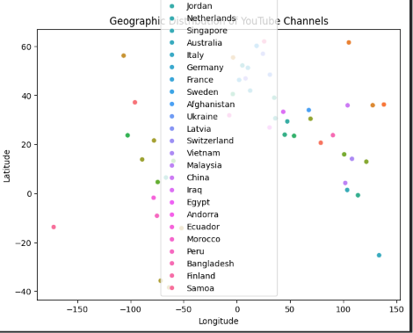
What is the average urban population percentage in countries with YouTube channels?
Are there any patterns in the distribution of YouTube channels based on latitude and longitude coordinates?

Slide 11

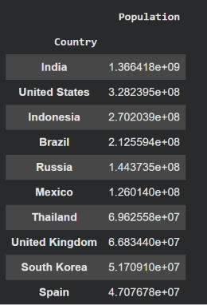
What is the correlation between the number of subscribers and the population of a country?
How do the top 10 countries with the highest number of YouTube channels compare in terms of their total population?

Slide 12
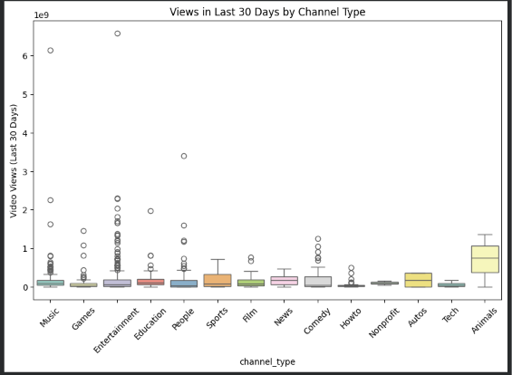

Is there a correlation between the number of subscribers gained in the last 30 days and the unemployment rate in a country?
How does the distribution of video views for the last 30 days vary across different channel types?

Slide 13
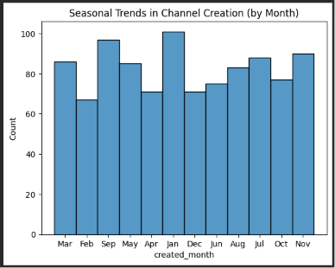

Are there any seasonal trends in the number of videos uploaded by YouTube channels?
What is the average number of subscribers gained per month since the creation of YouTube channels till now?

Slide 14
Insights
From the analysis, I found that T‑Series and MrBeast are among the top channels globally. The Music and Entertainment categories have the highest average subscribers and views, showing that these genres attract the largest audiences.
Countries like India and the United States dominate in terms of channel count and engagement. There is a weak correlation between uploads and views, meaning quality matters more than quantity.
I also noticed that channels created earlier tend to have higher subscriber counts, showing long‑term growth advantage.

Slide 15
Learnings
Through this project, I learned how to preprocess and analyze large datasets using Python. I understood how to use statistical functions and visualizations to interpret real‑world data.
It taught me how different metrics—like subscribers, views, and earnings—can be connected to audience behavior. I also learned the importance of cleaning data and checking correlations before drawing conclusions.
Overall, it improved my confidence in data analysis and visualization.

Slide 16
Conclusion
This project helped me understand the YouTube ecosystem from a data‑driven perspective. I concluded that success on YouTube depends on consistent engagement, content quality, and audience reach rather than just upload volume.
The Media & Technology industry shows how analytics can guide creators and companies to make better decisions. T
his case study strengthened my analytical thinking and gave me practical experience in applying data science to real‑world problems.

