Slide 1
ONLINE RECRUITMENT SYSTEM
(ORS)
Presented By:
Aditya Vyas
Akshita Vijay
Ankit Jangid
Ankit Shishodiya
Samarth Chaddha
Subin Jacob

Slide 2
OVERVIEW
This project is aimed at developing a job recruitment portal.
The primary function of this system is that job seekers can search for new jobs and employers can post jobs for job seekers.

Slide 3
USE CASE DIAGRAM
Register On Portal
Search Jobs
Update Information
Job Seeker
Register On Portal
Post Jobs
Employer

Slide 4
Edit Users
Delete Users
Admin

Slide 5
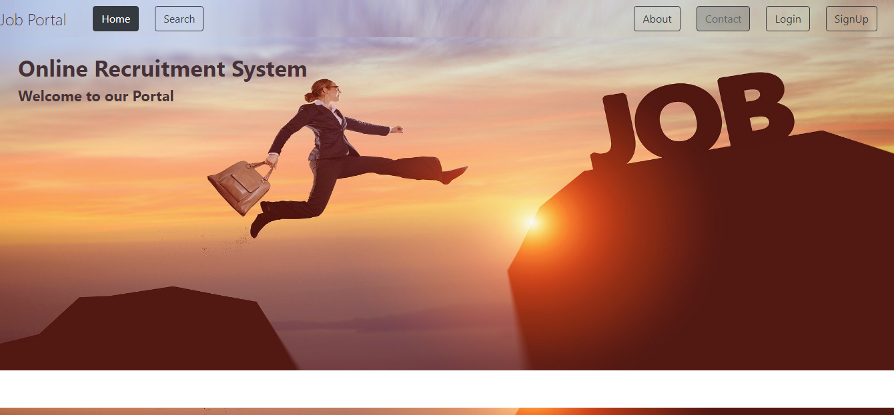
HOME PAGE

Slide 6
ROLES OF JOB SEEKER
Register On Portal: Job seeker can register on portal and then search for jobs.
Update Details: Job seeker can update his/her details along with resume so that employer know about the basic details and skills before finalizing that job seeker.
Search Job: Job seeker can search for various jobs using filters according to his/her choice.

Slide 7
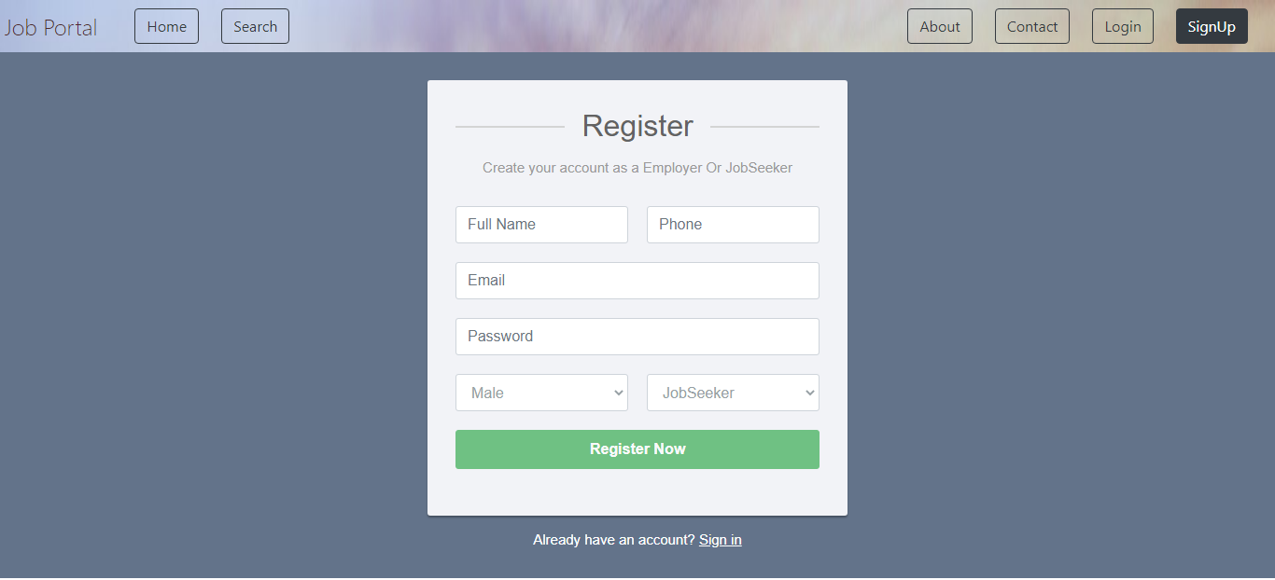
REGISTERATION

Slide 8
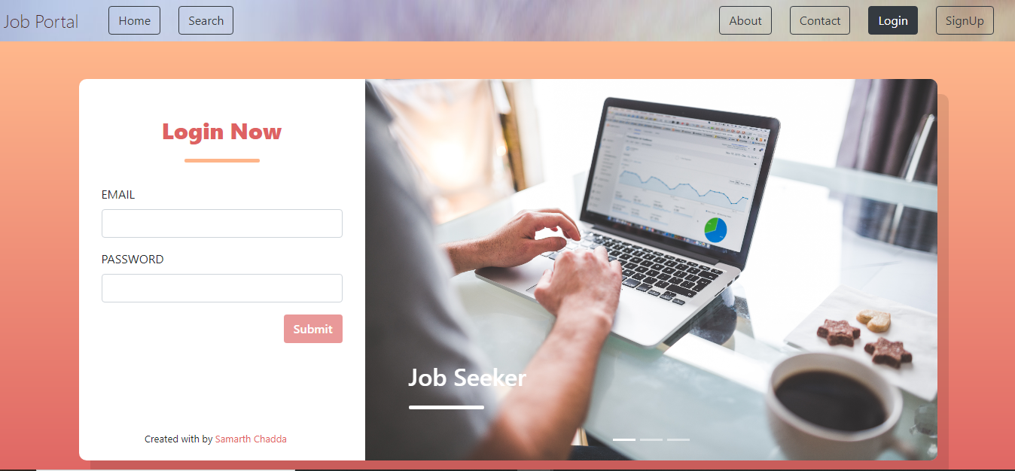
LOGIN

Slide 9
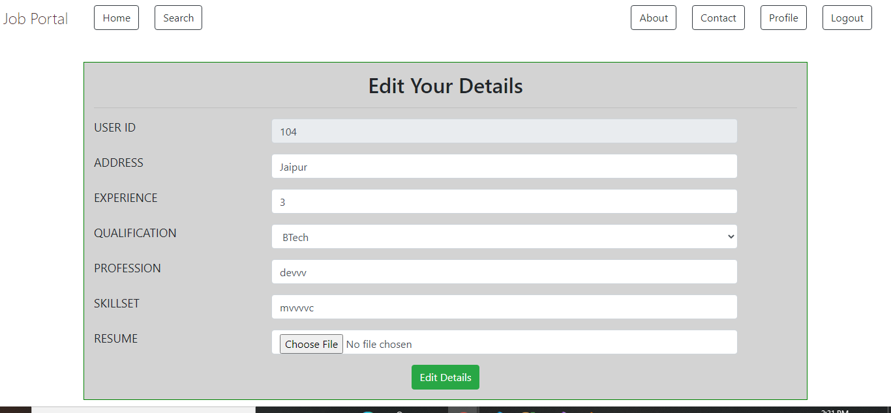
UPDATE INFORMATION

Slide 10
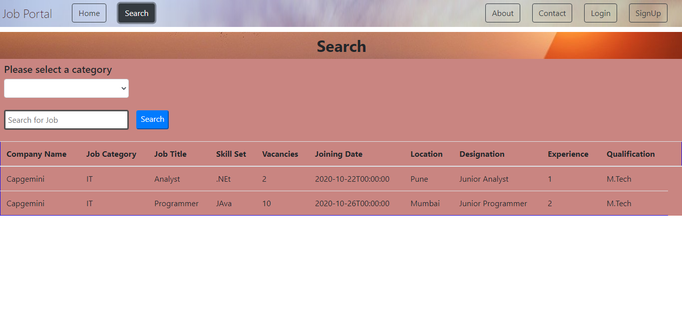
SEARCH JOBS

Slide 11
ROLES OF EMPLOYER
Resister On Portal: Employer can view received applications and their profiles before finalizing for the further process.
Post Job: Employer can post multiple jobs according to the vacancies available in his/her firm.

Slide 12
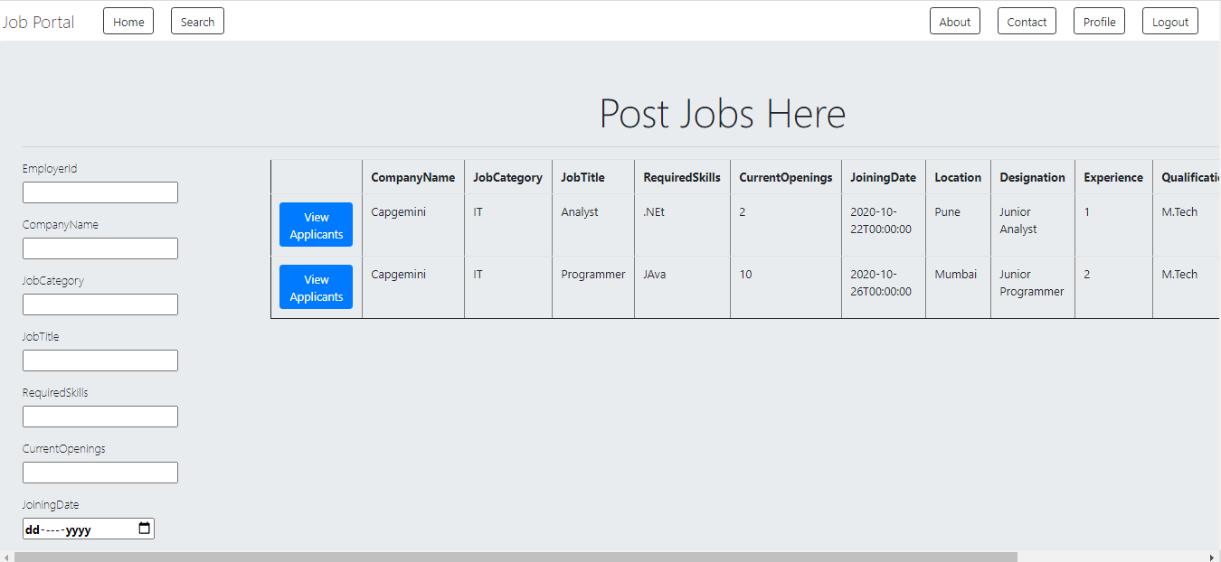
JOB DETAILS

Slide 13
ROLES OF ADMIN
Edit Users: Admin can edit users registered on portal.
Delete Users: Admin can delete not active users.

Slide 14
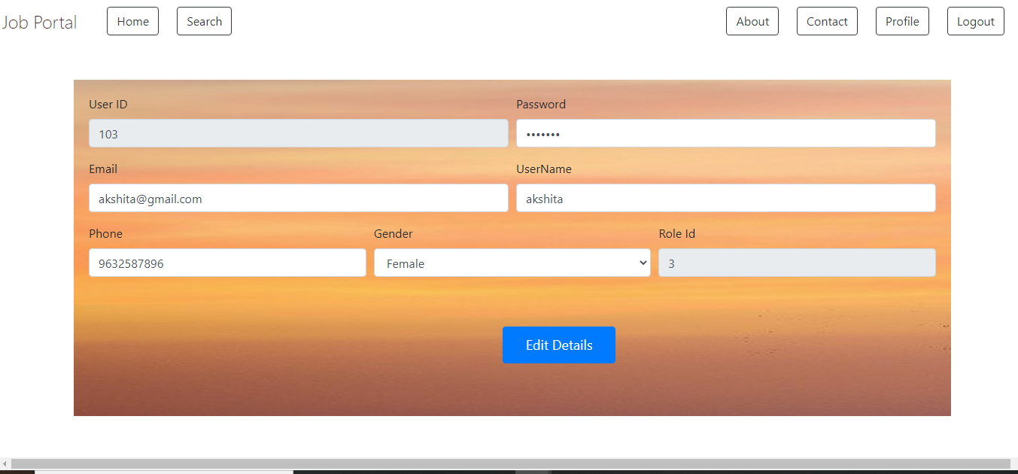
ADMIN PAGE

Slide 15
THANK YOU

