Slide 1
verity.ai
A handwriting-aware tutor that guides students without giving away the answer
STUDENT NOTEBOOK
2x + 3 = 11
2x = 8
x = 5
FLAGGED, LINE 3
SAIL
Akshit Ganesh · Kavin Karki · Timothy Chen
HINT 1
Look again at line 3.

Slide 2
verity.ai
SAIL
THE GAP
Homework tools either give too much or see too little
WHAT STUDENTS HAVE TODAY
WHAT VERITY.AI GIVES THEM
Solver apps hand over the answer
It reads the handwriting
Photomath-style apps print the full solution. That is why schools ban them.
Students write with a stylus exactly as they would on paper. No retyping, no photo.
Chat tutors cannot see your page
It names the first broken line
You retype your work into a box. The messy part, where the mistake actually is, never makes it across.
Every step is checked against the step above it, You find out where your thinking went wrong, not just that your final answer is wrong.
Grading only looks at the last line
Three hints, and none of them is the answer
A red X at the bottom. Which of your six lines went wrong? It does not say.
First what went wrong. Then a similar problem solved in full. Then your own step walked through. The answer is never shown.
Result: copy the answer, or guess again.
Result: the student still does the thinking.
No tool today reads the page in real-time and says: your mistake is on line 3, and it's a sign error
Notes:
Open with the tension: every homework tool today fails in one of two directions, too generous or too blind. Too generous: Photomath and Gauth print the whole solution. Fast, and useless for learning. Schools ban them for exactly that reason. Too blind: chat tutors like Khanmigo never see the page. Student has to retype their work, and the retyping loses the thing that matters, the scratchwork where the mistake actually lives. Too late: answer-only grading tells you "wrong" and stops. No signal about which step broke. Pivot: three things a student actually needs. See the work. Find the first mistake. Get nudged, not solved. We read handwriting directly. Stylus on ruled paper, live, no photo upload, no retyping. We check each line against the line above it. So the flag lands on the exact step where reasoning changed, not on the final answer. Hints escalate in three levels. Where to look, then what kind of mistake, then the concept. The answer never appears at any level. Land the close: nothing a student can open today watches the page as they write and tells them the mistake is on line 3 and it is a sign error. If asked about competitors: MathPad and Math-Tutor AI do step checking with deterministic verification, we do not claim otherwise. Our edge is live stroke input rather than a finished photo, plus hand-drawn chemistry, which nothing shipped does live.

Slide 3
verity.ai
SAIL
ARCHITECTURE
From your pen to your hint, in five steps
04
Verdict
01
02
03
05
SymPy · RDKit
PROVEN
Ink capture
Line segmentation
Transcription
Math and chemistry engines that prove whether your line follows from the one above it. They can’t guess.
Hint
Gemini turns the image into text the checker can use: an equation for math, a structure for chemistry. It only reads. It never judges.
Three levels, and only when you ask for them. Every hint is checked against the answer we already know, and blocked if it gives it away.
Pointer Events record position, timing, and pressure. A pen lift ends the line.
→
Strokes are grouped into ruled rows, then cropped to a clean per-line image.
→
→
→
Gemini
LABELLED
Handles the questions symbols cannot express, like a geometry proof. When AI makes the call, the verdict says so.
browser
canvas
Gemini 2.5 Flash
deterministic
TWO ENGINES, ONE LABELLED VERDICT
The rule that makes it trustworthy: when an engine can prove your line, it decides. When only AI can judge it, we label it so you know which one spoke.
CHECK ON PEN LIFT, NOT PER STROKE
One round trip per finished line is the design choice that keeps latency low.

Slide 4
verity.ai
SAIL
ENGINEERING
Every layer, and why it is that way
LAYER
WHAT WE USE
WHY
App
React + Vite, canvas
One codebase covers iPad and Samsung; no app store, and a demo is just a shared URL.
Ink
Pointer Events API
A web standard that exposes full stylus data (position, timing, pressure) and marks line ends on pen lift.
Transcription
Gemini 2.5 Flash on Vertex AI
Strong at reading messy handwriting with no model training; deterministic settings, fractions of a cent per line.
Verdict
SymPy · RDKit, with Gemini where they cannot reach
Exact symbolic checking cannot hallucinate, and reports its own limits instead of guessing.
Hints
Gemini, checked by SymPy and RDKit
The model writes the hint and the worked example. Our own engines re-check every line before it reaches the student, and the answer is filtered out on the way.
Backend
FastAPI, Pydantic schemas
Shared schemas are the contract between ink, transcription, and judging.

Slide 5
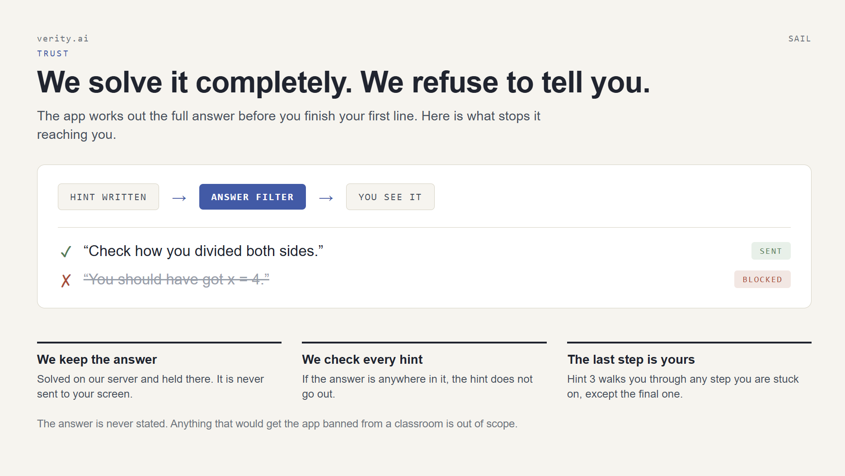

Slide 6
verity.ai

Slide 7
verity.ai
SAIL
TRUST
Where the AI is, and where it is not
THE AI'S ONE JOB
WHAT THE AI NEVER TOUCHES
Reading handwriting
Deciding right or wrong
Gemini 2.5 Flash on Vertex AI turns each finished row into typed math. Temperature zero, output capped, answers normalized, an explicit flag when a line is unreadable.
SymPy proves it symbolically. Out-of-scope steps return "unsupported", not "wrong".
Writing the hints
Templates keyed to an error category, with automated tests asserting no answer leaks.
If it misreads, the student retypes the line in one tap and the check re-runs for free. Misreads are an inconvenience, never a wrong verdict.
Seeing the solution
No model receives the problem or its answer, so there is nothing available to give away.
Our position on revealing answers:we don't, at any hint level, under any phrasing. Anything that would get the app banned from a classroom is out of scope by definition.

Slide 8
verity.ai
SAIL
STATUS
What runs today, and what does not yet
screenshot: stylus rows on ruled paper
screenshot: editable transcription panel
screenshot: flagged line with hint
RUNNING END TO END
Stylus capture with palm rejection
Row segmentation and per-line export
NOT YET
Transcription with error handling
SymPy checking with error categories
Coverage beyond arithmetic and one-variable linear equations
Three-level hint ladder
Editable transcription, free re-check
Chemistry recognition and judging
Segmentation for handwriting that drifts across rows
89 backend tests in CI, including answer-leak tests
Testing with real students, and deployment

Slide 9
verity.ai
SAIL
ROADMAP
Where we take it next
MILESTONE A
MILESTONE B
MILESTONE C
MILESTONE D
Every mistake gets a precise hint
The canvas feels like paper
Transcription we can trust
Chemistry structures
Per-line confidence, a failure log driving prompt changes, automatic typed fallback.
An RDKit judge behind the same interface, on a narrow rehearsed set of structures.
More provable error categories, fractions and decimals, then linear systems.
Pen-lift segmentation, checking without a button, undo, eraser, smoother ink.
THE BIGGER IDEA
Because we keep the strokes, we can show a teacher which lines a student rewrote, where they slowed down, and which hints they needed. A picture of how a student reasons, not just what they scored.

Slide 10
verity.ai
SAIL
THE PRODUCT
A notebook that checks the work as it is written
A browser app for iOS and Android tablets. The student writes with a stylus on ruled rows, and every finished line is read and checked against the line above it.
01
02
03
04
Live ink, not a photo
Line-by-line verdicts
A hint ladder on request
Never the answer
Stylus strokes stream in as the student writes, so feedback arrives while they are still working.
Green for a valid step, red for a proven mistake, amber when a step falls outside what we can verify.
Three levels: where to look, what kind of mistake, then the concept. Nothing is volunteered.
A product rule enforced in code. The hint generator never provides the solution.
WHO IT IS FOR
SUBJECTS
DEVICE
Built for middle and high school algebra today, expanding with coverage
Math now, chemistry next
Any modern tablet with stylus support, tested on iPad and Samsung

Slide 11
verity.ai
SAIL
IN MATH
One wrong line, three levels of help
HANDWRITTEN WORK
HINT 1, WHERE
Look again at line 3.
2x + 3 = 11
PROBLEM
2x = 8
VALID
HINT 2, WHAT
Something went wrong when you divided both sides.
x = 5
LINE 3, DIVISION
HINT 3, WHY
Dividing an equation only holds if both sides are divided by the same amount.
The checker proves 2x = 8 follows from the problem, and that x = 5 does not follow from 2x = 8. The flag lands on the first line that breaks.
The hint writer receives the error category and enough context to phrase a relevant hint. It never receives the answer, so it structurally cannot leak x = 4.

Slide 12
verity.ai
SAIL
CHEMISTRY, PLANNED
The same check, applied to chemistry
Once a drawing is parsed into a structure, correctness becomes a deterministic question again. Nothing on the market checks hand-drawn chemistry as it is written.
FUNCTIONAL GROUPS
MOCKUP
REDOX BALANCING
MOCKUP
Asked for an ester, drew an ether
Half-equation, electrons short
CH₃–CH₂–O–CH₃
FLAGGED
Fe³⁺ + e⁻ → Fe
FLAGGED
CH₃–CO–O–CH₃
ESTER
Fe³⁺ + 3e⁻ → Fe
BALANCED
Hint: the group you drew joins two carbons through oxygen alone. Check what a carbonyl adds.
Hint: add up the charge on each side before you move on.
Hand-drawn molecule recognition is an open research problem. Scope: a narrow, rehearsed set of structures. RDKit for the verdict, a vision model for recognition.

Slide 13
verity.ai
SAIL
DEMO
The whole loop in under two minutes
1
Write the problem: the first row on the sheet sets what everything else is checked against.
IF TRANSCRIPTION MISREADS
Type the correction in the side panel and keep talking. The checker re-runs instantly and costs nothing.
2
Write a correct step:it transcribes on pen lift and comes back green.
3
Write one mistake:that row underlines itself; nothing else on the page moves.
IF THE NETWORK FAILS
Switch to the recorded clip and saved screenshots. Stay inside rehearsed algebra either way.
4
Climb the hint ladder:three levels, and the answer never appears.
Rehearsed problem: 2x + 3 = 11 → 2x = 8 → x = 5
Editable transcription is a product decision, not a patch. Handwriting recognition will always miss sometimes, and a student should be able to fix it in one tap.

